Slide 1

22R1 General Release
Webinar
Vault Training, Station Manager, QualityDocs
Revision: 24 March 2022
Please use ‘Q&A’ to ask a question

Slide 2



Vault, Training, Station Manager, QualityDocs
22R1 Presenters
Jane Wells
Enterprise Quality Customer Success
Europe
jane.wells@veeva.com
Kirstin Dreyfürst
Enterprise Quality Customer Success
Europe
kirstin.dreyfuerst@veeva.com
Bob Kenney
Enterprise Quality Customer Success
North America
bob.kenney@veeva.com
Jason Cox
Enterprise Quality Customer Success
Manager, North America
jason.cox@veeva.com

Slide 3
Foreword
The content of this presentation is subject to change prior to the 22R1 Release
Please note the revision date on the title slide
Veeva encourages you to always reference Release documentation from our Release pages to ensure you are using the latest information
Help → Release Notes → About the 22R1 Release
    A recording of this webinar, and the associated slide deck, will be available on this page at the conclusion of the webinar series

Slide 4

Interact With Us!
Please use ‘Q&A’ to ask a question

Slide 5

Feature Enablement Detail
Auto-On Features
Configurable Features
Auto-On
Admin Checkbox
Configuration
Support
Turned On Day 1
Automatically available, some setup may be required
Turned Off
Requires enablement
Turned Off
Requires enablement
Requires
configuration
Turned Off
Requires enablement
Product Support Request

Slide 6
Planning for the 22R1 Release
Logistics
Announcements
Features
Identify key
release dates
Promote awareness of Veeva events
Review new features
based on themes
Note: Keep Alert for Polling!

Slide 7
QualityDocs

Slide 8

Vault Platform Feature Themes for QualityDocs
Working with Documents
Lifecycles and Workflows

Slide 9
Working with Documents

Slide 10

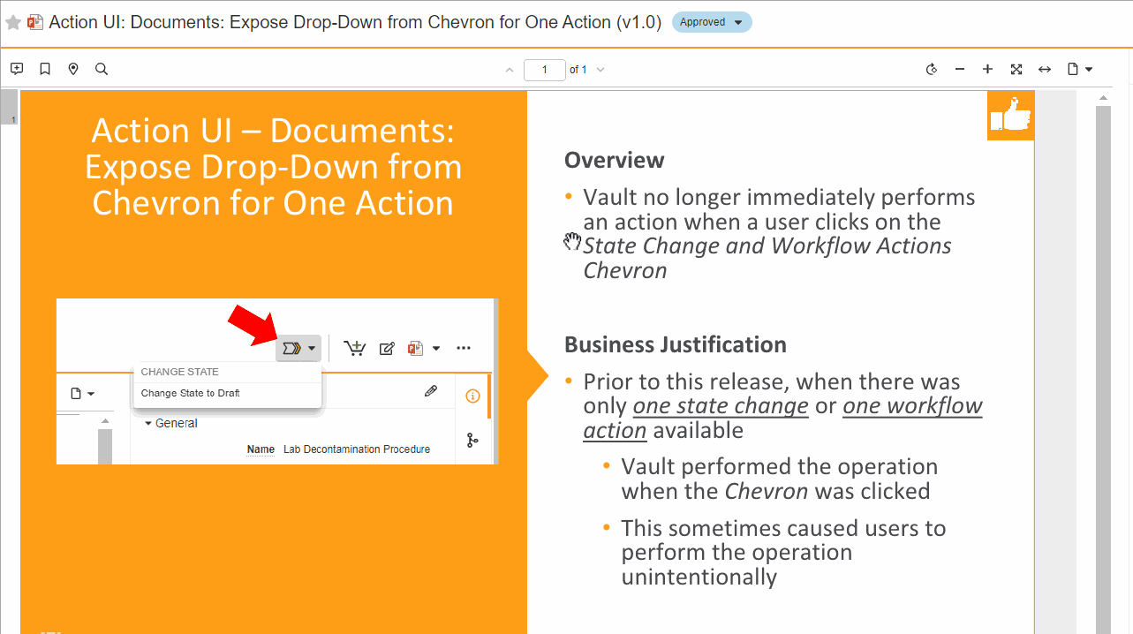
Copy Text from Viewer
Overview
              Copy text from a Vault document
              Hold the ‘C’ key (cursor changes to the copy tool), drag the mouse over text (highlighted text turns light blue), and release the mouse
              The highlighted text is copied to your paste buffer
Business Justification
Allow users to quickly copy text from a Vault document in order to paste it in another file
<Single screenshot only>

Slide 11
Copy Text from Viewer
Considerations
  Works in View mode (shown left) and Annotate mode
  Limited to authenticated users (not available on token-based, anonymous and public viewers)

Slide 12
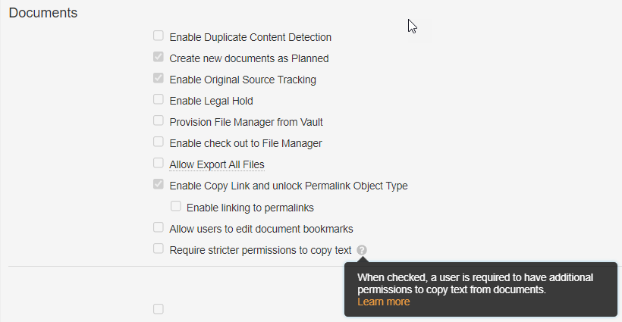
Annotate Usability Improvements
Overview
              By default, users can copy text from a document while viewing it in Vault
              An Admin can now require users have the ability to annotate the document, or download the document’s source or rendition, in order to copy a document’s text
Business Justification
Ensure a user cannot use Vault as a “backdoor” to copy a document’s content if the user does not have permission to copy it’s content outside Vault, or via the “Revise text” annotation
Admin setting on
Admin > Settings > General Settings page

Slide 13

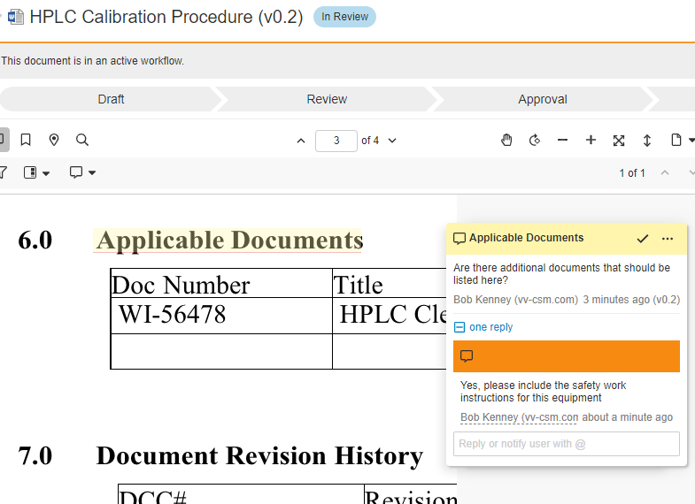
Notifications on Replies to Notes
Overview
              Vault will now send you a notification if a user replies to your annotation, or an annotation to which you previously replied
              It is not necessary to mention the owner of the annotation (@username) to trigger the notification
Business Justification
Help users close the loop on activities identified in collaborations captured in document annotations

Slide 14
Notifications on Replies to Notes
Details
  Vault prevents redundant notifications from a single annotation or reply, in cases where multiple notification criteria are met
    If a user replies to an annotation, and the reply “@user mentions” the author of the annotation, Vault will only send one notification to the annotation author
    If a user replies to an annotation, and the author of the annotation Favorited the document, Vault will only send one notification to the note author
  The priority order that determines which specific notification is sent when multiple notification criteria are met is as follows:
    @user mention notifications
    Annotation reply notifications
    Favorite document annotations

Slide 15
Google Drive Integration
Overview
Vault integrates directly with Google Drive
System Admins must enable Google Drive integration
Users can:
  Upload Files: Create Draft, Upload New Version, Upload to Placeholder (auto-on in 22R1 if Google Drive integration was already enabled)
  Check out
  Edit
  Check In
  Undo files checked out to Google Drive
Considerations
Vault security does not apply to checked out files in Google Drive (e.g. share files)
Consider Collaborative Authoring for Microsoft Office instead if checked out files require more control
Admin Checkbox

Slide 16
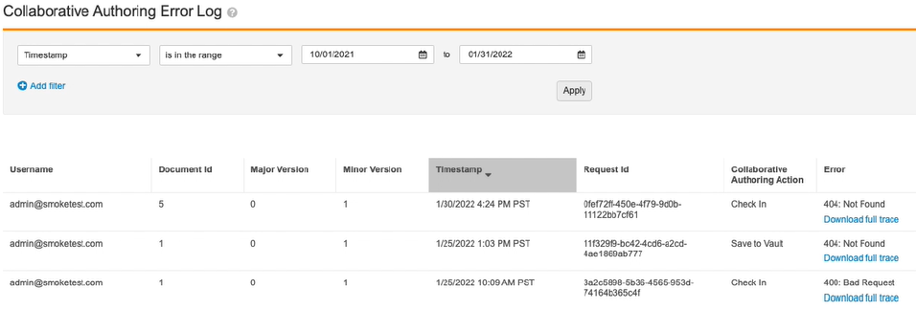
Collaborative Authoring Troubleshooting Page
Overview
              Admins now have an easy, self-service way to access Microsoft errors encountered with the Collaborative Authoring with Microsoft Office feature
              Admins can download the full Microsoft API trace file for each individual error
              Accessible from Admin > Logs > Collaborative Authoring Error Log
Business Justification
Microsoft support often requires Microsoft API trace files
Prior to this feature, customers required Veeva Support to retrieve Microsoft API trace files
Links provide access to Microsoft API trace files for each error

Slide 17
Lifecycles and Workflows

Slide 18

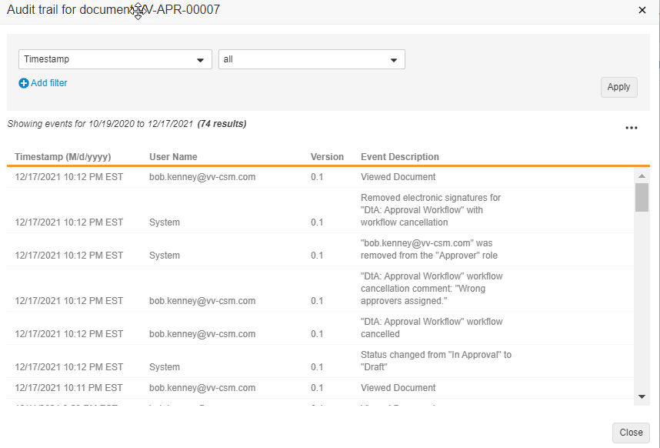
Remove eSignature from Documents
Overview
              Admins can setup a workflow to automatically remove e-signatures collected during a workflow that fails to complete successfully
Business Justification
Removing e-signatures from a “failed” workflow can be advantageous when:
  The workflow is cancelled for any reason (i.e. an incorrect or missing approver)
  The document is rejected due to incorrect metadata, and the approval signatures should be removed before re-routing the same document version after making metadata corrections

Slide 19
Remove eSignature from Documents
Considerations
  eSignatures can only be removed on the current active workflow (not from previous workflows)
  eSigantures can be removed using a Workflow Cancellation Action and a Content Action
  eSignatures can be removed for a specific task and verdict

Slide 20
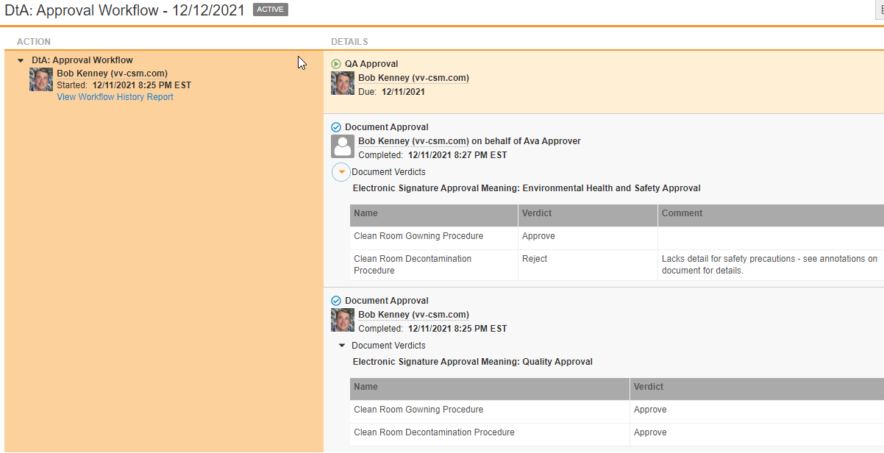
Verdict Information & Reporting on
Removed Documents
Overview
              When viewing a workflow, users can now see documents that were removed from the workflow
Business Justification
Documents are sometimes manually or automatically removed from a workflow
  e.g. remove documents rejected in the first workflow step so second step approvers only consider the necessary documents
Users want to see information about all of the documents that were originally included in a workflow, even the ones that were removed
<Single screenshot only>
Verdict information for the rejected document that was automatically removed from the workflow
Verdict information for the rejected document that was automatically removed from the workflow
Removed document shown in Workflow Timeline

Slide 21
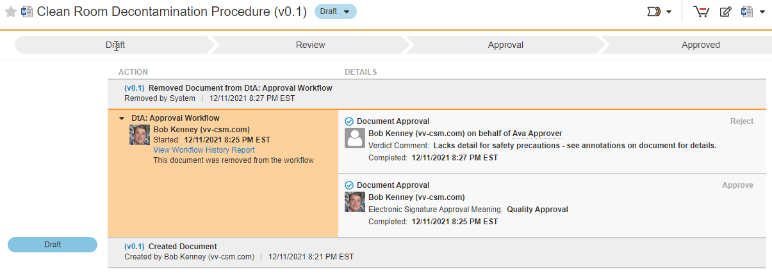
Document Timeline Showing Verdicts for Document Removed from Workflow
Removed document shown in Document Timeline
Verdict information for the rejected document that was automatically removed from the workflow

Slide 22
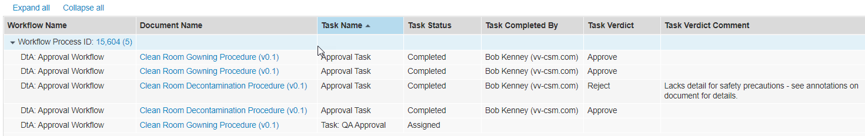
Workflow Report Showing Verdicts for Document Removed from Workflow
Removed document shown in Workflow report
First workflow task (Approval Task) verdicts are shown for the Clean Room Decontamination Procedure
The Clean Room Decontamination Procedure was removed, and it’s no longer part of the workflow in the second task (QA Approval)

Slide 23
Verdict Information & Reporting on
Removed Documents
Considerations
  Applies to documents that were removed manually by a user, or automatically by a workflow via a Content Action configuration
  Notifications will now include the removed document in the verdict token if the removed document was part of the verdict – previously the removed document would not have been included

Slide 24
Demonstration
Document Timeline Showing Verdicts for Document Removed from Workflow

Slide 25
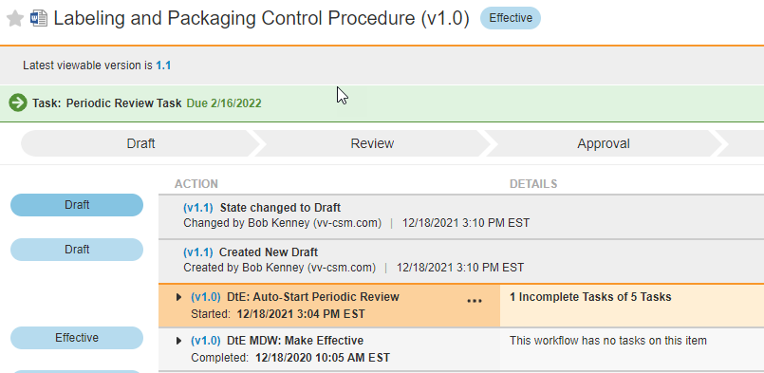
Bound Version Create Draft
Overview
              Customers can now use workflows to route Steady State versions of documents
              Admins can configure workflows to “stick” to a document’s Steady State version, even if a new Draft version of the document is created
Business Justification
QualityDocs: Periodic Review workflows should remain with the Steady State Effective version, even if a new Draft is created to start a new editing cycle
Later Draft version NOT in workflow
<Single screenshot only>
Workflow linked to Steady State (Effective) version

Slide 26
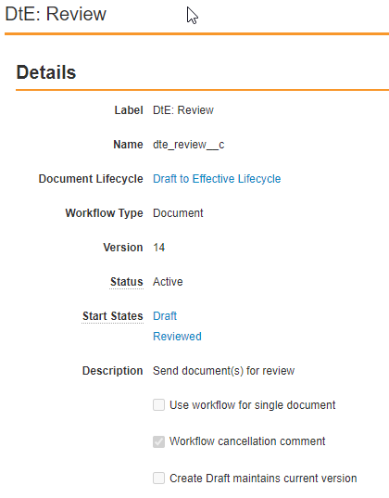
Bound Version Create Draft
Considerations
  This feature is available for OneWorkflows on documents
  Binding to a version is a configurable option when creating document workflows – the feature is automatically available (Auto On) for System Admins to utilize
  By default, all OneWorkflows for documents will use the latest version of documents

Slide 27
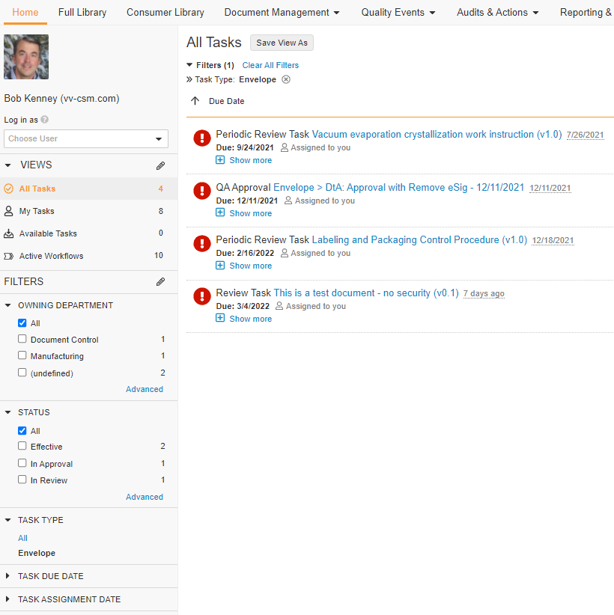
Filter Envelope Tasks by Document Fields
When a user filters Tasks by Envelope …
Overview
              Users can now filter OneWorkflow tasks using fields of the documents contained within the tasks
Business Justification
Enable users to quickly find OneWorkflow tasks that contain documents meeting document metadata
Users can add document field filters to show OneWorkflow tasks containing documents matching the filter criteria
Users can add document field filters to show OneWorkflow tasks that contain matching documents

Slide 28
Demonstration
Filter Envelope Tasks by Document Fields

Slide 29
Vault Training

Slide 30
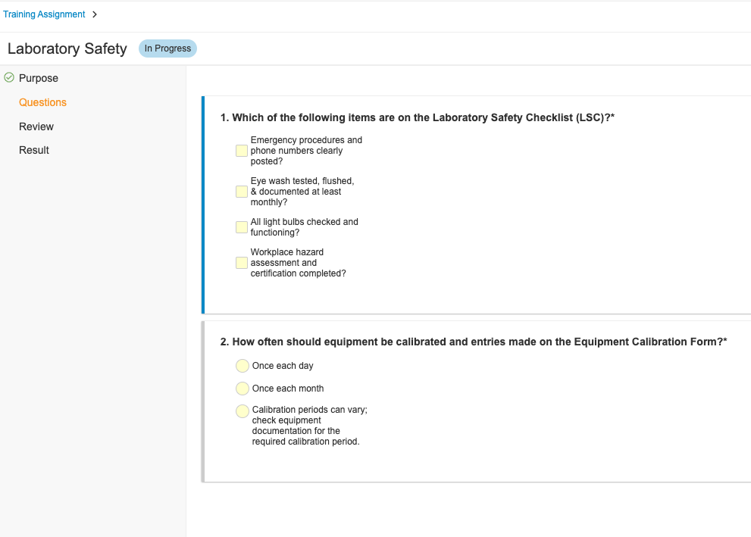
Quizzes: Question & Answer Randomization
Overview
              System Admins can configure a Training Requirement’s Quiz such that each time a Learner attempts the Quiz, Vault displays:
                All of the Quiz Questions in a random order
                Answers to particular Questions in a random order
Business Justification
Remove the possibility that Learners memorize the order of questions and their correct answers
Order of questions can be randomized
Order of a question’s answers can be randomized

Slide 31
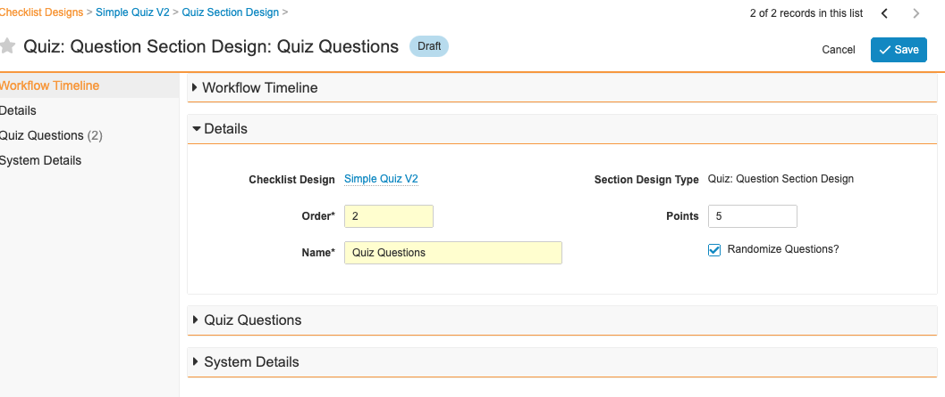
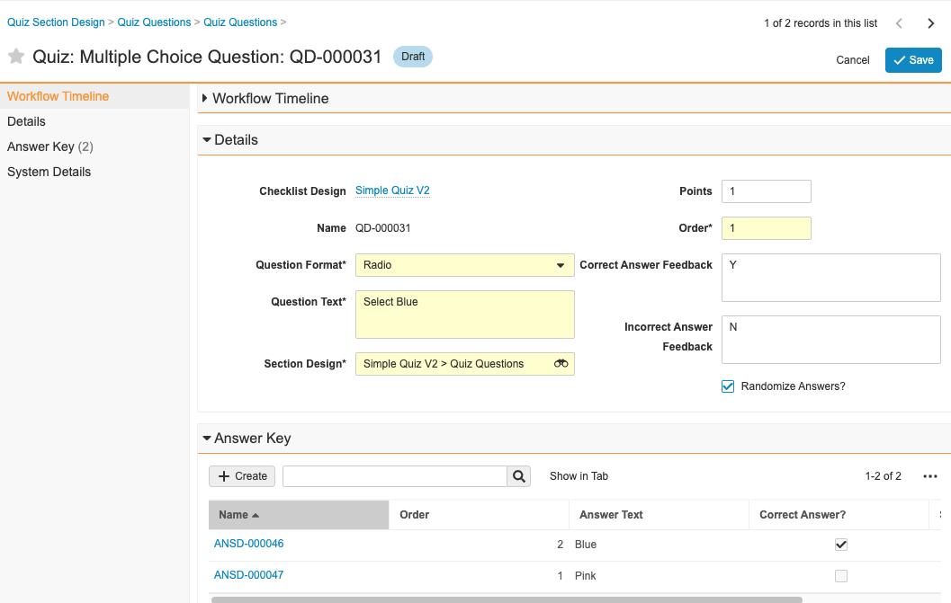
Quizzes: Question & Answer Randomization
System Admins can configure a Quiz to randomize the display of all Questions in the Quiz
System Admins can configure a Quiz to randomize the display of Answers for specific Questions in a Quiz

Slide 32
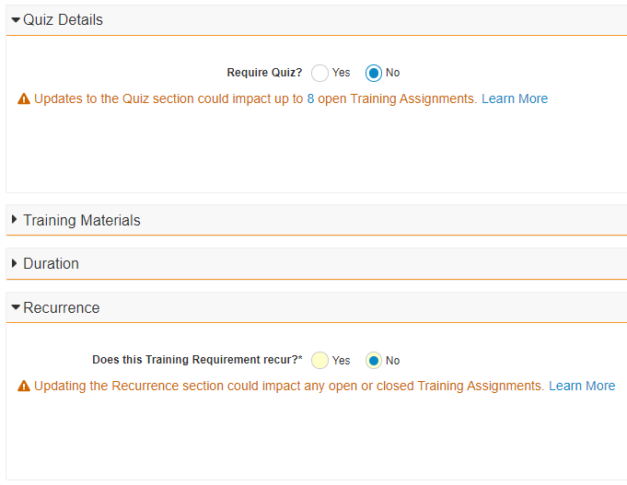
Admin Alerts:
Quiz and Recurrence
Overview
              System Admins can configure this feature to warn Training Admins about the impact on Training Assignments if a Training Requirement’s Quiz or Recurrence settings are changed
              Alert messages explain the impact of the change, how many Training Assignments could be affected
Business Justification
Help Training Admins confidently update Training Requirements by helping them understand the impact of the change on Training Assignments

Slide 33
Admin Alerts: Quiz and Recurrence
Details
  Enabling this feature requires a System Admin to add the Impact Alert: Quiz and Impact Alert: Recurrence application control fields to the Training Requirement object page layout

Slide 34
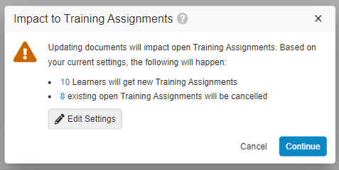
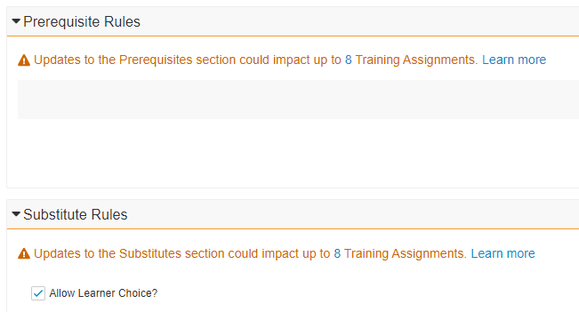
Admin Alerts: Training Materials, Prerequisite Rules and Substitute Rules
Overview
              This feature automatically alerts Training Admins about potential impact to Training Assignments when making a change to a Training Requirement’s
                Training Materials
                Prerequisite rules
                Substitute rules
              Alert messages explain the impact of the change, and how many Learners and Training Assignments could be affected
Business Justification
Help Training Admins confidently update Training Requirements by helping them understand the impact of the change on Training Assignments and Learners

Slide 35
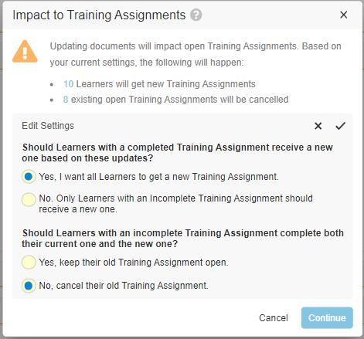
Admin Alerts: Training Materials, Prerequisite Rules and Substitute Rules
Details
  When updating Training Materials, Training Admins can adjust the settings that control impact directly from the warning message

Slide 36
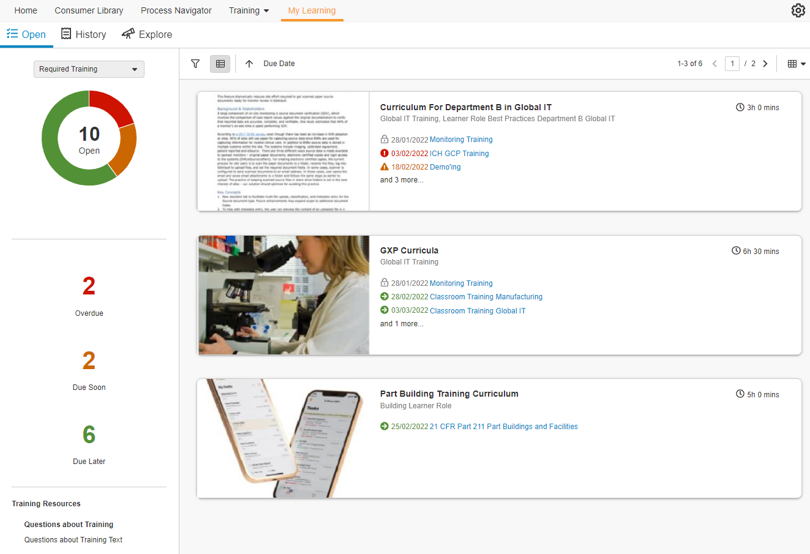
Learner Homepage:
Curriculum View
Overview
              Show Training Assignments on the Learner Homepage grouped by Curricula
              Each Curriculum is represented as a “card” with the number of Training Assignments assigned, description, and other helpful information for Learners
              From a Curriculum Card, a user can navigate to a Curriculum Details Page, which shows all Training Assignments assigned in the Curriculum, allowing the Learner to focus on a targeted list of Training Assignments
Business Justification
Allow Learners to prioritize training by curriculum and focus on a targeted list, rather than individual training tasks

Slide 37
Demonstration
Training Features

Slide 38
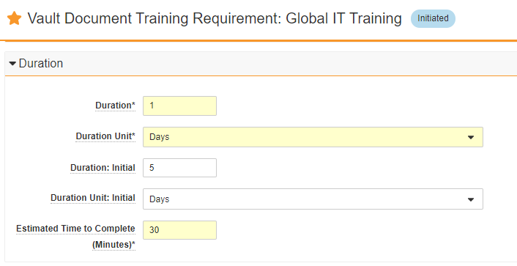
Initial Training Due Date
Overview
              A System Admin can configure Training Requirements so Training Admins can set a duration for initial training that is different from the standard training duration
Business Justification
Allows Vault to automatically assign Training Assignment due dates differently for Learners that have not previously satisfied the Training Requirement
Eliminates the need for Training Admins to manually update Training Assignment due dates for new hires and employee transfers

Slide 39
Initial Training Due Date
Details
  The definition of "Initial Training" is a Learner that never received a system-created Training Assignment for a Training Requirement
  Each Training Requirement can have its own Initial Training Duration
  When a Learner matches the criteria for Initial Training, the Initial Training Duration field values are used to calculate the due date for that Learner’s Training Assignment
  The field Latest Automation Update on a Learner’s Training Assignment will show how the Due Date on their Training Assignment was calculated (e.g. "Due Date calculated using Initial Due Date“)
Does Initial
Duration value exists on TR?
Use Initial Duration to calculate TA due date
Yes
Yes
Does Learner
match Initial Training criteria?
No
No
Use Default Duration to calculate Ta due date
This diagram shows the logic when an
Initial Due Date will be used for
a Learner’s Training Assignment

Slide 40
Additional 22R1 Vault Training Features
Process & Performance | Training Admin Usability | Configurable Features | System Admin Awareness
Issue Training Assignment Entry Action Update (auto-on) | Email Participant Action Available for Training Assignment (auto-on) | Training Requirement Impact Assessment: Action to Re-Evaluate Record (configuration) | Updates to Cancel Training Assignments Job (auto-on)
Training Jobs: New Jobs to Process Training Assignments (auto-on) | Direct Assignment: Hide Inactive or Ineligible Persons in the Learners Field (auto-on) | Training Requirement Impact Assessment (TRIA) for All Training Requirements (configuration) | HVO Migration Preparation: Field Configuration Limitations (auto-on)
 | Training Materials: Prevent Duplicate Documents (auto-on) | Training Requirement Impact Assessment: Optional Task Assignee (configuration) | Assignment Details Creation Allowed for Imported Records (auto-on)
 |  |  | Learner Application Role Updates in Sharing Settings (auto-on)
 |  |  | Prevent Duplicate Assignment Detail Records (auto-on)
 |  |  | China Link E-Learning Support

Slide 41
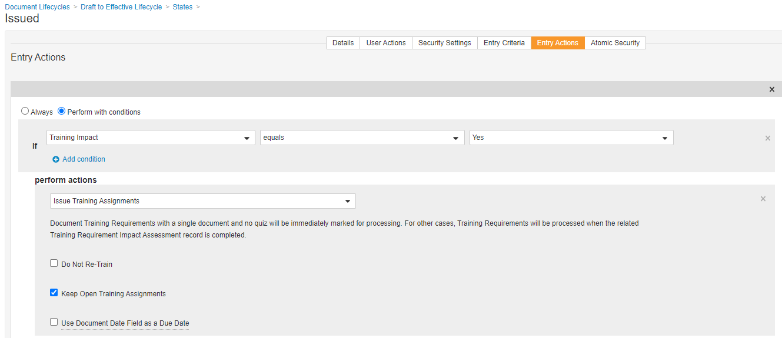
Issue Training Assignment Entry Action Update
Overview
              An Issue Training Assignment Entry Action is used when a document reaches the Issued status to automatically assign training tasks for the new document version
              When the Entry Action is executed, Vault checks if the document’s Training Requirement has a Training Requirement Impact Assessment (TRIA) record
              If an open Training Requirement Impact Assessment (TRIA) record is not found, the Issue Training Assignment Entry Action will now automatically update the document version on the Training Requirement
Business Justification
Vault should automatically update a Training Requirement’s document version when a new version becomes available for training and the Training Requirement does not have a TRIA record

Slide 42
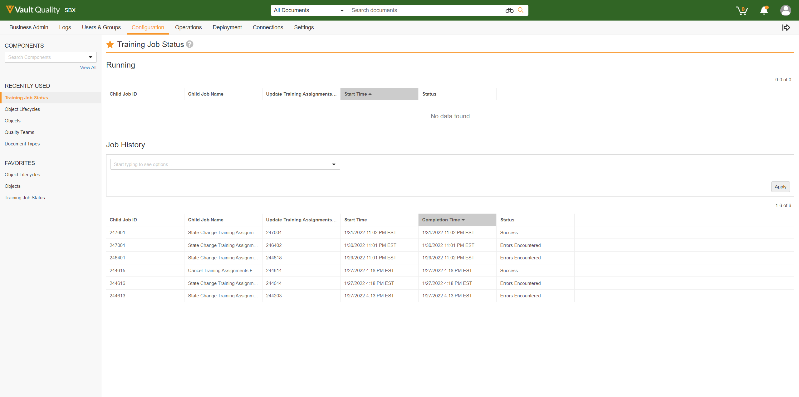
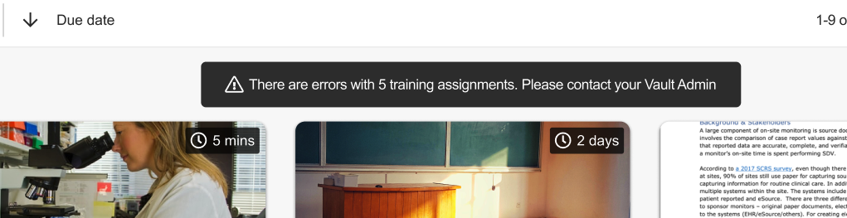
Training Jobs: New Jobs to Process Training Assignments
Overview
This feature improves Vault’s performance updating Training Assignments
The Update Training Assignment job has two new “child” jobs to manage:
  Training Assignment state changes
  Cancelling Training Assignments for Ineligible Persons
Business Justification
Ensure Training Assignments are performed quickly, even as an organization grows
Make Learners and Training Admins aware of Training Assignments that were not processed correctly
System Admins view the status of "child” training jobs in Configuration > Training job status
Vault alerts Learners if Training Assignments are not assigned properly

Slide 43
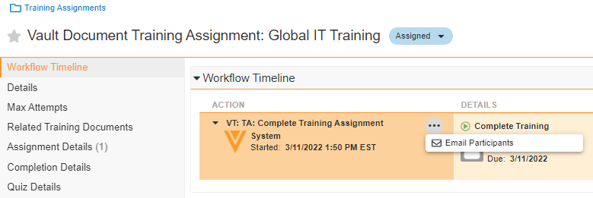
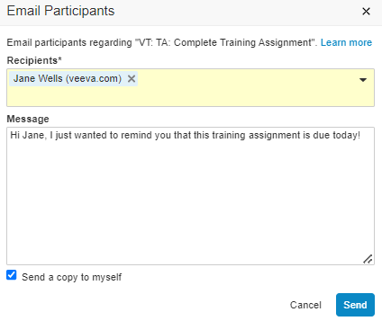
Email Participant Action Available for Training Assignment
Overview
              Training Admins can navigate to an active Training Assignment and send a message to the Learner
Business Justification
Allow a Training Admin to remind a Learner to complete an assigned training task

Slide 44
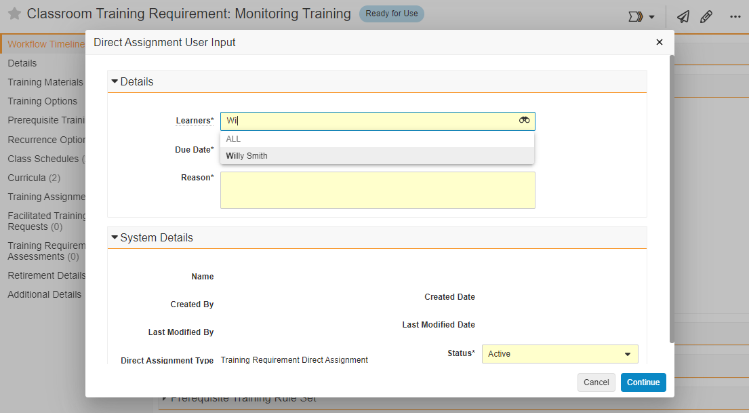
Direct Assignment: Hide Inactive or Ineligible Persons in the Learners Field
Overview
              Persons with Training Eligibility = Ineligible or Status = Inactive no longer appear in the Learners field during a Direct Assignment action
Business Justification
Eliminate the possibility of assigning training to a user that can’t complete the task
Inactive or Ineligible users are no longer available for selection

Slide 45
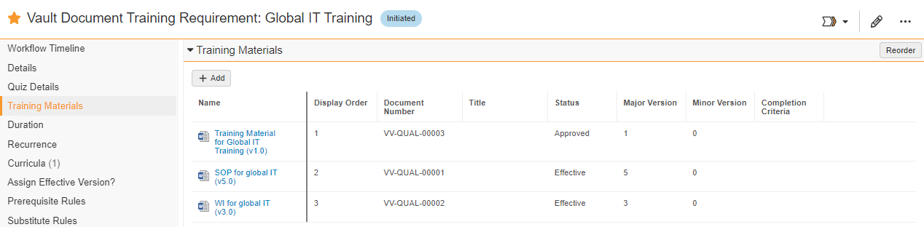
Training Materials: Prevent Duplicate Documents
Overview
              Vault now prevents Training Admins from adding another version of the same document into the Training Materials section of a Training Requirement
Business Justification
Eliminate the possibility of adding the same version of a document more than once because that causes an error when Vault creates Training Assignments for the Training Requirement

Slide 46
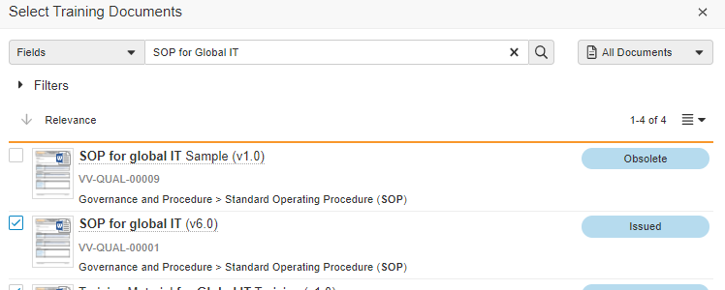
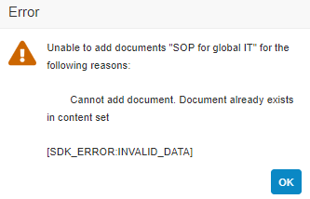
Training Materials: Prevent Duplicate Documents
V5.0 of document is already in
Training Materials
Issued v6.0 is selected to add to Training Materials
Vault displays an error message

Slide 47
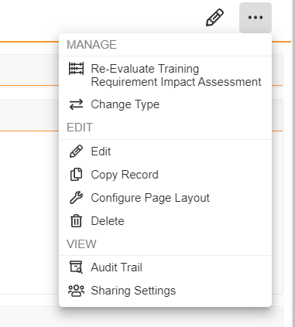
Training Requirement Impact Assessment Action to Re-Evaluate Record
Overview
              Provides the ability for a user to re-evaluate a Training Impact Assessment Record
Business Justification
This new action provides the ability for a user to re-evaluate a TRIA record in the event that the record cannot enter the Completed state.
This allows a quick way to update the record without requiring a configuration change

Slide 48
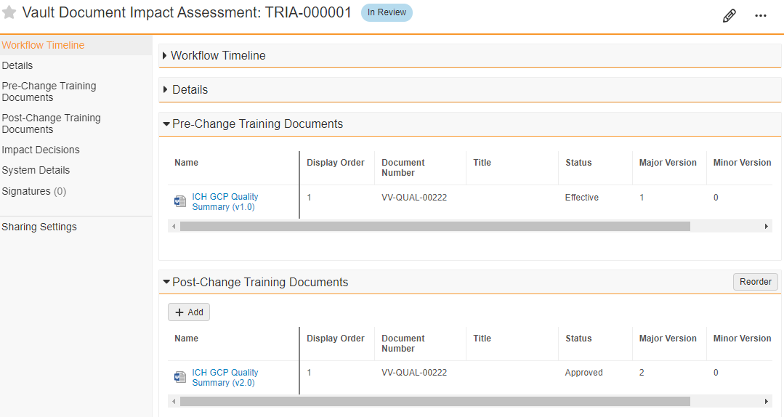
Training Requirement Impact Assessment (TRIA) for All Training Requirements
Overview
              Training Requirement Impact Assessment (TRIA) can now be triggered for simple training requirements which was previously only possible for complex training requirements
Business Justification
Users can now have a consistent process for all impact assessments including single-document training requirements
Users can add additional documents or assets to an existing simple training requirement via TRIA

Slide 49
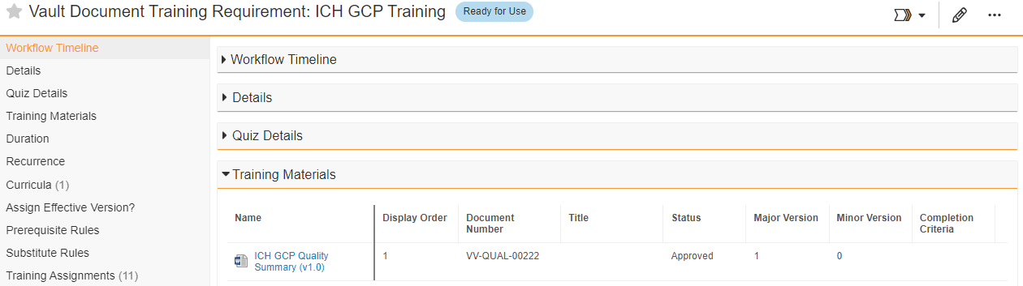
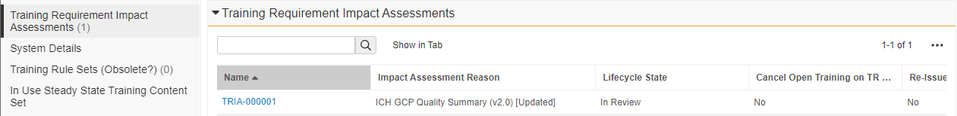
Training Requirement Impact Assessment (TRIA) for All Training Requirements
Training Requirement without Quiz with a single non-elearning document
A new Draft version 1.1 of the document has been created and then been Approved as 2.0
TRIA has been created

Slide 50
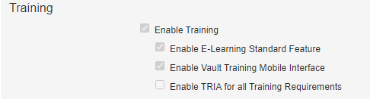
Training Requirement Impact Assessment (TRIA) for All Training Requirements
Considerations
  TRIA can be enabled for all Training Requirements in Admin / Settings / Application Settings
  Once the flag is enabled, it cannot be un-toggled

Slide 51
Training Requirement Impact Assessment: Optional Task Assignee
Overview
              For Administrators: The “Assign Task To” input for the Create Training Requirement Impact Assessment and Retire/Assess Training Impaction document entry actions is now optional
Business Justification
This allows configuration of Training Requirement Impact Assessment (TRIA) task owners at the TRIA object level instead of copying from the documents sharing settings

Slide 52
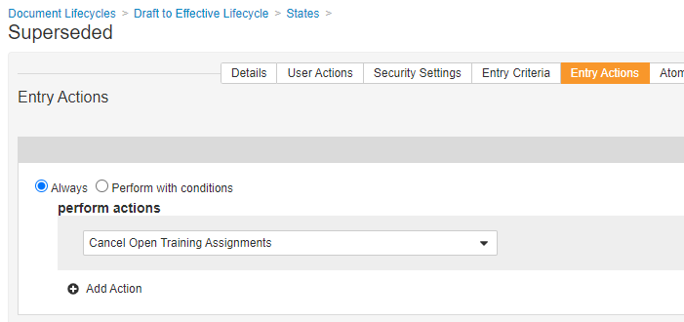
Updates to Cancel Training Assignments Job
Overview
              The Cancel Training Assignments job cancels open Training Assignments when a document reaches a particular state (i.e. Superseded, Obsolete)
              This job now logs the following when a document reaches a particular state:
                Whether or not any Training Assignments were cancelled for a document
                The actual Training Assignments that were cancelled
                Error information if an error occurred during job execution
Business Justification
Provide information about automated Training Assignment cancellation operations for documents
Document lifecycle state entry action invokes the job to cancel Training Assignments

Slide 53
Updates to Cancel Training Assignments Job
Details
  The Cancel Training Assignments job is not visible in Operations > Job Definitions, but the job’s execution results are visible in Operations > Job Status

Slide 54
HVO Migration Preparation: Field Configuration Limitations
Overview
              The following can no longer be created on the Training Assignment or Assignment Details objects:
                Field types that support field-level encryption
                More than two multi-value picklist fields.
Business Justification
Vault Training will move towards High Volume Objects (HVO) in an upcoming release. In order to facilitate this, limitations on configuration are necessary.
The move will enable Veeva to accommodate large numbers of training records.

Slide 55
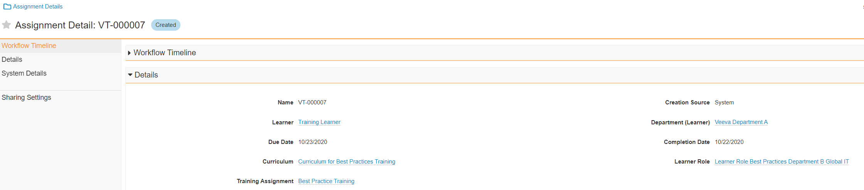
Assignment Details Creation Allowed for Imported Records
Overview
Assignment details can now be imported and related to historical Training Assignments
Business Justification
Previously any imported historical Training Assignments did not have any related Assignment Details.
By allowing Assignment Details to be imported, customers may now report on historical training assignments based on Curriculum, Learner, Learner Role etc.

Slide 56
Learner Application Role Updates in Sharing Settings
Overview
              You can now update the Learner Application Role in Sharing Settings on Training Assignment, Assignment Details, and other training objects.
Business Justification
This enables Training Assignments to be imported for Learners without a User reference, making configuration easier.
Learners can then be added to the Learner Application Role in Sharing Settings using the Vault API.

Slide 57
Prevent Duplicate Assignment Detail Records
Overview
              Stop the system or users from creating duplicate Assignment Details for a single Training Assessment.
Business Justification
The system previously allowed duplicates of a Curriculum + Learner Role for a given Training Assignment.
By preventing this duplication we reduce the risk of error and duplicate tasks.

Slide 58
Overview
              Infrastructure changes to allow China Link customers to use e-learning functionality with Vault Training
Business Justification
Previously, e-learning was not supported for China Link customers
China Link E-Learning Support

Slide 59
Station Manager

Slide 60
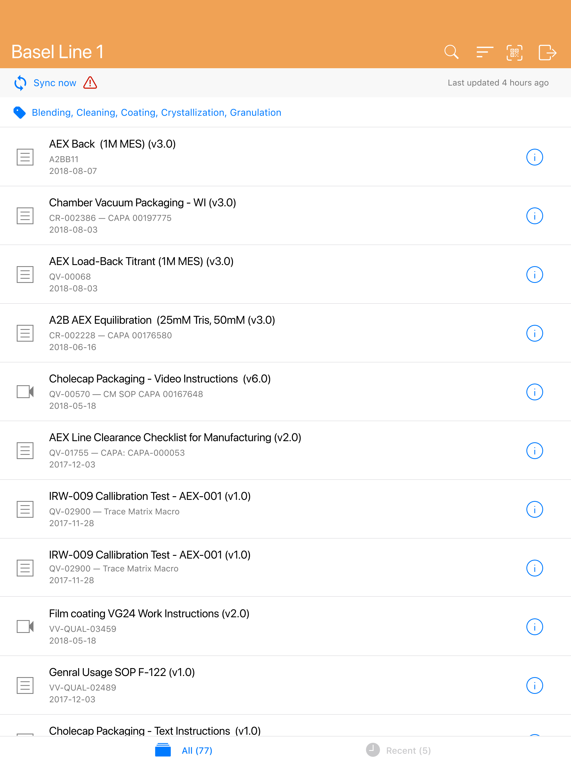

QR Code Reader for iOS & Android Station Manager Apps
Overview
              Station Manager supports finding a document or a category of documents from a QR Code
              This release adds an in-app QR Code reader within the Station Manager mobile app
Business Justification
Make it easier for user to read a QR Code by eliminating the need to switch out of Station Manager to a QR Code reader app
Access to the in-app QR Code Reader
Access to the in-app QR Code Reader

Slide 61
QR Code Reader for iOS Station Manager App
Details
  Reading non-Station Manager QR Codes will return an error
  Station Manager will still open a document or document category when a standalone QR Reader app sees a Station Manager QR Code
Considerations
  Refer to the Vault Help topic Station Manager Custom URLs & QR Codes for more information about how to create a Station Manager URL and associate to a QR Code

Slide 62
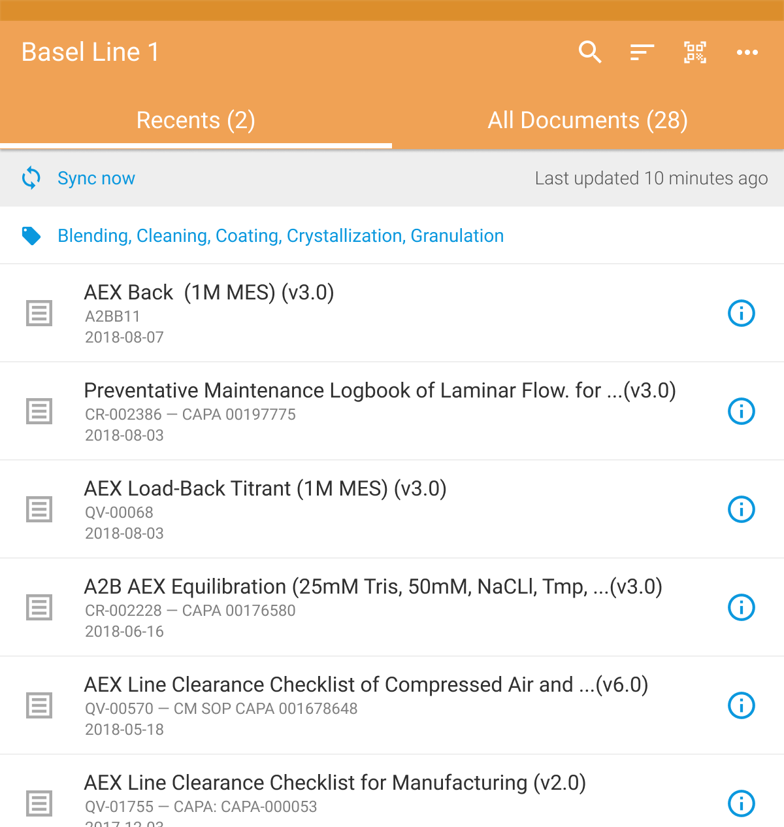

QR Code Reader for Android Station Manager App
Overview
              Station Manager supports finding a document or a category of documents from a QR Code
              This release adds an in-app QR Code reader within the Station Manager mobile app
Business Justification
Make it easier for user to read a QR Code by eliminating the need to switch out of Station Manager to a QR Code reader app
Access to the in-app QR Code Reader
Access to the in-app QR Code Reader
Notes:
One of the difficulties of taking advantage of the QR Code feature is having to switch out of Station Manager into another application in order to read QR Codes. While iOS users can switch to the camera app, it’s a bit worse for Android users because they also have to install a QR Code reader application on their devices since the native Android camera app doesn’t support reading QR Codes.

Slide 63
QR Code Reader for Android Station Manager App
Details
  Reading non-Station Manager QR Codes will return an error
  Station Manager will still open a document or document category when a standalone QR Reader app sees a Station Manager QR Code
Considerations
  Refer to the Vault Help topic Station Manager Custom URLs & QR Codes for more information about how to create a Station Manager URL and associate to a QR Code

Slide 64
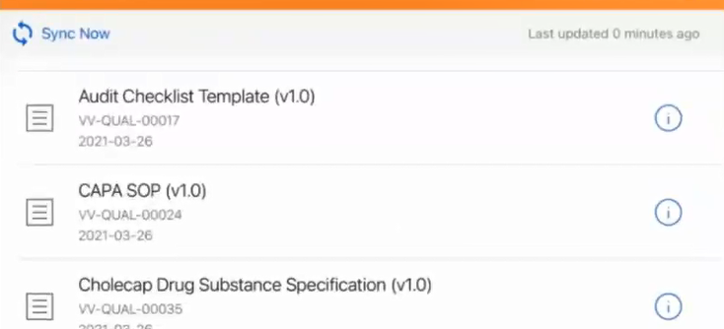
Background Sync on iOS
Overview
              This feature allows the Station Manager app on an iOS device to periodically sync to the latest content, even when the app is not actively being used (every 15 minutes)
              Previously, when the Station Manager app was not being actively used, iOS put the app in the background, and Station Manager was unable to sync with Vault
Business Justification
Increase the likelihood that the Station Manager app is fully up-to-date when opened, even if the app is left unused for an extended period of time
Opening Station Manager after several hours without being used, we see the device has recently updated

Slide 65
Background Sync on iOS
Details
  This feature is only applicable for iOS devices – Android devices already support synching with Vault when the Station Manager app is not in use
Considerations
  Background synch utilizes the iOS Background App Refresh feature, which must be enabled for the Station Manager app on the device

Slide 66
Announcements

Slide 67

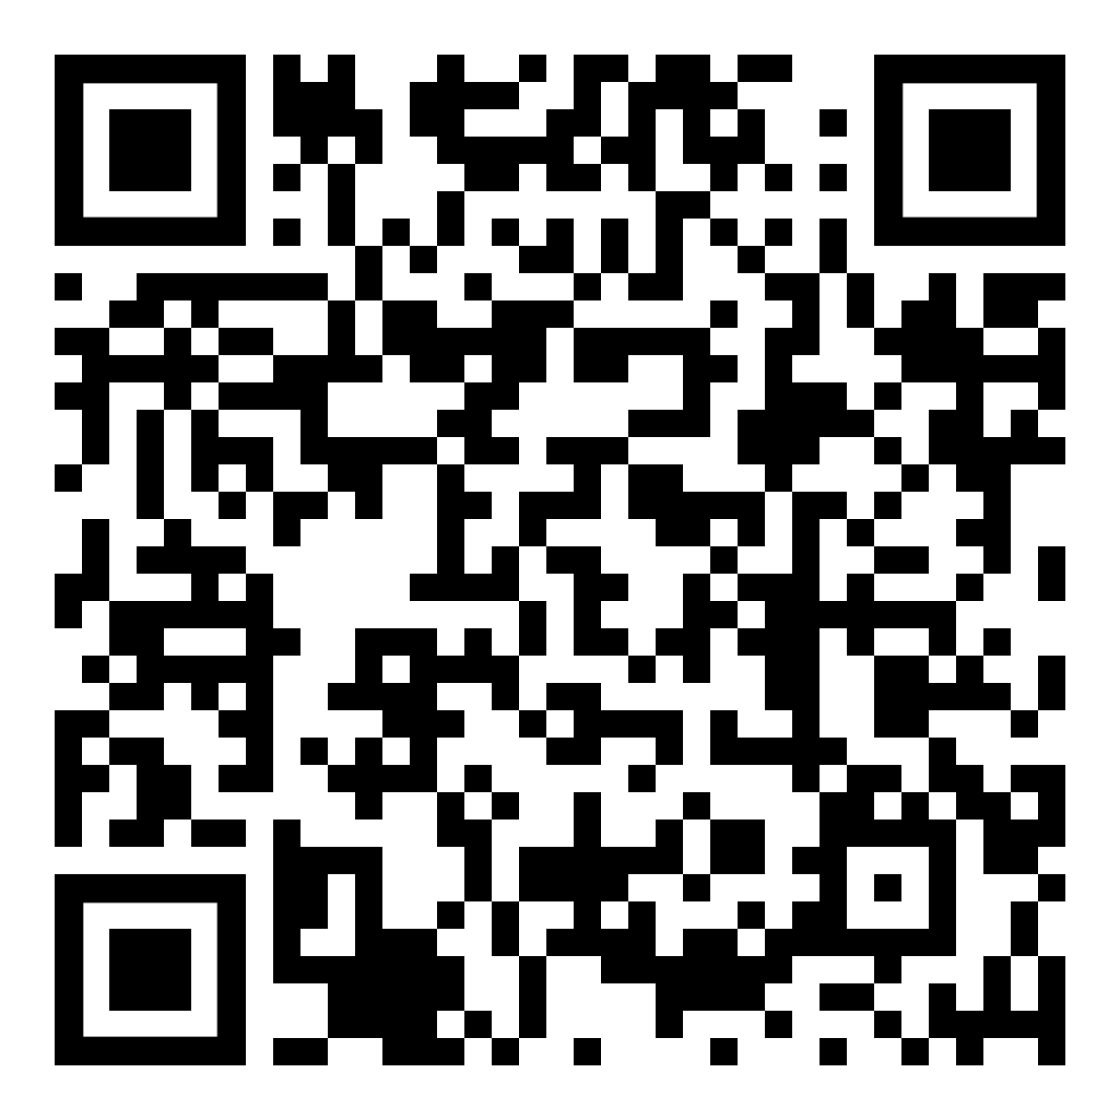
We’re excited to
get back together.
Reconnect and network with the life
sciences community for one day in Zurich
Zurich • 8 June 2022
Meet with old friends and colleagues and get to know some new ones.
Spark new ideas and gain practical advice.
Get inspired by stories of digital transformation at leading companies.
Be the first to learn about new innovations.
Save your spot.
Scan to register now.

Slide 68

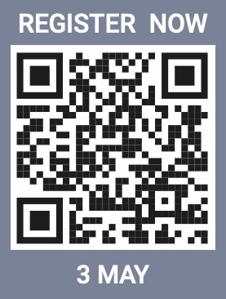
3 May 2022
Barcelona
8 June 2022

Slide 69
22R1 Developer Release Deep Dive
Thursday, April 7th at 8:00 AM PT / 11:00 AM ET / 4:00 PM CET
Join Veeva Customer Success and Product teams for an education session on new features in the Veeva Vault developer-focused toolkit
This webinar is geared towards current users of the Vault Developer toolkit (API)
Key topics for discussion will include:
  Detailed explanation of new features
  Spark Integration Services
  Java SDK updates
  Considerations for using new features, and impacts
  features may have on your Vault or end users
Advanced registration required

Slide 70

Internet Explorer (IE)
Microsoft has announced IE 11 will be retired on June 15, 2022
In the upcoming 22R1 release (April 2022), Vault will no longer support Microsoft Internet Explorer 11
Vault customers should explore transitioning to other browser applications in advance of this date
Refer to Vault’s list of supported browsers to identify an appropriate browser to use

Slide 71
Deprecation of Office Online™ Integration
Beginning with the 22R1 documents that have been checked out to Office Online™ will no longer be accessible
  The Collaborative Authoring with Microsoft Office™ feature replaces this functionality
  For more information about Collaborative Authoring, please visit the Resource Hub and reach out to your Customer Success Manager or Managed Services consultant
Note that documents that are checked out to Office Online™ can be checked back into Vault BEFORE the 22R1 release
  With 22R1, the legacy functionality will be deprecated completely. Check in from Office Online will no longer be possible and the check out must instead be cancelled
  Ensure that users check in Office Online documents prior to the 22R1 release date

Slide 72
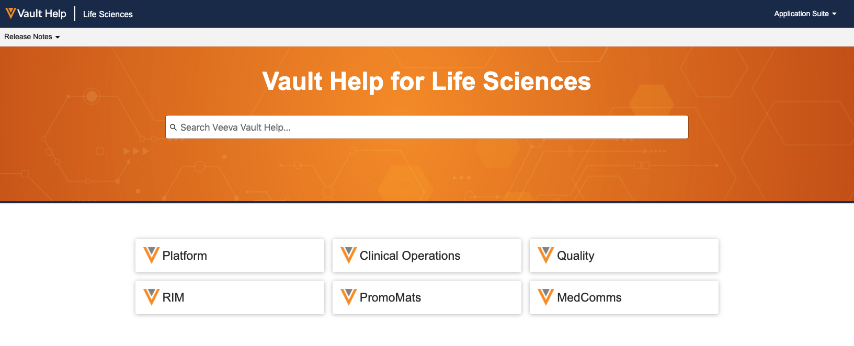

Vault Help Improvements*
Easy Access to Applications from Landing Page
Improved Search Capabilities
Updated Videos
Updated Learn More Links
*NOTE: Customers using Legacy Vault Help Links will need to update these links before the 22R2 Release as Legacy Vault Help will be retired

Slide 73
Vault Foundations
Platform
System Ownership
Validation and Change Control
Submissions
Document Management
Submission Content Planning
Health Authority Interactions
Reports and Dashboards
QualityDocs
Managing Vault Releases
Training
Controlled Document Management
ItoF and DtoA Document Management
Reports and Dashboards
eTMF
Document Contribution
Document QC
EDLs and Milestones
Reports and Dashboards
A new series of assets focused on helping customers be successful in managing their Vault applications as well as the use of core application functionality

Slide 74
Logistics

Slide 75

22R1 Release Calendar
Customer Validation
Sun | Mon | Tue | Wed | Thu | Fri | Sat
20 | 21 System Release Memo Pre-release Vaults available | 22 Compliance Documents 22R1 Release Webinars | 23 22R1 Release Webinars | 24 22R1 Release Webinars | 25 Executed OQs | 26
27 | 28 | 29 22R1 Release Webinars | 30 22R1 Release Webinars | 31 22R1 Release Webinars | 1 | 2
3 | 4 | 5 | 6 | 7 | 8 Upgrade – Early PODs VV1-12, VV1-1069, VV1-1065, VV1-1088, VV1-1054, VV2-2122 | 9
10 | 11 | 12 | 13 | 14 | 15 | 16
17 Easter | 18 | 19 | 20 | 21 | 22 Upgrade – all remaining PODs | 23
MAR
APR

Slide 76
22R1 Go Live
All customers upgraded to 22R1
  Applies to Production, Test, and Sandbox Vaults
APRIL
Friday 08
Date | POD | Start Time | Duration
8 Apr 2022 | US PODs VV1-1055, VV1-1121 Sandbox PODs | 2:00 pm PT | Up to 4 hours
 | US PODs VV1-2, VV1-1065, VV1-1088, VV1-1146 | 6:00 pm PT | Up to 4 hours
PODs VV1-2, VV1-1065,
VV1-1088, VV1-1146
Date | POD | Start Time | Duration
22 Apr 2022 | APAC POD VV3-3064 APAC & EU Sandbox PODs | 10:00 am PT | Up to 4 hours
 | US Sandbox PODs | 2:00 pm PT | Up to 4 hours
 | US PODs (except Apr 8th PODs) EU PODs APAC POD VV3-34 | 6:00 pm PT | Up to 4 hours
APRIL
Friday 22
All Other PODs

Slide 77
Early POD Upgrade Schedule
The annual schedule for early POD upgrades is as follows:
Release | Early PODs
 | Production | Sandbox | Agency
R1 - April | VV1-2 | VV1-1055 VV1-1121 | VV1-1065 VV1-1088
R2 - August | VV1-8 | VV1-1068 | VV1-1065 VV1-1088
R3 - December | VV1-12 | VV1-1069 | VV1-1065 VV1-1088
In each release, all Vaults on the designated early PODs will receive access to
Pre-Release 2 weeks earlier than other PODs

Slide 78
Pre-Release Environments
Since 20R1, customers have to provision and refresh their own
Pre-Release Vaults
  Veeva Operations enables Pre-Release 4-6 weeks ahead of each release
  We highly recommend refreshing prior to using the Pre-Release for testing
See Vault Help video for a walk-through of the creation and refresh process
Pre-Release Vaults include:
  Configuration
  Vault Owners
  Object Data referenced in configuration rules
  NO Documents or transactional data

Slide 79




22R1 Release Webinar Series
Product-specific webinars focused on the use cases and impact of key features
  All webinars are presented at multiple times
  One webinar per product set will be recorded and available after the series at:
  Help > Release Notes > About the 22R1 Release
Platform
QDocs, Station Mgr, Training
Mar 22 at 12 PM ET
Mar 23 at 9 AM ET
Mar 29 at 8 AM ET
QMS
Mar 22 at 8 AM ET
Mar 23 at 12 PM ET
Mar 24 at 9 AM ET
Mar 22 at 9 AM ET
Mar 24 at 3 PM ET
Mar 29 at 11 AM ET
Mar 22 at 9 AM ET
Mar 23 at 10 AM ET
Mar 24 at 12 PM ET
Mar 22 at 3 PM ET
Mar 23 at 12 PM ET
Mar 24 at 9 AM ET
Mar 31 at 8 AM ET
Register Here
Register Here
Register Here
Register Here

