Slide 1
How to Prepare for the Future of Clinical Research with Connected Studies

Slide 2
Table of Contents
1
Introduction
2
Discuss challenges with collaboration across systems
3
Learn about different methods for collaborating
4
Review progress that’s been made with connected studies
5
Discuss future progress made possible through connected studies
Notes:
Q&A at the end
Use Chat
Muted by Default

Slide 3





Speaker
Bree Burks, RN, MSN
VP of Strategy , Site Solutions
Notes:
Putting on the site hat today

Slide 4
Goals
Understand Methods for Collaborating across Stakeholders
Identify Pros & Cons of Methods
Improve your Tech Strategy through Connected Studies

Slide 5
Polling Question 1 of 3
How many technologies does your site use to run
a single clinical trial?
Notes:
1-5
6-10
More than 10

Slide 6
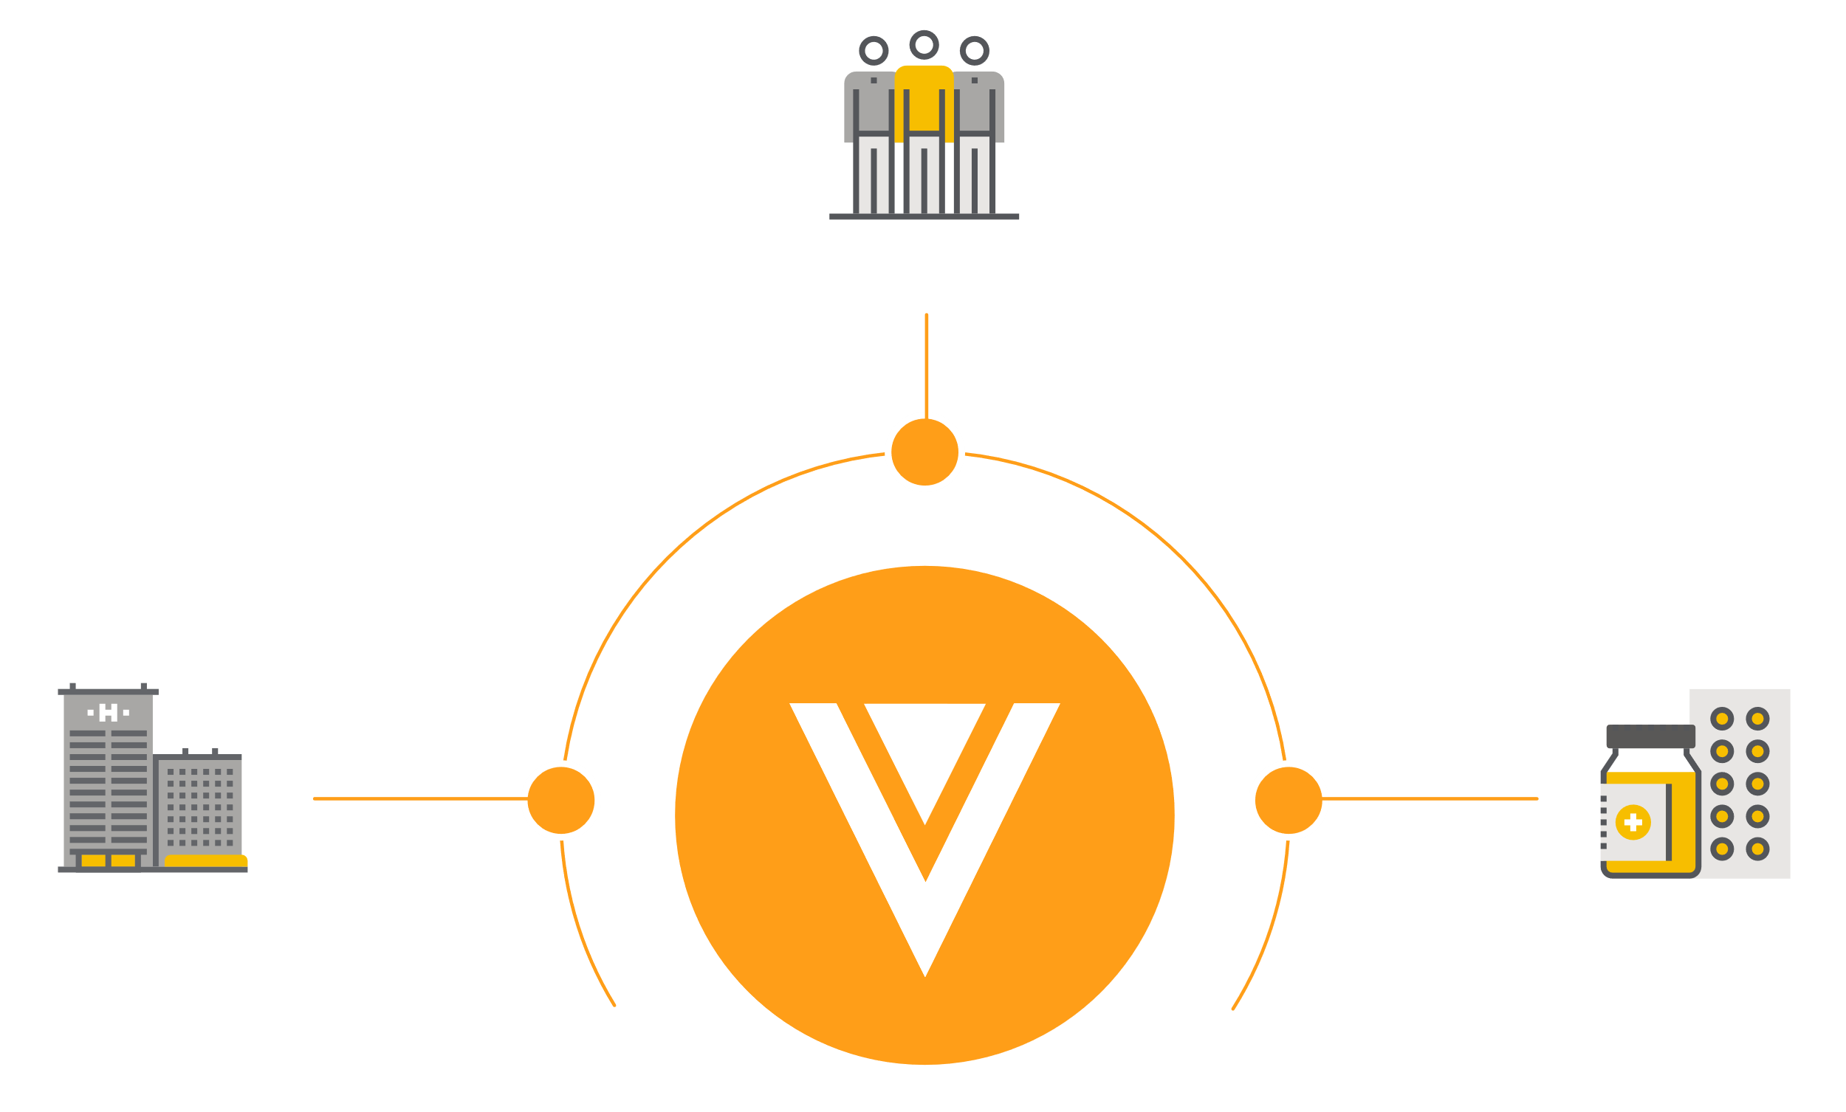
Connected Studies
Definition
A study that utilizes the power of technology to collaborate & seamlessly share documents and data across clinical trial stakeholders
Patients
Technology Partner
Sites
Sponsors
Notes:
Keys is that each stakeholder is using a system they own/control that meets the needs of their own business

Slide 7
Challenges with Technology
& Clinical Research

Slide 8
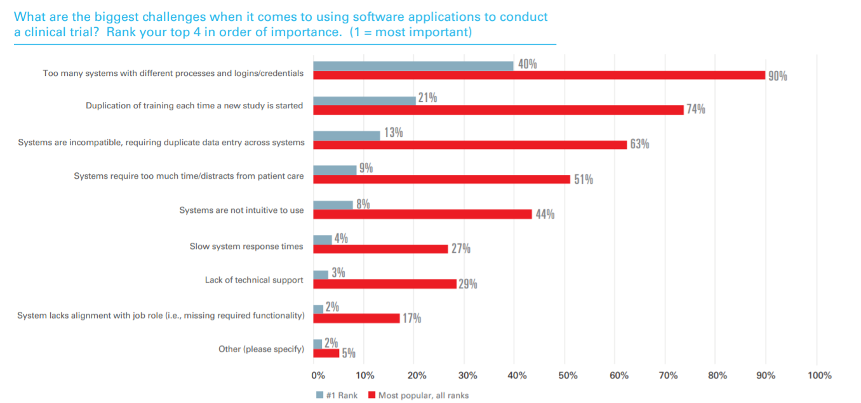
Sites Let Down by Technology
Too Many Systems
Source: Oracle and SCRS Study 2019

Slide 9
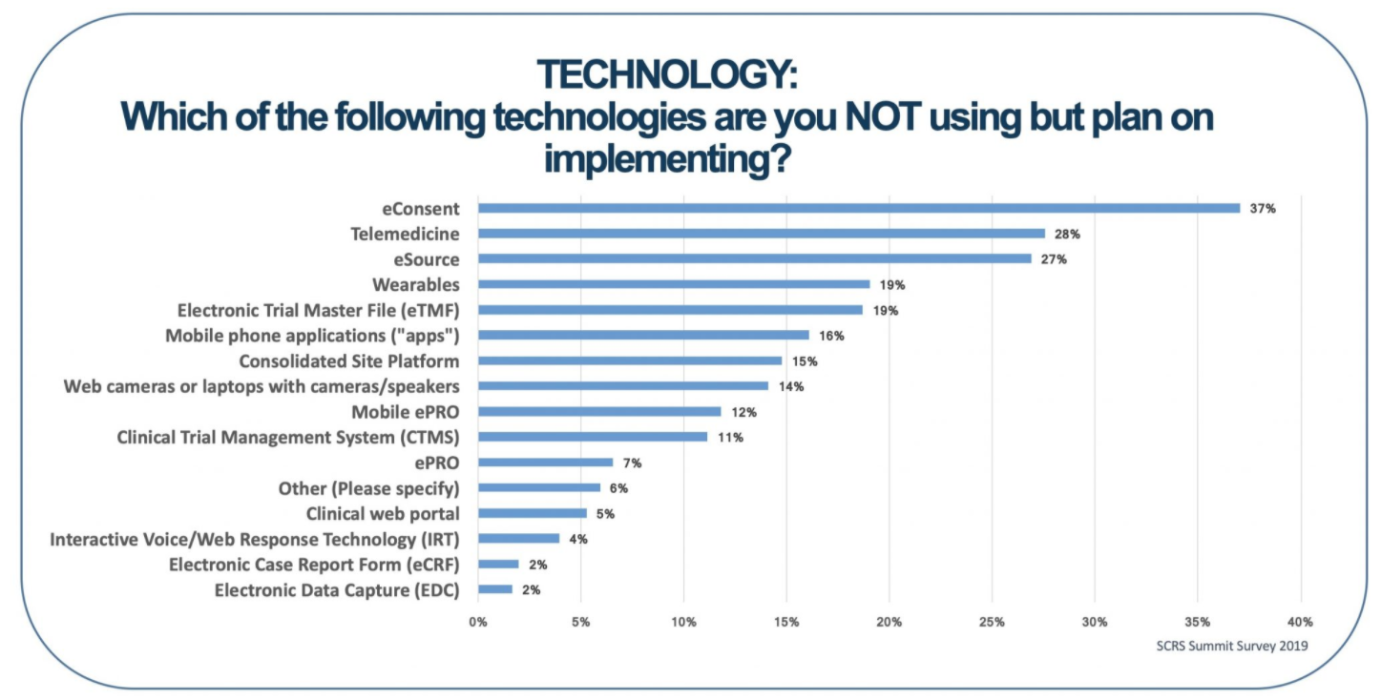
Sites Want More Technology
Source: 2020 SCRS Site Landscape Survey
Notes:
COVID and Decentralized trials have only further encouraged sites to purchase their own systems

Slide 10

The Double-Edged Sword
Notes:
Technology is not the enemy. Disconnected systems are the enemy.

Slide 11
Evolution of Site Technology
Unified Clinical Trial Ecosystem
Connected Studies Emerge
Sites & Sponsors Battle over Systems
Sites Begin Purchasing Systems
Integrations are Top of Mind
Sponsors Push Technology to Sites
Notes:
How did we get to so many disconnected systems?
As an industry, we are all at slightly different places on this roadmap

Slide 12
Methods for Connecting Across Stakeholders
Portal
API’s
Productized Integrations
Connected Studies
Notes:
Hint: I am going to poll you on what methods you most frequently use after I explain them in detail

Slide 13

Portal
Can help with reuse of documents and information, but is a disconnected way of working
Stakeholders must all use one system
Built around the needs of a single stakeholder
Notes:
TMF is a frequent one
Some CRO’s and Sponsors use these-if you are uploading your own documents into something your sponsor has provided (that you don’t own/does not serve as your own inspectable copy, you are using portals)

Slide 14

APIs (Application Programming Interface)
A set of programming code that enables data transmission between one software product and another (and also contains the terms of this data exchange)
Must be setup application by application
Each software product determines what is transmissible
Notes:
Think of “integrations”
Can be limited when standards don’t exist
How to identify a specific site over and over again across sponsors
More complexity with site networks and large institutions with multiple “sites”
Requires API’s to align (think of a zipper)
Can be incredibly complex (where is the source of truth)
Example study title
Incredibly hard to scale
Think back to the polling question on how many different technologies for a single trial
Requires a lot of ongoing maintenance
Vanderbilt-invested in a bot
Requires someone to write the check for creating and maintaining the connections
Note: this won’t go away, but we should focus on decreasing this ss the leading way to connect across parties

Slide 15

Productized Integrations
Integrations that are developed and maintained by the collaborating software companies
Saves users from having to maintain APIs
Requires companies to come together
Notes:
We are getting better!
Example: Gmail and Zoom; Virtual School (Teams); Trello and Slack
Push is from customers
This is challenging today because customers are using lots of different technologies
Integrations/API’s are still being used-but the tech companies themselves are managing that-takes a lot of investment from the tech companies and requires them to consistently work together
Example at Veeva with Zoom and Microsoft Word (have to think about who has the upper hand)
More scalable solution
Works well for technology companies that have a strong market share

Slide 16

Connected Studies
Stakeholders work on the same software platform
Technology Company must provide Products for all Stakeholders
Success requires valuing all stakeholders equally
Notes:
Technology cannot be retro-fit from one area/stakeholder to another
Goal is to decrease barriers for use across all studies (i.e. for sites across all sponsors)
Requires focus and best of breed applications that are purpose built (eReg as an example)
Success is achieved because stakeholders WANT to use products to enable their work (not because they are forced to by other stakeholders)
This is hard but achievable

Slide 17
Polling Question 2 of 3
What type of methods have you most frequently used to connect with your sponsors/CROs?
Notes:
1. Portals
2. API’s
3. Productized Integrations
4. Connected Studies
5. None

Slide 18
Today’s landscape of connected systems

Slide 19
Connected Studies: Current Progress
Patients
eISF
eTMF
eRegulatory
Sites
Sponsors
Notes:
Example: sharing docs for site selection
Site Benefits
ReUse of cross-study docs
Go paperless
Enhances compliance, facilitates remote work, empowers internal auditing, archiving with confidence
Sponsor Benefits
Efficiency
No need to manual classify docs from sites (average Phase III has 80,000 docs from sites in the TMF)
Today’s limitations: only works for sites and sponsors/CRO’s using the same tech

Slide 20
Connected Studies: Current Progress
ePRO App
Patients
eDC
Patient-Reported Outcomes
Sites
Sponsors
Notes:
Patient Benefits:
Use personal device
Automate reminders
Provide data virtually/flexibly
Save time
eDC Benefits:
Single source-direct flow into eDC system
Direct data capture-nothing to SDV
Real time insights into data
Today’s limitations: patients are not reusing apps across studies

Slide 21
Connected Studies: Current Progress
Patient App
Patients
TMF
eRegulatory
eConsent
Sites
Sponsors
Notes:
Key is that most processes actually cross stakeholders like eConsent-this becomes more challenging to facilitate
Will go into detailed benefits in next slides

Slide 22
eConsent: Deep Dive

Slide 23

Current Consenting Process
Typically managed through email and in-person visits between Sponsor, CRO, and Site
Inefficient and lacking transparency and compliance
V1.0
Patient
4. Patient travels to the site to sign the ICF
Site
Sponsors/CRO
2. ICF is updated then sent to IRB for review and approval
Monitor
1. ICF is drafted with protocol v1.0 specifics by Sponsor and emailed to site
3. Approved ICF is stored in multiple locations/formats
7. Monitor needs to find out which patients are consented on which version and if patients on V1.0 should be reconsented
V2.0
5. Signed ICF is stored locally at the site
6. A protocol amendment requires an IRB resubmission and a new ICF is used for next patient
Notes:
Throughout the process – be able to see what is happening, where are there bottlenecks, how can I make things more efficient over time
Improve the cycle time – concept to distribution
Look at it by brand or by team or by region – need visibility to be more efficient

Slide 24

Connected Study Consenting Process
Sponsor/CRO
Site
Patient
1. ICF is drafted and electronically shared with the site
2. ICF is received and sent to IRB for review and approval
3. Approved ICF is sent to patient
4. Patient reviews information about clinical trial (Q&A, Multimedia)
8. Sponsor’s system is updated with metrics on patient’s signed ICF
7. Final Signed ICF is automatically stored in eReg system
5. Patient signs eISF and a copy is stored in their app
6. Site Signs ICF
Monitor
Full visibility into all documentation and changes

Slide 25



Considerations for Collaboration with Technology
Ownership
Do stakeholders own their technology?
Standardization across Studies
Adding one more study-specific system?
Resources Required
Who is responsible for integration resources?
Duplication of Effort
Does the same information live in more that 1 system?
Technical Strategy
Which method is being used?

Slide 26
Polling Question 3 of 3
What process would you most benefit from at your site if it became digital and connected?
(i.e. you use a system you own, sponsors & patients receive what they need from your system)
Notes:
-eConsent
-Connected eSource
-Recruitment Activities (patient eligibility, screening, enrollment status)
-Staff Credentialing/Training
-Other

Slide 27
The Future of Clinical Trials

Slide 28
What Will Drive a More Connected Future?
1
2
3
New digital solutions
Simplification of processes & tech
Collaboration across all Stakeholders
Notes:
New Solutions
Staff credentialing/training (imagine something like CT.gov and LinkedIn combined)
Supports feasibility, sharing of training, delegation of responsibilities across studies and sponsors
Simplification
Tech companies are consolidating and partnering
Power is in using less systems to get done what you need
Challenge is not a lack of tech companies that can provide solutions, challenge is in the numbers of companies that exist
Collaboration
Stakeholders are demanding more collaboration from technology companies
As more tech companies serve as trusted partners, they will be forced to meet the demands of their customers
Think about the banking industry (high risk, very competitive, highly regulated, came together)

Slide 29



Connectivity at its Best
Healthcare Profile
Trial Searching
Education
Study Visits
Study Team Communication
ePROs
Study Adherence
Study Results
Study Searching
Feasibility
Patient Relationship Management
Recruitment
Staff Credentialing/Training
eRegulatory (ISF)
CTMS
Study Accounting
eSource
Site Selection
Regulatory
eConsent
Quality
Safety
CTMS
eDC
TMF
Submissions/Publishing
End of Study Media Transfer
Connected Technology Platform
Notes:
What we highlighted earlier is in bold
So much more opportunity for improvement
The challenge is first getting to a best of breed for these products (don’t want to invest in connecting something that people won’t use)
Then, you connect the bloodlines (this is a very hard process to undo-you now have to manage needs of stakeholders, develop processes across applications and development teams…. Not an easy overnight thing)
But, not an impossible thing

Slide 30
Key Takeaways
1
We need better collaboration across clinical trial stakeholders
2
All collaboration methods are not created equally
3
How your technology partners facilitates collaboration across stakeholders now and in the future should be top of mind

Slide 31

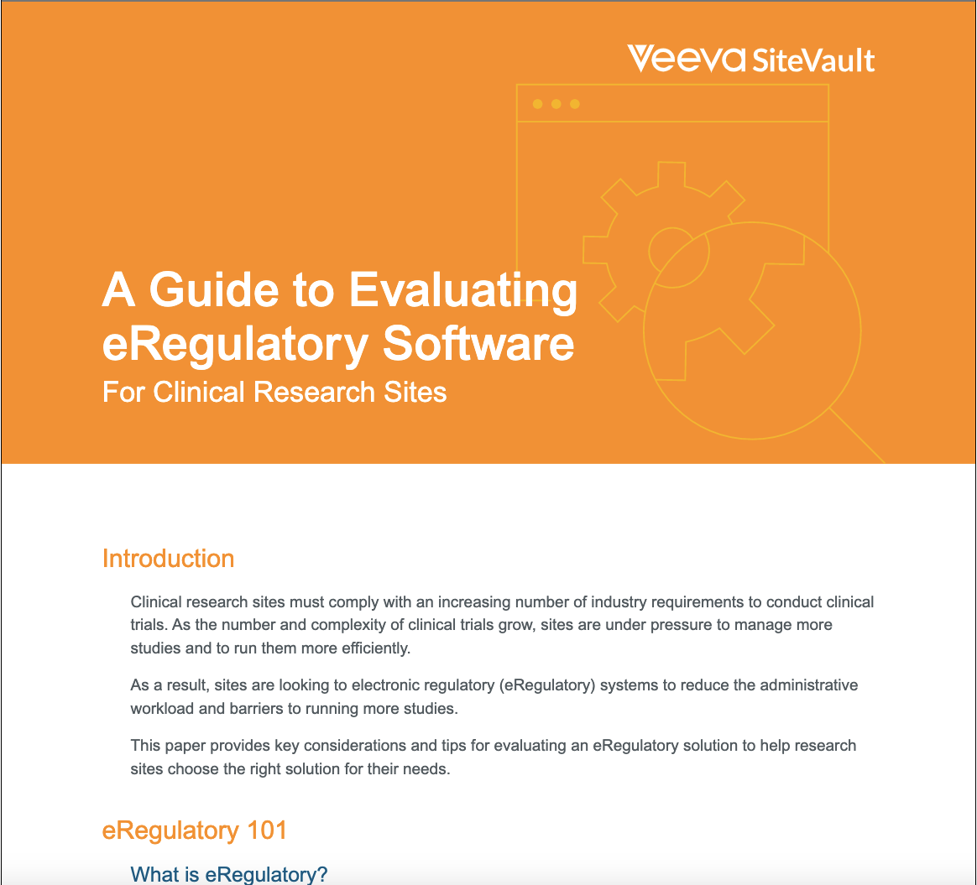

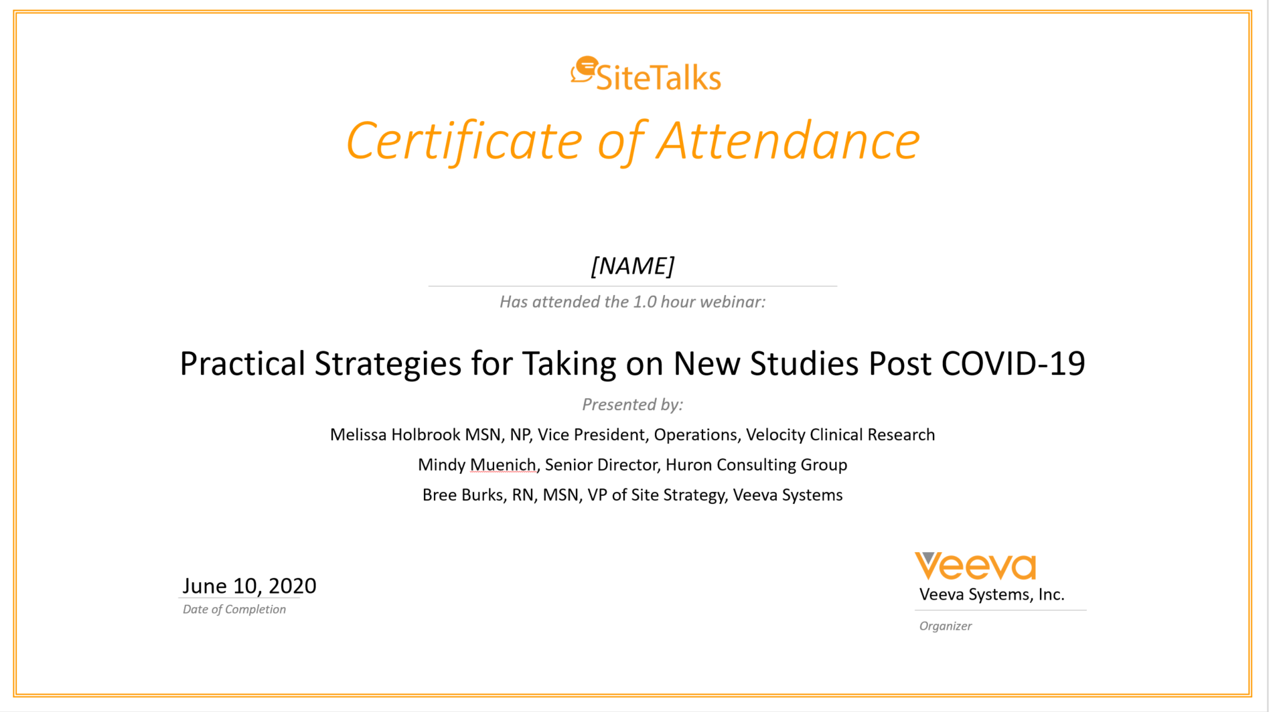


Additional Resources
You will receive the following via email:
Detailed slides & recording
You will receive the following via email within 1-2 weeks:
Guide to evaluating site technology

Slide 32
Notes:
Seed questions:
What is the difference between connected studies and SIP?
Is Veeva supporting connected studies today?
What is Veeva’s plan to facilitate connected studies in the future?
How do you determine who should pay for the connections across applications?

Slide 33

Upcoming events
SiteVault Customers
Community Meeting
  Wednesday, April 21 at 12:00 pm ET
Next SiteTalks Webinar:
Paving a New Path to Consent Patients with Veeva eConsent
  Thursday, April 29th 12:00 pm ET

