Slide 2
20R2 Vault Safety Updates and Enhancements
20R2
July 14, 2020
Please use ‘Q&A’ to ask a question

Slide 3
Vault Safety Platform 20R2 Webinar Team
Laura Jelin
Customer Success Manager, Vault Safety
laura.jelin@veeva.com
Asi Roll
Director Product Mgmt, Vault Safety
asi.roll@veeva.com

Slide 4
Foreword
The content of this presentation is subject to change prior to the 20R2 Release
Please note the revision date on the title slide
Veeva encourages you to always reference Release documentation from our Release pages to ensure you are using the latest information
Safety.VeevaVault.Help → Release Notes → About the 20R2 Release

Slide 5
Interact With Us!

Slide 6
Planning for the 20R2 Release
Logistics
Announcements
Features
Identify key
release dates
Promote awareness of Veeva events
Review new features
based on themes
Note: Keep Alert for Polling!

Slide 7
Logistics

Slide 8
20R2 Release Calendar
Customer Validation
Sun | Mon | Tue | Wed | Thu | Fri | Sat
12 | 13 | 14 20R2 Release Webinars Pre-Release Vault Platform Webinar | 15 | 16 | 17 | 18
19 | 20 | 21 | 22 | 23 | 24 | 25
26 | 27 | 28 | 29 | 30 | 31 | 1
2 | 3 | 4 | 5 | 6 | 7 | 8
9 | 10 | 11 | 12 | 13 | 14 | 15
JUL
https://go.veeva.com/20R2_Platform
Validation Package available on Veeva Docs
AUG
Executed OQs
Release to all LR PODs
Release to all GR PODs

Slide 9
Pre-Release Environments
Customers will provision and refresh their own Pre-Release Vaults
Veeva Operations enables Pre-Release approximately 3-4 weeks ahead of each release
Safety Release notes about Pre-Release
Pre-Release Vaults include:
Configuration
Vault Owners
Object Data referenced in configuration rules
NO Documents or transactional data

Slide 10
Pre-Release Environments

Slide 11
Validation & Supporting Docs
Veeva Compliance Docs
Validation Project Plan
IOQ Protocols
Business Requirement Documents
Traceability Matrices
System Release Memo
Release Notes
Summary Reports
Executed OQ Scripts (unexecuted in Word format available upon request)
Supporting Documents available on the 20R2 Release page in Vault Help
20R2 Release Impact Assessment
AUGUST
System Release Memo | July 24
Compliance Documents
Executed OQs | July 31

Slide 12
20R2 Go Live
All customers upgraded to 20R2
Applies to Production, Test, and Sandbox Vaults
AUGUST
Thursday 6th
Date | POD | Start Time | Duration
July 31st 2020 | All PODS – Authentication service update | 06:00 pm PT | 1 hour
LR PODS
Date | POD | Start Time | Duration
Aug 6th 2020 | Limited Release POD will be updated to 20R2 | 04:00 pm PT | Up to 4 hours*
AUGUST
Friday 14th
Date | POD | Start Time | Duration
Aug 14th 2020 | General Release POD will be available for Production Safety Vaults | 09:00 pm PT | Up to 4 hours*
GR PODS
* On July 31st 2020, http://trust.veeva.com will be updated with final downtime durations

Slide 13
Announcements

Slide 14
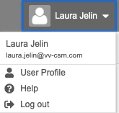
Notification Emails from Veeva
Opt-in to Product Announcements in User Profile to be contacted about:
Initial release announcement (RIA)
Release webinar invites
Pre-release and validation document availability
Go-live & key date reminders
Opt-in to Service Availability notifications in User Profile to be contacted about:
Planned system maintenance
Service disruptions

Slide 15
20R2 Developer Release Deep Dive
Thursday, 16-Jul at 7 a.m. PT / 10 a.m. ET / 3 p.m. GMT
Join Veeva Customer Success and Product teams for an education session on new features in the Veeva Vault developer-focused toolkit
This webinar is geared towards current users of the Vault Developer toolkit (API)
Key topics for discussion will include:
Detailed explanation of new features
Spark Integration Services
Java SDK updates
Considerations for using new features, and impacts features may have on your Vault or end users
Advanced registration required

Slide 16
October 13–14, 2020
Develop new industry partnerships
Share best practices
Network with sponsors, CROs, & sites
CLINICAL
QUALITY & MANUFACTURING
REGULATORY
SAFETY
IT

Slide 17
Features and Roadmap

Slide 18
August 20R2
Case Intake
Case Processing
Safety Coding
Case Review
Safety Data Exchange
ICSR Regulatory
Submissions
Periodic Reporting
E2BR2/R3 Ready Intake
Drag-N-Drop File Import
Case Checklist
Central Inbox
“OneCase” Intelligent Duplicate Check
Potential Match: Follow up
E2B Import – Product Library Match
Import Narratives API Endpoint
E2B R2 Product Import Converter + Enhancements
Duplication Detection Enhancements
Source Document: Report Type / Receipt Date
Study Arms and Blinded Product Names
Study Site Reporters
Case Product Dosage & Indications Section UX
Auto-Create Assessment Results Grid
Frequency: Multi-Option Control
Manual Case Lock
Substances
Combination Products: Drug / Biologic with Device constituents
Routes of Administration
Units of Measure
MedDRA
WHODrug
MedDRA Auto-coding
MedDRA SMQ/CMQ
xEVMPD Dosage Forms
Non-Standard Units
WHODrug Version Selector
MedDRA Browser hierarchy Tree view
MedDRA Centralization
Imprecise Dates, Enhanced Narratives, Blind Protection
Auto-expectedness / Auto-calculations
Visual Compare, Version Control & Annotation
Symptom Classification for Adverse Events
Precise Naming for Assessment Matrix
AESI & Configurable Watchlists
Case Level Relatedness
Automatic SUSAR / SAE Detection
Drug Role: Treatments
Medical Review Timeline
Controlled Vocabulary
E2B Formats
Line Listing Templates
AS/2 Gateways
SDX API
Partner Distribution Lists (ICSR)
Rulesets
Masked ICSR Distributions
Blinded Case Previews
E2B Notification Links
API Name for Transmission Profiles
Deprecated Controlled Vocabulary
FDA 3500A
CIOMS I
FDA Submission
EMA Submissions
DME Detection
Local Datasheets & Primary Expectedness
Health Canada E2B R2
Biologic – Drug Combination
Drug / Biologic with Device constituents
E2B R3/R2 Agency Validations
Aggregate Report Templates
PBRER Cumulative
DSUR Line Listings
FDA PADER Line Listing
PSUR Cumulative
CIOMS II Line Listings
DSUR: Regional Appendices
DSUR: Masked SAE Cumulative and Line Listings
Aggregate Report Template: Merge Fields
NEW
NEW
NEW
NEW
NEW
NEW
NEW
NEW
NEW
NEW
NEW
NEW
NEW
NEW
NEW
NEW
NEW
NEW
NEW
NEW
NEW
NEW

Slide 19
Best Practices for Managing Vault Releases
This video contains:
Information About Vault General Releases
Recommended General Release Strategy
Step 1: Auto-On Features
Step 2: Configurable Features
Sample Demonstration of a Release Process
Link to Presentation *
*(Support Portal Login Required)

Slide 20
20R2 Vault Safety Features

Slide 21
20R2 Vault Safety Themes
Case Review

Slide 22
Vault Safety Release Key Takeaways
CIOMS II
Medical Timeline Review
MedDRA Browser Hierarchy Tree View
DSUR Appendices
Manual Case Lock
MedDRA Centralization

Slide 23
Feature Personas
Viewer
Admin
Power User
Developer
Viewers read-only access
Power Users manage AER & Cases
through their lifecycles
using application-specific business processes
Business and System Admins maintain data,
security, and configurations
Developers build
data models, business process configurations,
system integrations, and data migrations

Slide 24
Feature Enablement Detail
Auto-On Features
Configurable Features
Auto-On
Admin Checkbox
Configuration
Support
Turned On Day 1
Automatically available, some setup may be required
Turned Off
Requires enablement
Turned Off
Requires enablement Requires configuration
Turned Off
Requires enablement Product Support Request

Slide 25
Platform Awareness

Slide 26
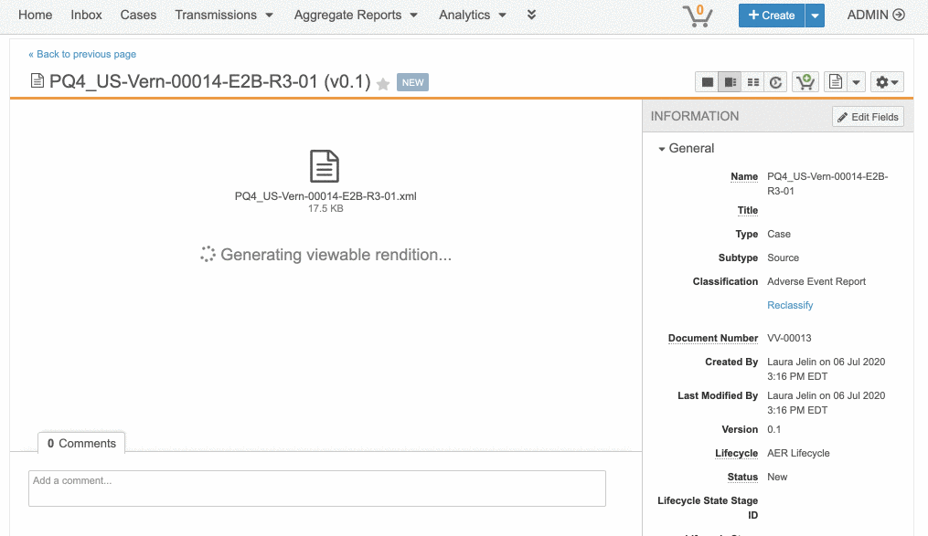
XML Rendering
Automatic
Overview
This features provides the ability to generate a viewable rendition for XML files
XML files are rendered in text format
Business Justification
Enable customers to review and annotate XML files within Vault
Setup by:
N/A
for use by:
Power User
Feature Risk
MEDIUM
Default Impact
VISIBLE TO ALL USERS

Slide 27
Sharing Settings UI Enhancements for Objects
Automatic
Overview
Redesigned UI provides one sortable table regardless of assignment types (manual, custom, matching sharing rules)
Searching for user access now returns both direct user role assignments and role assignments through groups
Business Justification
Provides improved usability and consistency with Document Sharing Setting UI
Setup by:
N/A
for use by:
Power User
Feature Risk
N/A
Default Impact
VISIBLE TO ALL USERS

Slide 28
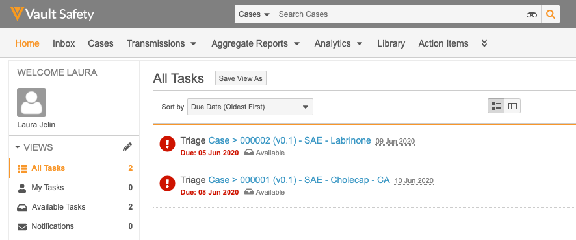
Default Search Context
Configurable
Overview
Administrators can now configure any document tab or object tab to be the default search context
The default search context is applicable when a user is on a tab that is not searchable: Home, Dashboards, or a web tab
Setup by:
N/A
for use by:
Power User
Business Justification
Many customers want to steer users to a steady state document tab when searching documents to prevent users from mistakenly performing processes using in-progress versions
When users login for the first time, or navigates to a tab that is not searchable (i.e. Home or Dashboards), the Search box context defaults to All Documents
This behavior could steer a user toward mistakenly using an in-progress version of a document
Feature Risk
LOW
Default Impact
VISIBLE TO ADMINS ONLY

Slide 29
Or Filter Logic
Automatic
Overview
Reports now support OR logic, as well as AND logic, between filters or prompts
Parentheses can be used to explicitly group filters together and define precedence
Business Justification
Customers often require reports that include both AND and OR logical operations
Setup by:
N/A
for use by:
Power User
Feature Risk
LOW
Default Impact
VISIBLE TO ALL USERS

Slide 30
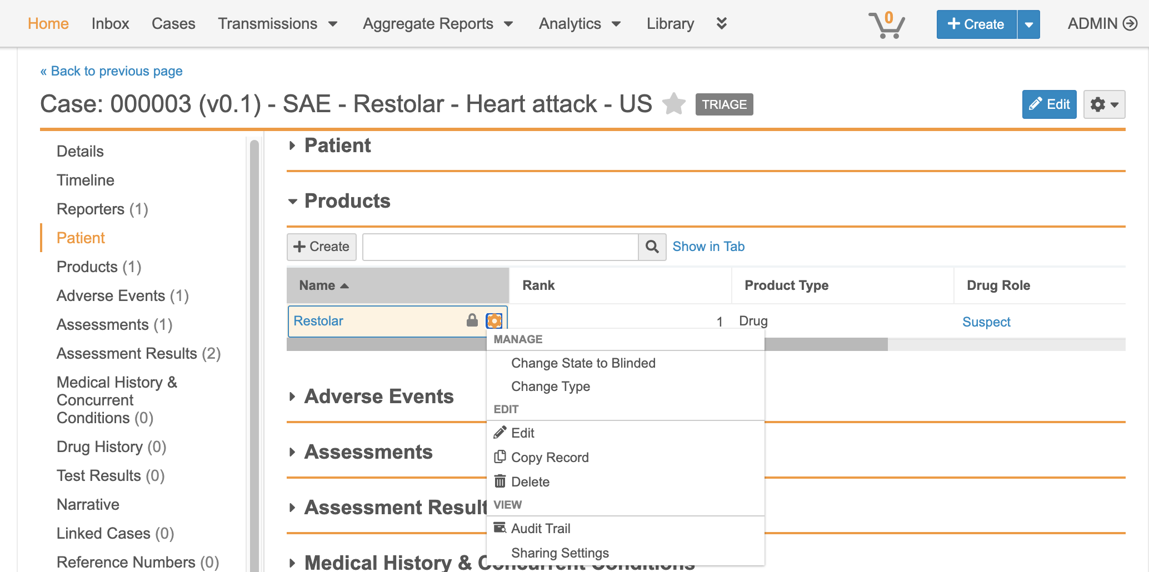
Add Change Type Action to Related Record
Automatic
Overview
This feature allows users to change the object type of related object records using the Actions menu within related record sections on an object record details page
Business Justification
This will streamline the management and correction of related records within the same page layout
Considerations
Requires that the related object has more than 1 object type and the user has edit permissions on the related object
Setup by:
N/A
for use by:
Power User
Feature Risk
LOW
Default Impact
VISIBLE TO ALL USERS

Slide 31
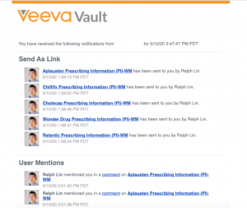
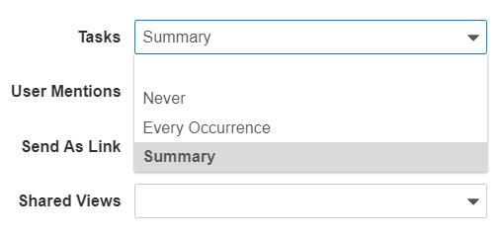
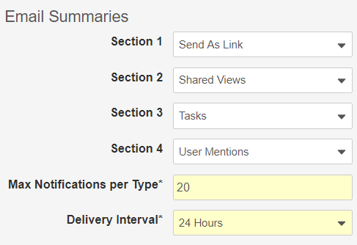
Notification Preferences
Notification Summary Email
Configurable
Overview
System Administrators and Vault Owners can :
setup Users’ email delivery preferences for certain types of notifications
configure how information appears in emails that summarize notifications
configure how often notification summary emails are sent to Users
Business Justification
This feature reduces “notification overload” by providing Users with emails containing notification summaries, rather than sending email each time an event triggers a notification
Considerations
Email preferences are Vault-specific
Refer to Vault Help for more information
Setup by:
N/A
for use by:
Power User
User Delivery Preferences
Summary Email Options
Feature Risk
LOW
Default Impact
VISIBLE TO ADMINS ONLY

Slide 32
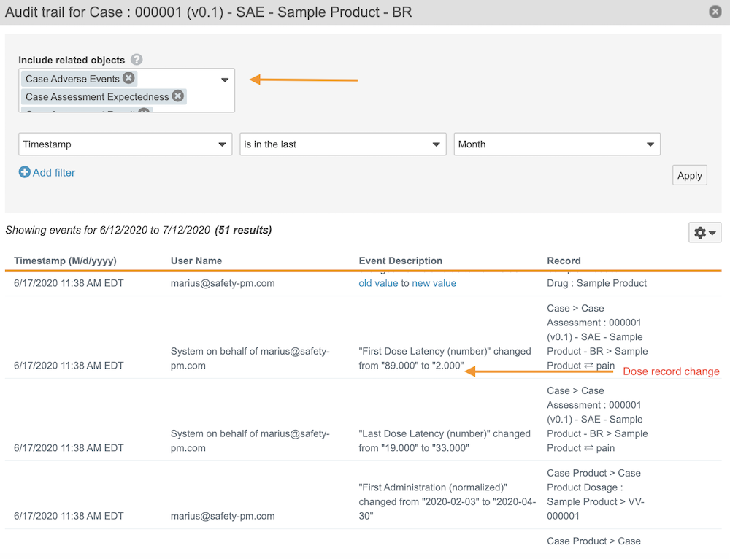
Individual Audit Filters
Automatic
Overview
Users can now apply Event and User filters, in addition to Date filters, when viewing audit trails for individual documents and object records
Business Justification
Allows users to more easily find specific activity of interest within a document’s or object record’s audit trails
i.e. find all edits performed in the last day
i.e. find all electronic signatures performed by a user within a specific date range
Considerations
Refer to the following link for a list of document audit trail events:
http://vaulthelp.vod309.com/wordpress/admin-user-help/auditing/document-audit-events/
Object Record
Audit Trail Filters
Setup by:
N/A
for use by:
Power User
Feature Risk
MEDIUM
Default Impact
VISIBLE TO ALL USERS

Slide 33
Other Platform Features
Long Text Field Enhancements
MDW: Execute Entry Action / Entry Criteria when Canceling Workflow / Removing Documents
Reports- Include prompts in filter
Document Lifecycle Atomic Security for Document Workflows Actions
Shared Document Lookup Fields
Save Version to Vault Without Ending Collaboration Session

Slide 34
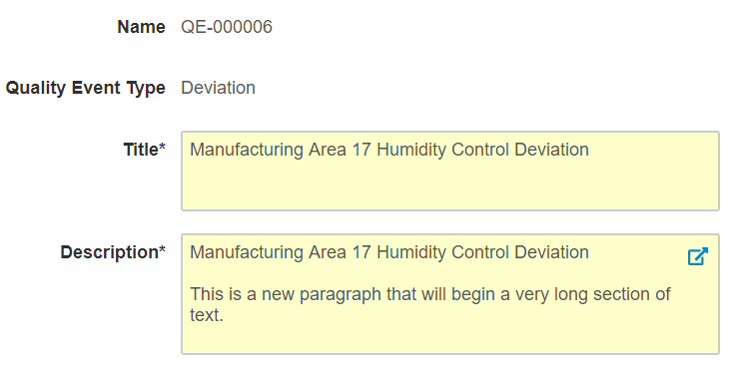
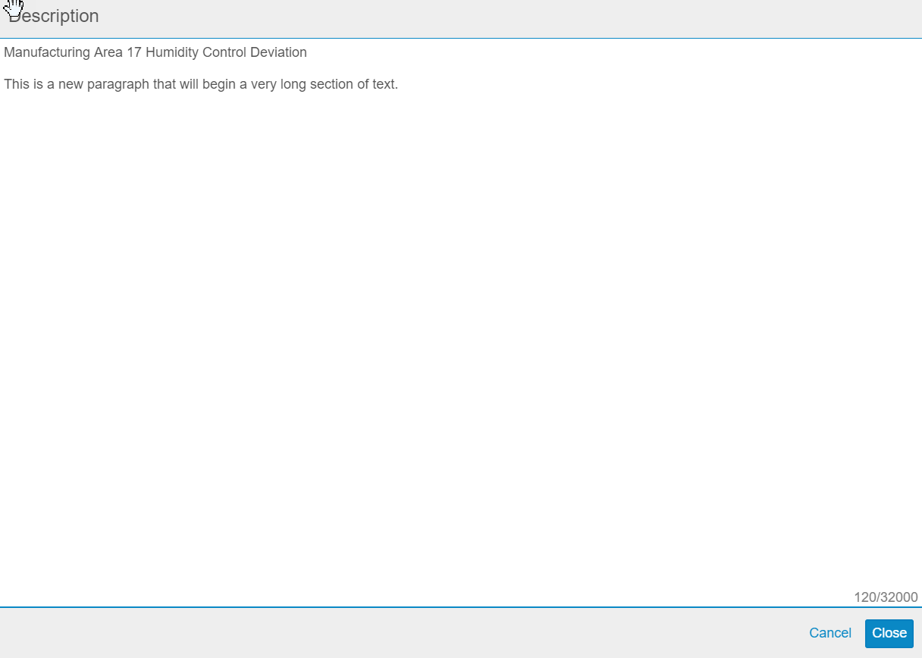
Long Text Field Enhancements
Automatic
Overview
Allow Admins to create LongText fields in the Admin UI
Allow users to edit LongText fields using a pop-up editor
Ensure all characters in LongText fields are included in exports from list views
Business Justification
Improve user experience of editing LongText fields
Ensure LongText fields are not truncated when exporting records from List views
Considerations
Pop-up editor for LongText fields, and ability to export all characters in LongText fields are Auto On features
Setup by:
N/A
for use by:
Power User
Feature Risk
MEDIUM
Default Impact
VISIBLE TO ALL USERS

Slide 35
Multi-Document Workflow: Execute Entry Action & Entry Criteria When Canceling Workflows or Removing Documents
Automatic
Overview
Vault now executes Entry Actions and Entry Criteria for the Cancel Workflow State when a user …
Cancels a multi-document workflow
Removes a document from a multi-document workflow
Business Justification
Help customers who would like to capture information like workflow cancellation date, or reset values that were set during the workflow process
Considerations
When users cancel a multi-document workflow, Vault moves the documents to the configured Cancel Workflow State
Administrators can configure the Cancel Workflow State to be
the “state in which the workflow started”, or
a specific state in a document lifecycle, or
no state change
Setup by:
N/A
for use by:
Power User
Feature Risk
MEDIUM
Default Impact
VISIBLE TO ALL USERS

Slide 36
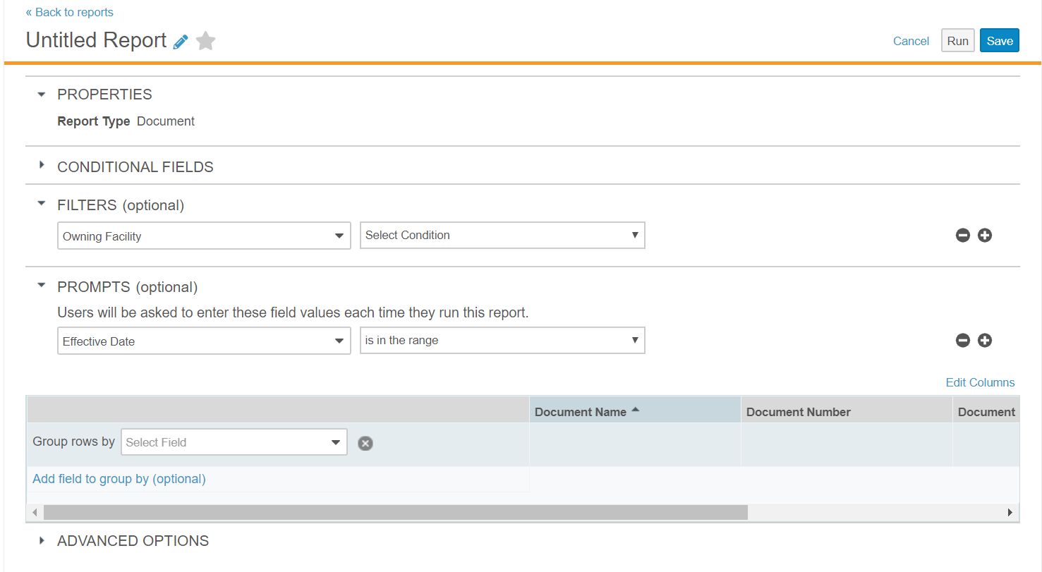
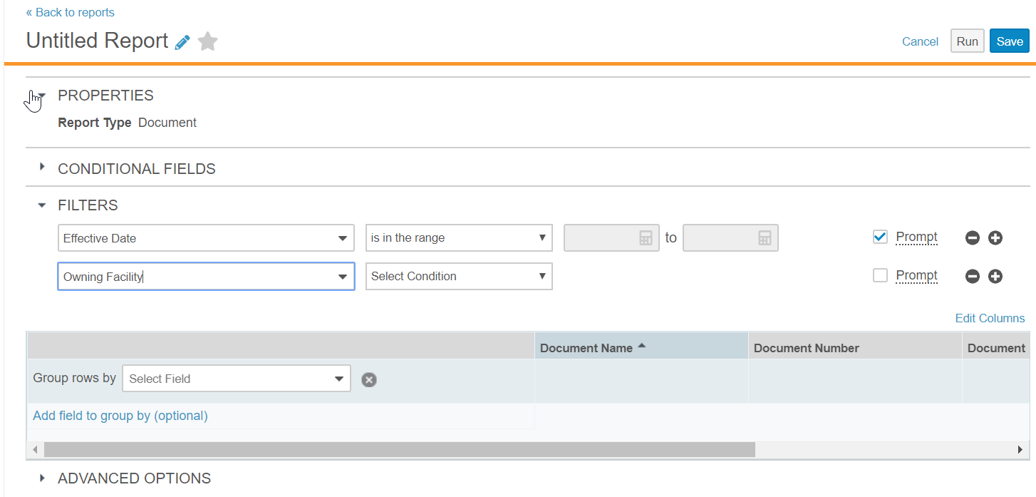
Include Prompts with Filters in Report Builder
Automatic
Overview
The option that prompts a user for information when running a report has been moved
Business Justification
Users building reports can define all filters in one location
Setup by:
N/A
for use by:
Power User
Before 20R2
Separate section for filters with runtime prompts
After 20R2
One section for all filters with checkbox for runtime prompt
Feature Risk
LOW
Default Impact
VISIBLE TO ALL USERS

Slide 37
Document Lifecyle Atomic Security: Active Workflow Actions
Support
Overview
Admins can configure which roles (i.e. Owner, Editor, Document Control, etc.) have permission to perform the following “active workflow actions” based on document status (i.e. In Edit, In Review, In Approval, Effective, etc.)
Cancel Workflow
Add Participants
Reassign Task
Cancel Task
Remove Document from a Multi-Document Workflow
Business Justification
Provides greater control over which roles can administer active workflow tasks for documents
e.g. Prior to this release, if a user’s Profile/Permission set allowed Cancel Workflow, that user could cancel any document workflow
Considerations
When enabled, the Workflow Initiator / Workflow Owner no longer receives automatic access to these actions
Admins will need to ensure that users who start workflows are in document roles with access to perform these actions as needed
Setup by:
Support
for use by:
Power User
Feature Risk
HIGH
Default Impact
NONE

Slide 38
Shared Lookup Fields for Documents
Configurable
Overview
Admins can now create Lookup type document fields as shared fields. It is also possible to convert existing lookup fields into shared fields
Business Justification
Prior to this release, document lookup fields that refer to an object reference could not be shared. These lookup fields are often used in DAC rules and sometimes the limit of 5 lookup fields per object reference field would be hit. Shared fields will help avoid reaching the limit and streamline DAC configurations
Considerations
In order to share a lookup field with a document type, an Admin must ensure the Lookup Object Field is on the same document type or inherited from a parent document type
All custom __c lookup fields can be converted to shared fields
Setup by:
Admin
for use by:
Power User
Feature Risk
LOW
Default Impact
VISIBLE TO ADMINS ONLY

Slide 39
Save Version to Vault Without Ending Collaboration Session
Automatic
Overview
This feature saves the latest file changes to Vault as a new minor version, but without ending the collaboration session
Any user with Edit Document permission can use Save to Vault
The user that checked out the document and started the collaboration session can use Save to Vault or Check In
Business Justification
Periodically save changes to Vault during a collaboration process, instead of waiting until collaboration is finished
Considerations
Cancel Checkout does not rollback / delete versions created by Save to Vault
The Save to Vault option is now available in the Action menu of the document
Save to Vault does not automatically bring forward annotations to the new document version
Collaborators are now notified that a collaboration session has ended when the document is checked in
Setup by:
N/A
for use by:
Power User
Feature Risk
MEDIUM
Default Impact
VISIBLE TO ALL USERS

Slide 40
Webinar Poll: Features Poll

Slide 41
Case Intake & Case Processing

Slide 42
E2B R2 Product Import Converter and Enhancements
Automatic
Overview
When importing E2B(R2) files, Vault Safety now merges drug duplicates and creates a single Case Product, including all of its dosages and substances. The system sends a warning notification if conflicting information is found under drug duplicates.
A drug is considered a duplicate when the following data points match: Proprietary medicinal product name All active substance names The country where the drug was obtained
Business Justification
Dosage is not a repeatable section in E2B(R2) format. For dosage regimen that involve more than one dosage form and/or changes in dosage, the sender can provide more than one iteration for the same drug.
Considerations
Products from a blinded study that have the same Application Numbers but different names will be merged on import.
Setup by:
N/A
for use by:
Power User
Feature Risk
HIGH
Default Impact
VISIBLE TO ALL USERS

Slide 43
Non-Standard Frequency Export for FDA E2B(R2)
Automatic
Overview
Vault Safety now exports non-standard frequency measurements (cyclical, as necessary, and total) to the dosage text field and leaves the frequency value and unit blank to ensure a compliant FDA E2B(R2) file is generated.
Vault Safety sends a notification when it maps non-standard frequency values this way during an FDA E2B (R2) export.
Business Justification
Vault supports cyclical, as necessary, and total as dosage frequency in the case form for E2B(R3) and Health Canada E2B(R2) export. FDA doesn’t accept these frequency values for E2B(R2) submissions.
Considerations
Vault doesn’t export the frequency information and doesn’t generate a notification.
Setup by:
N/A
for use by:
Power User
Feature Risk
HIGH
Default Impact
VISIBLE TO ALL USERS

Slide 44
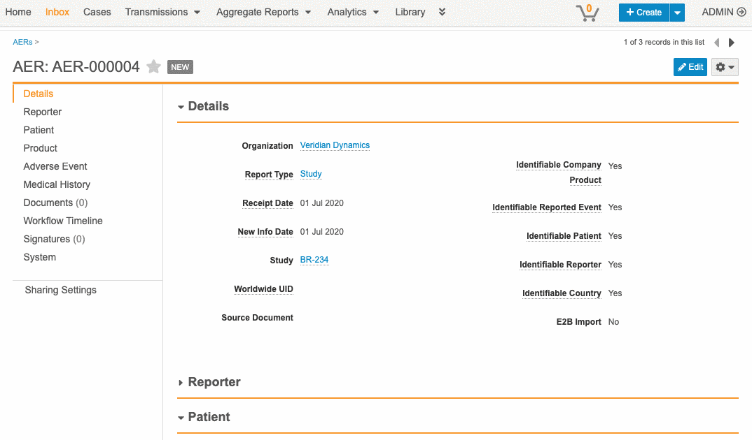
Duplicate Detection Enhancements
Automatic
Overview
Vault Safety will now use Study Arm Product and Site Reporter information for duplication detection.
Business Justification
It will return potential matches for cases which have only one MRN field matching for Patient information.
The potential matches page will show the Lifecycle state for the promoted AER and selected match to facilitate the review.
Setup by:
N/A
for use by:
Power User
Feature Risk
MEDIUM
Default Impact
VISIBLE TO ALL USERS

Slide 45
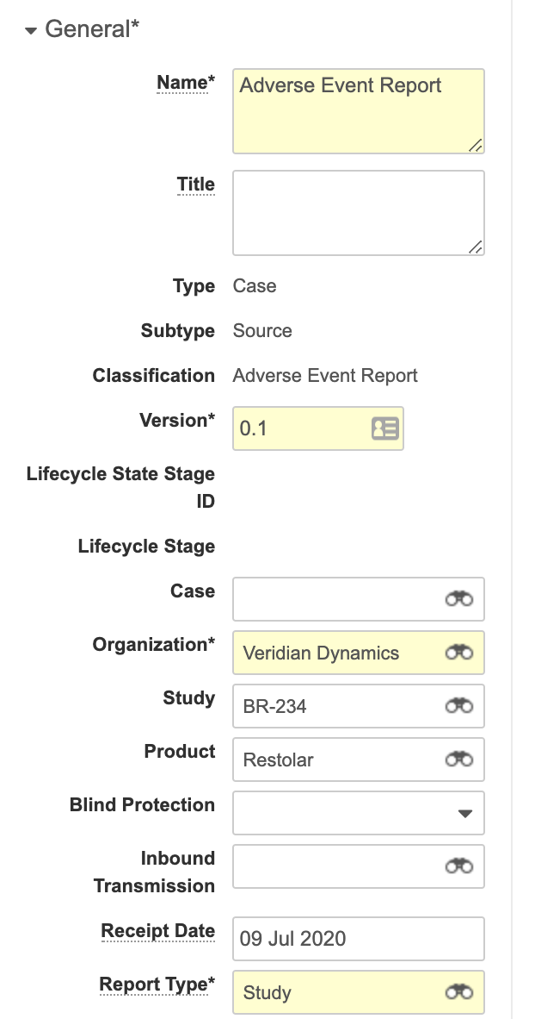
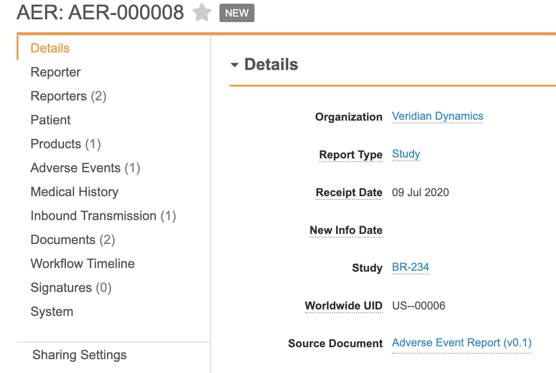
Copy Report Type and Receipt Date from AER Source Document Vault Metadata
Automatic
Overview
Users can now capture the report type and receipt date on an AER created from a document in the library. Two new shared document fields were created – Report Type & Receipt Date.
Business Justification
Customers can upload a document and create from AER but the AERs created from documents were marked as spontaneous with receipt date = Today.
Considerations
These changes will only have an effect on non-E2B files. If fields are left blank or not present on doc type selected, current behavior will still exist.
Setup by:
N/A
for use by:
Power User
Feature Risk
MEDIUM
Default Impact
VISIBLE TO ALL USERS

Slide 46
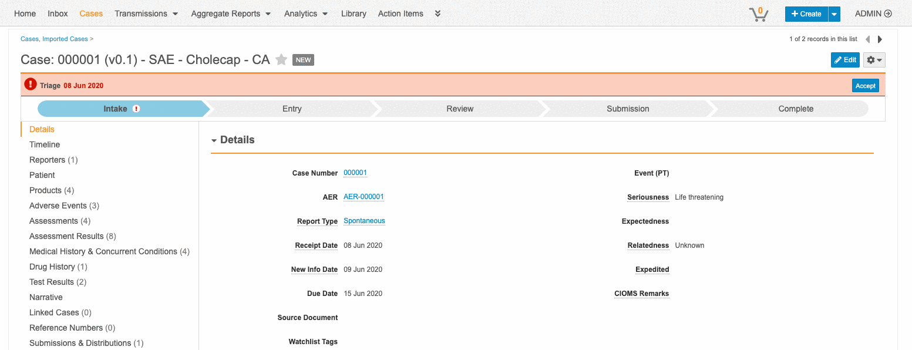
Manual Case Lock
Configurable
Overview
Individual users can now more easily lock Cases and their related records, including Case Adverse Events, Products, Medical History, and Assessments, to prevent other users from editing them. Privileged users can unlock and reassign.
Business Justification
Requests from customers that this feature existed in other Safety systems. This helps bring us to feature parity and should help with adoption
Setup by:
Admin
for use by:
Power User
Considerations
A new Case Locked icon will be automatically available with no configuration needed. The lock icon will appear by default on Cases in the Approved, Closed, Superseded, and Rejected states.
Feature Risk
MEDIUM
Default Impact
VISIBLE TO ADMINS ONLY

Slide 47
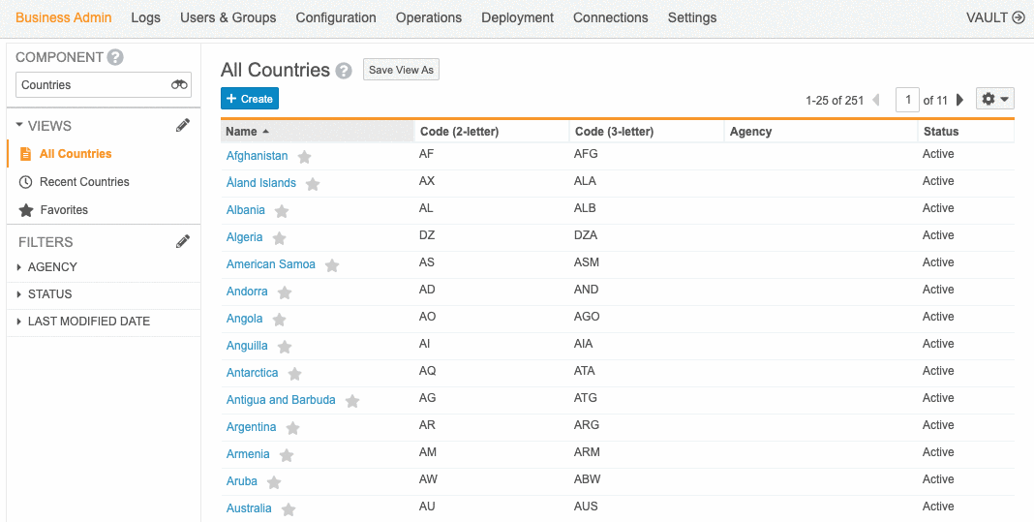
Substances
Configurable
Overview
Vault Safety can now track substances and their use in individual products. When adding a product to a case that is associated with a substance, the substance is snapshotted to the case product.
Business Justification
Customers want to track substance within one or more Products. Creating a separate substance object allowing the ability for users to create reports based on substance.
Setup by:
Admin
for use by:
Power User
Feature Risk
MEDIUM
Default Impact
VISIBLE TO ADMINS ONLY

Slide 48
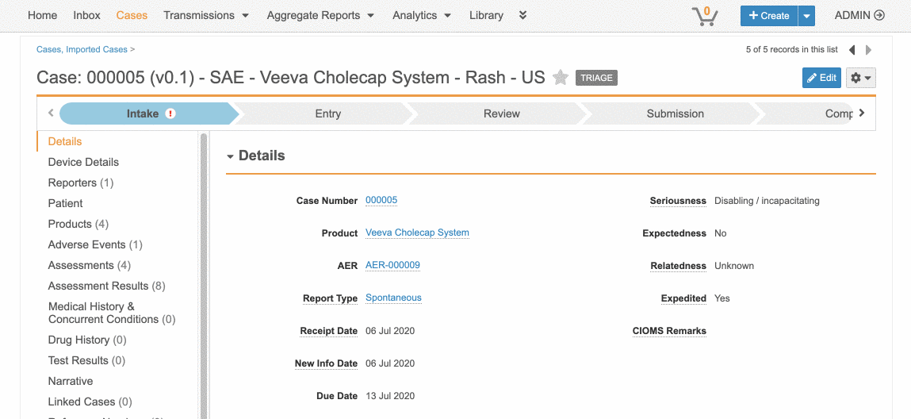
Drug / Biologic Combination Products with Device Constituents
Configurable
Overview
Vault Safety now supports end-to-end case processing for post-marketing drug/biologic combination products having device constituents. Additional device information can be entered during data entry, including device event problem codes, device evaluation codes, and remedial action information.
Setup by:
Admin
for use by:
Power User
Business Justification
Leveraging these capabilities to remain compliant with the FDA's PMSR requirements for combination products and their device constituents (21 CFR Part 4), which take effect July 31, 2020.
Considerations
If the combination product is marketed in the US, an FDA-bound E2B(R2) submission is generated, along with the new FDA regional fields for combination products.
Feature Risk
HIGH
Default Impact
VISIBLE TO ALL USERS

Slide 49
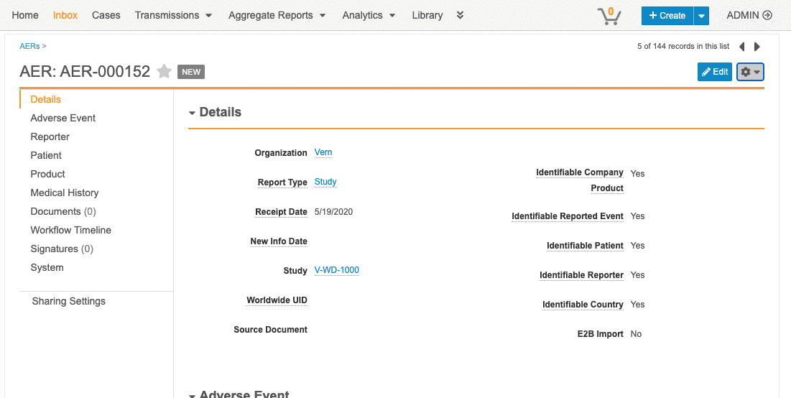
Performance Optimization: Promote to Case
Automatic
Overview
Slow performance in promote to case - many triggers were running with cascading logic (one trigger would trigger another). Updated framework to enhance Promote to Case performance speed.
Setup by:
N/A
for use by:
Power User
Feature Risk
LOW
Default Impact
NONE

Slide 50
Safety Coding

Slide 51
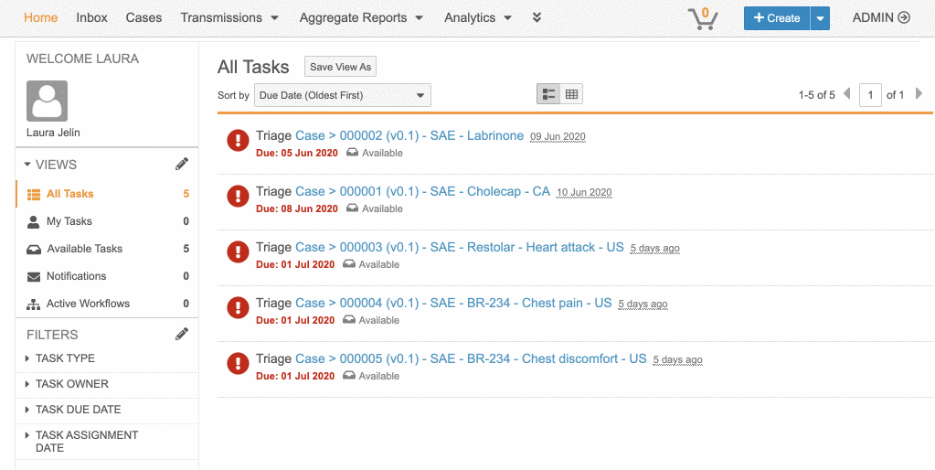
WHODrug Version Selection from Central Database
Configurable
Overview
While selecting the active WHODrug dictionary, administrators can now see when the list of releases in their vault is out of sync and fetch the latest WHODrug versions
Setup by:
Admin
for use by:
Admin
Feature Risk
LOW
Default Impact
VISIBLE TO ADMINS ONLY

Slide 52
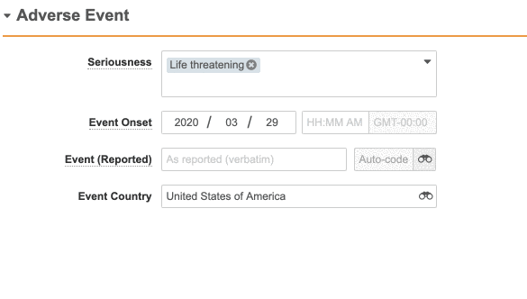
MedDRA Auto-Coding Control
Automatic
Overview
The MedDRA auto-code feature is now automatically available. Previously, this feature required configuration. Vault Safety 20R2 automatically updates all MedDRA fields to use the auto-code control.
Business Justification
Coding MedDRA by hand can be error prone and time consuming, enabling this as ON only will help all our customers benefit from the Auto-Coding feature.
Considerations
Exact Matching for Auto-coding
Setup by:
N/A
for use by:
Power User
Feature Risk
MEDIUM
Default Impact
VISIBLE TO ALL USERS

Slide 53
MedDRA Browser Hierarchy Tree View
Automatic
Overview
MedDRA Tree view allows users to explore the MedDRA hierarchy.
MedDRA hierarchy filter allows users to refine search results.
Added responsive elements to better take advantage of larger screens.
Business Justification
MedDRA is an immense library, finding a term can be complex and require additional refinement.
Considerations
No new MedDRA controls have been added (i.e. Drug History Indication / Reaction did not get a MedDRA control) . Auto-on in vaults that use the MedDRA auto-code control .
Setup by:
N/A
for use by:
Power User
Feature Risk
LOW
Default Impact
VISIBLE TO ALL USERS

Slide 54
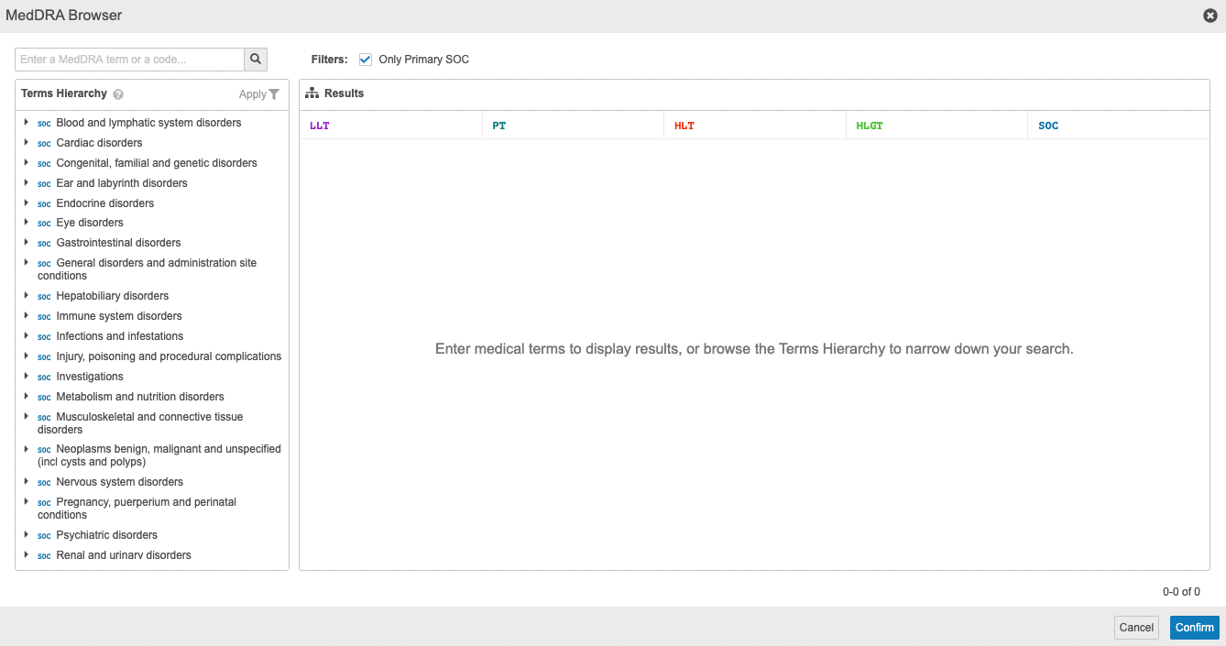
MedDRA Browser Hierarchy Tree View
Automatic
Setup by:
N/A
for use by:
Power User
Feature Risk
LOW
Default Impact
VISIBLE TO ALL USERS

Slide 55
MedDRA - Centralization
Admin Checkbox
Overview
Vault Safety now offers access to a centralized Veeva-managed MedDRA dictionary that's regularly updated twice per year. A new configuration option provides greater flexibility on how to code follow-up cases, by choosing to always use the currently active MedDRA version instead of the same MedDRA version as the initial case and visually notifying users of non-current terms.
Business Justification
Simplifies the ongoing management of MedDRA, alleviating customers from having to manually update the dictionary in their own vaults.
Considerations
Simplify your operations by transitioning to our centralized MedDRA dictionary; it's optional but highly recommended.
Setup by:
Admin
for use by:
Admin
Feature Risk
MEDIUM
Default Impact
VISIBLE TO ADMINS ONLY

Slide 56
Webinar Poll: Case Management & Safety Coding

Slide 57
Case Review

Slide 58
Case Product Drug Role: Treatment
Configurable
Overview
Users can now assign the drug role of a Case Product to be a treatment of the adverse event. Case Products designated as a treatment will not be included in any standard generated reports
Business Justification
Required for classification and customer data migrations.
Setup by:
Admin
for use by:
Power User
Feature Risk
MEDIUM
Default Impact
VISIBLE TO ADMINS ONLY

Slide 59
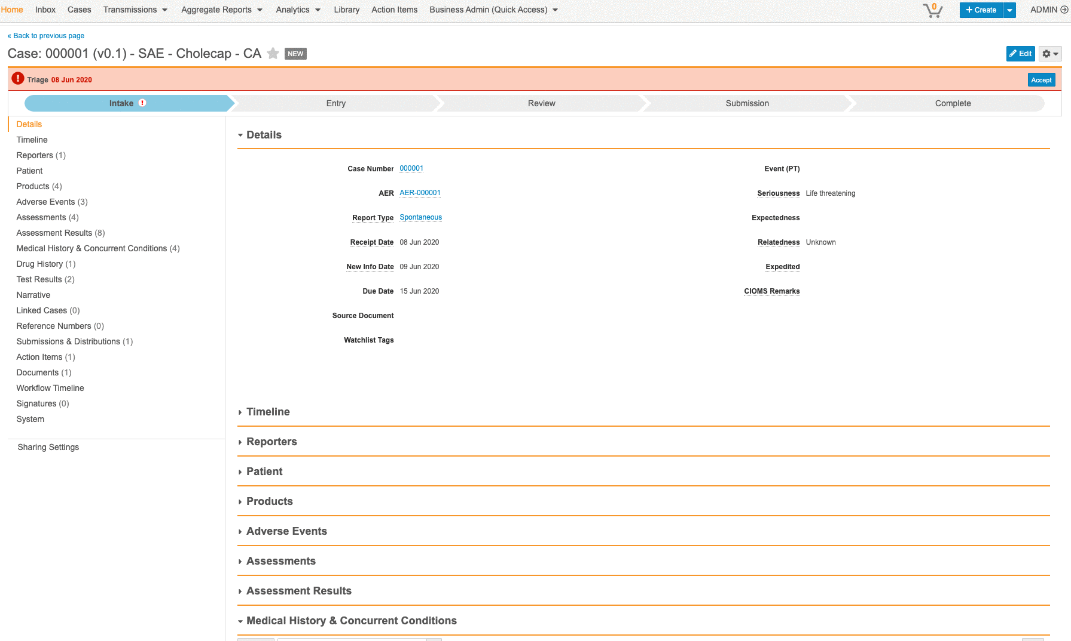
Medical Review Timeline
Configurable
Overview
Visual and Interactive way to see case data in a temporal context
Shows Adverse Events, Case Products, Case Product Dose, Case Test Result, Case Medical History, Case Drug History
Calculates start and end dates when they are not provided (ex: Onset Date + Duration)
Setup by:
Admin
for use by:
Power User
Business Justification
Cases can have many adverse events, dosages, etc. happening around the same times but this is hard to compare in text
Considerations
Color and legend categories are not configurable
Does not allow users to edit data in timeline view
Feature Risk
MEDIUM
Default Impact
VISIBLE TO ADMINS ONLY

Slide 60
Safety Data Exchange

Slide 61
Deprecated Controlled Vocabularies
Configurable
Overview
Vault Safety now enables customers to transfer records with deprecated controlled vocabularies from another system into Vault Safety while ensuring a clear UI that displays historic mentions of the deprecated terms without allowing further usage of them.
Business Justification
This is particularly useful for migration data.
Considerations
Users will not be able to select deprecated controlled vocabularies for new cases, but not be blocked when processing older ones.
Setup by:
Admin
for use by:
Power User
Feature Risk
MEDIUM
Default Impact
VISIBLE TO ADMINS ONLY

Slide 62
ICSR Regulatory Submissions

Slide 63
Optimized Submissions: Local Datasheets & Primary Expectedness
Automatic
Overview
Vault Safety will now generate submissions based on local expectedness (based on a product registration’s country, product and local datasheet). Auto-expectedness will also now calculate only the primary case assessment.
Case-level expectedness ← Primary Assessment
Submissions generation (including due dates) respect expectedness records in primary assessment
Business Justification
Case-level expectedness not calculated same as seriousness, relatedness
Seriousness ← Primary AE
Relatedness ← Primary Assessment
Expectedness ← All Serious Assessments
Submission rules don’t respect expectedness defined by local datasheets
Considerations
Auto-On in vaults with Product Datasheets configured. In vaults that do not have Product Datasheets, administrators must perform configuration to make this feature available to end-users.
Setup by:
N/A
for use by:
Power User
Feature Risk
HIGH
Default Impact
VISIBLE TO ALL USERS

Slide 64
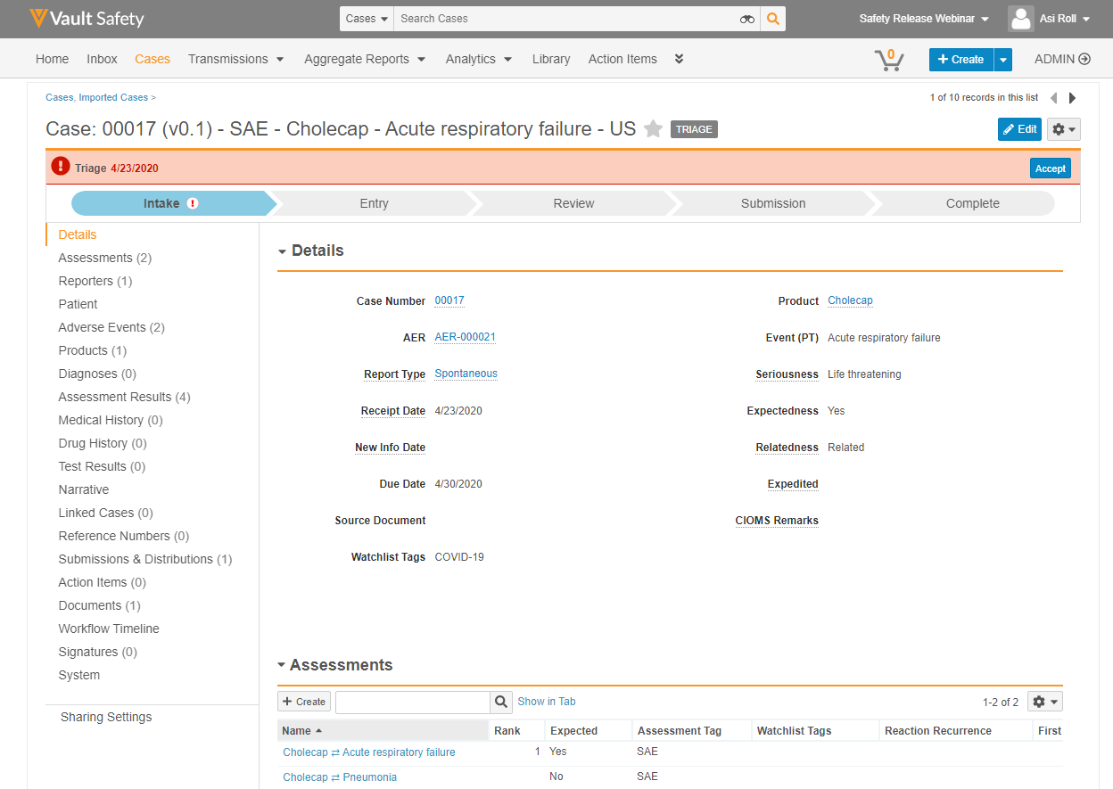
Optimized Submissions: Local Datasheets & Primary Expectedness
Automatic
Case-level expectedness obtained from primary assessment
Setup by:
N/A
for use by:
Power User
Feature Risk
HIGH
Default Impact
VISIBLE TO ALL USERS

Slide 65
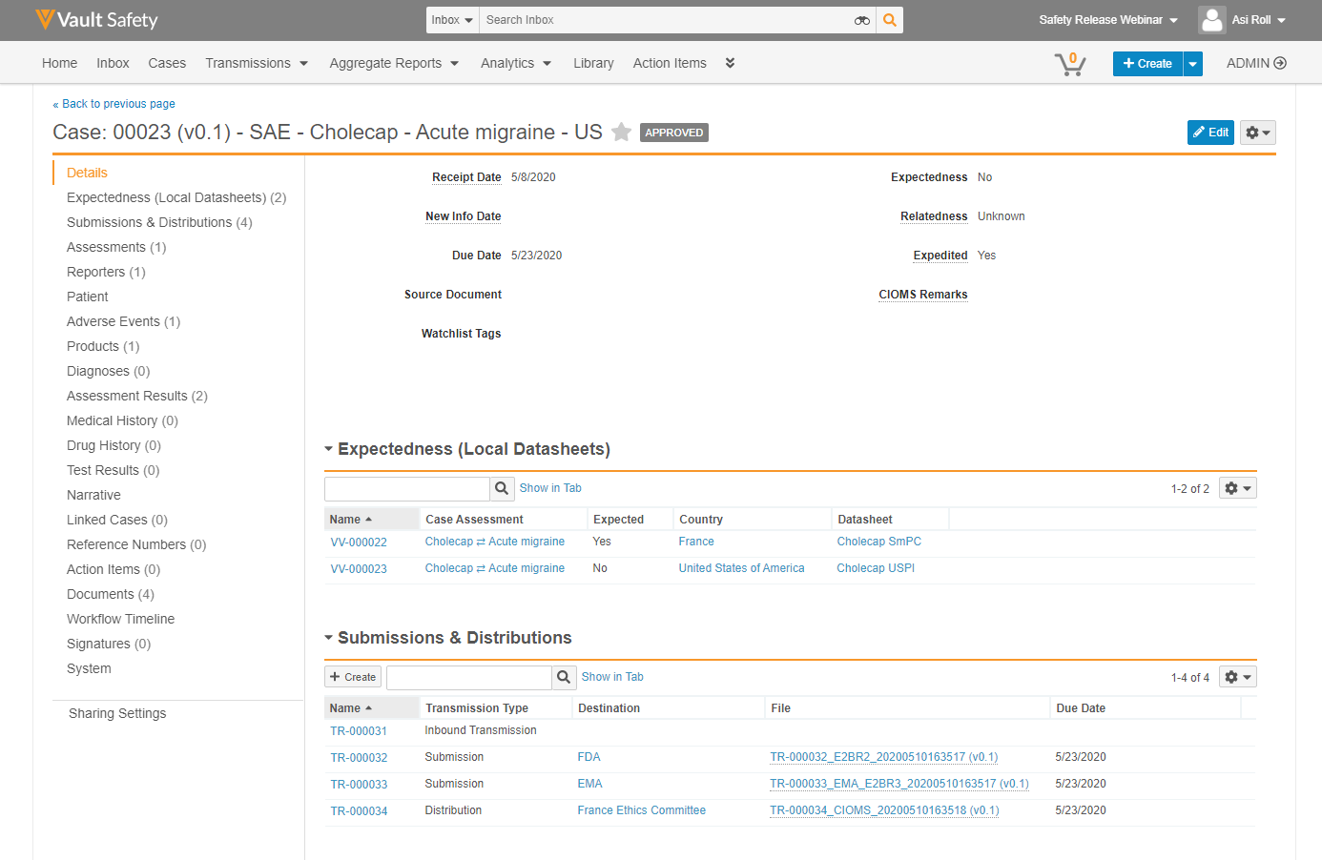
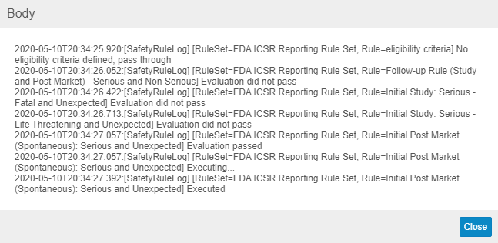
Optimized Submissions: Local Datasheets & Primary Expectedness
Automatic
Case-level expectedness obtained from primary assessment
Setup by:
N/A
for use by:
Power User
Feature Risk
HIGH
Default Impact
VISIBLE TO ALL USERS

Slide 66
Health Canada E2B R2 Export
Automatic
Overview
Vault Safety now supports the ability to export ICSRs in the Health Canada compliant E2B(R2) .xml format.
Business Justification
Health Canada requires electronic submission of Post-Market and Phase-4 study ICSRs via E2B(R2) files.
Health Canada has some specific E2B formatting and business requirements.
Considerations
Health Canada doesn’t provide software vendors and service providers with a testing environment, therefore our E2B(R2) was implemented and tested based on the specification document but couldn’t be validated by transmitting to Canada Vigilance Gateway.
Setup by:
N/A
for use by:
Power User
Feature Risk
HIGH
Default Impact
VISIBLE TO ALL USERS

Slide 67
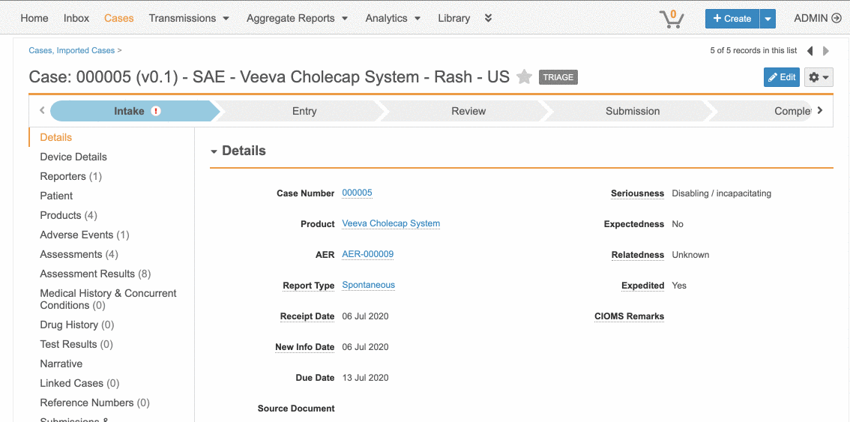
Drug ⇄ Biologic Combination Products
Configurable
Overview
Vault Safety now supports end-to-end case processing for post-marketing drug/biologic combination products having device constituents. When a combination product case is opened, its pre-configured constituents are downloaded to the case, and assessment records are auto-generated for them
Setup by:
Admin
for use by:
Power User
Business Justification
Leveraging these capabilities to remain compliant with the FDA's PMSR requirements for combination products and their device constituents (21 CFR Part 4), which take effect July 31, 2020.
Considerations
Watchlists created for the combination product (e.g. AESI, IME) are applied to the case. If the combination product is marketed in the US, an FDA-bound E2B(R2) submission is generated, along with the new FDA regional fields for combination products.
Feature Risk
HIGH
Default Impact
VISIBLE TO ADMIN ONLY

Slide 68
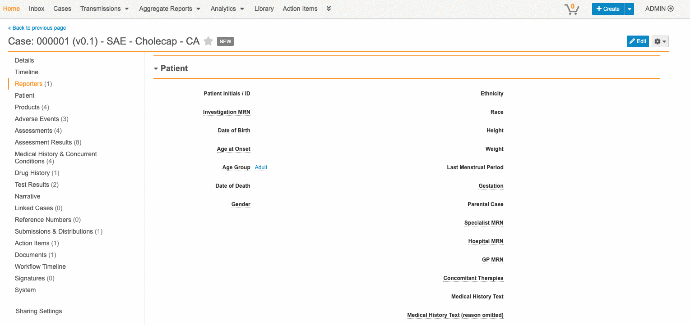
E2B R2 & R3 Validation
Automatic
Overview
This feature allows users to validate data when E2B files are generated, see validation errors and fix them before attempting to submit. Vault Safety also validates specific Reason Omitted values during data entry, as well as Value/Unit pair controls, and displays an icon for the invalid selections.
Setup by:
N/A
for use by:
Power User
Business Justification
At the time of creation, a Submission E2B file (EMA E2B R3, FDA E2B R2, and FDA Combination Products) is validated against the XML schema, and errors reported, so that the user can address validation errors before attempting to submit to the Health Authority.
Feature Risk
HIGH
Default Impact
VISIBLE TO ALL USERS

Slide 69
Webinar Poll: Vault Safety Usability

Slide 70
Periodic Reporting

Slide 71
PSUR Cumulative Tabulations and CIOMS II Line Listings
Configurable
Overview
Vault Safety users can now generate a PSUR aggregate report that includes:
CIOMS II Line Listings
Cumulative tabulations - Serious Unlisted ADRs and Serious Listed + Non Serious ADRs
Reports can be generated based on drugs, studies, and/or active substances.
Business Justification
Periodic Safety Update Reports (PSURs) with CIOMS II Line Listings are used for the purpose of periodic reporting.
Considerations
Must configure core datasheets to accurately mark AEs as listed vs not listed in cumulative summary tabulation.
Limitations
Currently does not print IBD, Reporting Period or Active Substance on Line Listing or Cumulative Summary Tabulations.
Setup by:
Admin
for use by:
Power User
Feature Risk
HIGH
Default Impact
VISIBLE TO ADMINS ONLY

Slide 72
PSUR Cumulative Tabulations and CIOMS II Line Listings
Configurable
One report - two tables
Serious Unlisted ADRs
Serious Listed & Non-Serious ADRs
Reporting Period
Serious Listed and Non-Serious - interval
Serious Unlisted - Cumulative
Listedness based on Core Datasheet
For primary case products or substance
ADRs classified by SOC and Event Reported (verbatim & MedDRA PT)
Cumulative Tabulations
Setup by:
Admin
for use by:
Power User
Feature Risk
HIGH
Default Impact
VISIBLE TO ADMINS ONLY

Slide 73
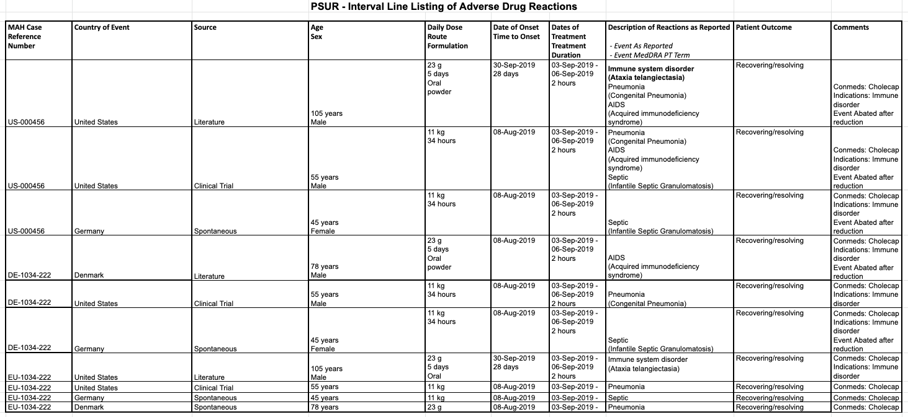
PSUR Cumulative Tabulations and CIOMS II Line Listings
Configurable
CIOMS II Line Listings
Includes all types of cases from spontaneous and literature sources
Only serious, related cases from studies
For primary case products or substance
List primary adverse event followed by other adverse events
Based on interval data
Setup by:
Admin
for use by:
Power User
Feature Risk
HIGH
Default Impact
VISIBLE TO ADMINS ONLY

Slide 74
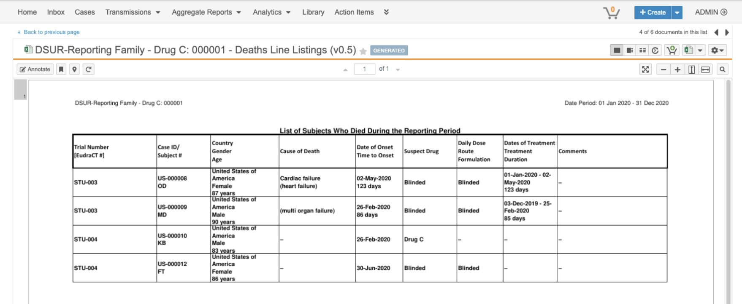
DSUR Appendices: Cumulative SAR & Death Cases
Configurable
Overview
Customers will be able to generate Appendix R1 Cumulative Tabulation of SARs, and Appendix R2 List of Subjects Who Died During the Reporting Period.
Business Justification
To facilitate both DSUR submissions to health authorities and distributions to partners/committees.
Setup by:
Admin
for use by:
Admin
Feature Risk
HIGH
Default Impact
VISIBLE TO ADMINS ONLY

Slide 75
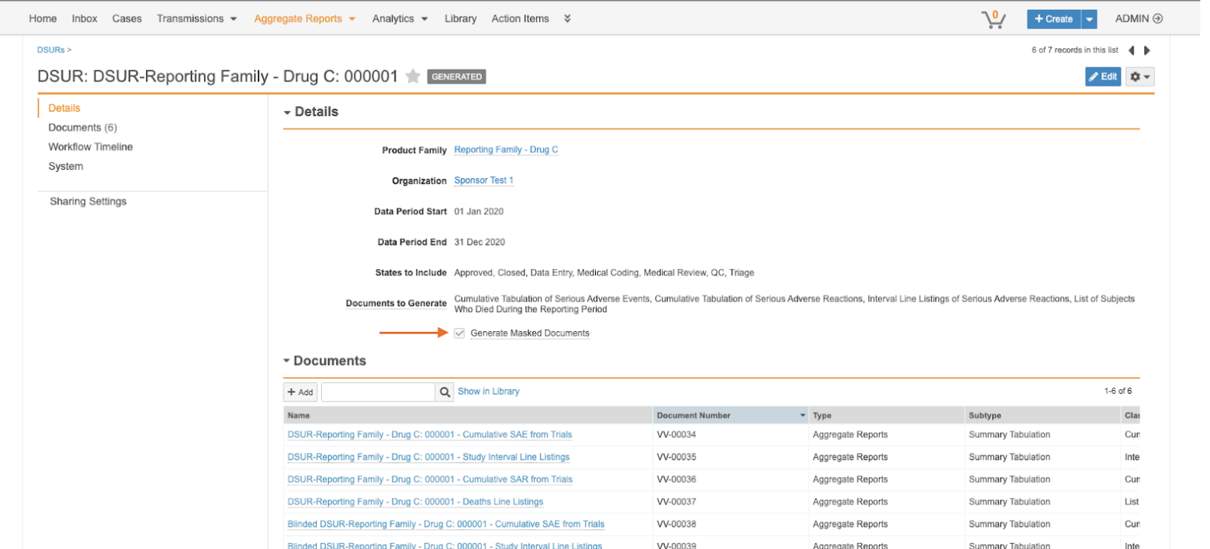
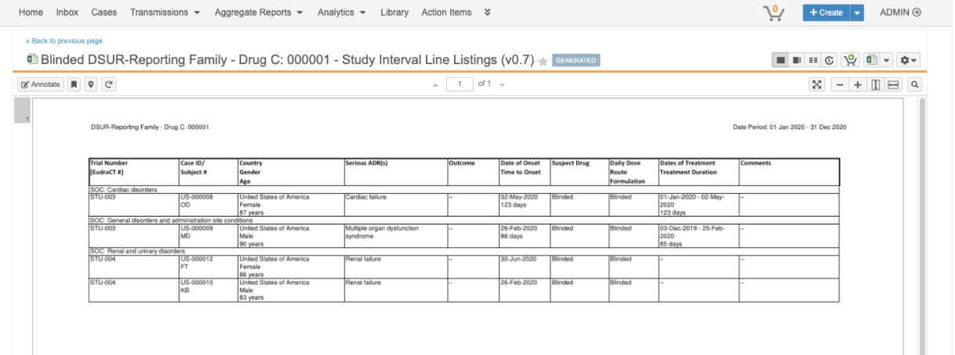
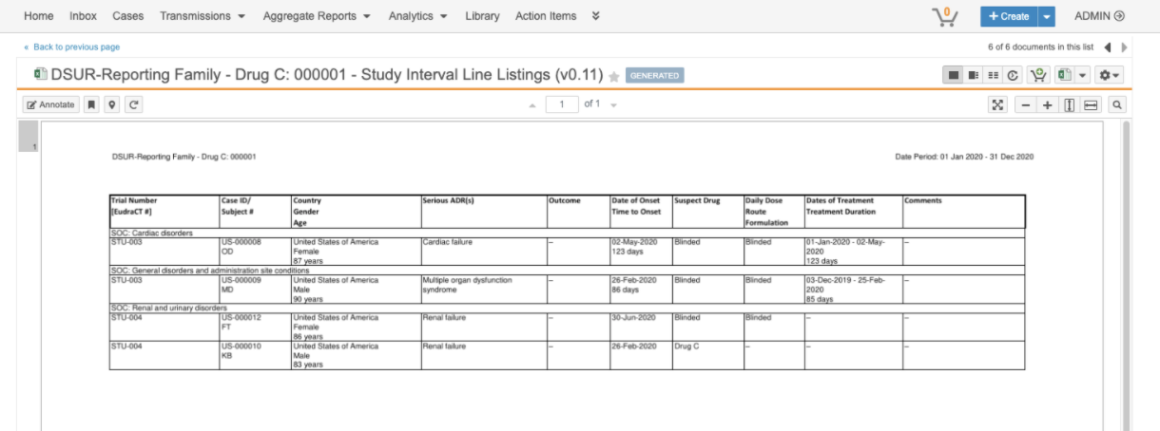
DSUR Appendices: DSUR Masked Distribution
Configurable
Overview
Customers will be able to generate both masked and unmasked versions of the Cumulative Tabulation of SAEs and Interval Line Listings.
Business Justification
To facilitate both DSUR submissions to health authorities and distributions to partners/committees.
Setup by:
Admin
for use by:
Admin
DSUR Masked Interval Line Listings
Feature Risk
HIGH
DSUR Unmasked Interval Line Listings
Default Impact
VISIBLE TO ADMINS ONLY

Slide 76
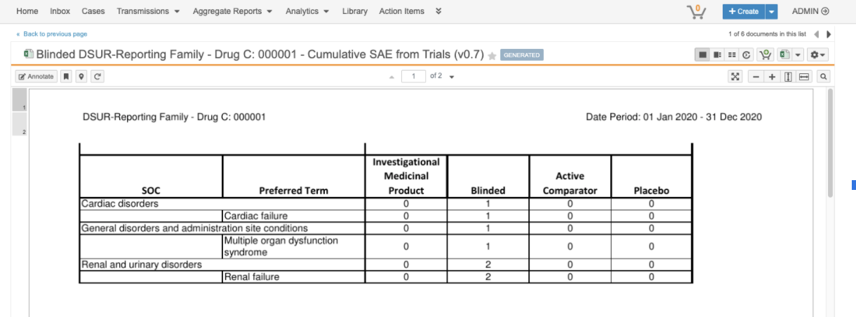
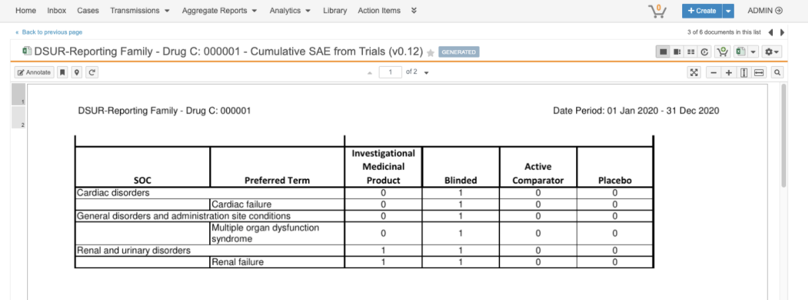
DSUR Appendices: DSUR Masked Distribution
Configurable
Overview
Customers will be able to generate both masked and unmasked versions of the Cumulative Tabulation of SAEs and Interval Line Listings.
Business Justification
To facilitate both DSUR submissions to health authorities and distributions to partners/committees.
Setup by:
Admin
for use by:
Admin
DSUR Masked Cumulative SAE
Feature Risk
HIGH
DSUR Unmasked Cumulative SAE
Default Impact
VISIBLE TO ADMINS ONLY

Slide 77
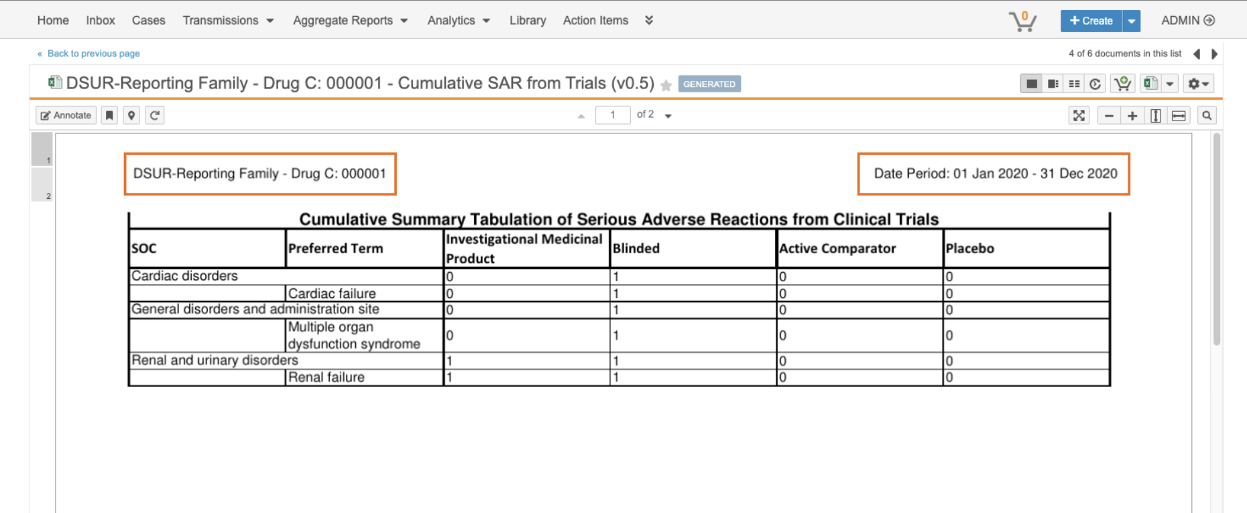
XLSX Report Templates
Configurable
Overview
This release adds support for Vault MergeFields with the use of .XLSX Aggregate templates.
Business Justification
Allows administrators to configure additional aggregate details (product family, date, etc.) on the templates that will render on generated Aggregate Line Listings and Cumulative reports.
Setup by:
Admin
for use by:
Admin
Feature Risk
HIGH
Default Impact
VISIBLE TO ADMINS ONLY

