Slide 1

20R2
Release Clinical
Preview and Planning
Revision: 14 Jul 2020
Please use ‘Q&A’ to ask a question

Slide 2




Vault Clinical 20R2 Presenters
Kelly Butler
Customer Success Manager, R&D kelly.butler@veeva.com
Neha Ramani
Customer Success Manager, R&D neharika.ramani@veeva.com
Olga Radyushkina
Customer Success Manager, R&D olga.radyushkina@veeva.com
Barbara Cano Gonzalez
Customer Success Manager, R&D barbara.cano@veeva.com
Anne Rudick-Lowe
Customer Success Manager, R&D anne.rudicklowe@veeva.com
Mike Ferrell
Manager, R&D SMB Customer Success michael.ferrell@veeva.com

Slide 3
Foreword
The content of this presentation is subject to change prior to the 20R2 Release
Please note the revision date on the title slide
Veeva encourages you to always reference Release documentation from our Release pages to ensure you are using the latest information
Help → Release Notes → About the 20R2 Release

Slide 4
Interact With Us!
Please use ‘Q&A’ to ask a question

Slide 5
Planning for the 20R2 Release
Logistics
Announcements
Features
Identify key
release dates
Promote awareness of Veeva events
Review new features
based on themes
Note: Keep Alert for Polling!

Slide 6
Logistics

Slide 7
20R2 Release Calendar
Customer Validation
Sun | Mon | Tue | Wed | Thu | Fri | Sat
5 | 6 | 7 20R2 Release Webinars | 8 20R2 Release Webinars | 9 20R2 Release Webinars | 10 | 11
12 | 13 Pre-Release Vaults System Release Memo | 14 Compliance Documents 20R2 Release Webinars | 15 | 16 | 17 Executed OQs | 18
19 | 20 | 21 | 22 | 23 | 24 | 25
26 | 27 | 28 | 29 | 30 | 31 Upgrade - VV1-8, VV1-1068, VV1-1065, VV1-1088 | 1
2 | 3 | 4 | 5 | 6 | 7 Upgrade - all remaining PODs | 8
JUL
AUG

Slide 8
Early POD Upgrade Schedule
The early POD designation will no longer be variable
The schedule for early POD in future releases is as follows:
Release | Early PODs Production, Sandbox, Agency
R1 - April | VV1-2, VV1-1055, VV1-1065 & VV1-1088
R2 - August | VV1-8, VV1-1068, VV1-1065 & VV1-1088
R3 - December | VV1-12, VV1-1069, VV1-1065 & VV1-1088
In each release, all Vaults on the designated early PODs will receive access to
Pre-Release 2 weeks earlier than other PODs

Slide 9
Pre-Release Environments
Starting with 20R1, customers now provision and refresh their own
Pre-Release Vaults
  Veeva Operations enables Pre-Release 4-6 weeks ahead of each release
  We highly recommend refreshing prior to using the Pre-Release for testing
See Vault Help video for a walk-through of the creation and refresh process
Pre-Release Vaults include:
  Configuration
  Vault Owners
  Object Data referenced in configuration rules
  NO Documents or transactional data

Slide 10
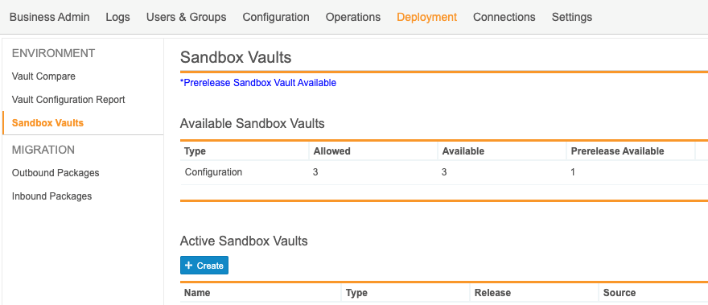
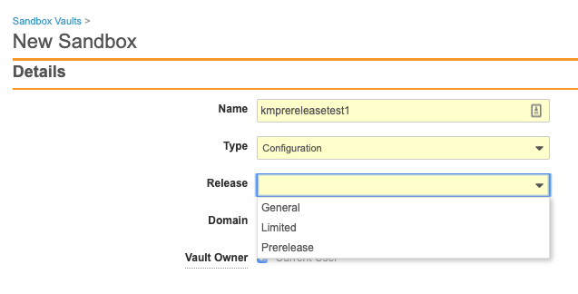
Pre-Release Environments

Slide 11
Validation & Supporting Docs
Veeva Compliance Docs
  Validation Project Plan
  IOQ Protocols
  Business Requirement Documents
  Traceability Matrices
  System Release Memo
  Release Notes
  Summary Reports
  Executed OQ Scripts
  (unexecuted in Word format available upon request)
Supporting Documents available on the 20R2 Release page in Vault Help
  20R2 Release Impact Assessment
JULY
System Release Memo | Monday 13th
Compliance Documents | Tuesday 14th
Executed OQs | Friday 17th

Slide 12
20R2 Go Live
All customers upgraded to 20R2
  Applies to Production, Test, and Sandbox Vaults
JULY
Friday 31
PODs VV1-8, VV1-1068,
VV1-1065, VV1-1088
Date | POD | Start Time | Duration
Jul 31 2020 | US POD VV1-1068 Sandbox POD | 12:00 pm PT | Up to 4 hours*
 | All PODs – Authentication service update | 6:00 pm PT | 1 hour
 | US PODs VV1-8, VV1-1065, VV1-1088 | 7:00 pm PT | Up to 4 hours*
AUGUST
Friday 7
Date | POD | Start Time | Duration
Aug 7 2020 | APAC POD VV3-3064 APAC & EU Sandbox PODs | 10:00 am PT | Up to 4 hours*
 | US Sandbox PODs | 2:00 pm PT | Up to 4 hours*
 | US PODs (except July 31st PODs) EU PODs APAC POD VV3-34 | 6:00 pm PT | Up to 4 hours*
All Other PODs
* On July 10 2020, http://trust.veeva.com will be updated with final downtime durations

Slide 13




20R2 Release Webinar Series
Product-specific webinars focused on the use cases and impact of key features
  All webinars are presented at multiple times
  One webinar per product set will be recorded and available after the series at:
  Help > Release Notes > About the 20R2 Release
Platform
Jul 8 at 3 PM EDT
Jul 9 at 9 AM EDT
Jul 14 at 12 PM EDT
QDocs, Station Mgr, Training
Jul 7 at 12 PM EDT
Jul 8 at 9 AM EDT
QMS
Jul 8 at 3 PM EDT
Jul 9 at 9 AM EDT
Jul 8 at 9 AM EDT
Jul 9 at 12 PM EDT
Jul 14 at 9 AM EDT
Jul 8 at 12 PM EDT
Jul 9 at 3 PM EDT
Jul 14 at 9 AM EDT
go.veeva.com/20R2_clinical
go.veeva.com/20R2_quality
go.veeva.com/20R2_rim
go.veeva.com/20R2_platform

Slide 14
Announcements

Slide 15
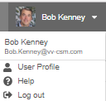
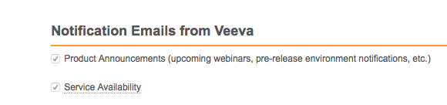
Notification Emails from Veeva
Opt-in to Product Announcements in User Profile to be contacted about:
  Initial release announcement (RIA)
  Release webinar invites
  Pre-release and validation document availability
  Go-live & key date reminders
Opt-in to Service Availability notifications in User Profile to be contacted about:
  Planned system maintenance
  Service disruptions

Slide 16
20R2 Developer Release Deep Dive
Thursday, 16-Jul at 7 a.m. PT / 10 a.m. ET / 3 p.m. GMT
Join Veeva Customer Success and Product teams for an education session on new features in the Veeva Vault developer-focused toolkit
This webinar is geared towards current users of the Vault Developer toolkit (API)
Key topics for discussion will include:
  Detailed explanation of new features
  Spark Integration Services
  Java SDK updates
  Considerations for using new features, and impacts features may have
  on your Vault or end users
Advanced registration required

Slide 17


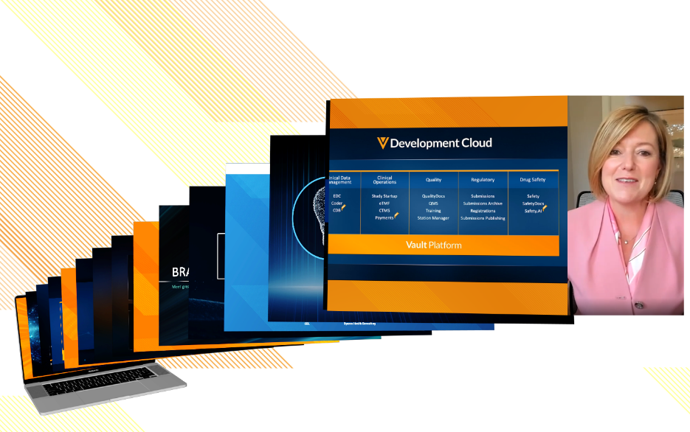
October 13–14, 2020
Develop new
industry partnerships
Share best practices
Network with
sponsors, CROs, & sites
CLINICAL
QUALITY & MANUFACTURING
REGULATORY
SAFETY
IT

Slide 18

Feature Enablement Detail
Auto-On Features
Configurable Features
Auto-On
Admin Checkbox
Configuration
Support
Turned On Day 1
Automatically available, some setup may be required
Turned Off
Requires enablement
Turned Off
Requires enablement
Requires
configuration
Turned Off
Requires enablement
Product Support Request

Slide 19
Clinical Roadmap Themes
&
Key Takeaways from 20R2

Slide 20





20R2 Clinical Roadmap Themes
Archiving
Investigator Initiated Studies
Collaborative Authoring – Alert Box for Documents Being Edited
Optimized Engagement
Risk Based Study Management (RBSM)
EDL Automation for Study Personnel, Organizations & Products
Streamlined Clinical Processes
Site Packages: Vault Clinical
Simple TMF Transfer
Rule Set Override
Unify Clinical Operations
Document Lifecycle Atomic Security: Active Workflow Actions
Or Filter Logic
Informed Decisions
Notification Preferences
Domain Users: Add Vaults in CSV Export
Unified Navigation Behavior when Clicking Object References in Document Fields
Additional Platform Features

Slide 21
Key Takeaways from 20R2
Archiving
Clinical Risk Assessments
Or Filter Logic
Investigator Initiated Studies in Vault Clinical Operations
Simple TMF Transfer
EDL Automation for Study Personnel, Organizations & Products

Slide 22
Optimized Engagement

Slide 23

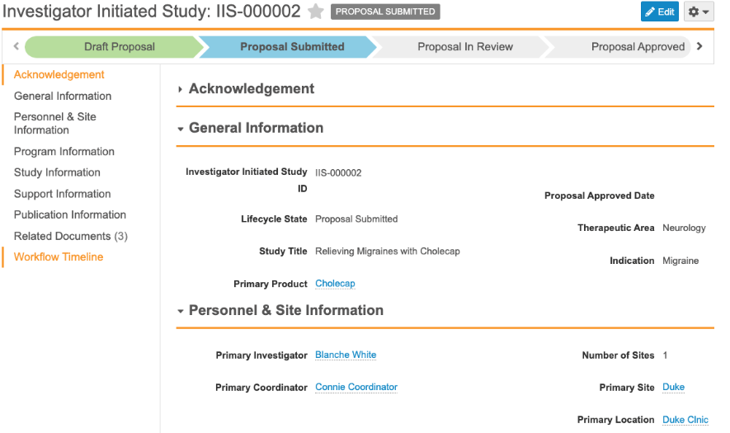
Investigator Initiated Studies in Vault Clinical Operations
Configurable
Overview
  Allows users to track the internal processes of Investigator Initiated Studies (IIS)
    Study planning and execution
    Document and Publication tracking
    Review and approval workflows for Proposals
    Fields to track the Proposal and subsequent Study
  Business Justification
  Reuses existing data in customer Vaults
  to track Investigator Initiated Studies
  Allows for one place to report across all
  Internal and externally initiated studies
  Considerations
  Free for all customers with at least one of our Clinical Operations Applications (eTMF, SSU, or CTMS)
  Data model is Auto-On, but configuration is required
Feature Risk
MEDIUM
Default Impact
VISIBLE TO ADMINS ONLY

Slide 24


Archive TMF User Action & Snapshot
Automatic
Support
Overview
  This feature will introduce a user action for archiving a study, its documents and related records in a single automated job. The one-click archival function will automatically do the following:
  Move all study documents into the Vault platform archive
  Create a study-specific copy (“snapshot”) for documents used across multiple studies
  Restrict access to study documents and objects to users with the “View Archive” permission
  Archive/ inactivate study/ country/ site objects, EDL/ milestone objects, and CTMS objects
Business Justification
  This feature will eliminate the need for configuring custom archival processes and allow more customers to reuse documents without the concern of reused documents not being visible in the Library
Considerations
  The archival job may take several hours to complete and may best be executed overnight
Additional clarifying information
Feature Risk
LOW
Feature Risk
MEDIUM
Default Impact
VISIBLE TO ALL USERS
Default Impact
NONE

Slide 25
Archive: Snapshot CrossLink Documents
Automatic
Automatic
Support
Overview
  This feature will expand on the “snapshotting” concept introduced as part of the Archive TMF feature. The snapshot behavior is executed as part of the study archival job and will include any documents that are cross-linked. Therefore any cross-linked documents will be protected from further changes when a study is archived
Business Justification
  Creating snapshots of all cross-linked documents at the time of archival will ensure their immutability while allowing the original cross-linked documents to live on for future use (in other studies)
Considerations
  Snapshots are not expected to be created instantaneously
Additional clarifying information
Additional clarifying information
Feature Risk
LOW
Feature Risk
LOW
Feature Risk
MEDIUM
Default Impact
VISIBLE TO ALL USERS
Default Impact
VISIBLE TO ALL USERS
Default Impact
NONE

Slide 26
Archive TMF Security
Overview
  Changes Studies in the "Archive" Study Lifecycle State from Inactive records to Active records
    Displays archived content in the TMF Viewer after the study has been archived
  Leverages existing “Manage Archive” and new “View Archive” permissions for archived studies
  Allows users with the “Manage Archive” permission to grant access to study (e.g. Give external inspector access) and upload new study documents
  Users without “View Archive” permission will not see archived studies or have access to archived study records
  Ability to manage archived studies without “un-archiving”
Business Justification
  Streamline archiving process with security
Considerations
  If you have archived documents for a study that has not yet been archived, they will not appear in TMF Viewer or in the study document reports
  If you have view archive permission to the archive study, you will see the archive study object as a picklist value when creating new documents (but not be able to save the document to that archived study)
Support
Feature Risk
MEDIUM
Default Impact
NONE

Slide 27
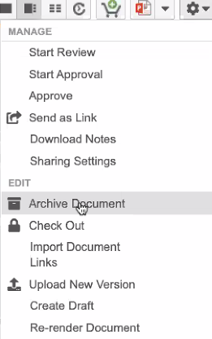
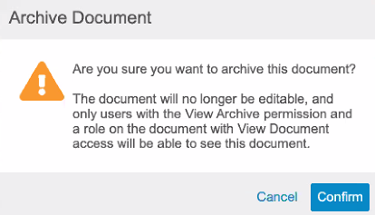
Archived Document Security Enhancements
Automatic
Overview
  No user will be able to edit fields or relationships for archived documents and most actions are prohibited including checking out and starting workflows
  Users require the new “View Archive” access in their Permission Set, and “View Document” access via a lifecycle role/status, in order to view the archived document
  “Manage Archive” permission allows the user to archive and unarchive documents – this can now be done from the action menu
Business Justification
  Documents should be immutable once they are archived with limited user access
Considerations
  Migration Mode allows some fields edits to be made
  All users will have “View Archive” permission by default
*In Vaults where Archive has already been enabled
Feature Risk
HIGH
Default Impact
VISIBLE TO ALL USERS

Slide 28


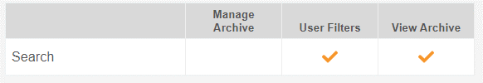
Archived Document Security Enhancements
Automatic
Considerations (continued)
  Access to the Archive Tab is now solely based on having access to that tab in the Permission Set. In order for a user to see the Archive tab, a user’s Permission Set must …
  grant View access to the Archive tab
  and
  provide View Archive permission
  Once documents are archived, Vault prevents users from taking the following actions:
*In Vaults where Archive has already been enabled
Editing Fields or Checking out Documents | Starting a workflow and executing a user action
Adding or removing relationships and attachments | Adding/editing/removing annotations
Deleting the document or document versions (without Power Delete permission) | Creating new Draft documents or uploading new document versions
Feature Risk
HIGH
Default Impact
VISIBLE TO ALL USERS

Slide 29
DEMO
Archiving

Slide 30
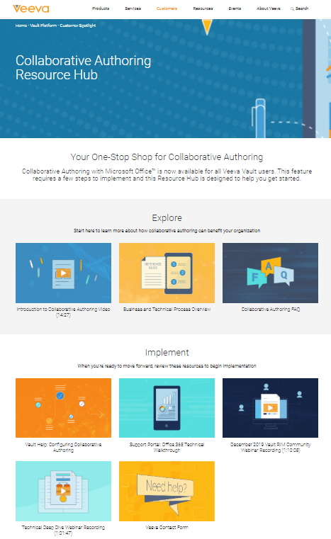
Collaborative Authoring Resource Hub
One-stop shop for collaborative authoring materials
Explore - describes the functionality and answers common questions
Implement - watch technical deep dives to learn about setup
Request assistance directly through the ‘Need Help’ link
https://www.veeva.com/products/vault-platform/collaborative-authoring/

Slide 31
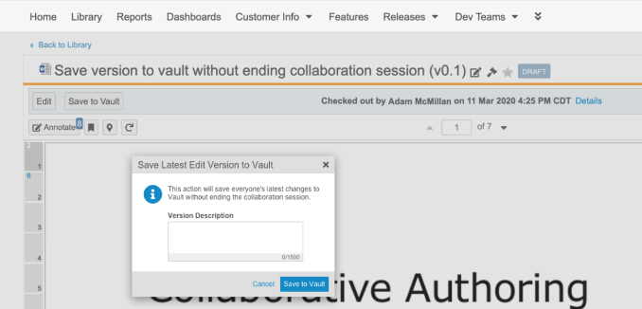
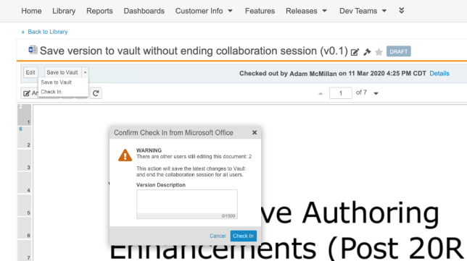
Save Version to Vault Without Ending Collaboration Session
Automatic
Overview
  This feature saves the latest file changes to Vault as a new minor version, but without ending the collaboration session
  Any user with Edit Document permission can use Save to Vault
  The user that checked out the document and started the collaboration session can use Save to Vault or Check In
Business Justification
  Periodically save changes to Vault during a collaboration process, instead of waiting until collaboration is finished
Considerations
  Cancel Checkout does not rollback / delete versions created by Save to Vault
  Save to Vault does not automatically bring forward annotations to the new document version
  Note: Collaborators are now notified that a collaboration session has ended when the document is checked in
Collaborator
Collaborator that Started Collaboration Session
Feature Risk
MEDIUM
Default Impact
VISIBLE TO ALL USERS

Slide 32
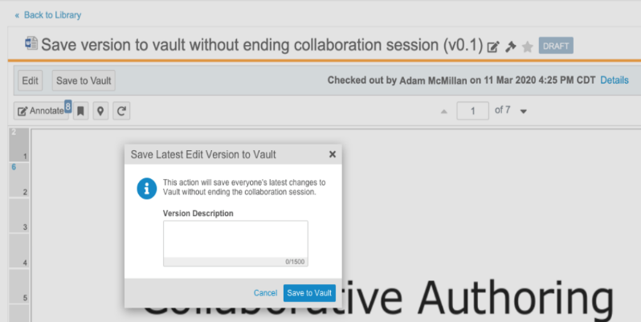
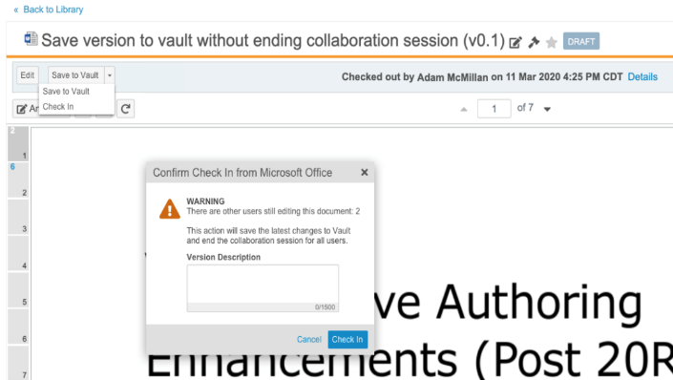
Save Version to Vault Without Ending Collaboration Session
Automatic
Overview
  This feature saves the latest file changes to Vault as a new minor version, but without ending the collaboration session
  Any user with Edit Document permission can use Save to Vault
  The user that checked out the document and started the collaboration session can use Save to Vault or Check In
Business Justification
  Periodically save changes to Vault during a collaboration process, instead of waiting until collaboration is finished
Any Collaborator
Collaborator that Started Collaboration Session
Feature Risk
MEDIUM
Default Impact
VISIBLE TO ALL USERS

Slide 33
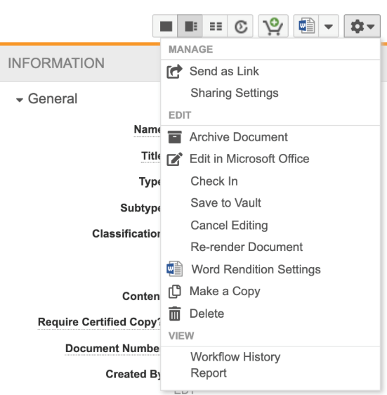
Save Version to Vault Without Ending Collaboration Session
Automatic
Considerations
  Cancel Checkout does not rollback / delete versions created by Save to Vault
  The Save to Vault option is now available in the Action menu of the document
  Save to Vault does not automatically bring forward annotations to the new document version
  Collaborators are now notified that a collaboration session has ended when the document is checked in
Feature Risk
MEDIUM
Default Impact
VISIBLE TO ALL USERS

Slide 34
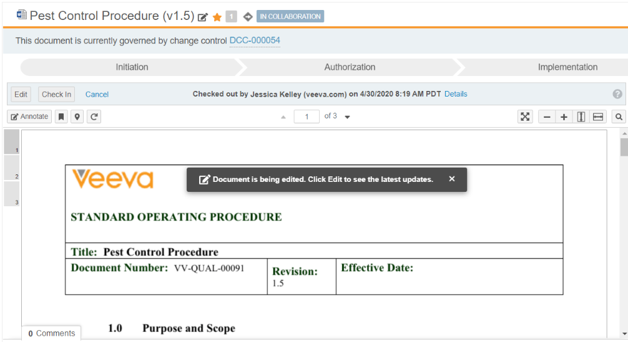
Collaborative Authoring – Alert Box for Documents Being Edited
Automatic
Overview
  Users are able to see when a document is currently being edited
Business Justification
  Users need to be aware that the content they see in the Vault viewer may not include the latest updates
Feature Risk
N/A
Default Impact
VISIBLE TO ALL USERS

Slide 35
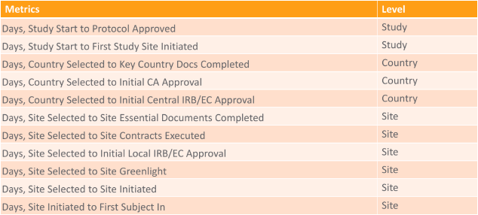
Milestone Evolution & Standard Metrics
Configurable
Overview
  This feature introduces industry-standard Global Milestone Types and Global Milestone Offsets to measure key cycle times between milestones. Users can map custom milestone types to these standards and Vault calculates Cycle Times between completed milestones on a daily basis and recalculates Cycle Times to support historical data
  Also adds a field - Block Automatic Updates - on milestone, that indicates whether updates to its baseline or planned dates should be blocked, whether by rollups or dependencies
Business Justification
  This feature allows customers to measure key startup cycle times, in both new and historical studies, without modifying their milestone templates. Analysis of that performance data can inform future planning
  By defining these industry standards, this feature lays the groundwork for future intelligent planning capabilities
Sample Cycle Time Metrics:
SSU
Feature Risk
Medium
Default Impact
VISIBLE TO ADMINS ONLY

Slide 36
Configure Auto-Open Safelist for
Vault File Manager (VFM)
Automatic
Overview
  Admins can configure which file types automatically open when checked out to VFM
  Uses a new standard VFM File Security Policy object
  Before 20R2, VFM would attempt to auto open any file checked out to VFM
Business Justification
  By defining the file types, it eliminates the risk of automatically opening files that may be an issue (e.g. malicious file uploaded as a document’s source file)
Considerations
  Auto-on for Vaults with VFM enabled
  Vault-wide safelist – Not for specific set of users, groups, or roles
  Requires that Users have at least Read access to the new object “VFM File Security Policy” or no files will auto-open
  Only applies to single document VFM checkout
Feature Risk
LOW
Default Impact
VISIBLE TO ALL USERS

Slide 37
Configure Auto-Open Safelist for Vault File Manager (VFM)
Automatic
New section located in Admin > Settings > Checkout Settings
Add new file extensions that VFM is allowed to auto open upon checkout
Sort columns
Feature Risk
LOW
Click to view record detail page
Double-click to inline edit
Default Impact
VISIBLE TO ALL USERS

Slide 38
EDL Item Upload Visibility Update
Automatic
Overview
  To access the Upload action on EDL Item records, Vault now requires users to have Edit permission on the EDL Item object, and if Sharing Settings are enabled, the user must also be in an Editor role
Business Justification
  This feature makes the permission checks for the Upload to EDL Item action consistent with other permission checks across the system
Feature Risk
N/A
Default Impact
VISIBLE TO ALL USERS

Slide 39
Streamlined Clinical Processes

Slide 40
RBSM: Clinical Risk Assessments
Configurable
Overview
  Risk Based Study Management (RBSM) allows users to apply risk-based practices to study management. This first feature as part of RBSM allows users to curate a library of selectable risks, create re-usable risk assessment templates (collections of risks for a particular purpose), and generate study-specific risk assessments that can be modified, scored, reviewed, and approved by the study team
Business Justification
  This feature will help customers streamline their operations by eliminating the need to track risks outside of Vault via spreadsheets and emails. Customers will be able to take advantage of the system functionality such as Lifecycles and Workflows to handle this business process
  By tracking impact, probability, and detectability on study-specific risks, customers will gain a better understanding of the specific areas of risk and how the study compares to the risk of other studies
Considerations
  Risk Based Study Management is included with Vault CTMS, and Vault CTMS is required to use it
  The Clinical Risk Assessment feature is modeled after the Risk Assessment & Categorization Tool (RACT), developed as part of TransCelerate’s framework for risk-based monitoring. Given the extensibility of Vault, additional categories, fields, and processes can be added based on a customer's needs
CTMS
Feature Risk
LOW
Default Impact
VISIBLE TO ADMINS ONLY

Slide 41
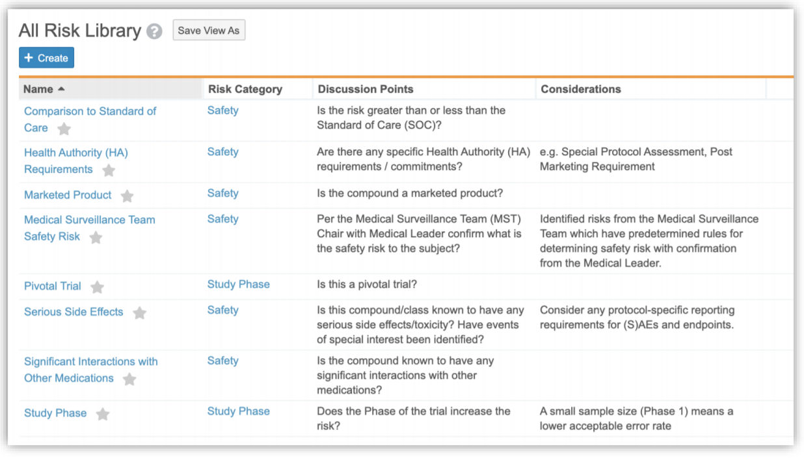
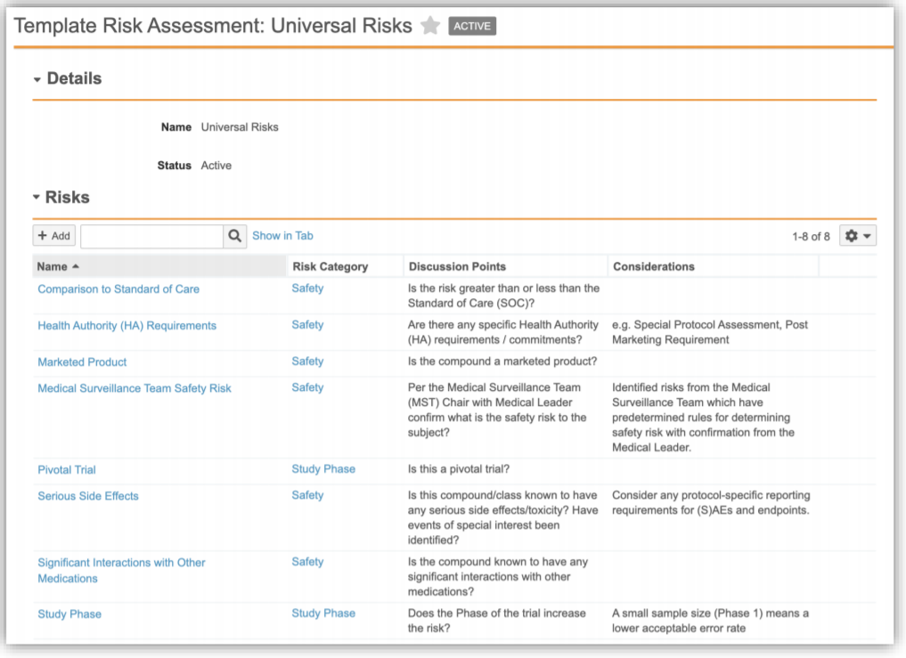
RBSM: Clinical Risk Assessments
Configurable
Slide 2 of 3
The Risk Library holds the list of risks that can be re-used across multiple studies and used to create Template Risk Assessments that can be applied to a Study
CTMS
The Template Risk
Assessments might be created
for a specific phase or
therapeutic area of a study, or
perhaps just a generic standard
risk assessment to be used for
all Studies
Feature Risk
LOW
Default Impact
VISIBLE TO ADMINS ONLY

Slide 42
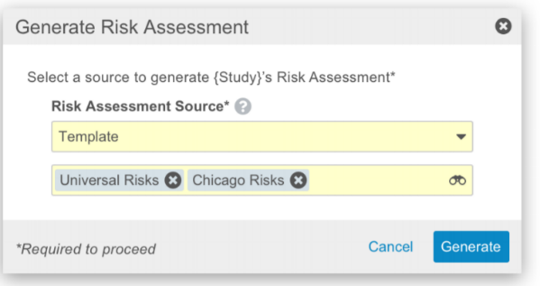
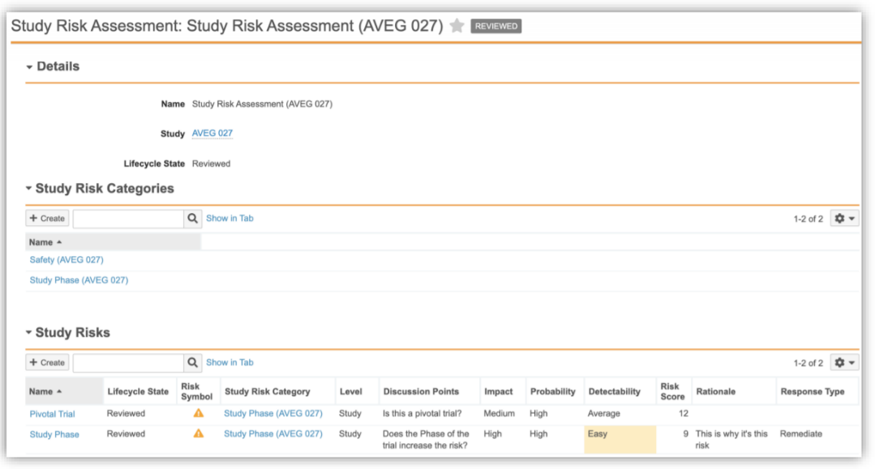
RBSM: Clinical Risk Assessments
Configurable
Slide 3 of 3
When one or more Template Risk Assessment(s) is applied to a Study, a Study Risk Assessment is created. This record will have a deduplicated list of all the related Study Risk Categories and Study Risks that were referenced in the Template Risk Assessment(s)
CTMS
The Study Risk Assessment will be where the study team provides their impact, probability and detectability assessments, along with a rationale and response type. This record would then be sent for review and, upon approval, would be filed and approved as a document in eTMF
Feature Risk
LOW
Default Impact
VISIBLE TO ADMINS ONLY

Slide 43
DEMO
RBSM: Clinical Risk Assessments

Slide 44
EDL Automation for
Study Personnel, Organizations & Products
Configurable
Overview
  This feature allows users to apply EDL Item Templates to specific roles for a Study Person, Study Organization, and Study Product in a given study. Vault automatically creates EDL Items that match on a Person, Organization, or Product when those are added to a study, and it links the new EDL Items to open milestones based on template configuration
Business Justification
  This feature alleviates the resourcing effort – whether currently a manual Vault process or tracked outside of Vault in a spreadsheet – to relate an EDL Item to a Study Person, Study Organization, and Study Product or to maintain the correct # Expected for personnel-related documents
Considerations
  This feature is available for configuration in vaults with (1) Clinical EDL Template Refactor and (2) Person & Organization Migration features enabled
  Clients who are using ad hoc events to create milestones and increment # Expected for personnel changes should evaluate whether to modify their processes when adopting this feature
Feature Risk
Medium
Default Impact
VISIBLE TO ADMINS ONLY

Slide 45
EDL Item Upload Visibility Update
Automatic
Overview
  To access the Upload action on EDL Item records, Vault now requires users to have Edit permission on the EDL Item object, and if Sharing Settings are enabled, the user must also be in an Editor role
Business Justification
  This feature makes the permission checks for the Upload to EDL Item action consistent with other permission checks across the system
Feature Risk
N/A
Default Impact
VISIBLE TO ALL USERS

Slide 46
DEMO
EDL Automation for Study Personnel, Organizations & Products

Slide 47
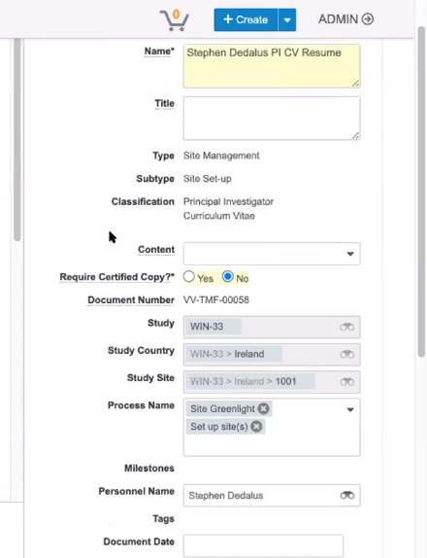
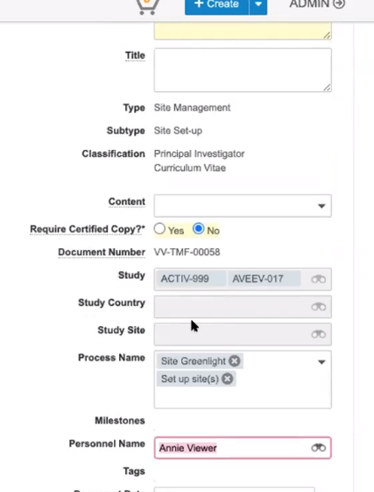
Pre-Save Field Defaulting
Automatic
Overview
  You are now able to modify the study/personnel (Controlling filed) value and that will dynamically cause the product (Controlled) field to update in real time while in Edit mode (default in the UI), rather than updating post-save as previously
Business Justification
  Customers identified post-save behavior as confusing, because it was not always clear what will happen to a controlled field when you were modifying a controlling field
Considerations
  If you have field dependencies on a controlled field, those will be overridden by the defaulting
Feature Risk
LOW
Default Impact
VISIBLE TO ALL USERS

Slide 48
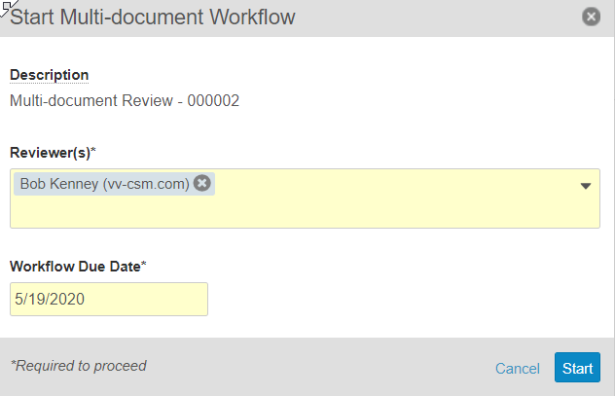
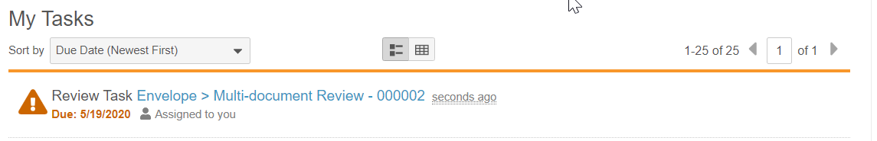
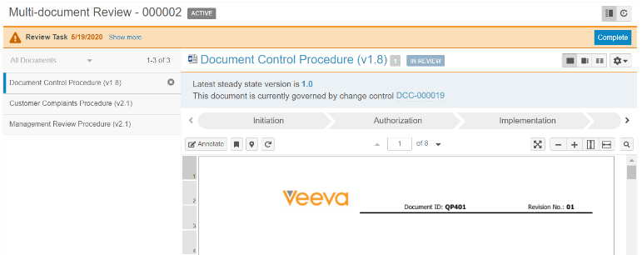
Auto-Number Envelope Record for
Multi-Document Workflow
Support
Overview
  Admins can now configure a multi-document workflow to automatically generate the name for the Envelope record
  The name can consist or any string and a token for a unique number
  If enabled the workflow name is read-only in the start dialogue
Business Justification
  This feature ensures efficiency, uniqueness and consistency of envelope names
  As a result this can reduce training overhead
Considerations
  It’s recommend using the term ‘multi-document’ in the name to differentiate from single document tasks
Feature Risk
MEDIUM
Default Impact
NONE

Slide 49
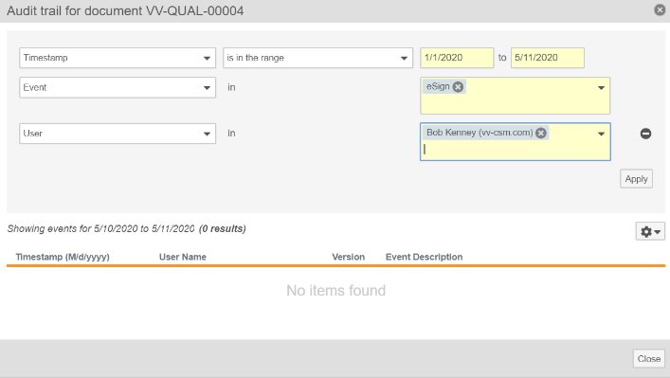
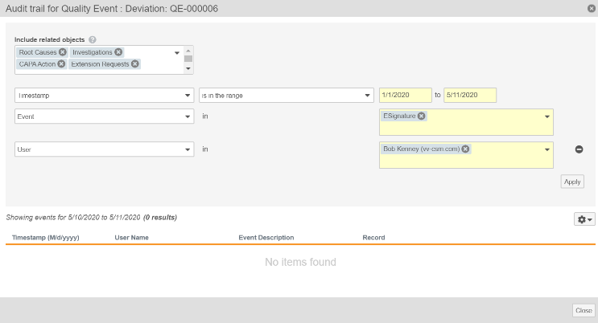
Individual Audit Filters
Automatic
Document
Audit Trail Filters
Overview
  Users can now apply Event and User filters, in addition to Date filters, when viewing audit trails for individual documents and object records
Business Justification
  Allows users to more easily find specific activity of interest within a document’s or object record’s audit trails
  i.e. find all edits performed in the last day
  i.e. find all electronic signatures performed by a user within a specific date range
Considerations
  Refer to the following link for a list of document audit trail events:
  http://vaulthelp.vod309.com/wordpress/admin-user-help/auditing/document-audit-events/
Object Record
Audit Trail Filters
Feature Risk
MEDIUM
Default Impact
VISIBLE TO ALL USERS

Slide 50
Minimum Match Logic: Strict Matching
Automatic
Overview
  When searching with documents or records with multiple search terms, strict matching will require most of the user's search terms to match
  Searches with two terms require all terms to match
  Searches with three or four terms require all but one term to match
  Searches with five or more terms require all but two terms to match
  e.g. a search for “Investigator’s Brochure” no longer returns results such as “Principal Investigator’s CV” since the term “Brochure” would not match
Business Justification
  Return fewer, more relevant results as the number of search terms increase
Considerations
  This feature is auto-on, but can be turned off with an Admin checkbox in Search Settings
Feature Risk
LOW
Default Impact
VISIBLE TO ALL USERS

Slide 51

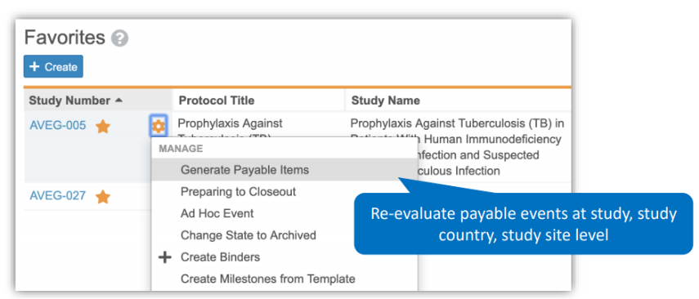
Payments: Generate Payable Items User Action
Configurable
Overview
  Vault Payments is designed to generate Payable Items as eligible Payable Events (subject visits, procedures, and site fees) are created and updated
  Changes to the related objects do not trigger a re-evaluation of the eligible Payable Events to generate appropriate Payable Items. The new ‘Generate Payable Items’ action will allow customers to re-evaluate Payable Events and recalculate rate-based fees and generate additional Payable Items
Business Justification
  The supported use cases include adding new fees to the Fee Schedules, new enrolled subjects in the rate-based Fee Schedule, and activities performed by sites before the Fee Schedule is loaded and approved in Vault Payments
Feature Risk
MEDIUM
Default Impact
VISIBLE TO ADMINS ONLY

Slide 52
Unify Clinical Operations

Slide 53
Site Connect: Site Packages
Support
Overview
  Users can create custom regulatory document packages to be sent to Study Sites SiteVault using the “Send Document via Clinical Network” user action
  SiteVault Users receive and respond to regulatory document requests
  For example:
  Send a document to a site (e.g. protocol)
    Request a document from a site (e.g. CV)
    Request a form completion from a site (e.g. 1572)
Business Justification
  Better visibility to the status of key site documents to help expedite collection
Considerations
  Requires Site Connect
  Replaces the existing “Send Document Package” feature
*Available for Early Adopters only
SITE CONNECT
Feature Risk
MEDIUM
Default Impact
NONE

Slide 54
Simple TMF Transfer
Configurable
Overview
  Transfer study, study country, and study site records as well as TMF Reference Model 3.0 documents from the CRO Vault to the Sponsor Vault without the need for mappings and defaults
  Before 20R2, the receiving Vault/Sponsor required mappings or defaults for every required field on the Study Country, Study Site, and transferred TMF documents
Business Justification
  A time consuming Services engagement is no longer required
Considerations
  ‘TMF Document’ is a new Document Type at the Base Document level
  ‘Source Artifact’ is a new field on the new 'TMF Document' document type
  The new Artifact field will be used to determine the TMF Viewer section (Future release)
Feature Risk
MEDIUM
Default Impact
VISIBLE TO ADMINS ONLY

Slide 55
Rule Set Override
Automatic
Overview
  Enables Users to constrain the set of documents transferred by the Simple TMF Transfer when an Agreement is made active
  For example:
  The CRO may want to only send documents to the Sponsor where the QA Check Completed field is set to Yes
  In this case, Rule Overrides can be used to apply these constraints to any documents and records sent to the receiving Vault
Business Justification
  Greater control over which objects and documents are transferred to the receiving Vault
Considerations
  Each Vault is responsible for their own outgoing transfer where clauses
  Study Country and Study Site object rules can use overrides to constrain what is transferred
Feature Risk
MEDIUM
Default Impact
VISIBLE TO ADMINS ONLY

Slide 56
DEMO
Simple TMF Transfer

Slide 57
Vault Clinical Docs Update
Automatic
Overview
  This feature updates Site Connect to utilize mappings to the Vault Clinical Docs model rather than mappings to the TMF Reference Model 3.0
Business Justification
  Currently the Clinical Network transfers a document from SiteVault to Vault Clinical, it uses each customer’s mapping of document types to TMF Reference Model 3.0 Artifacts to determine which document type the transferred document needs to be created in
  The TMF Reference Model 3.0 does not have the same level of granularity as most customer document type hierarchies, customers map multiple classifications to single TMF Reference Model 3.0 Artifacts. This unfortunately leads to the Clinical Network using the first mapping it finds and likely creating the document in an incorrect classification
  Moving mappings to the granular Vault Clinical Docs model will allow the Clinical Network to transfer and create documents more accurately
Feature Risk
N/A
Default Impact
VISIBLE TO ADMINS ONLY

Slide 58
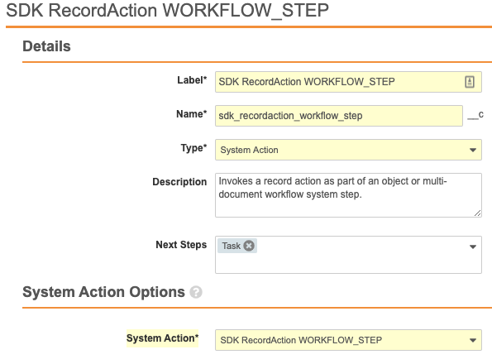
Object & Multi-Document Workflows: Invoke Record Action via a System Action Step
Configurable
Overview
  Admins can now configure a System Action workflow step that invokes a Vault Java SDK Record Action as part of an Object Workflow or a Multi-document Workflow
Business Justification
  Vault Java SDK Record Actions allow your organization to meet your specific business rules within workflows that cannot be achieved via Vault configuration
Feature Risk
MEDIUM
Default Impact
VISIBLE TO ADMINS ONLY

Slide 59
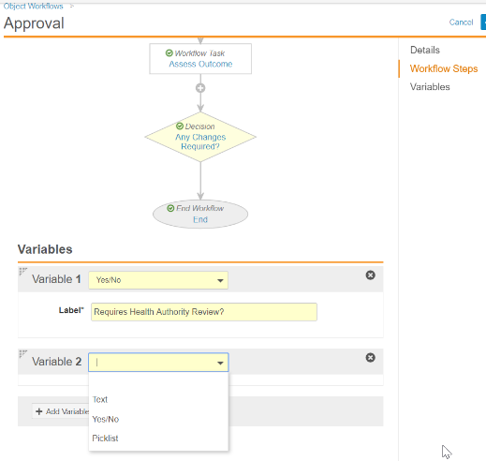
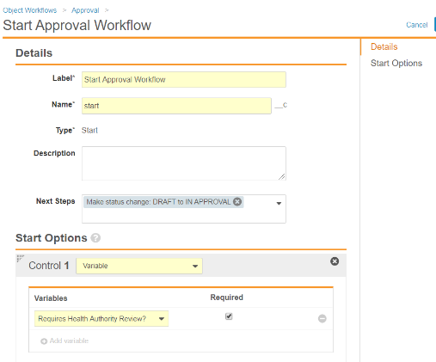
Variables for Multi-Document and
Object Workflows
Configurable
Overview
  Admins can configure a workflow to prompt a workflow initiator for a value to be assigned to a “variable”
  The value of a workflow “variable” can be used to determine which path a workflow follows
Business Justification
  Workflow “variables” allow business process variations to be accommodated in a single workflow, rather than configuring multiple workflows
Considerations
  Available in Multi-Document and Object workflows
  Workflow “variables” are currently limited to text, yes/no, or picklist field types
  A workflow “variable” value must be assigned when the workflow is initiated
1
2
Feature Risk
MEDIUM
Default Impact
VISIBLE TO ADMINS ONLY

Slide 60
Multi-Document Workflow: Execute Entry Action & Entry Criteria When Canceling Workflows or Removing Documents
Automatic
Overview
  Vault now executes Entry Actions and Entry Criteria for the Cancel Workflow State when a user …
  Cancels a multi-document workflow
  Removes a document from a multi-document workflow
Business Justification
  Help customers who would like to capture information like workflow cancellation date, or reset values that were set during the workflow process
Considerations
  When users cancel a multi-document workflow, Vault moves the documents to the configured Cancel Workflow State
  Administrators can configure the Cancel Workflow State to be
  the “state in which the workflow started”, or
  a specific state in a document lifecycle, or
  no state change
Feature Risk
MEDIUM
Default Impact
VISIBLE TO ALL USERS

Slide 61
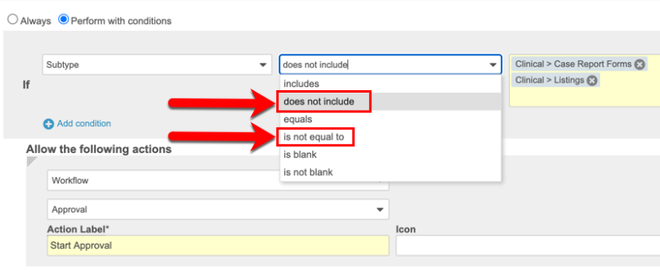
Additional Operators for Document Lifecycle State Entry Actions, User Actions & Entry Criteria
Configurable
Overview
  This feature adds two new operators to the conditions for document lifecycle state user actions, entry actions, and entry criteria:
  the "is not equal to" operator for document type, subtype, and classification
  the "does not include" operator for all object reference fields, including document type, subtype, and classification
Business Justification
  Allows simpler configuration to exclude only a few document types, subtypes or classifications from an action or criteria, rather than having to explicitly include all others
Feature Risk
N/A
Default Impact
VISIBLE TO ADMINS ONLY

Slide 62
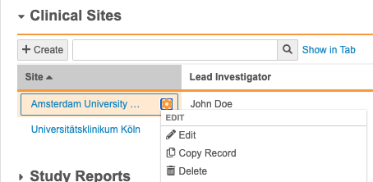
Add Copy Record Action to Related Record
Automatic
Overview
  This feature allows users to copy a related object record directly from the Actions menu within related record sections on an object record details page
Business Justification
  This will streamline the copy process of a related object record as the user can stay on the object record details page when copying a related object record
Considerations
  User needs permission on the related object to be able to copy the record
  Copy Record is available for all types of related lists except simple many-to-many related lists
Feature Risk
LOW
Default Impact
VISIBLE TO ALL USERS

Slide 63
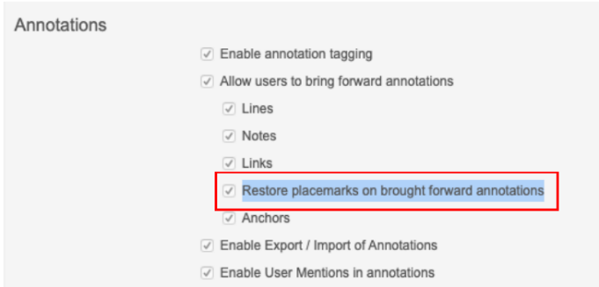
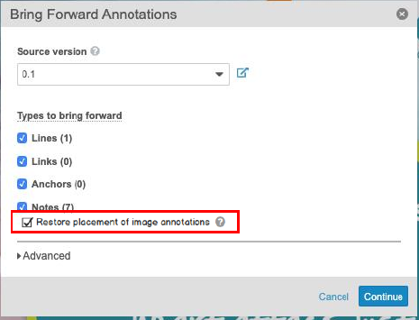
Auto-Place Brought Image Forward Annotations
Automatic
Overview
  Brought forward annotations on images and text are automatically placed based on the page and coordinates in the source version
  If the coordinates or page do not exist in the new version, Vault places the annotations at the page level
Business Justification
  Applies to all non-text annotations: Image, Sticky, Line, Link and Anchor
Considerations
  Dependent on existing flag: “Restore placemarks on brought forward annotations”
  User can opt out at runtime (Default: On)
Feature Risk
LOW
Default Impact
VISIBLE TO ALL USERS
Admin Setting
User Option

Slide 64
Yuzu – CTN Enhancements
Support
Overview
  Various enhancements on Yuzu - Clinical Trial Notification for Japan feature such as:
    - Made CTN Site IP Name selectable from a list on Study Country
    Improved error handling with XML validation
    User Action on Global CTN Data to trigger the Change Log job immediately
    CTN Data JIS Level 1 and 2 character sets validation on save
    Generated Word format/indentation improvements
Business Justification
  This enhancement incorporates the feedback of Early Adopters for Yuzu to improve usability
*Available for Early Adopters only
CTMS
Feature Risk
MEDIUM
Default Impact
NONE

Slide 65
Constrain Object Reference Search
Automatic
Overview
  For filters on object reference fields, the system now constrains the values that can be found through the search box to only those that are included on the documents or records returned in the search results
Business Justification
  The filter values returned in this search box will now always match at least one record or document preventing users from selecting values that are not applicable
Considerations
  This feature only applies to the search box that appears when an object reference field contains more than 15 filter values
Feature Risk
LOW
Default Impact
VISIBLE TO ALL USERS

Slide 66
Allow Inclusion of KeyInfo in SAML Requests
Configurable
Overview
  With this feature, SAML Profiles allow inclusion of the KeyInfo element in SAML Requests. The inclusion of KeyInfo helps Identity Provider systems to select the proper certificate during the SAML SSO process. This will be especially important when Vault releases a new certificate in anticipation of certificate roll over later this year
Business Justification
  This feature provides for testing time to ensure the customers' Identity Provider solutions are properly configured to support the new certificate when it is released
Considerations
  Only applies to SAML Profiles where the SP-Initiated Request Binding is set to "HTTP Post"
Feature Risk
HIGH
Default Impact
VISIBLE TO ADMINS ONLY

Slide 67
Clinical Operations Data Model Changes
Slide 1 of 4
Automatic
Overview
  This feature groups the addition of new components (e.g. objects, fields, doc types) that are added to all Clinical Operations Vaults at the time of General Release
Business Justification
  With every release, we update the data model to better support evolving needs and new feature functionality
Considerations
  We have added components to all Clinical Vaults to support Simple TMF Transfer and Site Packages
  We have deprecated the Study Organization object
  Please review the new components listed in the hidden slides 2-4 or on Vault Help: http://vaulthelp2.vod309.com/wordpress/rn/limited-release/releasenotes-ft/new-in-20r14/
Feature Risk
N/A
Default Impact
VISIBLE TO ALL USERS

Slide 68
Components added for Simple Transfer
Slide 2 of 4
TMF Document (tmf_document__v) document type
Simple Transfer Rule Set (simple_transfer_ruleset__v) field on the Clinical Network Rule Set (cdx_rule_set__v) object
Object Creation State (object_creation_state__v) field on the Clinical Network Rule (cdx_rule_v) object
Simple Transfer Study (simple_transfer__v) field on the following objects:
  Study (study__v)
  Study Country (study_country__v)
  Study Site (site__v)
Added the following lifecycles:
  TMF Exchange Document Lifecycle (tmf_exchange_document_lifecycle__v)
  CDX Agreement (cdx_agreement_lifecycle__v)
  CDX Issue Lifecycle (cdx_issue_lifecycle__v)
Added the following objects:
  Agreement (cdx_agreement__v)
  Agreement Activity Item (cdx_agreement_activity_item__v)
  Clinical Network Connection User (cdx_connection_user__v)
  Clinical Network Issue (cdx_issue__v)
  Clinical Network Rule (cdx_rule__v)
  Clinical Network Rule Set (cdx_rule_set__v)
  Configuration Mapping (cdx_configuration_mapping__v)
  Data Mapping (cdx_data_mapping__v)
  Document Lifecycle State Mapping (cdx_data_mapping__v)
  Document Type Sub-Rule (cdx_document_type_subrule__v)
  Field Default (cdx_field_default__v)
  Pending Scope Variable Value (cdx_pending_scope_variable_value__v)
  Scope Variable (cdx_scope_variable__v)
  Scope Variable Field Mapping (cdx_scope_variable field mapping__v)
  Scope Variable Value (cdx_scope_variable_value__v)

Slide 69
Components added for Simple Transfer
Components added for Rule Set Override
Slide 3 of 4
New document fields:
  Created by Clinical Network (created_by_clinical_network__v)
  Level (level__v)
  Source Artifact (source_artifact__v)
  Source Create By (source_created_by__v)
  Source Created Date (source_created_date__v)
  Source Doc Type (source_doc_type__v)
  Source Document Connection (source_document_connection__v)
  Source Document Date (source_document_date__v)
  Source Document Number (source_tmf_document_number__v)
  Source Document Version (source_document_version__v)
  Source Person (source_person__v)
  Source Product (source_product__v)
Clinical Network Rule Override (cdx_rule_override__v)
Clinical Network Override Agreement (cdx_override_agreement__v)

Slide 70
Components added for Site Packages
Deprecation of Study Organization Objects
Slide 4 of 4
New objects:
  Site Packages Definition (site_package_definition__v)
  Site Package Document (site_package_document__v)
New fields on the Distribution Task (distribution_task__v) object:
  Action (action__v)
  CDX ID (cdx_id__v)
  Complete (complete__v)
  Completion Date (completion_date__v)
  Cycle Time (Days) (cycle_time__v)
  Delivery Method (delivery_method__v)
  Document Type (doc_type_details__v)
  Due Date (due_date__v)
  Organization (organization__v)
  Return Document Version (return_version__v)
  Return Document Version (unbound) (return_version_unbound__v)
  Source (source__v)
  Source ID (source_id__v)
The following objects will be removed from all Clinical Vaults where they are not in use:
  study_organization__v
  study_country_organization__v
  study_site_organization__v
These object types have been replaced by the Study Org base object: Base Study Organization (base_v)

Slide 71
Informed Decisions

Slide 72
Or Filter Logic
Slide 1 of 2
Automatic
Overview
  Reports now support OR logic, as well as AND logic, between filters or prompts
Business Justification
  Customers often require reports that include both AND and OR logical operations
Considerations
  Once two eligible filters or prompts have been added, Add advanced logic appears below the filters. Build the formula using the numbers indicated next to the filters. Check syntax using the Validate button
  AND operations are evaluated before OR operations by default - parentheses can be used to explicitly group filters together and define precedence
Feature Risk
LOW
Default Impact
VISIBLE TO ALL USERS

Slide 73
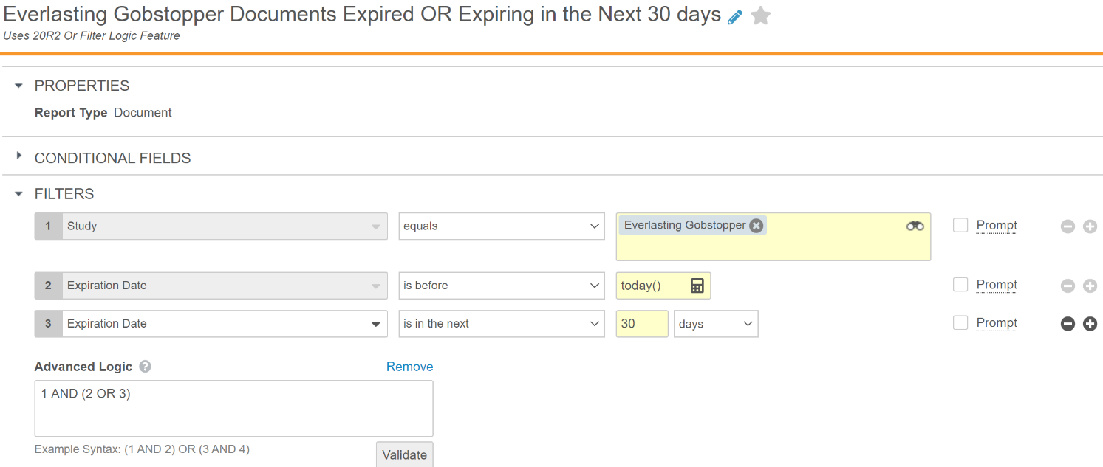
Or Filter Logic
Slide 2 of 2
Automatic
Feature Risk
LOW
Default Impact
VISIBLE TO ALL USERS

Slide 74
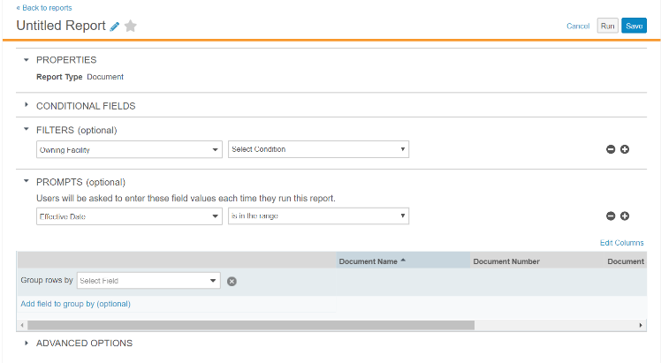
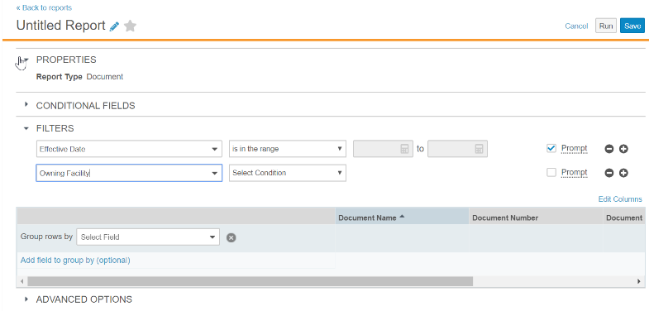
Include Prompts with Filters in Report Builder
Automatic
Overview
  The option that prompts a user for information when running a report has been moved
Business Justification
  Users building reports can define all filters in one location
Before 20R2
Separate section for filters with runtime prompts
After 20R2
One section for all filters with checkbox for runtime prompt
Feature Risk
LOW
Default Impact
VISIBLE TO ALL USERS

Slide 75
DEMO
Or Filter Logic and Include Prompts

Slide 76
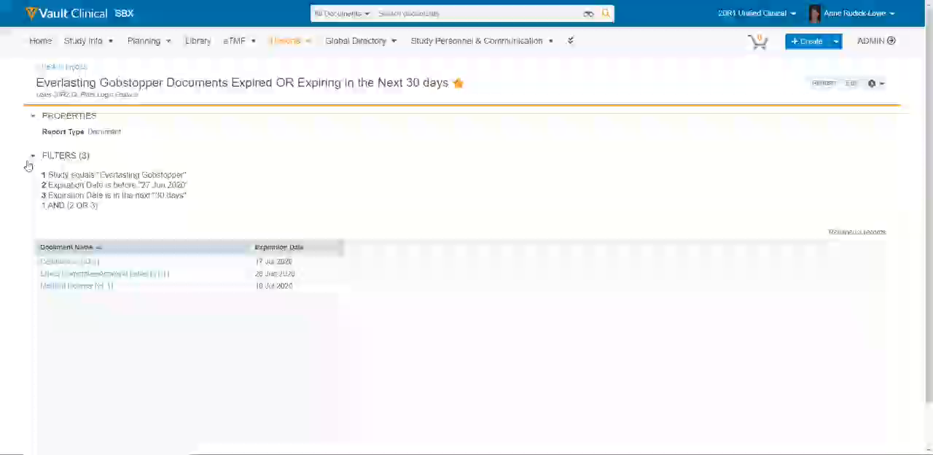

Slide 77
Atomic Security for Documents:
Active Workflow Actions
Support
Overview
  Admins can configure which roles (i.e. Owner, Editor, Document Control, etc.) have permission to perform the following “active workflow actions” based on document status (i.e. In Edit, In Review, In Approval, Effective, etc.)
  Cancel Workflow
  Add Participants
  Reassign Task
  Cancel Task
  Remove Document from a Multi-Document Workflow
Business Justification
  Provides greater control over which roles can administer active workflow tasks for documents
  e.g. Prior to this release, if a user’s Profile/Permission set allowed Cancel Workflow, that user could cancel any document workflow
Considerations
  When enabled, the Workflow Initiator / Workflow Owner no longer receives automatic access to these actions
  Admins will need to ensure that users who start workflows are in document roles with access to perform these actions as needed
Feature Risk
HIGH
Default Impact
NONE

Slide 78
Atomic Security for Documents:
Lifecycle User Actions
Support
Overview
  Admins can configure which user roles (i .e. Owner, Editor, Document Control, etc. ) have permission to perform specific lifecycle User Actions like changing document state, and starting a workflow
Business Justification
  Previously, a user role had permission to start ALL workflows, or perform ALL state changes from a particular document state (or none at all)
  With this release, Admins have more granular control, based on lifecycle state and role, over who can perform specific lifecycle user actions.
  For example, customers can now configure to allow the Owner role to start the Review workflow, but not the Approval workflow.
Considerations
  Upon enabling this feature, there should be no changes to user access in your Vault because Vault will automatically perform some migration actions upon enabling. See Vault Help link for more information
  http://vaulthelp2.vod309.com/wordpress/rn/limited-release/releasenotes-ft/new-in-20r14/#atomic_security_for_documents_lifecycle_user_actions
Feature Risk
HIGH
Default Impact
NONE

Slide 79
Additional Platform Features

Slide 80
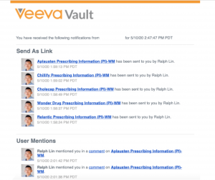
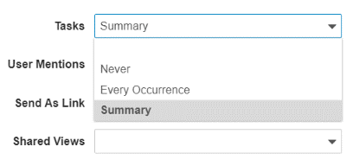
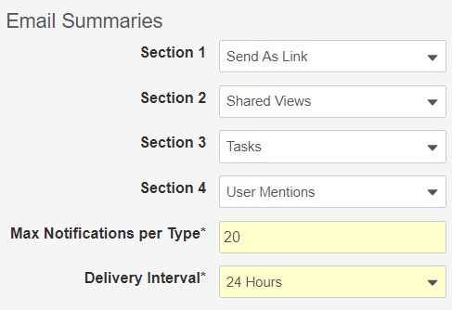
Notification Preferences
Notification Summary Email
Configurable
Overview
  System Administrators and Vault Owners can:
  setup Users’ email delivery preferences for Send As Link, User Mention, Task, and Shared View notifications
  configure how information appears in emails that summarize notifications
  configure how often notification summary emails are sent to Users
Business Justification
  This feature reduces “notification overload” by providing Users the option to have notification summary emails, rather than receiving email each time an event triggers a notification
Considerations
  Email preferences are Vault-specific
  User fields will be deployed as blank, default behavior is:
  Every Occurrence for Send As Link, Tasks, User Mentions
  Never for Shared Views (new notification type with 20R2)
  Admins can make fields visible in the User object page layout
User Delivery Preferences
Summary Email Options
Feature Risk
LOW
Default Impact
VISIBLE TO ADMINS ONLY

Slide 81
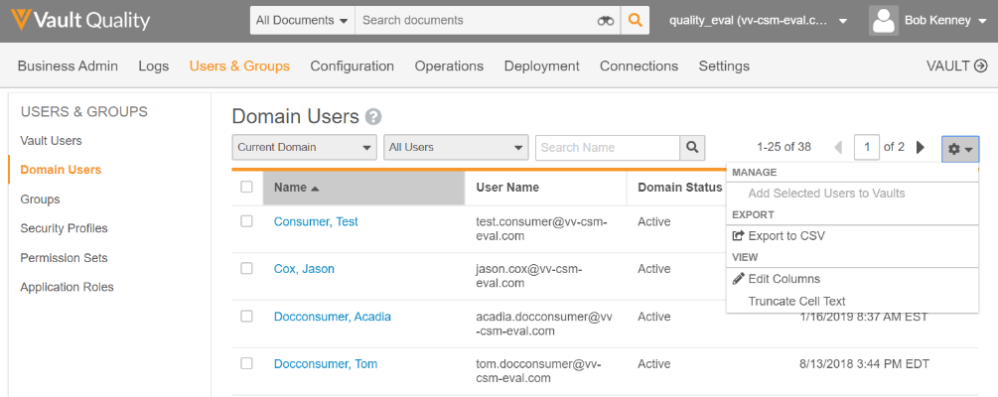
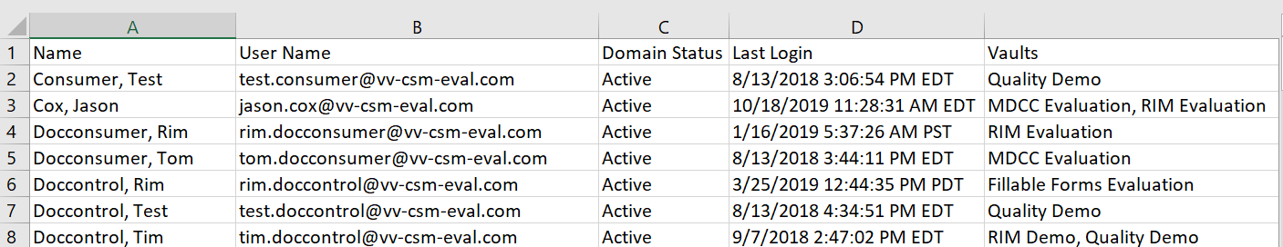
Domain Users: Add Vaults in CSV Export
Automatic
Overview
  Domain Admins can see the Vaults to which users belong when exporting a list of users to a CSV file
Business Justification
  Allows Domain Admins to see Vault membership across a list of users, rather than determining Vault membership one user at a time
Considerations
  Domain Admins must filter on All Users or Current Domain on the Domain Users page
Feature Risk
LOW
Default Impact
VISIBLE TO ADMINS ONLY

Slide 82
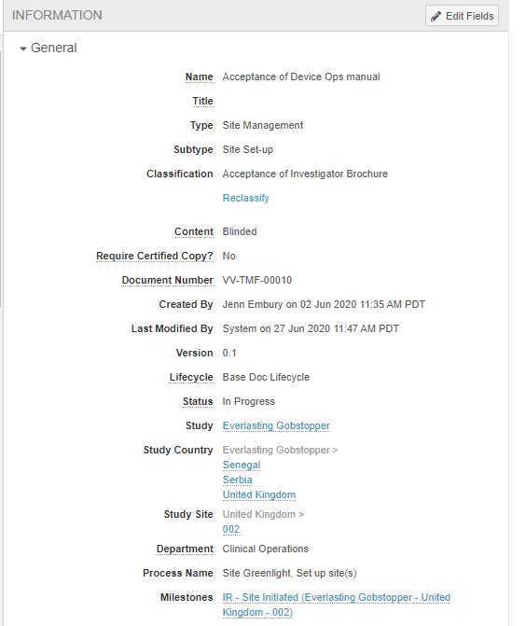
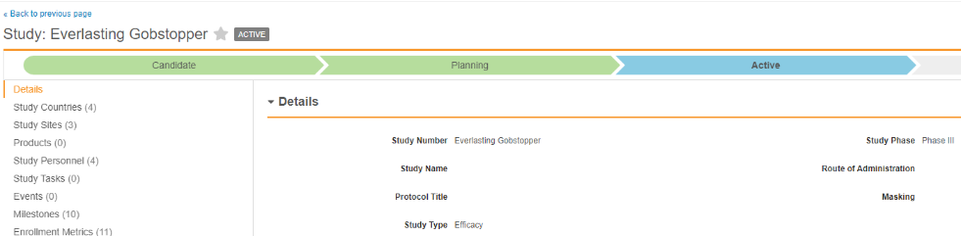
Unified Navigation Behavior when Clicking Object References in Document Fields
Automatic
Overview
  When a user clicks an object record in a document field, Vault always takes the user to the record’s detail page
Business Justification
  Previously, clicking on an object record in a document field took the user to one of the following based on the user’s access: a custom tab, the business admin page, or the record’s detail page
  This feature makes Vault’s behavior more consistent
click
click
Feature Risk
N/A
Default Impact
VISIBLE TO ALL USERS

Slide 83
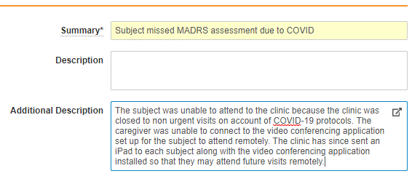
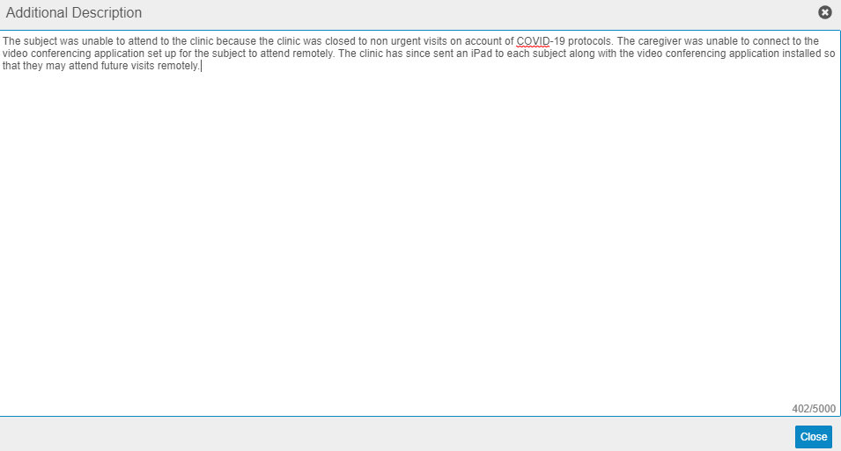
Long Text Field Enhancements
Automatic
Overview
  Allow Admins to create LongText fields in the Admin UI
  Allow users to edit LongText fields using a pop-up editor
  Ensure all characters in LongText fields are included in exports from list views
Business Justification
  Improve user experience of editing LongText fields
  Ensure LongText fields are not truncated when exporting records from List views
Considerations
  Pop-up editor for LongText fields, and ability to export all characters in LongText fields are Auto On features
Feature Risk
MEDIUM
Default Impact
VISIBLE TO ALL USERS

Slide 84
Sharing Settings UI Enhancements for Objects
Automatic
Overview
  Redesigned UI provides one sortable table regardless of assignment types (manual, custom, matching sharing rules)
  Searching for user access now returns both direct user role assignments and role assignments through groups
Business Justification
  Provides improved usability and consistency with Document Sharing Setting UI
Feature Risk
N/A
Default Impact
VISIBLE TO ALL USERS

Slide 85
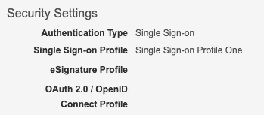
Separate SAML SSO Configuration for Login & eSignature
Configurable
Overview
  Vault now supports two different types of SAML profiles:
  Single Sign-on Profile: this Profile is required for SSO login
  eSignature Profile: this new Profile is optional and used specifically for electronically signing documents and object records via SAML
Business Justification
  Enables customers to create separate SAML configurations at their Identity Provider solutions such that eSignatures via SAML behave differently than single sign-on
  e.g. some customer may require a multi-factor authentication for single sign-on, while only user name and password for eSignatures
Considerations
  If no eSignature Profile is configured in a Security Policy, the Single Sign-on Profile is used for both SSO login and eSignature
  As part of this feature SAML Profiles are renamed to Single Sign-on Profiles
Feature Risk
High
Default Impact
VISIBLE TO ADMINS ONLY

Slide 86
Document Migration Mode API Header
Automatic
Overview
  Users with a Security Profile that includes the new Document Migration permission can include a document migration mode header in bulk API calls
  This enables Migration Mode during execution of bulk API calls, rather than for the entire Vault
Business Justification
  Reduces the impact on regular end-user Vault operations like auto-matching processes for EDLs and Legal Holds
Considerations
  Learn more about the Document Migration Mode API Header in the Vault Developer Portal:
  https://developer.veevavault.com/rn/20.2/#document-migration-mode-api-header
  Learn more about Document Migration Mode in Vault Help:
  http://vaulthelp.vod309.com/wordpress/admin-user-help/admin-vault-loader/about-document-migration-mode/
Feature Risk
LOW
Default Impact
VISIBLE TO ADMINS ONLY

Slide 87

Document Migration Mode for Vault Loader
Automatic
Overview
  Vault Loader can now perform the Create action for the following Object Types, without placing the entire Vault in Migration Mode
  Documents
  Document Versions
  Document Renditions
  Documents, Versions, Roles
Business Justification
  Improves efficiency by removing the need to raise a Product Support ticket to enable and disable Document Migration Mode for a Vault
Feature Risk
MEDIUM
Considerations
  The user must have a Permission Set that grants the new Document Migration permission
  There is also a Document Migration Mode parameter (-documentmigrationmode) available for the Vault Loader Command Line tool.
Default Impact
VISIBLE TO ADMINS ONLY

Slide 88
Inbound Component Dependency Validation
Automatic
Overview
  During the Review and Deploy process, Admins can now
  View VPK component dependencies, and which component dependencies are required
  Identify whether the dependent components exist in the inbound package, or the target Vault
  Change the order in which components are deployed before executing the deployment process
Business Justification
  Eliminate the need to iteratively deploy a VPK in order to troubleshoot missing component dependencies one at a time
Considerations
  Not all component types are supported
  Circular dependencies are not supported
  Refer to Vault Help for more information
Feature Risk
MEDIUM
Default Impact
VISIBLE TO ALL USERS

Slide 89

Re-establish Vault to Vault Connection
Automatic
Overview
  Allows connections to be more easily re-established when a source or target Vault is refreshed, cloned or created
Business Justification
  Re-establishing a connection will no longer require re-configuration of the components including integration-related components such as Integrations, Integration Points and Integration Rules
Considerations
  User must have the “Manage Connections” permission selected in the Permission Set
  Available for both custom and standard connections
Feature Risk
LOW
Default Impact
VISIBLE TO ADMINS ONLY

Slide 90
Spark Integration Rules UI
Automatic
Overview
  Admins can now rapidly configure Spark Messaging integration rules in the Vault UI. Previously, integration rule configuration was only available through MDL. With this feature, Admins can configure integrations much more quickly and easily
Business Justification
  It addresses the unique requirements for data or documents that should be sent to a target vault in a Spark-based integration, therefore these rules can be configured on the target vault telling the callback what parameters should be used to select the data
Considerations
  If an admin has the proper Security Profile they will have access to the Integrations Rules configuration screen on the Configuration tab of the Admin area of Vault
  Any configurations made in the Integrations Rules configuration task will be available to developers writing integration code
  Any existing Integrations Rules loaded through MDL will be available in the Integrations Rules configuration task
Feature Risk
LOW
Default Impact
VISIBLE TO ADMINS ONLY

Slide 91

Default Search Context
Configurable
Overview
  Administrators can now configure any document tab or object tab to be the default search context
  The default search context is applicable when a user is on a tab that is not searchable: Home, Dashboards, or a web tab
Business Justification
  Many customers want to steer users to a steady state document tab when searching documents to prevent users from mistakenly performing processes using in-progress versions
  When users login for the first time, or navigates to a tab that is not searchable (i.e. Home or Dashboards), the Search box context defaults to All Documents
  This behavior could steer a user toward mistakenly using an in-progress version of a document
Feature Risk
LOW
Default Impact
VISIBLE TO ADMINS ONLY

Slide 92
Improvements for Long Running Jobs
Automatic
Overview
  Vault now clears out jobs that are stalled and do not make progress for three (3) days
Business Justification
  In past releases, job instances would remain stalled in a Running state for 14 days before getting cleared out
Feature Risk
N/A
Default Impact
VISIBLE TO ADMINS ONLY

Slide 93


Rename Permission for Mobile Applications
Automatic
Overview
  With this release, the label for the "Enable App Store Configuration" permission is changed to
  "Enable Direct Installation"
Business Justification
  The new label and help text better reflect how that permission works for Vault mobile applications
Label prior to 20R2
Label as of 20R2
Feature Risk
N/A
Default Impact
VISIBLE TO ADMINS ONLY

Slide 94
VPK Deployment Order & Dependency Validation
Automatic
Overview
  This feature enables Administrators to validate all supported dependencies and to determine the correct deployment order prior to deploying the VPK
  The Administrator can now download a validation log that contains all component dependency information, including whether components are required and whether they exist in the package or in the target Vault
Business Justification
  Troubleshooting is easier and more efficient now that dependencies can be corrected prior to deployment of the VPK Package
Feature Risk
LOW
Default Impact
VISIBLE TO ADMINS ONLY

Slide 95

Custom Job Processors with the Vault Java SDK
Configurable
Overview
  In this release, the Vault Java SDK now provides the ability to create custom job processors
  After creating a custom job processor and deploying it to your vault, SDK Job will appear as a selectable Type when creating a new job definition from Admin > Operations > Job Definitions
Business Justification
  Allows customers to leverage Vault Java SDK to create job types and jobs that perform automated actions that cannot be done with the standard job types in Vault currently
Considerations
  In addition, Vault extensions such as triggers or actions can execute job processors without a job definition
  "SDK Job" only appears as a selectable type if the job code is set to be configured by admins – if needed, the ability to create a job by admins in the UI can be hidden/restricted
  Every SDK job must have a Jobmetadata component to be run in Vault
Feature Risk
N/A
Default Impact
VISIBLE TO ADMINS ONLY

Slide 96

Shared Lookup Fields for Documents
Configurable
Overview
  Admins can now create Lookup type document fields as shared fields. It is also possible to convert existing lookup fields into shared fields
Business Justification
  Prior to this release, document lookup fields that refer to an object reference could not be shared. These lookup fields are often used in DAC rules and sometimes the limit of 5 lookup fields per object reference field would be hit. Shared fields will help avoid reaching the limit and streamline DAC configurations
Considerations
  In order to share a lookup field with a document type, an Admin must ensure the Lookup Object Field is on the same document type or inherited from a parent document type
  All custom __c lookup fields can be converted to shared fields
Feature Risk
LOW
Default Impact
VISIBLE TO ADMINS ONLY

Slide 97

Display Page X of Y & Datetime in PDF Audit Exports
Automatic
Overview
  This feature adds the following to each page of an audit trail exported to a PDF file:
  Total page count
  Vault name
  Audit trail name
  Date and time the audit trail was exported to PDF
Business Justification
  These changes to PDF audit exports make them more consistent with PDF report exports
Feature Risk
MEDIUM
Considerations
  Date and time shown is based on the user’s time zone defined in their user profile
Default Impact
VISIBLE TO ALL USERS

Slide 98
XML Rendering
Automatic
Overview
  This features provides the ability to generate a viewable rendition for XML files
  XML files are rendered in text format
Business Justification
  Enable customers to review and annotate XML files within Vault
Feature Risk
MEDIUM
Default Impact
VISIBLE TO ALL USERS

Slide 99

Add Change Type Action to Related Record
Automatic
Overview
  This feature allows users to change the object type of related object records using the Actions menu within related record sections on an object record details page
Business Justification
  This will streamline the management and correction of related records within the same page layout
Considerations
  Requires the related object has more than 1 object type, and the user has edit permissions on the related object
Feature Risk
LOW
Default Impact
VISIBLE TO ALL USERS

Slide 100
Auto-Place Brought Image Forward Annotations
Automatic
Overview
  Brought forward annotations on images and text are automatically placed based on the page and coordinates in the source version
  If the coordinates or page do not exist in the new version, Vault places the annotations at the page level
Business Justification
  Applies to all non-text annotations: Image, Sticky, Line, Link and Anchor
Considerations
  Dependent on existing flag: “Restore placemarks on brought forward annotations”
  User can opt out at runtime (Default: On)
Feature Risk
LOW
Default Impact
VISIBLE TO ALL USERS
Admin Setting
User Option

Slide 101

Change to Maximum Length for Link Field
Automatic
Overview
  Link (link_sys) is a system field on all objects that is used for integrations, including Spark Messaging integrations
  With this release the maximum field is reduced from 1,500 characters to 255 characters
Business Justification
  Veeva updated the System Field Link maximum length to better suit its usage as idParam in Upsert Operations and also as Unique ID in Vault to Vault applications
  This field should not be used by end users, and it is not shown in the default Page Layouts
Feature Risk
LOW
Default Impact
VISIBLE TO ALL USERS

Slide 102

Enhanced Document Number & ID Pattern Search
Automatic
Overview
  Users can search for documents using the beginning, middle, or end of a Document Number
To find document VV-123-DEF, use any of the following:
VV-123-DEF
VV123DEF
VV123
123DEF
123-DEF
VV.123.DEF
  Advanced Search now supports multiple Document Numbers
Feature Risk
LOW
Business Justification
  Find documents more easily using Document Number, Alphanumeric, or ID Pattern searches
Default Impact
VISIBLE TO ALL USERS

Slide 103

Indicate When Annotations Hidden by Filters
Automatic
Overview
  When a user views a document with annotations that are hidden, either by Annotate filter settings or by the Hide button on Info Card, Vault displays an alert message to the user which includes a count of the currently hidden annotations
Business Justification
  This brings awareness to the user that some annotations are hidden
Considerations
  This count is limited to 99, and updates whenever annotations are created, hidden, un-hidden or deleted
Feature Risk
LOW
Default Impact
VISIBLE TO ALL USERS

Slide 104

Support Priority Multi-Document Workflow Fields in Reports
Automatic
Overview
  Task Verdict Comment and Task Verdict Reason fields for Multi-Document Workflows can be included in Workflow with Document Reports
Business Justification
  The Multi-Document Workflow can be configured to accept a comment and reason for the verdicts that a user provides but until now, it was not possible to include this information in a workflow report
Feature Risk
LOW
Default Impact
VISIBLE TO ALL USERS

Slide 105


Audit Captures Source Record ID in Copy
Automatic
Overview
  Vault now distinguishes between create and copy actions in the Event Description for object record audit trails – copy is a new Event Description in 20R2
  When users copy a record, the Event Description in the new record’s audit trail now includes the source record’s name
Business Justification
  Make it easier to identify how object records were created, and trace the origin of object records that were copied
Feature Risk
N/A
Default Impact
VISIBLE TO ALL USERS

Slide 106
Default Profile Image for System User
Automatic
Overview
  Adds a Veeva “V” logo as the user image for system-owned users such as System or Application Owner
Business Justification
  Makes it clearer that the users are system controlled
Considerations
  This image will also appear in notification summary emails where a notification was sent from a System-owned User
Feature Risk
N/A
Default Impact
VISIBLE TO ALL USERS

Slide 107
Enablement Change – Localize Vault to Dutch
Automatic
Overview
  In a previous release, we added Vault UI support for Dutch as a language to display for users. This no longer requires Veeva Support to enable
Business Justification
  Dutch is now automatically available, streamlining the process to display this language for users
Considerations
  Users can update the language Vault displays for them by changing the language settings on the User Profile page
Feature Risk
N/A
Default Impact
VISIBLE TO ALL USERS

Slide 108

Full EDL Job Match
Automatic
Overview
  With this release the Match EDL Job used to match documents to the Expected Document Lists (EDLs) is optimized to run more efficiently
  The first time the job runs after the Vault release, it will evaluate every document in the customer’s Vault for matching against active EDL Item records
  It is possible that Vault will match or unmatch older EDL Items to Documents as the job was doing only incremental updates prior to this release
Business Justification
  Make the EDL job more scalable to support more complex EDL Items usage scenarios
Feature Risk
N/A
Default Impact
VISIBLE TO ALL USERS

Slide 109
Localize Vault to Hungarian
Automatic
Overview
  The Veeva Vault UI now supports Hungarian
  Vault also supports setting Hungarian translations for labels in user-configurable data such as document types, fields, picklist values, and lifecycle names
Business Justification
  This feature expands the number of languages that Vault supports and can display information in
Considerations
  Users can update the language Vault displays for them by changing the language settings on the User Profile page
Feature Risk
N/A
Default Impact
VISIBLE TO ALL USERS

Slide 110

Move Merge Anchors to Create Anchor Tool
Automatic
Overview
  Prior to this release, the Merge Anchors action appeared when the Link tool was selected. With this enhancement, the Merge Anchors action appears when the Create Anchor tool is selected
  The Merge Anchors action no longer requires Edit Relationships permission
Business Justification
  Associating Merge Anchors with the Create Anchor tool is more intuitive. Also, the user is not required to have additional permissions
Considerations
  In order to Merge Anchors users must have the following permissions:
  Security Profile permission: Merge Anchors
  Document Role permission: Annotate
  Document Role permission: Create Anchors
Feature Risk
N/A
Default Impact
VISIBLE TO ALL USERS

Slide 111
Platform Data Model Changes
Automatic
Overview
  Every release we make changes to the data model to support evolving business needs
Business Justification
  Data model changes enable Veeva to add value for our customers by increasing functionality
Considerations
  For a full list of Platform data model changes please refer to the link named What's New in 20R2 on the About the 20R2 Release page in Vault Help
Feature Risk
N/A
Default Impact
VISIBLE TO ALL USERS

Slide 112

Restore Resizing to Annotation Comments Field
Automatic
Overview
  Users can resize the Comment field vertically to make it taller or shorter
  The entire dialog increases to accommodate the size of the Comment field.
Business Justification
  Allows users to view significantly more entered text all at once
Considerations
  Users cannot make the Comment field wider
Feature Risk
N/A
Default Impact
VISIBLE TO ALL USERS

Slide 113
State Change Job Improvements
Automatic
Overview
  State change jobs on documents are enhanced to handle cases where there is an active workflow on the latest version of a document, and a prior Steady State document needs to change state
Business Justification
  For example, you may have a job that expires an Effective document, but a newer draft is In Review. With this release, the workflow can continue on the newer version after the state change is executed on the prior version
  Prior to this change, Vault would not perform the state change if there was an active workflow on any document version unless an Admin canceled the workflow manually
Feature Risk
N/A
Default Impact
VISIBLE TO ALL USERS

Slide 114
Vault File Manager: Check In & Check Out Enhancements
Automatic
Overview
  Vault no longer opens a new browser tab when a user checks out a single document to Vault File Manager, or when a user checks in a single document from Vault File Manager
Business Justification
  Eliminates the side effect of many open browser tabs after check out / check in operations
Considerations
  Automatic refresh of the document in the browser after check in will be provided in a future release
Feature Risk
NA
Default Impact
VISIBLE TO ALL USERS

Slide 115
CJK Optimized Record Search
Support
Overview
  This feature provides a CJK Optimized setting for Vaults to improve findability of object records when:
  most object records in the Vault use Chinese, Japanese, or Korean text
  many users search using Chinese, Japanese, or Korean
  the Vault Language is any non-CJK language (typically English)
Business Justification
  When this setting is enabled, Vault will split all CJK phrases into tokens on object record text, picklist, and object reference fields so that field values are easier to find when users perform searches
Considerations
  Enabling this option means Vault searches are no longer optimized for the Vault Language (typically English)
  e.g. A Vault whose Vault Language is English, and enables the CJK Optimized setting, will no longer use English Stemming or split words on case changes
Feature Risk
N/A
Default Impact
NONE

Slide 116
Additional Information

Slide 117

Best Practices for Managing Vault Releases
This video contains:
Information About Vault General Releases
Recommended General Release Strategy
  Step 1: Auto-On Features
  Step 2: Configurable Features
Sample Demonstration of a Release Process
Link to Presentation *
*(Support Portal Login Required)

