Slide 1

20R2 Release
Vault QualityDocs, Training &
Station Manager
Revision: 09 Jul 2020
Please use ‘Q&A’ to ask a question

Slide 2






20R2 Vault QualityDocs, Training, Station Manager Presenters
Jason Cox
Manager, Quality & RIM Customer Success
jason.cox@veeva.com
Mike Holland
Enterprise Quality Customer Success
Europe
mike.holland@veeva.com
Brandi Andreas
Enterprise Quality Customer Success
North America
brandi.andreas@veeva.com
Jessica Kelley
Enterprise Quality Customer Success
North America
jessica.kelley@veeva.com
Erik Osterlund
SMB Quality Customer Success
North America erik.osterlund@veeva.com
Sapan Modi
SMB Quality Customer Success
North America
sapan.modi@veeva.com
Bob Kenney
Enterprise Quality Customer Success
North America
bob.kenney@veeva.com

Slide 3
Foreword
The content of this presentation is subject to change prior to the 20R2 Release
Please note the revision date on the title slide
Veeva encourages you to always reference Release documentation from our Release pages to ensure you are using the latest information
Help → Release Notes → About the 20R2 Release

Slide 4
Interact With Us!
Please use ‘Q&A’ to ask a question

Slide 5
Planning for the 20R2 Release
Logistics
Announcements
Features
QualityDocs
Training
Station Manager
Identify key
release dates
Promote awareness of Veeva events
Review new features
based on themes
Note: Keep Alert for Polling!

Slide 6
Logistics

Slide 7
20R2 Release Calendar
Customer Validation
Sun | Mon | Tue | Wed | Thu | Fri | Sat
5 | 6 | 7 20R2 Release Webinars | 8 20R2 Release Webinars | 9 20R2 Release Webinars | 10 | 11
12 | 13 Pre-Release Vaults System Release Memo | 14 Compliance Documents 20R2 Release Webinars | 15 | 16 | 17 Executed OQs | 18
19 | 20 | 21 | 22 | 23 | 24 | 25
26 | 27 | 28 | 29 | 30 | 31 Upgrade - VV1-8, VV1-1068, VV1-1065, VV1-1088 | 1
2 | 3 | 4 | 5 | 6 | 7 Upgrade - all remaining PODs | 8
JUL
AUG

Slide 8
Early POD Upgrade Schedule
The early POD designation will no longer be variable
The schedule for early POD in future releases is as follows:
Release | Early PODs Production, Sandbox, Agency
R1 - April | VV1-2, VV1-1055, VV1-1065 & VV1-1088
R2 - August | VV1-8, VV1-1068, VV1-1065 & VV1-1088
R3 - December | VV1-12, VV1-1069, VV1-1065 & VV1-1088
In each release, all Vaults on the designated early PODs will receive access to
Pre-Release 2 weeks earlier than other PODs

Slide 9
Pre-Release Environments
Starting with 20R1, customers will now provision and refresh their own
Pre-Release Vaults
  Veeva Operations enables Pre-Release 4-6 weeks ahead of each release
  We highly recommend refreshing prior to using the Pre-Release for testing
See Vault Help video for a walk-through of the creation and refresh process
Pre-Release Vaults include:
  Configuration
  Vault Owners
  Object Data referenced in configuration rules
  NO Documents or transactional data

Slide 10
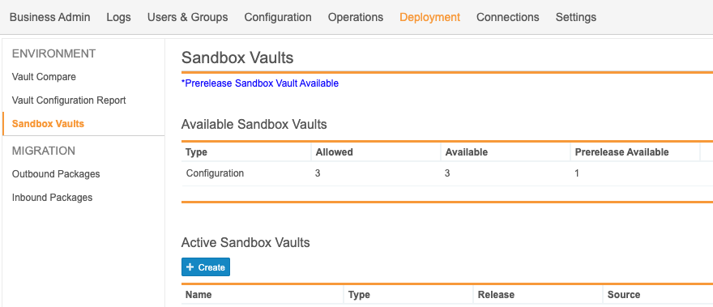
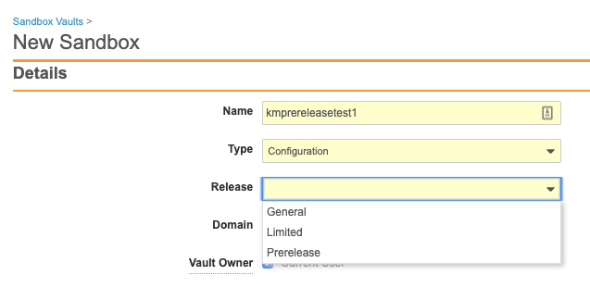
Pre-Release Environments

Slide 11
20R2 Go Live
All customers upgraded to 20R2
  Applies to Production, Test, and Sandbox Vaults
JULY
Friday 31
PODs VV1-8, VV1-1068,
VV1-1065, VV1-1088
Date | POD | Start Time | Duration
Jul 31 2020 | US POD VV1-1068 Sandbox POD | 12:00 pm PT | Up to 4 hours*
 | All PODs – Authentication service update | 6:00 pm PT | 1 hour
 | US PODs VV1-8, VV1-1065, VV1-1088 | 7:00 pm PT | Up to 4 hours*
AUGUST
Friday 7
Date | POD | Start Time | Duration
Aug 7 2020 | APAC POD VV3-3064 APAC & EU Sandbox PODs | 10:00 am PT | Up to 4 hours*
 | US Sandbox PODs | 2:00 pm PT | Up to 4 hours*
 | US PODs (except July 31st PODs) EU PODs APAC POD VV3-34 | 6:00 pm PT | Up to 4 hours*
All Other PODs
* On July 10 2020, http://trust.veeva.com will be updated with final downtime durations

Slide 12




20R2 Release Webinar Series
Product-specific webinars focused on the use cases and impact of key features
  All webinars are presented at multiple times
  One webinar per product set will be recorded and available after the series at:
  Help > Release Notes > About the 20R2 Release
Platform
Jul 8 at 3 PM EDT
Jul 9 at 9 AM EDT
Jul 14 at 12 PM EDT
QDocs, Station Mgr, Training
Jul 7 at 12 PM EDT
Jul 8 at 9 AM EDT
QMS
Jul 8 at 3 PM EDT
Jul 9 at 9 AM EDT
Jul 8 at 9 AM EDT
Jul 9 at 12 PM EDT
Jul 14 at 9 AM EDT
Jul 8 at 12 PM EDT
Jul 9 at 3 PM EDT
Jul 14 at 9 AM EDT
go.veeva.com/20R2_clinical
go.veeva.com/20R2_quality
go.veeva.com/20R2_rim
go.veeva.com/20R2_platform

Slide 13
Announcements

Slide 14
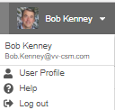
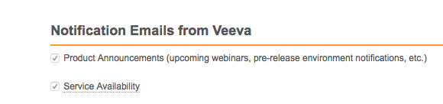
Notification Emails from Veeva
Opt-in to Product Announcements in User Profile to be contacted about:
  Initial release announcement (RIA)
  Release webinar invites
  Pre-release and validation document availability
  Go-live & key date reminders
Opt-in to Service Availability notifications in User Profile to be contacted about:
  Planned system maintenance
  Service disruptions

Slide 15



October 13–14, 2020
Develop new
industry partnerships
Share best practices
Network with
sponsors, CROs, & sites
CLINICAL
QUALITY & MANUFACTURING
REGULATORY
SAFETY
IT
Notes:
https://www.veeva.com/events/rd-summit/

Slide 16

Product Would Like to Know…..
Poll Question #1

Slide 17
Product would like to know…
Poll Question #1
What would you say is the biggest barrier to implementing a new feature? (multiple choice)
Creating a Business Case for Feature Adoption
Our validation process (e.g. is too complicated or resource heavy)
Change management with our end users
Collaboration between internal teams
Lack of knowledge in how to configure the feature
Lack of funds for services to help configure the feature
Other

Slide 18
QualityDocs Features

Slide 19

QualityDocs Release Themes & Features
QualityDocs + Applicable Platform
Document Collaboration | Document Control | Content & Renditions | User Experience | Workflow Processes | Reporting & Analytics
2
8
5
10
5
2
Notes:
Auto On + Config …
Document Collaboration: 2
Collaborative Authoring Alert Box for Documents Being Edited
Save Version to Vault Without Ending Collaboration Session
Document Control: 7
Archived Document Security Enhancements
Auto-Close Completed MDCCs
Full EDL Job Match
Include Purpose for eSignatures Cascaded from MDCCs to Docu
Synchronize MDCC & Document States
Atomic Security for Documents: Lifecycle User Actions
MDCC: Banner Visibility Update
Content & Renditions: 5
Auto-Place Brought Forward Image Annotations
Indicate When Annotations Hidden by Filters
Move Merge Anchors to Create Anchor Tool
Restore Resizing to Annotation Comments Field
XML Rendering
User Experience: 10
Add Change Type Action to Related Record
Add Copy Record Action to Related Record
CJK Optimized Record Search
Constrain Object Reference Search
Default Search Context
Enhanced Document Number & ID Search
Minimum Match Logic Strict Matching
Sharing Settings UI Enhancements for Objects
Unified Navigation Behavior when Clicking Object References
Vault File Manager Check In & Check Out Enhancements
Workflow Processes: 5
Atomic Security for Documents Active Workflow Actions
Auto-Number Envelope Record for Multi-Document Workflow
Multi-Document Workflow Execute Entry Action & Entry Criteria When Canceling Workflows or Removing Documents
Support Priority Multi-Document Workflow Fields in Reports
Variables for Multi-Document & Object Workflows
Reporting & Analytics
Include Prompts with Filters in Report Builder
Or Filter Logic

Slide 20

QualityDocs Key Takeaways
Synchronize MDCC & Document States
Auto-Close Completed MDCCs
Include Purpose for eSignatures Cascaded
from MDCCs to Documents
Save Version to Vault Without Ending Collaboration Session
Enhanced Document Number
Pattern Search
Reports
Or Filter Logic

Slide 21
Feature Personas
Viewer
Admin
Power User
Developer
Viewers access approved docs and records
Power Users manage docs and records
through their lifecycles
using application-specific business processes
Business and System Admins maintain data,
security, and configurations
Developers build
data models, business process configurations,
system integrations, and data migrations

Slide 22

Feature Enablement Detail
Auto-On Features
Configurable Features
Auto-On
Admin Checkbox
Configuration
Support
Turned On Day 1
Automatically available, some setup may be required
Turned Off
Requires enablement
Turned Off
Requires enablement
Requires
configuration
Turned Off
Requires enablement
Product Support Request

Slide 23
Impact Assessment
Auto-On Features
QualityDocs + Applicable Platform
System
Admin
25
19
Auto-On
High: 1
Med: 3
Low: 11
NA: 10
High: 0
Med: 6
Low: 6
NA: 7
Turned On Day 1
Automatically available, some setup may be required

Slide 24
Document Collaboration

Slide 25

Save Version to Vault Without Ending Collaboration Session
Automatic
Overview
  This feature saves the latest file changes to Vault as a new minor version, but without ending the collaboration session
  Any user with Edit Document permission can use Save to Vault
  The user that checked out the document and started the collaboration session can use Save to Vault or Check In
Business Justification
  Periodically save changes to Vault during a collaboration process, instead of waiting until collaboration is finished
Considerations
  Cancel Checkout does not rollback / delete versions created by Save to Vault
  The Save to Vault option is now available in the Action menu of the document
  Save to Vault does not automatically bring forward annotations to the new document version
  Collaborators are now notified that a collaboration session has ended when the document is checked in
Setup by:
N/A
for use by:
Power User
Feature Risk
MEDIUM
Default Impact
VISIBLE TO ALL USERS
Notes:
Note: Does a collaborator see that another collaborator Saved to Vault and created a new version while they are in their editing application? No
If a document is being edited by 3 users, and user #2 saves to Vault, are the changes from user 1 and 3 also saved to Vault? Yes, Save to Vault uploads all changes in the file.

Slide 26
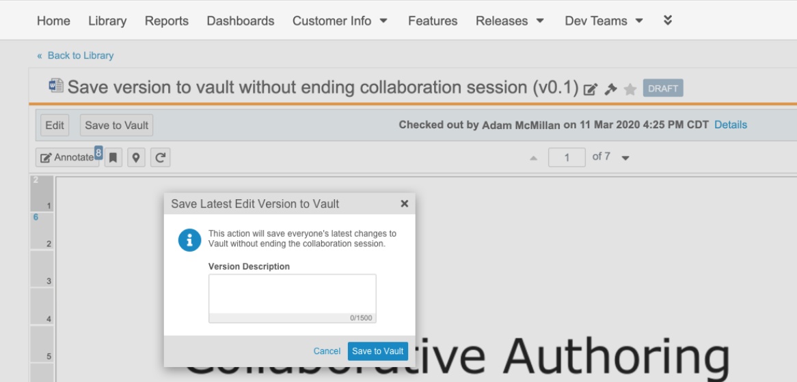
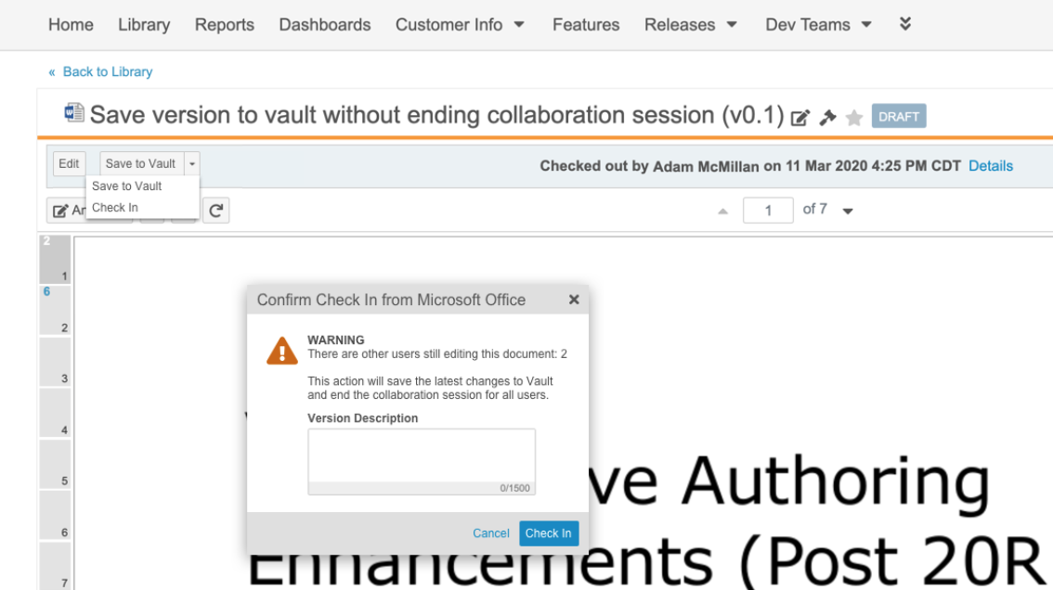
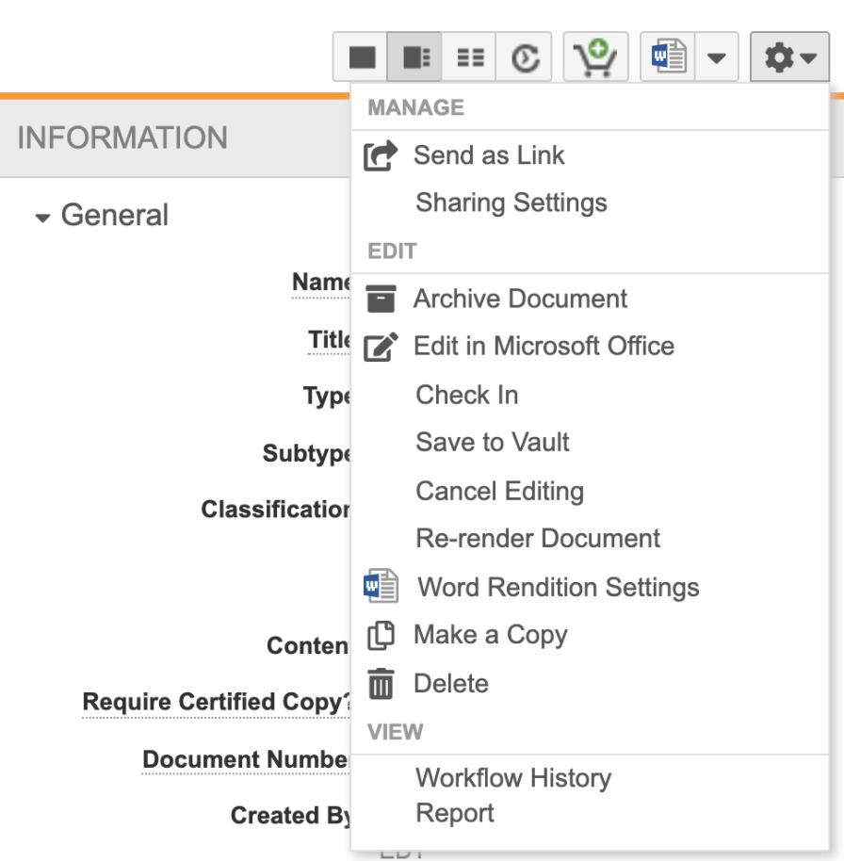
Save Version to Vault Without Ending Collaboration Session
Automatic
Collaborator
Collaborator that Started Collaboration Session
Setup by:
N/A
for use by:
Power User
Feature Risk
MEDIUM
Default Impact
VISIBLE TO ALL USERS
Notes:
Note: Does a collaborator see that another collaborator Saved to Vault and created a new version while they are in their editing application? No
If a document is being edited by 3 users, and user #2 saves to Vault, are the changes from user 1 and 3 also saved to Vault? Yes, Save to Vault uploads all changes in the file.

Slide 27
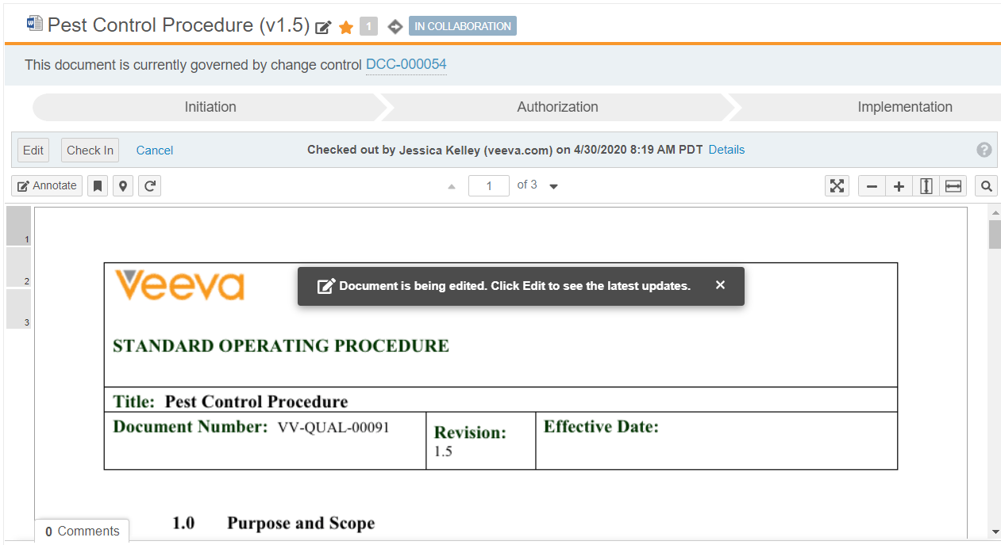
Collaborative Authoring – Alert Box for Documents Being Edited
Automatic
Overview
  Users are able to see when a document is currently being edited
Business Justification
  Users need to be aware that the content they see in the Vault viewer may not include the latest updates
Setup by:
N/A
for use by:
Power User
Feature Risk
N/A
Default Impact
VISIBLE TO ALL USERS

Slide 28
Demo
DEMO

Slide 29
Product Would Like to Know…..
Poll Question #2

Slide 30
Product would like to know…
Poll Question #2
At what stage is your company at with the adoption of Collaborative Authoring with Microsoft Office? ( Single Choice)
Answer 1: Feasibility Assessment - (technical requirements)
Answer 2: Business Assessment - (business process alignment)
Answer 3: Configured in Sandbox - (user testing)
Answer 4: Live in Production
Answer 5: Not considering Collaborative Authoring at this time
Answer 6: I don't know

Slide 31
Document Control

Slide 32

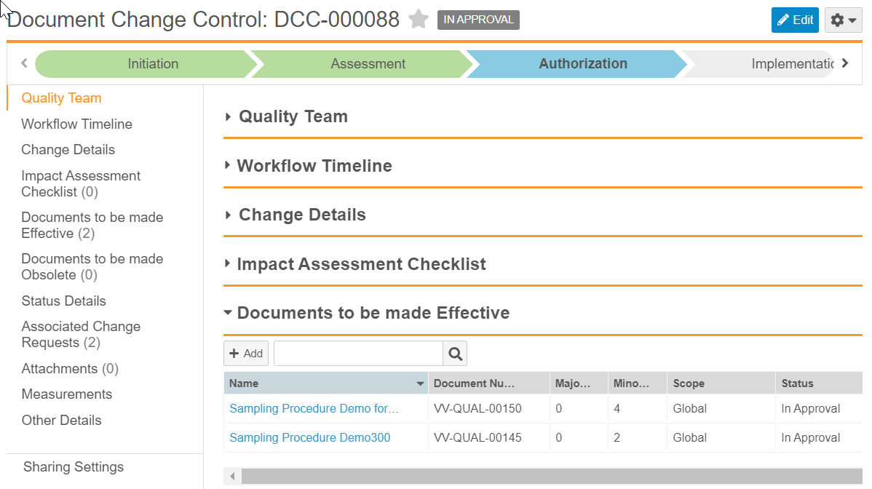
Synchronize MDCC & Document States
Configurable
Overview
  Admins can now configure Multi-document Change Control to synchronize key states on the MDCC lifecycle with key states on the lifecycle of Documents to be Made Effective
Business Justification
  Improved compliance by controlling access to Documents to be Made Effective during the Multi-document Change Control approval process
Setup by:
Admin
for use by:
Power User
Considerations
  Synchronize the following three states between Multi-document Change Control (DCC) and Draft to Effective (DtoE) documents:
  When DCC is In Approval, DtoE docs move to lifecycle’s In Change Control Approval State (i.e. In Approval)
  When DCC is Approved, DtoE docs move to lifecycle’s Change Control Approved State (i.e. Approved)
  If DCC Approval is Rejected and returns to Open, DtoE docs move to lifecycle’s Pending Change Control Approval State (i.e. Reviewed or Ready for Approval)
Feature Risk
HIGH
Default Impact
VISIBLE TO ADMINS ONLY

Slide 33
Auto-Close Completed MDCCs
Configurable
Overview
  Admins can configure a new document lifecycle state Entry Action to automatically transition Multi-Document Change Control (MDCC) records to a Closed state type when all:
  Documents to be made Effective reach the Steady State (i.e. Effective)
  and
  Documents to be made Obsolete reach the Obsolete State (i.e. Obsolete)
Setup by:
Admin
for use by:
Power User
Business Justification
  Reduces manual work involved in monitoring and closing MDCC records
Considerations
  If Auto-Close fails to change a DCC’s state to Closed, details about the failure appear in the Closure System Details field on the DCC record
    Suggest creating a Flash Report to detect these cases so Document Control can manually close the DCCs
  Suggest restricting the manual state change on DCC from Approved to Closed to Document Control in case Auto-Close fails, and someone needs to manually close the DCC
Feature Risk
HIGH
Default Impact
VISIBLE TO ADMINS ONLY
Notes:
The Closed State Type on the Draft to Effective lifecycle will be set to Closed in the 20R2 release for call customer Vaults.
Logging for the Close Document Change Control job includes information about the document version whose state transition started the job.

Slide 34
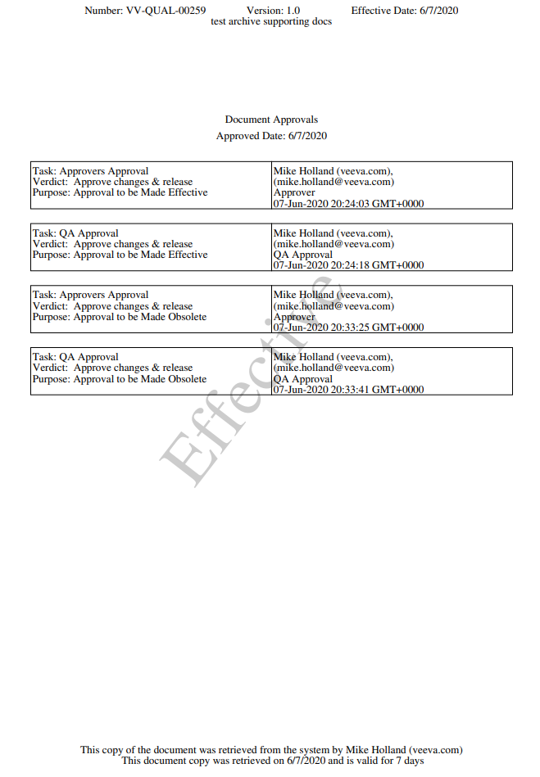
Include Purpose for eSignatures Cascaded from MDCCs to Documents
Configurable
Overview
  It’s now possible to include purposes for cascading eSignatures from Document Change Controls to Documents to be made Effective and Obsolete.
Business Justification
  On the signatures page, users will now be able to differentiate between eSignatures for release and eSignatures for obsolescence.
  This ensures that if a user approves the release of a document, then later approves the obsolescence of that same version, this activity is recorded as two separate signatures.
Considerations
  This must be configured on both the MDCC Approval Workflow and the Document Signature Page.
  Once configured, this will be applied to newly generated document signature pages - document signature pages that exist before the configuration change are not affected
Setup by:
Admin
for use by:
Power User
Feature Risk
HIGH
Default Impact
VISIBLE TO ADMINS ONLY

Slide 35

Atomic Security for Documents: Lifecycle User Actions
Support
Overview
  Admins can configure which user roles (i.e. Owner, Editor, Document Control, etc. ) have permission to perform specific lifecycle User Actions like changing document state, and starting a workflow
Business Justification
  Previously, a user role had permission to start ALL workflows, or perform ALL state changes from a particular document state
  e.g. if a document’s Draft state includes a User Action to start a Review workflow and an Approval workflow, it was not possible to limit the Owner role to just the Review workflow
Considerations
  Upon enabling this feature, there should be no changes to user access in your Vault - refer to the following Vault Help link for more information
  http://vaulthelp2.vod309.com/wordpress/rn/limited-release/releasenotes-ft/new-in-20r14/#atomic_security_for_documents_lifecycle_user_actions
  In Vault Quality, the Distribute Controlled Copy User Action does not support Atomic Security, so access to this User Action will continue to be governed by the Distribute Controlled Copies permission
Setup by:
Admin
for use by:
Power User
Feature Risk
HIGH
Default Impact
NONE

Slide 36
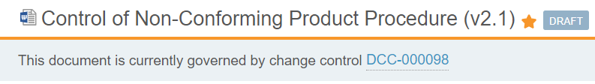
MDCC: Banner Visibility Update
Automatic
Overview
  Starting with 20R2, the MDCC banner will only appear on a document to be made Effective or a document to be made Obsolete when the document has an active DCC, and the user has at least one of the following permissions on the document
  Edit Document
  Edit Fields
  Annotate
  Version
  Prior to 20R2, users with Start Workflow or Change State also saw the MDCC banner, but this will no longer be the case
Business Justification
  This change accommodates the new Atomic Security model for documents – Atomic Security for documents is enabled by Support
Considerations
  Contact your Managed Services Consultant or CSM to help determine which user roles may no longer see an MDCC banner on specific document states
Setup by:
N/A
for use by:
Power User
Feature Risk
N/A
Default Impact
VISIBLE TO ALL USERS

Slide 37
Demo
DEMO

Slide 38
Additional Document Control Features
Feature | Business Justification | Enablement
Archived Document Security Enhancements | Documents should be immutable once they are archived with limited user access | Auto-On (for Vaults where Archiving is enabled)
Full EDL Job Match | Make the EDL job more scalable to support more complex EDL Items usage scenarios | Auto-On (for Vaults where EDLs are configured)
EDL Item Upload Visibility Update | Make the permission checks for the Upload to EDL Item action consistent with other permission checks across the system | Auto-On (for Vaults where EDLs are configured)

Slide 39
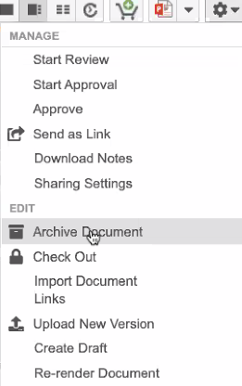
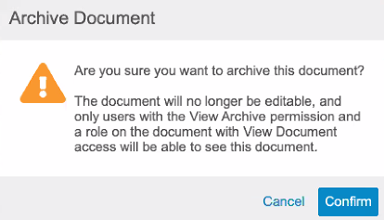
Archived Document Security Enhancements
Automatic
Overview
  No user will be able to edit fields or relationships for archived documents and most actions are prohibited including checking out and starting workflows
  Users require the new “View Archive” access in their Permission Set, and “View Document” access via a lifecycle role/status, in order to view the archived document
  “Manage Archive” permission allows the user to archive and unarchive documents – this can now be done from the action menu
Business Justification
  Documents should be immutable once they are archived with limited user access
Considerations
  Migration Mode allows some field edits to be made
  All users will receive “View Archive” permission - the 20R2 upgrade will grant “View Archive” to all custom Permission Sets
Setup by:
N/A
for use by:
Power User
Feature Risk
HIGH
Default Impact
VISIBLE TO ALL USERS
Notes:
* View Archive granted to all permission sets except the standard Business Administrator Actions, External User Actions, and Read Only User Actions permission sets

Slide 40


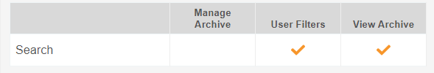
Archived Document Security Enhancements
Automatic
Considerations (continued)
  Access to the Archive Tab is now solely based on having access to that tab in the Permission Set. In order for a user to see the Archive tab, a user’s Permission Set must …
  grant View access to the Archive tab
  and
  provide View Archive permission
  Once documents are archived, Vault prevents users from taking the following actions:
Setup by:
N/A
for use by:
Power User
Editing Fields or Checking out Documents | Starting a workflow and executing a user action
Adding or removing relationships and attachments | Adding/editing/removing annotations
Deleting the document or document versions (without Power Delete permission) | Creating new Draft documents or uploading new document versions
Feature Risk
HIGH
Default Impact
VISIBLE TO ALL USERS

Slide 41
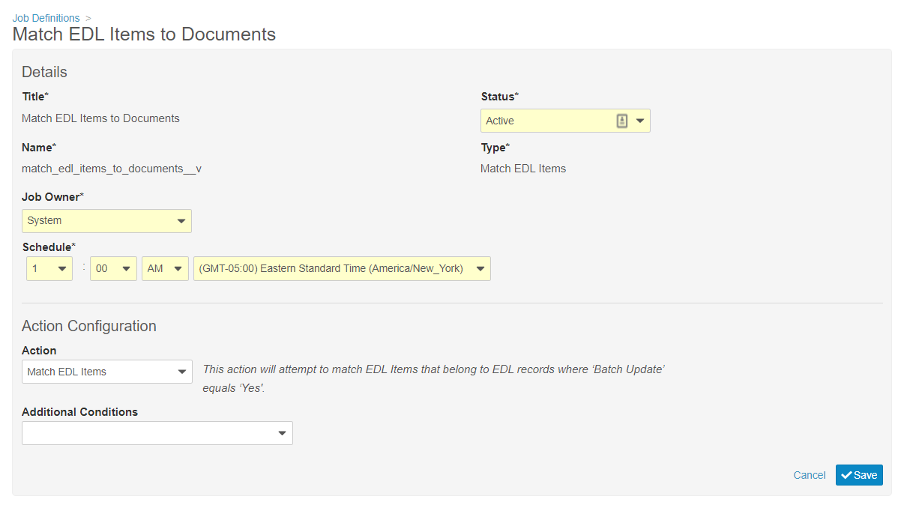
Full Match EDL Items to Documents
Automatic
Overview
  With this release the Match EDL Job used to match documents to the Expected Document Lists (EDLs) is optimized to run more efficiently
  The first time the job runs after the Vault release, it will evaluate every document in the customer’s Vault for matching against active EDL Item records
  It is possible that Vault will match or unmatch older EDL Items to Documents as the job was doing only incremental updates prior to this release
Business Justification
  Make the EDL job more scalable to support more complex EDL Items usage scenarios
Setup by:
N/A
for use by:
Power User
Feature Risk
N/A
Default Impact
VISIBLE TO ALL USERS

Slide 42
EDL Item Upload Visibility Update
Automatic
Overview
  To access the Upload action on EDL Item records, Vault now requires users to have Edit permission on the EDL Item object, and if Sharing Settings are enabled, the user must also be in an Editor role
Business Justification
  This feature makes the permission checks for the Upload to EDL Item action consistent with other permission checks across the system
Feature Risk
N/A
Default Impact
VISIBLE TO ALL USERS

Slide 43
Content & Renditions

Slide 44
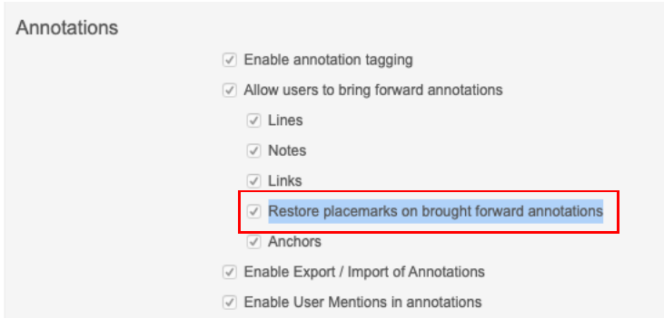
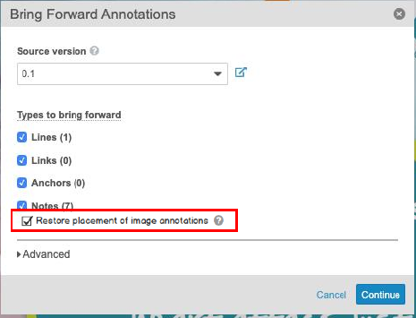
Auto-Place Brought Image Forward Annotations
Automatic
Overview
  Brought forward annotations on images and text are automatically placed based on the page and coordinates in the source version
  If the coordinates or page do not exist in the new version, Vault places the annotations at the page level
Business Justification
  Applies to all non-text annotations: Image, Sticky, Line, Link and Anchor
Considerations
  Dependent on existing flag: “Restore placemarks on brought forward annotations”
  User can opt out at runtime (Default: On)
Setup by:
N/A
for use by:
Power User
Feature Risk
LOW
Default Impact
VISIBLE TO ALL USERS
Admin Setting
User Option

Slide 45
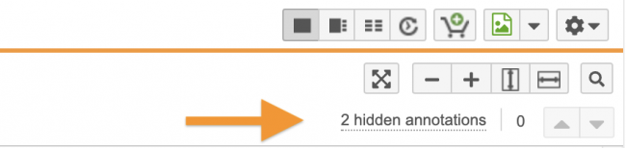
Indicate When Annotations Hidden by Filters
Automatic
Overview
  When a user views a document with annotations that are hidden, either by Annotate filter settings or by the Hide button on Info Card, Vault displays an alert message to the user which includes a count of the currently hidden annotations
Business Justification
  This brings awareness to the user that some annotations are hidden
Considerations
  This count is limited to 99, and updates whenever annotations are created, hidden, un-hidden or deleted
Setup by:
N/A
for use by:
Power User
Feature Risk
LOW
Default Impact
VISIBLE TO ALL USERS

Slide 46
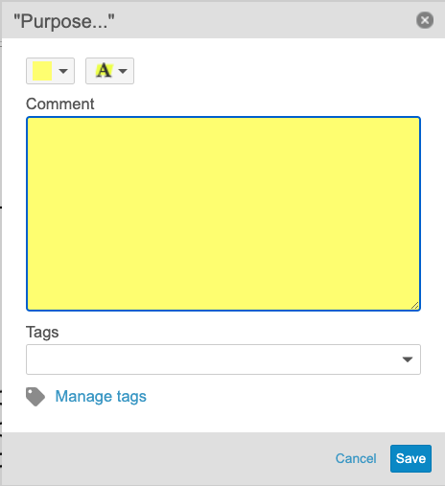
Restore Resizing to Annotation Comments Field
Automatic
Overview
  Users can resize the Comment field vertically to make it taller or shorter
  The entire dialog increases to accommodate the size of the Comment field.
Business Justification
  Allows users to view significantly more entered text all at once
Considerations
  Users cannot make the Comment field wider
Setup by:
N/A
for use by:
Power User
Feature Risk
N/A
Default Impact
VISIBLE TO ALL USERS

Slide 47
Additional Content & Renditions Features
Feature | Business Justification | Enablement
XML Rendering | Enable customers to review and annotate XML files within Vault | Auto-On
Move Merge Anchors to Create Anchor Tool | Associating Merge Anchors with the Create Anchor tool is more intuitive. Also, the user is not required to have additional permissions. | Auto-On

Slide 48
XML Rendering
Automatic
Overview
  This features provides the ability to generate a viewable rendition for XML files
  XML files are rendered in text format
Business Justification
  Enable customers to review and annotate XML files within Vault
Setup by:
N/A
for use by:
Viewer
Feature Risk
MEDIUM
Default Impact
VISIBLE TO ALL USERS

Slide 49
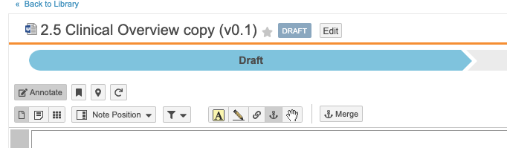
Move Merge Anchors to Create Anchor Tool
Automatic
Overview
  Prior to this release, the Merge Anchors action appeared when the Link tool was selected. With this enhancement, the Merge Anchors action appears when the Create Anchor tool is selected
  The Merge Anchors action no longer requires Edit Relationships permission
Setup by:
N/A
for use by:
Power User
Business Justification
  Associating Merge Anchors with the Create Anchor tool is more intuitive. Also, the user is not required to have additional permissions
Considerations
  In order to Merge Anchors users must have the following permissions:
  Security Profile permission: Merge Anchors
  Document Role permission: Annotate
  Document Role permission: Create Anchors
Feature Risk
N/A
Default Impact
VISIBLE TO ALL USERS

Slide 50
User Experience

Slide 51
Vault File Manager: Check In & Check Out Enhancements
Automatic
Overview
  Vault no longer opens a new browser tab when a user checks out a single document to Vault File Manager, or when a user checks in a single document from Vault File Manager
Business Justification
  Eliminates the side effect of many open browser tabs after check out / check in operations
Considerations
  Automatic refresh of the document in the browser after check in will be provided in a future release
Setup by:
N/A
for use by:
Power User
Feature Risk
NA
Default Impact
VISIBLE TO ALL USERS

Slide 52
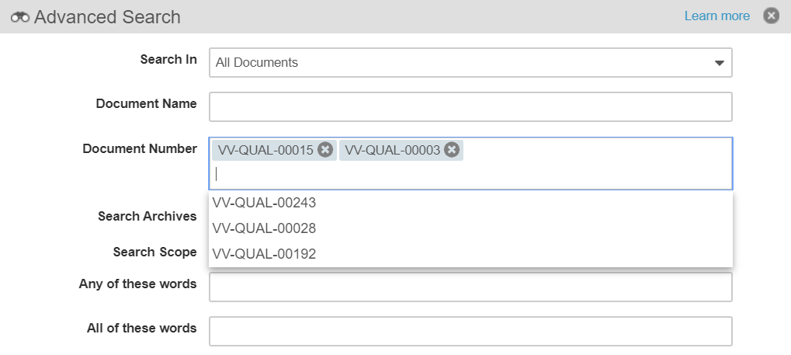
Enhanced Document Number & ID
Pattern Search
Automatic
Overview
  Users can search for documents using the beginning, middle, or end of a Document Number
To find document VV-123-DEF, use any of the following:
VV-123-DEF
VV123DEF
VV123
123DEF
123-DEF
VV.123.DEF
Setup by:
N/A
for use by:
Viewer
  Advanced Search now supports multiple Document Numbers
Feature Risk
LOW
Business Justification
  Find documents more easily using Document Number, Alphanumeric, or ID Pattern searches
Default Impact
VISIBLE TO ALL USERS

Slide 53
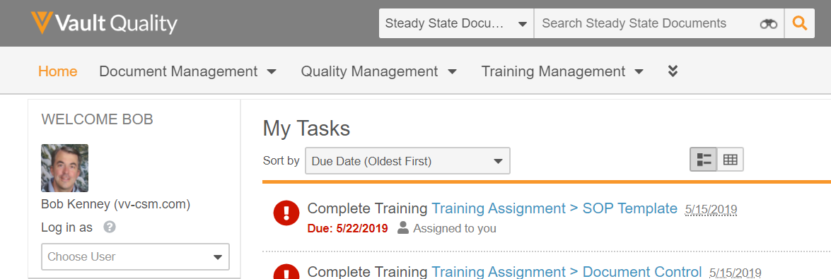
Default Search Context
Configurable
Overview
  Administrators can now configure any document tab or object tab to be the default search context
  The default search context is applicable when a user is on a tab that is not searchable: Home, Dashboards, or a web tab
Setup by:
N/A
for use by:
Viewer
Business Justification
  Many customers want to steer users to a steady state document tab when searching documents to prevent users from mistakenly performing processes using in-progress versions
  When users login for the first time, or navigates to a tab that is not searchable (i.e. Home or Dashboards), the Search box context defaults to All Documents
  This behavior could steer a user toward mistakenly using an in-progress version of a document
Considerations
  The default search context is set to the document Library tab by default
Feature Risk
LOW
Default Impact
VISIBLE TO ADMINS ONLY

Slide 54
Minimum Match Logic: Strict Matching
Automatic
Overview
  When searching with documents or records with multiple search terms, strict matching will require most of the user's search terms to match
  Searches with two terms require all terms to match
  Searches with three or four terms require all but one term to match
  Searches with five or more terms require all but two terms to match
  e.g. a search for “FDA Submission” no longer returns results such as “Submission Planning Meeting Minutes” since the term “FDA” would not match.
Business Justification
  Return fewer, more relevant results as the number of search terms increase
Considerations
  This feature is auto-on, but can be turned off with an Admin checkbox in Search Settings
Setup by:
N/A
for use by:
Viewer
Feature Risk
LOW
Default Impact
VISIBLE TO ALL USERS

Slide 55
CJK Optimized Record Search
Support
Overview
  This feature provides a CJK Optimized setting for Vaults to improve findability of object records when:
  most object records in the Vault use Chinese, Japanese, or Korean text
  many users search using Chinese, Japanese, or Korean
  the Vault Language is any non-CJK language (typically English)
Business Justification
  When this setting is enabled, Vault will split all CJK phrases into tokens on object record text, picklist, and object reference fields so that field values are easier to find when users perform searches
Considerations
  Enabling this option means Vault searches are no longer optimized for the Vault Language (typically English)
  e.g. A Vault whose Vault Language is English, and enables the CJK Optimized setting, will no longer use English Stemming or split words on case changes
Setup by:
Admin
for use by:
Viewer
Feature Risk
N/A
Default Impact
NONE

Slide 56
Additional User Experience Features
Feature | Business Justification | Enablement
Sharing Settings UI Enhancements for Objects | Provides improved usability and consistency with Document Sharing Setting UI | Auto-On
Unified Navigation Behavior when Clicking Object References in Document Fields | Previously, clicking on an object record in a document field took the user to one of the following based on the user’s access: a custom tab, the business admin page, or the record’s detail page This feature makes Vault’s behavior more consistent | Auto-On
Add Copy Record Action to Related Record | This will streamline the copy process of a related object record as the user can stay on the object record details page when copying a related object record | Auto-On
Add Change Type Action to Related Record | This will streamline the management and correction of related records within the same page layout | Auto-On
Constrain Object Reference Search | The filter values returned in this search box will now always match at least one record or document preventing users from selecting values that are not applicable | Auto-On

Slide 57
Sharing Settings UI Enhancements for Objects
Automatic
Overview
  Redesigned UI provides one sortable table regardless of assignment types (manual, custom, matching sharing rules)
  Searching for user access now returns both direct user role assignments and role assignments through groups
Business Justification
  Provides improved usability and consistency with Document Sharing Setting UI
Setup by:
N/A
for use by:
Power User
Feature Risk
N/A
Default Impact
VISIBLE TO ALL USERS

Slide 58
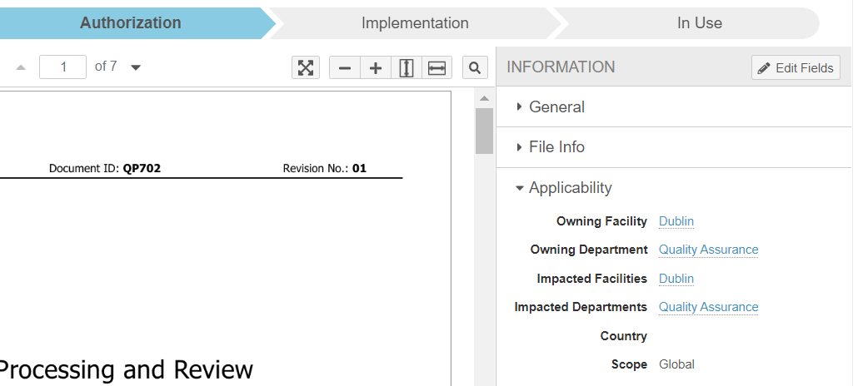
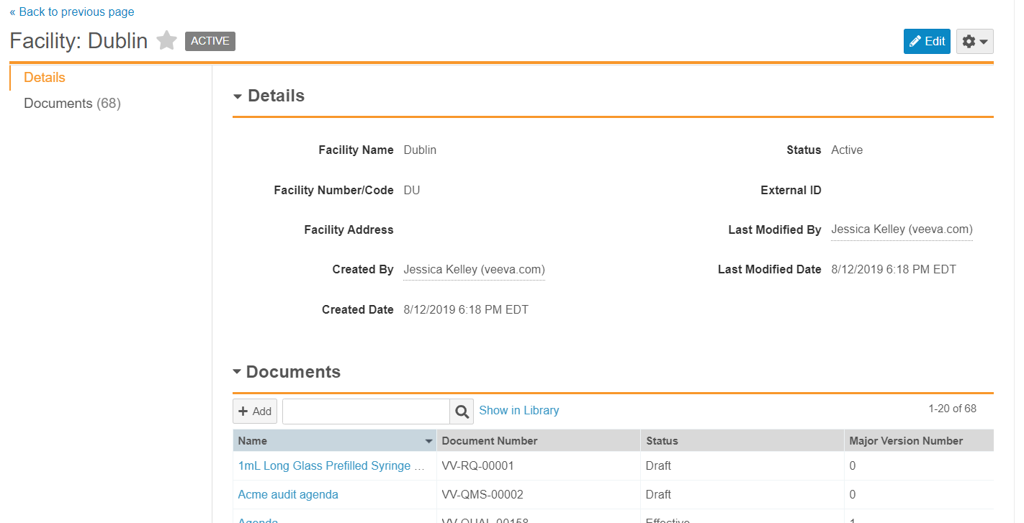
Unified Navigation Behavior when Clicking Object References in Document Fields
Automatic
Overview
  When a user clicks an object record in a document field, Vault always takes the user to the record’s detail page
Business Justification
  Previously, clicking on an object record in a document field took the user to one of the following based on the user’s access: a custom tab, the business admin page, or the record’s detail page
  This feature makes Vault’s behavior more consistent
Setup by:
N/A
for use by:
Viewer
click
click
Feature Risk
N/A
Default Impact
VISIBLE TO ALL USERS

Slide 59
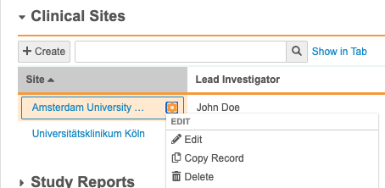
Add Copy Record Action to Related Record
Automatic
Overview
  This feature allows users to copy a related object record directly from the Actions menu within related record sections on an object record details page
Business Justification
  This will streamline the copy process of a related object record as the user can stay on the object record details page when copying a related object record
Setup by:
N/A
for use by:
Viewer
Considerations
  User needs permission on the related object to be able to copy the record
  Copy Record is available for all types of related lists except simple many-to-many related lists
Feature Risk
LOW
Default Impact
VISIBLE TO ALL USERS

Slide 60
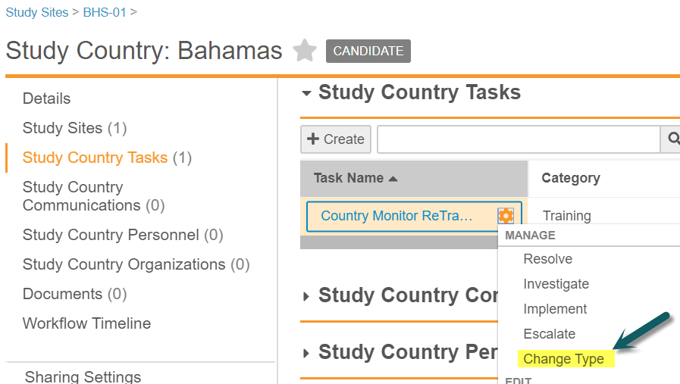
Add Change Type Action to Related Record
Automatic
Overview
  This feature allows users to change the object type of related object records using the Actions menu within related record sections on an object record details page
Business Justification
  This will streamline the management and correction of related records within the same page layout
Considerations
  Requires the related object has more than 1 object type, and the user has edit permissions on the related object
Setup by:
N/A
for use by:
Viewer
Feature Risk
LOW
Default Impact
VISIBLE TO ALL USERS

Slide 61
Constrain Object Reference Search
Automatic
Overview
  For filters on object reference fields, the system now constrains the values that can be found through the search box to only those that are included on the documents or records returned in the search results
Business Justification
  The filter values returned in this search box will now always match at least one record or document preventing users from selecting values that are not applicable
Considerations
  This feature only applies to the search box that appears when an object reference field contains more than 15 filter values
Setup by:
N/A
for use by:
Viewer
Feature Risk
LOW
Default Impact
VISIBLE TO ALL USERS

Slide 62
Product Would Like to Know…..
Poll Question #3

Slide 63
Product would like to know…
Poll Question #3
Does your company use a Manufacturing Execution System (MES)? ( Single Choice)
Answer 1: Yes, in all facilities
Answer 2: Yes, in some facilities
Answer 3: No, but we plan to implement MES in the 2 years
Answer 4: No, we have no plans to implement MES
Answer 5: Not applicable

Slide 64
Product Would Like to Know…..
Poll Question #4

Slide 65
Product would like to know…
Poll Question #4
Does your company use a Lab Information Management System (LIMS)? ( Single Choice)
Answer 1: Yes, in all facilities
Answer 2: Yes, in some facilities
Answer 3: No, but we plan to implement LIMS in the 2 years
Answer 4: No, we have no plans to implement LIMS
Answer 5: Not applicable

Slide 66
Workflow Processes

Slide 67
Document Lifecycle Atomic Security: Active Workflow Actions
Support
Overview
  Admins can configure which roles (i.e. Owner, Editor, Document Control, etc.) have permission to perform the following “active workflow actions” based on document status (i.e. In Edit, In Review, In Approval, Effective, etc.)
  Cancel Workflow
  Add Participants
  Reassign Task
  Cancel Task
  Remove Document from a Multi-Document Workflow
Business Justification
  Provides greater control over which roles can administer active workflow tasks for documents
  e.g. Prior to this release, if a user’s Profile/Permission set allowed Cancel Workflow, that user could cancel any document workflow
Considerations
  When enabled, the Workflow Initiator / Workflow Owner no longer receives automatic access to these actions
  Admins will need to ensure that users who start workflows are in document roles with access to perform these actions as needed
Setup by:
Admin
for use by:
Power User
Feature Risk
HIGH
Default Impact
NONE

Slide 68
QualityDocs and Multi-Document Routing
Multi-Document
Change Control (MDCC)
routes documents connected by a common governing change, and a common set of approvers
Contact your CSM
to discuss how
MDCC and MDW
can help your business
increase process efficiency
Routing multiple documents reduces the effort of routing each individually
Multi-Document
Workflow (MDW)
routes documents connected by a common set of authors or reviewers

Slide 69
Multi-Document Workflow (MDW) Features
Feature | Business Justification | Enablement
Variables for Multi-Document and Object Workflows | Workflow “variables” allow business process variations to be accommodated in a single workflow, rather than configuring multiple workflows | Configurable
Support Priority Multi-Document Workflow Fields in Reports | The Multi-Document Workflow can be configured to accept a comment and reason for the verdicts that a user provides but until now, it was not possible to include this information in a workflow report | Auto-On
Auto-Number Envelope Record for Multi-Document Workflow | This feature ensures efficiency, uniqueness and consistency of envelope names. As a result this can reduce training overhead. | Support
Multi-Document Workflow: Execute Entry Action & Entry Criteria When Canceling Workflows or Removing Documents | Help customers who would like to capture information like workflow cancellation date, or reset values that were set during the workflow process | Auto-On

Slide 70
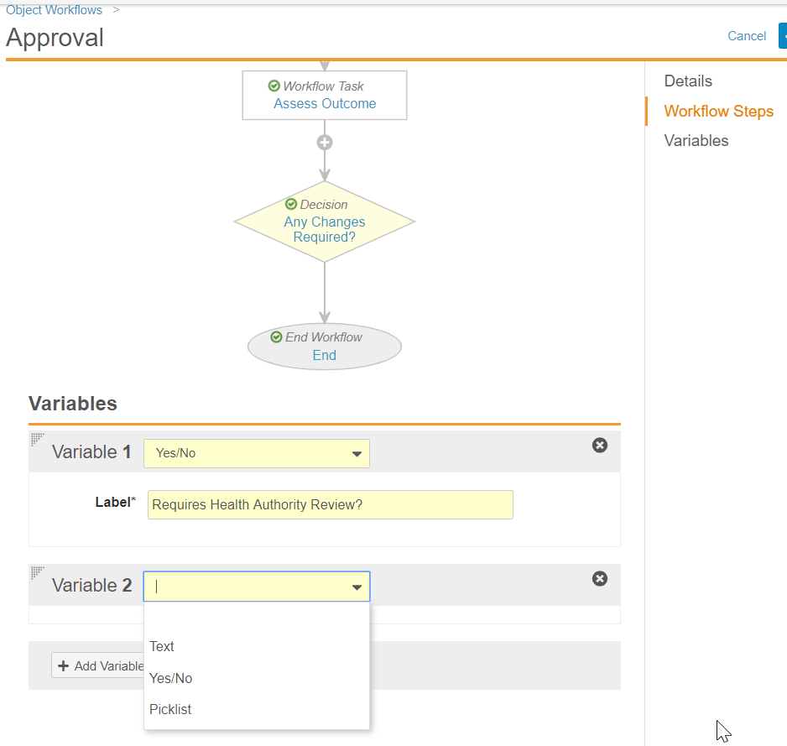
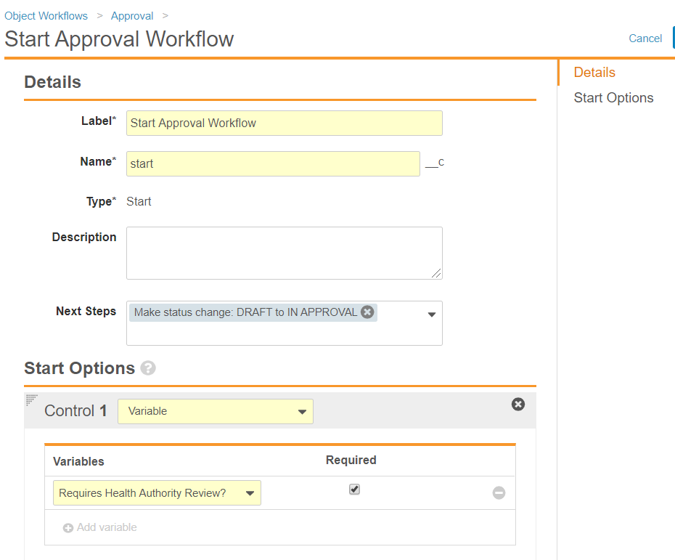
Variables for Multi-Document and Object Workflows
Configurable
Overview
  Admins can configure a workflow to prompt a workflow initiator for a value to be assigned to a “variable”
  The value of a workflow “variable” can be used to determine which path a workflow follows
Business Justification
  Workflow “variables” allow business process variations to be accommodated in a single workflow, rather than configuring multiple workflows
Considerations
  Available in Multi-Document and Object workflows
  Workflow “variables” are currently limited to text, yes/no, or picklist field types
  A workflow “variable” value must be assigned when the workflow is initiated
1
Setup by:
Admin
for use by:
Power User
2
Feature Risk
MEDIUM
Default Impact
VISIBLE TO ADMINS ONLY

Slide 71
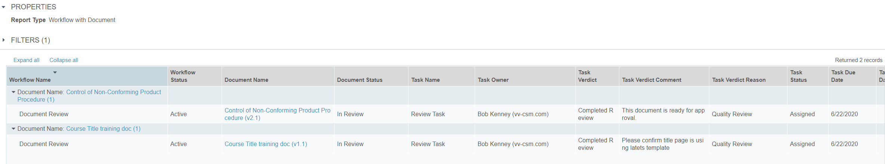
Support Priority Multi-Document Workflow Fields in Reports
Automatic
Overview
  Task Verdict Comment and Task Verdict Reason fields for Multi-Document Workflows can be included in Workflow with Document Reports
Business Justification
  The Multi-Document Workflow can be configured to accept a comment and reason for the verdicts that a user provides but until now, it was not possible to include this information in a workflow report
Setup by:
N/A
for use by:
Viewer
Feature Risk
LOW
Default Impact
VISIBLE TO ALL USERS

Slide 72
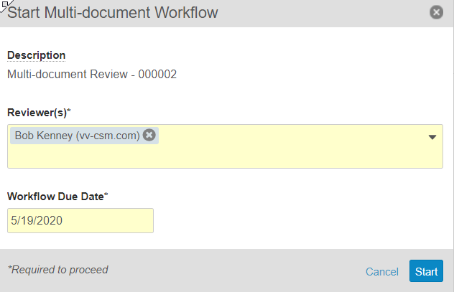
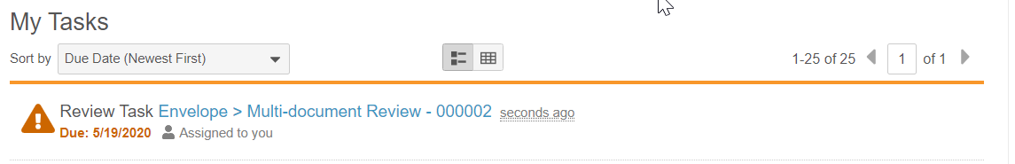
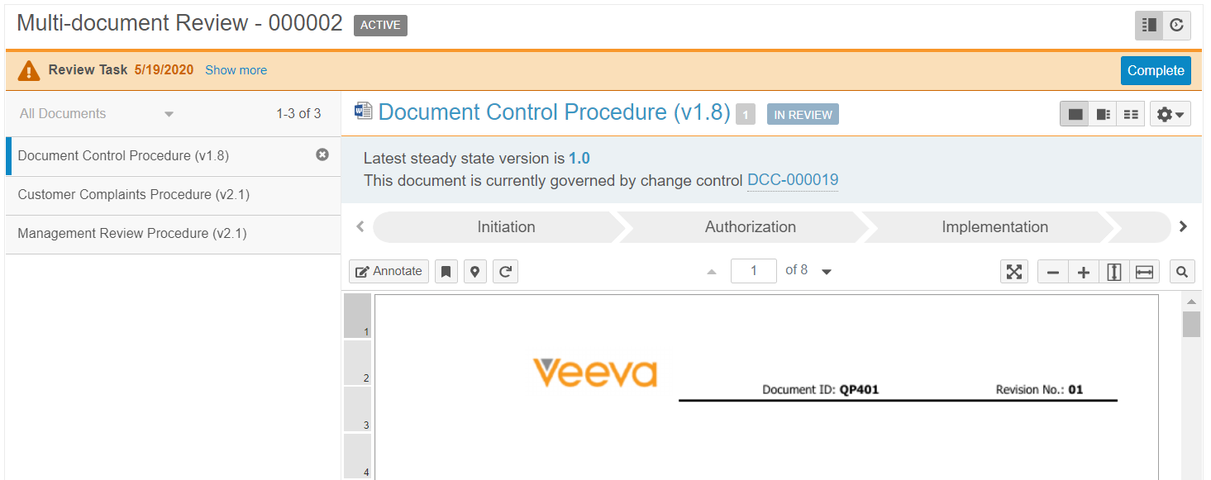
Auto-Number Envelope Record for
Multi-Document Workflow
Support
Overview
  Admins can now configure a multi-document workflow to automatically generate the name for the Envelope record.
  The name can consist or any string and a token for a unique number.
  If enabled the workflow name is read-only in the start dialogue.
Business Justification
  This feature ensures efficiency, uniqueness and consistency of envelope names.
  As a result this can reduce training overhead
Considerations
  It’s recommend using the term ‘multi-document’ in the name to differentiate from single document tasks.
Setup by:
Admin
for use by:
Power User
Feature Risk
MEDIUM
Default Impact
NONE

Slide 73
Multi-Document Workflow: Execute Entry Action & Entry Criteria When Canceling Workflows or Removing Documents
Automatic
Overview
  Vault now executes Entry Actions and Entry Criteria for the Cancel Workflow State when a user …
  Cancels a multi-document workflow
  Removes a document from a multi-document workflow
Business Justification
  Help customers who would like to capture information like workflow cancellation date, or reset values that were set during the workflow process
Considerations
  When users cancel a multi-document workflow, Vault moves the documents to the configured Cancel Workflow State
  Administrators can configure the Cancel Workflow State to be
  the “state in which the workflow started”, or
  a specific state in a document lifecycle, or
  no state change
Setup by:
N/A
for use by:
Power User
Feature Risk
MEDIUM
Default Impact
VISIBLE TO ALL USERS

Slide 74
Reporting & Analytics

Slide 75
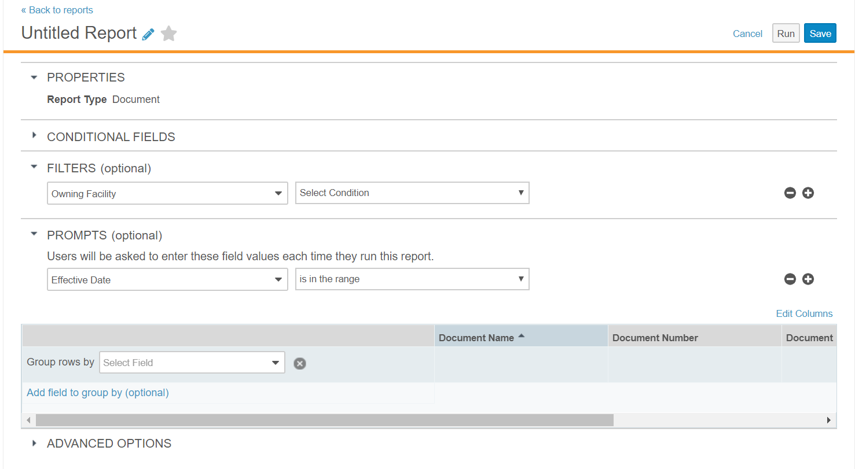
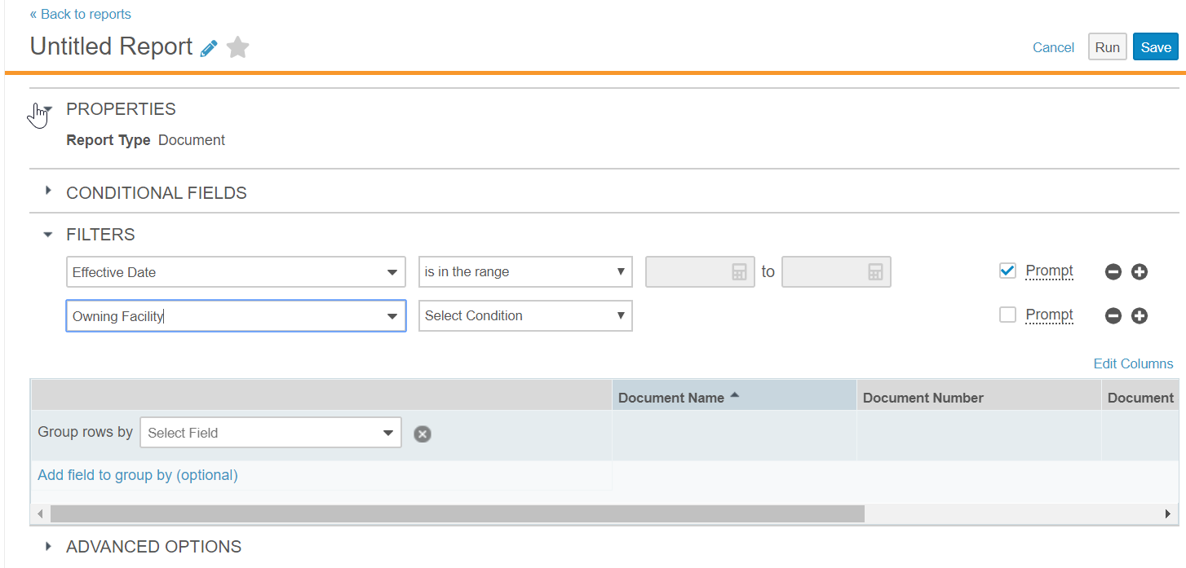
Include Prompts with Filters in Report Builder
Automatic
Overview
  The option that prompts a user for information when running a report has been moved
Business Justification
  Users building reports can define all filters in one location
Considerations
  Existing reports containing prompts will be automatically updated by the 20R2 upgrade
Setup by:
N/A
for use by:
Power User
Before 20R2
Separate section for filters with runtime prompts
After 20R2
One section for all filters with checkbox for runtime prompt
Feature Risk
LOW
Default Impact
VISIBLE TO ALL USERS

Slide 76
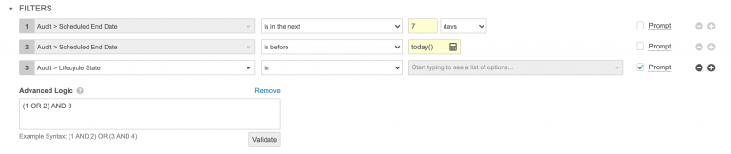
Or Filter Logic
Automatic
Overview
  Reports now support OR logic, as well as AND logic, between filters or prompts
Business Justification
  Customers often require reports that include both AND OR logical operations
Considerations
  Once two eligible filters or prompts have been added, Add advanced logic appears below the filters. Build the formula using the numbers indicated next to the filters. Check syntax using the Validate button
  AND operations are evaluated before OR operations by default - parentheses can be used to explicitly group filters together and define precedence
Setup by:
N/A
for use by:
Power User
Feature Risk
LOW
Default Impact
VISIBLE TO ALL USERS

Slide 77
Demo
DEMO

Slide 78
System Admin Features
Notes:
System Admin: 29
System admin user features (15)
System admin toolkit features (14)
Quality Suite: 1
- Quality Data Model
QualityDocs & Applicable Platform (31) + Quality Suite – Quality Data Model (1) + System Admin User Features (15) + System Admin Toolkit features (14) + Platform Data Model (1) = 59 total

Slide 79
System Admin - User Features
See Platform Webinar Deck for Related Slides
Audit Captures Source Record ID in Copy | Inbound Component Dependency Validation
Default Profile Image for System User | Individual Audit Filters
Display Page X of Y & Datetime in PDF Audit Exports | Localize Vault to Hungarian
Document Migration Mode for Vault Loader | Notification Preferences
Domain Users Add Vaults in CSV Export | Re-establish Vault to Vault Connection
Enablement Change Localize Vault to Dutch | Spark Integration Rules UI
Improvements for Long Running Jobs | VPK Deployment Order Dependency & Validation
Rename Permission for Mobile Applications | < intentionally left blank >

Slide 80
System Admin - Toolkit Features
See Platform Webinar Deck for Related Slides
Additional Operators for Document Lifecycle State Entry Actions, User Actions & Entry Criteria
Change to Maximum Length for Link Field
Configure Auto-Open Safelist for Vault File Manager
Custom Job Processors with the Vault Java SDK
Document Migration Mode API Header
LongText Field Enhancements
Object & Multi-Document Workflows Invoke Record Action via a System Action Step
Separate SAML SSO Configuration for Login & eSignature
Shared Lookup Fields for Documents
State Change Job Improvements
Updates to Object Workflow & Lifecycle Formula UI
Allow Inclusion of KeyInfo in SAML Requests
Platform Data Model Changes
Quality Data Model Changes

Slide 81
20R2 Developer Release Deep Dive
Thursday, 16-Jul at 7 a.m. PT / 10 a.m. ET / 3 p.m. GMT
Join Veeva Customer Success and Product teams for an education session on new features in the Veeva Vault developer-focused toolkit
This webinar is geared towards current users of the Vault Developer toolkit (API)
Key topics for discussion will include:
  Detailed explanation of new features
  Spark Integration Services
  Java SDK updates
  Considerations for using new features, and impacts features may have
  on your Vault or end users
Advanced registration required
Notes:
Webinar registration link -https://veeva.zoom.us/webinar/register/WN_1vHoZYNrRqytWiSxODJMzA

Slide 82
Quality Data Model Changes
Automatic
Overview
  Every release we make changes to the data model to support evolving business needs
Business Justification
  Data model changes enable Veeva to add value for our customers by increasing functionality
Considerations
  For a full list of Quality data model changes please refer to the link named What's New in 20R2 on the About the 20R2 Release page in Vault Help
Setup by:
N/A
for use by:
N/A
Feature Risk
N/A
Default Impact
VISIBLE TO ALL USERS

Slide 83
Training Features

Slide 84
Training Release Themes & Features
Training + Applicable Platform
Job Robustness | E-Learning Standards Support | Feature Expansion | Customer Feedback
2
1
3
5

Slide 85
Key Takeaways
SCORM
support
Facilitated Training
Substitute Training

Slide 86
Feature Personas
Learner
Training Admin
Manager
System Admin
Learner access and complete Training Assignments
Managers may view and/or approve Training Assignments, and view Training Status for direct reports
Training Admins assign and manage Training Assignments and Curriculums
System Admins maintain data,
security, and configurations

Slide 87
Job Robustness

Slide 88
Training Nightly Job Performance & Robustness Improvements
Setup by:
N/A
for use by:
Learners
Automatic
Overview
  In addition to performance improvements, the job now skips over situations where an error is encountered, and continues issuing Training Assignments for other Training Requirements
Business Justification
  Improve performance and robustness of the job that drives Vault Training automation
Considerations
  Veeva can help customers run the training job more frequently than once a day. Please reach out to your CSM for more information
Feature Risk
MEDIUM
Default Impact
VISIBLE TO ALL USERS

Slide 89
E-Learning Standards Support

Slide 90
E-Learning Technology Standards Support
Setup by:
System Admin
for use by:
Learner
Support
Overview
  Enables Vault Training to play e-learning content published in the AICC, SCORM 1.2, or SCORM 2004 standards
  When e-learning content is uploaded, Vault Training automatically detects and sets the proper standard
  E-learning content can be added to a Training Requirement just like any other QualityDocs document
  As a Learner interacts with e-learning content, the course data is stored in Vault
  Information from e-learning content about a Learner’s quiz score, quiz result (i.e. passed, completed, failed, etc.) and duration are stored in Vault
Business Justification
  Allows customers to license content from partners or online resources
  Customers can build their own e-learning content using tools such as Adobe Captivate or Articulate Storyline
  Provides the opportunity to create rich, interactive training beyond reading a document or watching a video
Considerations
  SCORM or AICC content must be a ZIP file, and must adhere to e-learning standards
Feature Risk
MEDIUM
Default Impact
NONE

Slide 91
DEMO

Slide 92
Product Would Like to Know…..
Poll Question #5

Slide 93
Product would like to know…
Poll Question #5
Do you plan on using SCORM or AICC content in Vault Training? ( Single Choice)
Answer 1: Yes, sometime this year or as soon as possible
Answer 2: Yes, but not until sometime next year
Answer 3: No, I am a Vault Training customer but do not have plans to use this content at this time
Answer 4: No, I am not a current Vault Training customer

Slide 94
Product Would Like to Know…..
Poll Question #6

Slide 95
Product would like to know…
Poll Question #6
What is your primary source of SCORM or AICC content currently if applicable or your plan for the future if not applicable? ( Single Choice)
Answer 1: We plan on building it in-house/We have built content in-house
Answer 2: We purchase it from a 3rd party/We plan on purchasing it from a 3rd party
Answer 3: We have no SCORM or AICC content and have no plans on building or purchasing it

Slide 96
Feature Expansion

Slide 97
Facilitated Training
Setup by:
System Admin
for use by: Training Admin
Configurable
Overview
  This feature provides a Training Admin with the ability to give completion credit for Training Assignments on behalf of Learners that do not have access to Vault
  Vault Training issues Training Assignments to these Learners without sending a workflow task
  After training occurs, Training Admins can initiate a Facilitated Training Request process for a Learner to confirm completion credit for the appropriate Training Assignments
  The process can also give completion credit to Learners that do have access to Vault
Business Justification
  Supports situations where a Learner must complete training for GXP functions, but the Learner does not have Vault access
  Examples:
  Training for third party contractors
  Training logged on a paper form during on-the-job training and then recorded by a Training Admin at later date
Feature Risk
MEDIUM
Default Impact
VISIBLE TO ADMINS ONLY

Slide 98
Substitute Training
Setup by:
System Admin
for use by: Learner
Configurable
Overview
  This feature allows a Learner to fulfill a training requirement by completing an alternate or substitute training task in place of a primary training task
Business Justification
  There may be cases where a Learner is assigned a training task but may complete an alternate training task that is deemed as a substitute for that training requirement
  Examples:
  All employees are required to train on a Code of Conduct a Learner in Germany may train on the German Code of Conduct and receive credit for this training requirement
  A classroom training is given to go over multiple SOPs. That classroom training may be a substitute to the individual SOP training tasks
Feature Risk
MEDIUM
Default Impact
VISIBLE TO ADMINS ONLY

Slide 99
DEMOS
FACILITATED TRAINING AND SUBSTITUTE TRAINNG

Slide 100
Power Delete Action for the Training Assignment Object
Setup by:
System Admin
for use by:
System Admin
Configurable
Overview
  A new record action can be configured to completely delete one or more Training Assignment records
  The action deletes a Training Assignment record, and all of its related records
Business Justification
  Increases efficiency for Admins who need to delete a Training Assignment record and its related records during migration or integration testing
Feature Risk
MEDIUM
Default Impact
VISIBLE TO ADMINS ONLY
Notes:
When the action is performed on a single Training Assignment record, all related records such as : “below records” ….are deleted. Record that was deleted will be captured in the Power Delete Training Assignments job log
Assignment Detail
Training Assignment E- Signature
Training Content Status
E-Learning Status Detail
Quiz Issuance Tracker
Class Roster
Session Roster
TA Checklist
TA Dependency
TA Response
TA Section
TA Sub-Checklist

Slide 101
Customer Feedback

Slide 102
Classroom Training: Usability Enhancements
Setup by:
System Admin
for use by:
Learner
Configurable
Overview
  Workflow and Learner task pages are enhanced for the Instructor-Led Training feature
  When a Classroom Training Assignment is started, a workflow can be assigned to the Learner to make it easy to access the record
  If a Learner is not yet added to a Class Roster, Vault Training makes the Learner aware that the Learner is not yet part of a Class Roster
Business Considerations
  To make the substitute training feature easy for Learners, we will start workflow on a classroom training assignment
Feature Risk
MEDIUM
Default Impact
VISIBLE TO ADMINS ONLY
Notes:
Classroom Training now has a workflow that makes it easy for a Learner to find training assignments. Now, when a classroom Training Assignment is created, a workflow is started and it shows up on the Learner’s home tab.

Slide 103
Training Assignment Lifecycle User Actions
Setup by:
Admin
for use by:
Learner/ Manager/ Training Admin
Automatic
Overview
  Admins can now edit User Actions on the Training Assignment Lifecycle to utilize the Download Formatted Output user action
Business Justification
  Provide users with a way to create a formatted, printable report for an individual Training Assignment record’s metadata
Considerations
  This feature is only intended to support the Download Formatted Output user action – do not configure other user action operations for Training Assignment records
Feature Risk
MEDIUM
Default Impact
VISIBLE TO ADMIN ONLY
Notes:
Training Assignment Lifecycle User Actions
The “Download Formatted Output” user action can now be configured on the Training Assignment Lifecycle
This could be useful during an audit if it is requested to produce a training report for a particular person for a particular document or other assignment

Slide 104
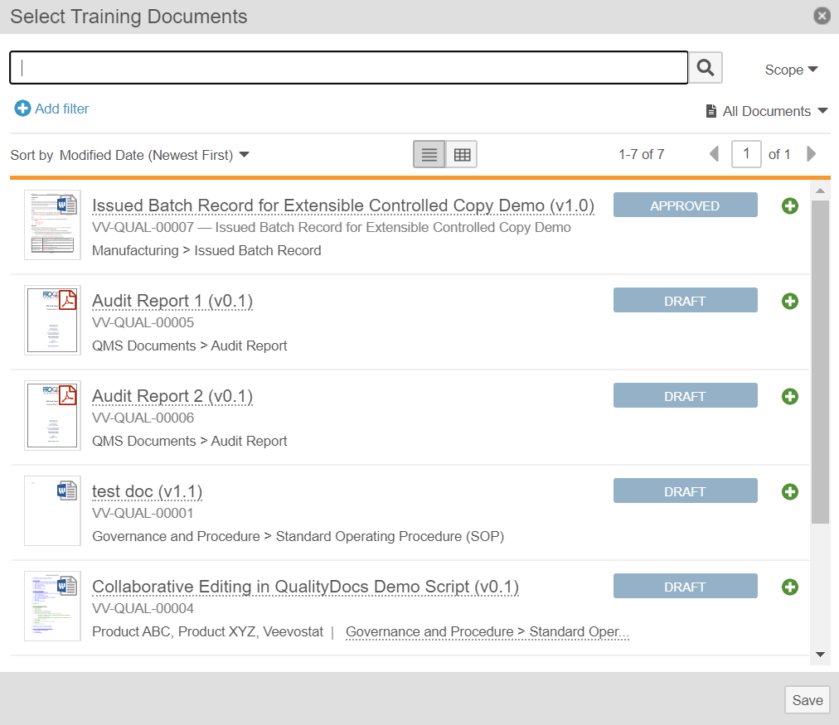
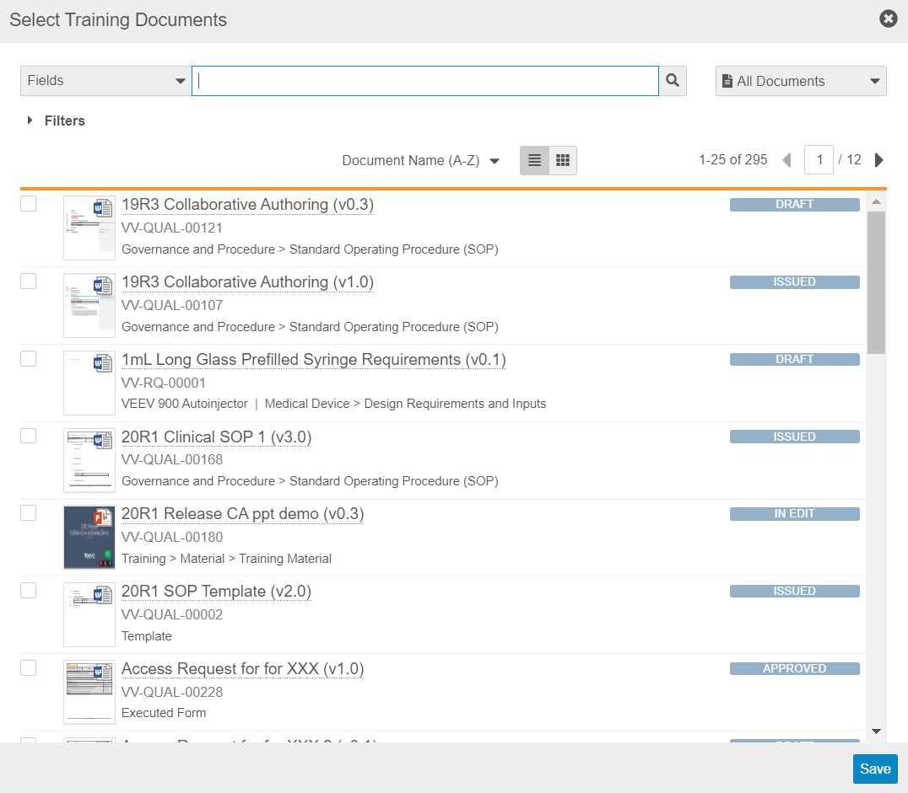
Updated Training Requirement Document Picker Dialog
Setup by:
N/A
for use by:
Training Admin
Automatic
Overview
  The dialog box used to select documents in a Training Requirement or a Training Requirement Impact Assessment record has been updated to match the checkbox-style document picker introduced in the 20R1 Vault release
Business Justification
  Create a consistent user experience across the Vault user interface
Before 20R1
After 20R2
Feature Risk
N/A
Default Impact
VISIBLE TO ALL USERS

Slide 105
Assignment Details Lifecycle State No Longer Updated
Setup by:
N/A
for use by:
Learners
Automatic
Overview
  The Assignment Details lifecycle state is no longer updated when a Training Assignment record enters the Assigned, Completed, or Cancelled states
  A new lookup field, named Training Assignment Lifecycle State on Assignment Details records, now shows the parent Training Assignment record’s lifecycle state
Business Justification
  Allows users to see the real-time lifecycle state of a Training Assignment record from its related Assignment Details record
  Improves performance of the Update Training Assignment job
Considerations
  If you have reports, filters, or views that use the Assignment Details lifecycle state field, they should be updated to use the new Training Assignment Lifecycle State lookup field instead
Feature Risk
MEDIUM
Default Impact
VISIBLE TO ALL USERS
Notes:
Assignment Details Lifecycle State No longer Updated
To improve job performance, the application no longer changes the state of the Assignment Details. Instead, a lookup field for the Training Assignment Lifecycle State is added to Assignment Details in real time
Considerations: If there are reports that currently use Assignment Details Lifecycle state, those must be updated to use the lookup field

Slide 106
Platform Features with Applicability to Training
Feature | Business Justification | Enablement
Notification Preferences | This feature reduces “notification overload” by providing Users with emails containing notification summaries, rather than sending email each time an event triggers a notification | Configuration

Slide 107
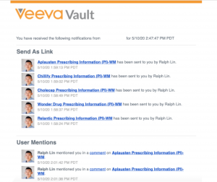
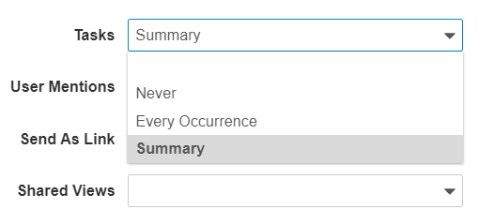
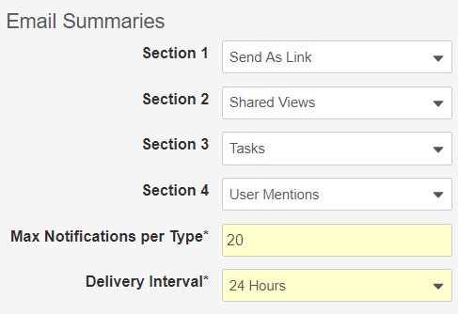
Notification Preferences
Notification Summary Email
Configurable
Overview
  System Administrators and Vault Owners can:
  setup Users’ email delivery preferences for Send As Link, User Mention, Task, and Shared View notifications
  configure how information appears in emails that summarize notifications
  configure how often notification summary emails are sent to Users
Business Justification
  This feature reduces “notification overload” by providing Users the option to have notification summary emails, rather than receiving email each time an event triggers a notification
Considerations
  Email preferences are Vault-specific
  User fields will be deployed as blank, default behavior is:
  Every Occurrence for Send As Link, Tasks, User Mentions
  Never for Shared Views (new notification type with 20R2)
  Admins can make fields visible in the User object page layout
User Delivery Preferences
Summary Email Options
Feature Risk
LOW
Default Impact
VISIBLE TO ADMINS ONLY

Slide 108
Product Would Like to Know…..
Poll Question #7

Slide 109
Product would like to know…
Poll Question #7
What training features do you plan on implementing next? ( Multiple Choice)
Answer 1: Quizzes
Answer 2: Multi-document Training
Answer 3: Classroom Training
Answer 4: External Training/SCORM or AICC
Answer 5: Substitute Training

Slide 110
Station Manager Features

Slide 111
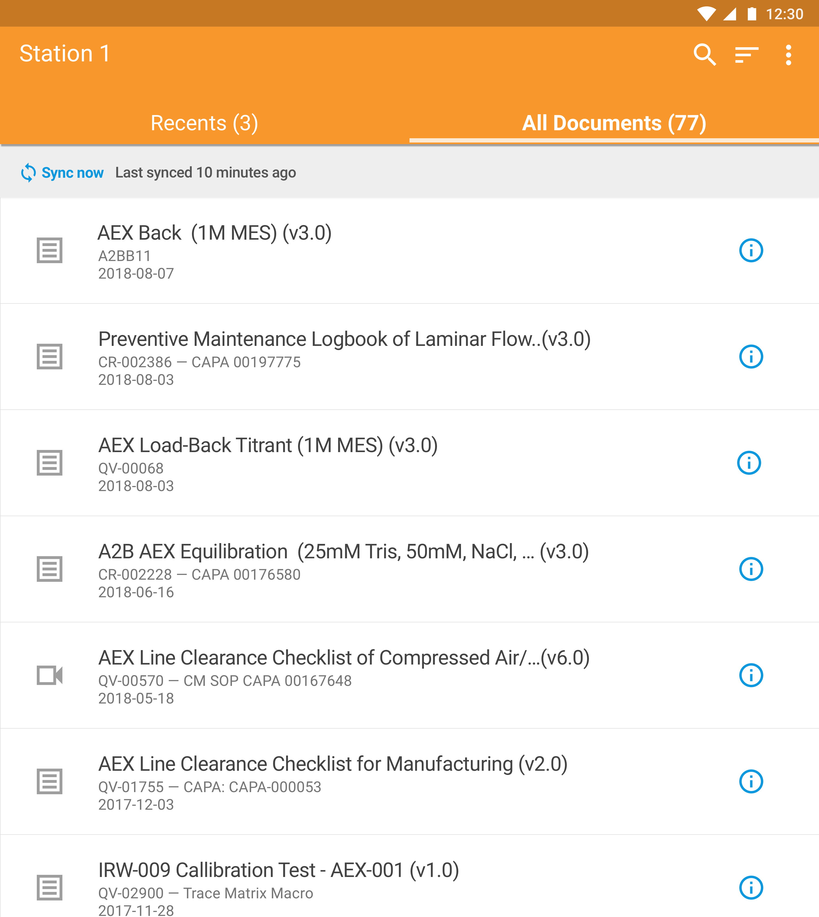
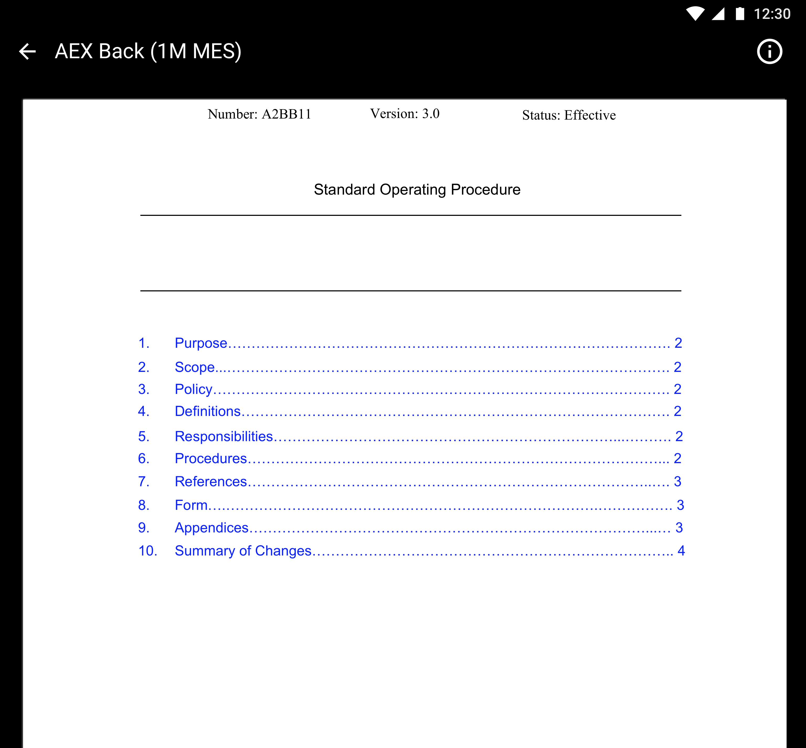
Station Manager
Overview
  Mobile app (iOS, Android) that allows users to view controlled content using shared iPads
  Android and iOS apps support documents, iOS app also supports video
  Fast, offline, 24 x 7, full screen access to documents stored in QualityDocs
  Fit for purpose – e.g. minimize “pinching” for personnel wearing gloves
Business Justification
  Electronic access to latest effective versions of specific documents, eliminating the need for paper controlled copies and a reconciliation process
  Applicable to manufacturing and lab environments
Considerations
  Station Manager is a separately licensed application
  Station Manager is an Early Adopter application

Slide 112



Station Manager
Site Business Administrator
Vault web application user that associates documents with Stations
Site IT
Sets up Station Manager by logging in and associating a tablet with a Station
Logs out of Station Manager when the tablet needs to be re-purposed (e.g. moved to another station).
Site Manufacturing User
Accesses a tablet’s/Station’s specific documents to perform their job
Already trained on the Station’s documents (training tracked in LMS)
This Photo by Unknown Author is licensed under CC BY-SA

Slide 113
Station Manager iOS & Android Enhancements

Slide 114
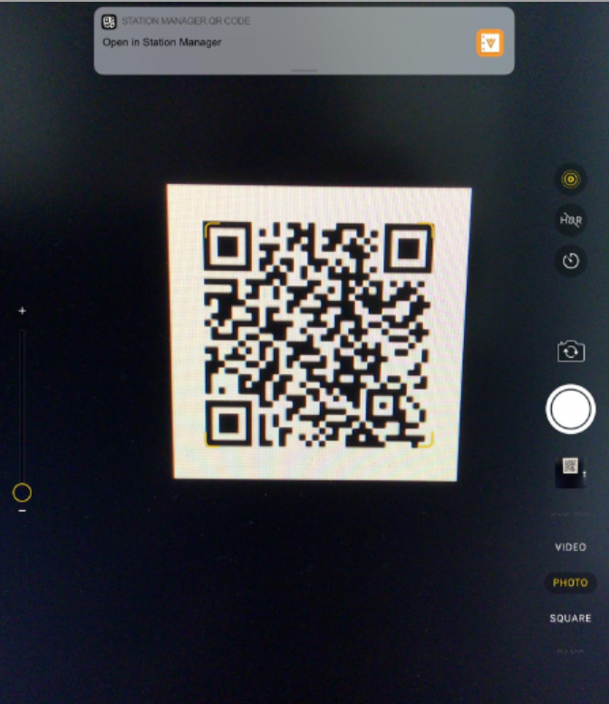
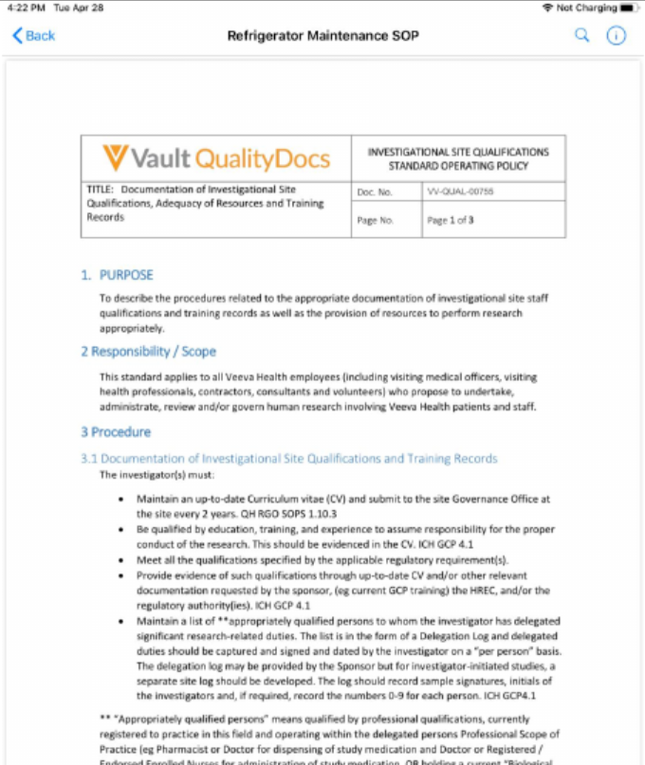
Custom URL & QR Code Support
Automatic
Overview
  Customers can generate custom Station Manager URLs for documents
  When manufacturing operator scans a QR code on their tablet, the target document opens in the mobile app
  Supports URLs that point to current Effective version, specific versions, page numbers, and timestamps for videos
Business Justification
  Provides an easy way for manufacturing operators to quickly navigate to the documents they need to perform their task
Considerations
  Creating custom URLs is a manual process – there is no mechanism within Vault to request a custom URL or QR code
Setup by:
N/A
for use by:
Viewer
Feature Risk
LOW
Default Impact
VISIBLE TO ALL USERS

Slide 115
Natively Open Embedded Links
Automatic
Overview
  While viewing a document in Station Manager, tapping on a link that points to another QualityDocs document will open the target document directly within the app
Business Justification
  Users often embed links within SOPs to other QualityDocs documents like Work Instructions
  Making a link to a Work Instruction navigable from within an SOP makes it easy for a user to move between documents and provides context
Considerations
  The target document must also be downloaded to the device. Otherwise the URL will be opened in the default browser
  Supports Vault document URL options for version and page number, but not lifecycle state or state type
    Refer to the following Vault Help page for more information about Vault document URLs http://vaulthelp.vod309.com/wordpress/user-help/document-collaboration-markup/vault-document-urls/
  Does not support Permalinks created using the Create Link function
Setup by:
N/A
for use by:
Viewer
Feature Risk
LOW
Default Impact
VISIBLE TO ALL USERS

Slide 116
Station Manager
Additional Android Enhancements

Slide 117
Enforce Client Permissions on Android
Automatic
Overview
  This feature ensures shared accounts used by IT administrators cannot be used to login to Android Station Manager, unless the app is installed via an Enterprise Mobility Management solution
Business Justification
  Enables customers to tightly control usage of the Android Station Manager app within their organization
Considerations
  Contact Veeva for guidance to provision the AppConfig properties from their EMM solution, and enable the right permissions in their Station User Permission Sets before upgrading mobile apps to this release
Setup by:
N/A
for use by:
Admins
Feature Risk
HIGH
Default Impact
VISIBLE TO ALL USERS

Slide 118
Release to Google Play
N/A
Overview
  Android Station Manager is now available via Google Play
Business Justification
  Enables customers to use an Enterprise Mobility Management (EMM) solution with Google Play to provision the application to corporate-owned devices with additional security controls using AppConfig variables
Setup by:
N/A
for use by:
Admins
Feature Risk
N/A
Default Impact
NONE

Slide 119
DEMO

Slide 120
Validation & Supporting Docs
Veeva Compliance Docs
  Validation Project Plan
  IOQ Protocols
  Business Requirement Documents
  Traceability Matrices
  System Release Memo
  Release Notes
  Summary Reports
  Executed OQ Scripts
  (unexecuted in Word format available upon request)
Supporting Documents available on the 20R2 Release page in Vault Help
  20R2 Release Impact Assessment
JULY
System Release Memo | Monday 13th
Compliance Documents | Tuesday 14th
Executed OQs | Friday 17th

Slide 121

Best Practices for Managing Vault Releases
This video contains:
Information About Vault General Releases
Recommended General Release Strategy
  Step 1: Auto-On Features
  Step 2: Configurable Features
Sample Demonstration of a Release Process
Link to Presentation *
*(Support Portal Login Required)
Notes:
If you haven’t had a chance to attend our Best Practices for Managing Vault Releases Webinar you can find a link to a recoding of the presentation included in this slide
The recording of this presentation includes information about vault general releases
As well as the recommended general release strategy and a sample demonstration of a release process

