Slide 1

19R3 RIM
Release Preview and Planning
Revision: 05 Nov 2019
Please use ‘Q&A’ to ask a question

Slide 2

Vault RIM 19R3 Presenters
Karen Gorman
R&D Customer Success Manager karen.gorman@veeva.com
Renee Menco
R&D Customer Success Manager renee.menco@veeva.com

Slide 3
Foreword
The content of this presentation is subject to change prior to the 19R3 Release
Veeva encourages you to always reference Release documentation from our Release pages to ensure you are using the latest information
Help → Release Notes → About the 19R3 Release

Slide 4
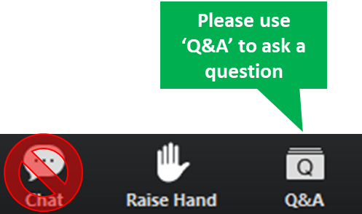
Interact With Us!

Slide 5
Planning for the 19R3 Release
Logistics
Announcements
Features
Identify key
release dates
Promote awareness of Veeva events
Review new features
based on themes
Note: Keep Alert for Polling!

Slide 6
Logistics

Slide 7
19R3 Release Calendar
Customer Validation
Sun | Mon | Tue | Wed | Thu | Fri | Sat
27 | 28 | 29 | 30 19R3 Release Webinars | 31 19R3 Release Webinars | 1 | 2
3 | 4 Pre-Release Vaults | 5 Validation docs 19R3 Release Webinars | 6 19R3 Release Webinars | 7 | 8 | 9
10 | 11 | 12 | 13 | 14 | 15 | 16
17 | 18 | 19 | 20 | 21 | 22 Upgrade - VV1-12, VV1-1065, VV1-1069 | 23
24 | 25 | 26 | 27 | 28 | 29 | 30
1 | 2 | 3 | 4 | 5 | 6 Upgrade - all remaining PODs | 7
OCT
NOV
DEC
Notes:
Looking at some of the key dates for the release, we have this general release calendar
Next week we will release the pre-release vaults and will have access to your validations documentation which will be added to our Compliance Docs vault
We will be talking more about this at the end of this call to talk about managing vault released
But always feel free to reach out to your CSM or Managed Services Consultant for additional
As we move through the next few weeks, this is your opportunity to perform any change control or validations per your policies and SOPs
On Aug 2nd, we will be upgrading VV1-8
On Aug 9th, we upgrade all the remaining PODs
Note that all customers are upgraded to 19R3 and applies to Production, Test, and Sandbox Vaults
Downtime will be approximately 7 hours and we will have additional details at the end of this call
If you need help locating which number POD you are on, it is located in Vault help as well as on the admin side of Vault in Settings > General Settings > Vault Information

Slide 8
Pre-Release Environments
We have changed our approach to provisioning Pre-Release environments
All customers will continue to receive a Pre-Release environment, including new Production Vaults provisioned post-19R2 Pre-Release
Customers who have used Pre-Release in last two releases will be refreshed with Production configuration
Customers who haven’t used Pre-Release in the last two releases will not be refreshed with Production configuration
  Refresh can be requested via Support ticket
Pre-Release Vaults include:
  Configuration
  Vault Owners
  Object Data referenced in configuration rules
  NO Documents or transactional data

Slide 9
Pre-Release Vault
The Pre-Release Environment
  Starting October 21st, Veeva began refreshing customers’ existing Pre-Release Vaults with their current Production configuration
    Pre-Release environments for VV1-12 Production Vaults were refreshed on October 10
  Starting October 24th, Veeva began cloning newer Production Vaults for the 19R3 Pre-Release environments
  A new Vault with a copy of your Production Environment
    Vault Owners users are provisioned
    CSM and Managed Services consultant are included in System Admin role
    Production Configuration
    No Documents or transactional data
  Based on IQ/OQ qualified 19R3 Release
  Available up to 4 weeks after your Production and Sandbox Vaults are upgraded to 19R3
NOVEMBER
Monday 4th
Notes:
Existing customer Pre-Release Vaults that were used in the past 2 releases are refreshed from their Production Vault configuration BEFORE they are upgraded to the next release.
Existing customer Pre-Release Vaults that were not used in the past 2 releases will simply be upgraded to the latest limited release, i.e. 19R1.4. Customers can request a refresh from Production configuration
The cloning/refresh process takes place about 2–3 weeks before the Pre-Release Vaults are scheduled to be available. This timing is important to consider if customers are planning to make configuration changes to their Production Vaults around this time frame to determine if the changes will be included in their Pre-Release Vault.
** If you had a Pre-Release Vault from a previous upgrade, all users that were in the previous Pre-Release Vault will be available in the new Pre-Release Vault.

Slide 10
Validation & Supporting Docs
Veeva Compliance Docs
  Validation Project Plan
  IOQ Protocols
  Business Requirement Documents
  Traceability Matrices
  System Release Memo
  Release Notes
  Summary Reports
  Executed OQ Scripts (unexecuted in Word format available upon request)
Supporting Documents available on the 19R3 Release page in Vault Help
  19R3 Release Impact Assessment
NOVEMBER
Tuesday 5th

Slide 11
Sandbox POD Separation
Majority of sandbox POD moves have been
completed, remaining will be done prior to Nov 22
Schedule communicated via Service Availability setting
Customers should ensure IP whitelisting is done by domain or IP range
More information can be found on Vault Help
19R3: Sandbox PODs will be upgraded up to
8 hours before production vaults
Schedule communicated via Service Availability setting

Slide 12
Early POD Upgrade Schedule
The early POD designation will no longer be variable
The schedule for early POD in future releases is as follows:
Release | Early PODs
R1 - April | VV1-2, VV1-1065, VV1-1055
R2 - August | VV1-8, VV1-1065, VV1-1068
R3 - December | VV1-12, VV1-1065, VV1-1069
Vaults on the designated early POD will receive access to Pre-Release 2 weeks earlier than other PODs

Slide 13
19R3 Go Live
All customers upgraded to 19R3
  Applies to Production, Test, and Sandbox Vaults
NOVEMBER
Friday 22
PODs VV1-12, VV1-1065,
VV1-1069
Date | POD | Start Time | Duration
Nov 22 2019 | US POD VV1-1069 Sandbox POD | 1:00 pm PT | Up to 4 hours*
 | All PODs – Authentication service update | 5:00 pm PT | 1 hour
 | US POD VV1-12, VV1-1065 | 6:00 pm PT | Up to 4 hours*
DECEMBER
Friday 06
Date | POD | Start Time | Duration
Dec 06 2019 | APAC POD VV3-3064 APAC & EU Sandbox PODs | 10:00 am PT | Up to 4 hours*
 | US Sandbox PODs | 2:00 pm PT | Up to 4 hours*
 | US PODs (except Nov 22nd PODs) EU PODs APAC POD VV3-34 | 5:00 pm PT | Up to 4 hours*
All Other PODs
* On November 1 2019, http://trust.veeva.com will be updated with final downtime durations

Slide 14




19R3 Release Webinar Series
Product-specific webinars focused on the use cases and impact of key features
  The same webinars are presented at multiple times
  One webinar per product will be recorded and available after the series via …
  Help > Release Notes > About the 19R3 Release
Platform
Oct 30 at 12 PM EDT
Oct 31 at 3 PM EDT
Nov 5 at 8 AM EDT
Nov 6 at 9 AM EDT
Oct 30 at 8 AM EDT
Oct 31 at 9 AM EDT
Nov 5 at 12 PM EDT
Nov 6 at 3 PM EDT
Oct 30 at 9 AM EDT
Oct 31 at 8 AM EDT
Nov 5 at 3 PM EDT
Nov 6 at 3 PM EDT
Oct 31 at 12PM EDT
Nov 5 at 9 AM EDT
go.veeva.com/19R3_clinical
go.veeva.com/19R3_quality
go.veeva.com/19R3_rim
go.veeva.com/19R3_platform
Notes:
We do offer webinars for each of our application suites
We do record the webinars and make the slides and recording available on our 19R3 help site, so you will have the ability to go back and review these

Slide 15
Announcements

Slide 16
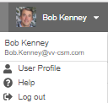
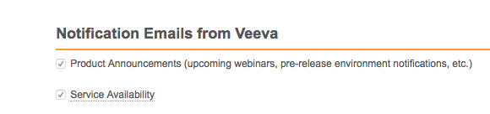
Notification Emails from Veeva
Opt-in to Product Announcements in User Profile to be contacted about:
  Initial release announcement (RIA)
  Release webinar invites
  Pre-release and validation document availability
  Go-live & key date reminders
Opt-in to Service Availability notifications in User Profile to be contacted about:
  Planned system maintenance
  Service disruptions

Slide 17
Internet Explorer™ 11 on Windows™ 7
In January 2020, Veeva will no longer support the combination of
Internet Explorer™ 11 on Windows™ 7
  Internet Explorer™ 11 is still a supported browser on other operating systems
We encourage all Veeva customers to upgrade to a newer browser
Learn more about supported browsers for Vault

Slide 18
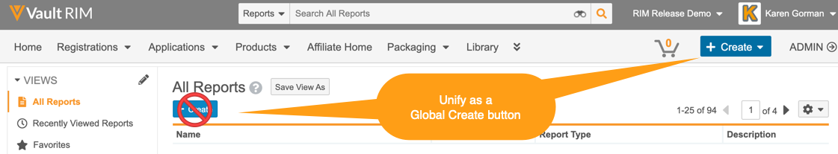
Coming in 2020: Create Button Unification
In early 2020, we will unify Vault Create buttons and use the Global Create button across document, object, report, and custom tabs.
  The ‘Global Create’ button will be contextual – i.e. dynamic based on the context of the action
  Introduces ‘Most Recent’ create action options
  Merges document create actions – i.e. Create from Template, Create Binder, and Upload Document etc. under one option
  Removes the inline Create button from Object Tabs and Reports
The Unified Global Create button will be designated as ‘Auto-on’
  No action required for 19R3
  Planned for 20R1

Slide 19
Register Now
700+
140+
attendees from life sciences
life science companies
Join our European R&D Community
Share Best Practices
Develop New Industry Partnerships
Network with Peers
18 – 20 May 2020 | Barcelona, Spain

Slide 20

Feature Enablement Detail
Auto-On Features
Configurable Features
Auto-On
Admin Checkbox
Configuration
Support
Turned On Day 1
Automatically available, some setup may be required
Turned Off
Requires enablement
Turned Off
Requires enablement
Requires
configuration
Turned Off
Requires enablement
Product Support Request

Slide 21
19R3 Vault RIM Themes
Connected Information
Streamlined Processes
Working with Documents
System Administration

Slide 22
Connected Information

Slide 23

Additional Regulatory Data Model Updates
Automatic
Overview
  In this release we have applied data model changes to support the Enhancements to Create Registrations Wizard feature, the Registrations Spark Connection: Change Control & Variation Management feature, and the Create Inactive Records Using Content Plan Template Constraints feature
Business Justification
  Below are the highlighted data model changes. The full list can be found on Vault Help:
  Added the following components to support the Enhancements to Create Registrations Wizard feature :
    Added the Object Type Mapping (object_type_mapping__v ) object with fields
    Added the Registration Scope (registration_scope__v) object with fields
    Added the Registration Scope Type picklist
  Added the following components to support the Registrations Spark Connection: Change Control & Variation Management feature :
    Added the following fields to the Event (event__rim) object:
      Change Event GUID (change_event_guid__v)
      Impact Assessment GUID (impact_assessment_guid__v)
Feature Risk
LOW
Default Impact
VISIBLE TO ADMINS ONLY

Slide 24
Additional Regulatory Data Model Updates
Automatic
  Business Justification (Cont.)
  Added the following components to support the Create Inactive Records Using Content Plan Template Constraints feature :
    Added the following field to the Content Plan Template Constraint (content_plan_template_constraint__v) object:
      Constraint Option (constraint_option__v)
    Added the Constraint Option (constraint_option__v) picklist
Considerations
  These data model updates are automatically available on all RIM vaults. Admins must perform additional configuration to make them available for users
Feature Risk
LOW
Default Impact
VISIBLE TO ADMINS ONLY

Slide 25


Bundle Regulatory Objectives
Configurable
Overview
  This feature expands on the ability to group planned regulatory changes by allowing users to start the bundling process at the Regulatory Objective record level rather than the Activity record level
  The wizard guides users through a process of bundling regulatory objectives while updating associated reference relationships
  This feature also updates the existing bundling and splitting wizards
  Bundling wizard now allows users to optionally create a submission record (previously was required)
  Splitting wizard now allows users to create a new activity rather than updating an existing activity with the
  new regulatory objective details
Business Justification
  Often it is necessary to push changes to local country teams. At the country level, several changes can be bundled together into a single submission. In 18R3 we introduced this capability from Activities. This can now be done by grouping Regulatory Objectives
Considerations
  This can only be leveraged if you have enabled the Bundling feature in your Vault (Vaults created before 18R3 may not have this feature enabled)
Feature Risk
MEDIUM
Default Impact
VISIBLE TO ADMINS ONLY

Slide 26
Enhancements to Create Registrations Wizard
Automatic
Overview
  This release provides several enhancements to the bulk creation process for registrations:
    The bulk create wizard now copies custom field values from submission join records to the corresponding registered detail records
    Vault now automatically relates the Regulatory Objective selected in the bulk create wizard to the newly-created Registration records
    Labels in the bulk create wizard UI now use object and field labels instead of static text to better match customers’ Vault configurations
    Admins can configure multiple registration scopes for the same country depending on the registration object type (limited to our current registration scope types: Marketed Product Variant, Marketed Pack Size, Investigational Product, Investigational Study, and Investigational Site)
    Admins can configure the object type with which the bulk create wizard creates registered details based on the registration object type the user selects
    Several medical device fields and joins introduced in 19R2 are now carried forward from submissions to registrations
  Business Justification
  These enhancements improve the user experience and better support customers with different registration types, such as drug products or medical devices
Feature Risk
MEDIUM
Default Impact
VISIBLE TO ALL USERS

Slide 27
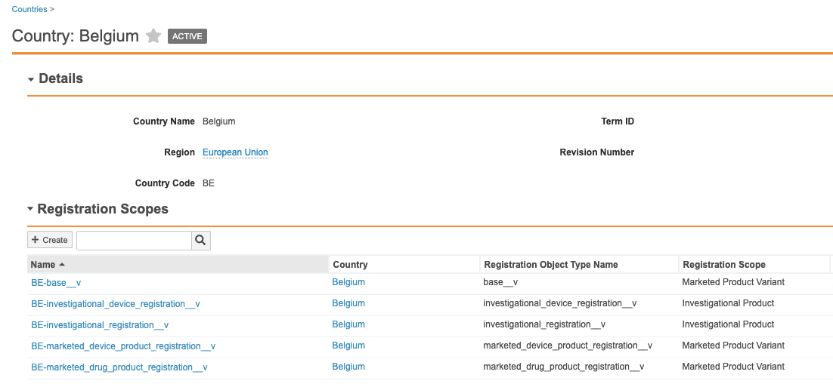
Enhancements to Create Registrations Wizard
Automatic
  Considerations
  In past releases, Vault used the Registration Scope and Clinical Trial Authorization Scope fields on the Country object to define registration scopes for a country. Starting in the 19R3 release, Vault now uses a separate Registration Scope object.
  The Registration Scope object is a child of the Country object and needs to be added to the Country page layout (admins can also hide the Registration Scope and Clinical Trial Authorization Scope fields as they are no longer used by the wizard)
  Your vault must contain a Registration Scope record for each Registration object type for each active Country record in order for the bulk Create Registrations wizard to work. For existing Vaults, the system will create Registration Scope records automatically for each Registration object type for each Country that is active at release time. Registration object types or Countries added (or activated) after the release will require an admin to add the appropriate Registration Scope records
Feature Risk
MEDIUM
  Copy of custom field values from submission relationship records to registered detail records requires that custom fields with matching names and field types are configured on both objects
Default Impact
VISIBLE TO ALL USERS

Slide 28
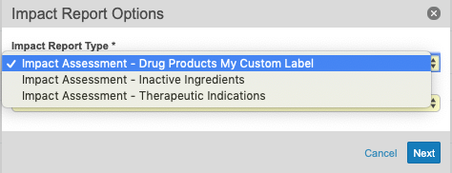
Dynamic Labels in Impact Assessment Report Prompt
Automatic
Overview
  In the Impact Assessment Report start dialog, the options in the Impact Report Type and Report Scope drop-downs now display Admin-defined object labels and object field labels
Business Justification
  Previously, the values displayed in the Impact Report Type and Report Scope were hard-coded. This was confusing for customers who chose to relabel the objects to which these picklists referred. This update will represent customers’ Vault configurations and provide a consistent user experience
Feature Risk
MEDIUM
Default Impact
VISIBLE TO ALL USERS

Slide 29

XEVMPD Gateway Submission
Configurable
Overview
  This feature allows customers who generate XEVPRM messages within Vault to submit these to the European Medicines Agency (EMA) through the EMA AS2 Gateway and receive acknowledgement of the submissions
  Business Justification
  Submission through the gateway streamlines the process. Additionally, the acknowledgements received from the EMA contain important identifiers that need to be captured and updated in Vault. This feature supports this by automatically updating the relevant records with the data
Considerations
  Customers must register with the EMA before using the gateway (this includes providing EMA with their certificate and Vault URL information)
  With gateway integration, Vault submits the message to the EMA and provides status details for the transfer. Vault adds responses from the EMA, known as acknowledgments, as attachments to the Product Data Messages record and updates related fields, allowing you to track and manage acknowledgments from the EMA within Vault
  The user who submitted the message receives Vault notifications for all updates from the EMA
  Information about configuration and a sample gateway connection form is available in Vault Help
Feature Risk
HIGH
Default Impact
VISIBLE TO ADMINS ONLY

Slide 30

Registrations Spark Connection: Change Control & Variation Management
Support
Overview
  This feature leverages the Vault Spark framework to connect QMS vaults to Registrations vaults
  When enabled, this feature automatically creates Event records in the RIM Registrations vault when a new Quality Event record is sent for regulatory impact assessment in the QMS vault. Once the regulatory assessment is complete, QMS users receive live updates of country approval status based on the Activity records associated with the Event in the Registrations vault
Business Justification
  Often, organizations use separate systems and processes for change control and variation management. In such a case, using separate systems can result in duplicate data entry and a lack of synchronization, which prolongs the process and results in changes that occur without a proper understanding of regulatory impact
  This feature streamlines the variation process for manufacturing change controls for organizations using both Vault QMS and Vault Registrations
  Considerations
  This feature requires configuration and potentially business process changes
  It is currently only available to early adopters (who have Vault QMS and Vault Registrations)
  Please reach out to your CSM if you are interested in using this feature
  This feature is not validated in pre-release Vaults
Feature Risk
MEDIUM
Default Impact
NONE

Slide 31
Multi-Pass Reporting Enhancements
Configurable
Overview
  With 19R3 we’ve added multiple enhancements to Multi-Pass Reporting:
    The ability to create report views from Workflow Reports
    Add groups to report views
    Join report views by text fields
    Ability to define conditional fields in both report views and multi-pass reports
    Ability to select inner join in addition to left join when joining report views
    Ability to filter on aggregate fields defined in report views
Business Justification
  Allows Admins to create and join reports with more options and flexibility
Considerations
  Inner join (new in 19R3) - Vault returns records that have matching values from both views
  Left join - Vault returns all records from the view on the left side and only records with matching fields from the view on the right side
Feature Risk
LOW
Default Impact
VISIBLE TO ADMINS ONLY

Slide 32
Simple Join Objects Include Lifecycle State Fields
Automatic
Overview
  When Admins add a lifecycle to a simple join object, the object will now remain a simple join object
Business Justification
  This allows users to multi-select multiple related records and show the parent records in a simple join related object section for join objects that have a lifecycle
Considerations
  If an existing complex join has only Lifecycle fields in addition to the System fields, Vault shows the Add button instead of the Create button
  If there are additional fields in that object that are not system or Lifecycle fields, then that object section will continue to remain a complex join
Feature Risk
LOW
Default Impact
VISIBLE TO ALL USERS

Slide 33
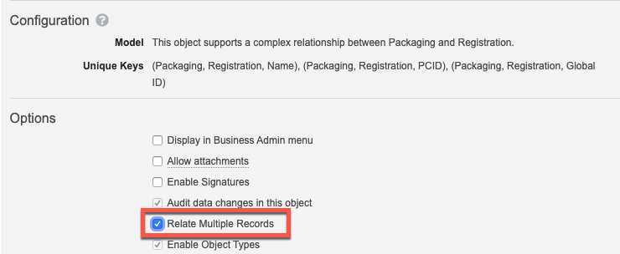
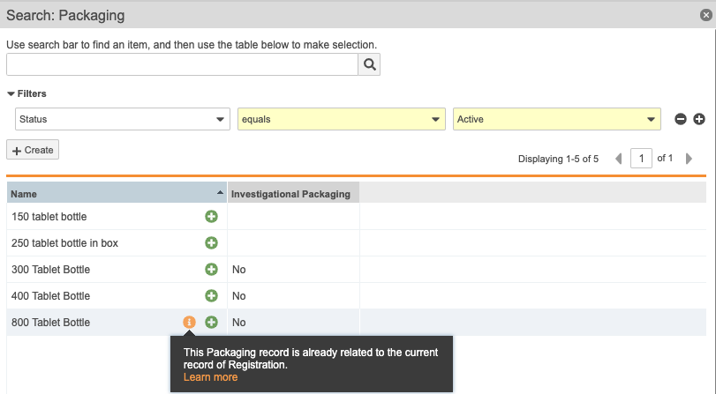



Relate Multiple Records: Complex Join Related Sections
Configurable
Overview
  Admins can configure the system to relate multiple object records through a complex join from the Related Object section
Business Justification
  Users can now quickly relate multiple object records in a complex join Related Object section on a parent object record page, similar to simple join sections (“Add” instead of “Create”)
Considerations
  Vault automatically creates complex join records
  in the background
  Records that are already related are shown with
  an indicator but can be selected again
  Use discretion – If the complex join object has fields
  that should be populated then this option should not be enabled
Feature Risk
LOW
Default Impact
VISIBLE TO ADMINS ONLY

Slide 34
Download List of Unrelated Parent Records
Automatic
Overview
  From simple & complex join Related Object sections, users can now click a link to download a CSV file containing a list of parent records that Vault could not relate to the current record
Business Justification
  Prior to 19R3, if records were not related successfully, it used to fail silently
  This feature will allow users to see a list of records that could not be related with the reason of the failure
Feature Risk
N/A
Default Impact
VISIBLE TO ALL USERS

Slide 35
Webinar Poll – Connected Information

Slide 36
Streamlined Processes

Slide 37

Regulatory Buttons & Breadcrumbs
Automatic
Overview
  This release provides additional navigation options in various RIM applications
    The Submissions Archive Viewer contains links to object record detail pages for the Application or, when filtered, Submissions
    The content plan Hierarchy Viewer contains breadcrumbs that allow for quick navigation to the primary Application, Submission, or root Content Plan record
    Submission records that have a related content plan include a button to navigate to the Hierarchy Viewer
    Application records that have one or more imported or published dossiers include a button to navigate to the Submissions Archive Viewer
    Submissions with an imported or published dossier include a button to navigate to the Submissions Archive Viewer from the Submission record or the Hierarchy Viewer
Business Justification
  These new navigation aids allow users to easily traverse content plans, the Hierarchy Viewer, the Submissions Archive Viewer, and Application and Submission records
Feature Risk
LOW
Default Impact
VISIBLE TO ALL USERS

Slide 38
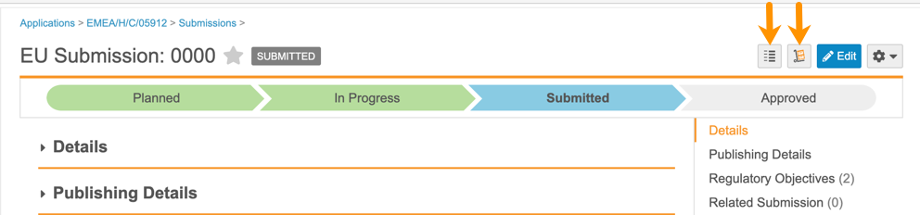
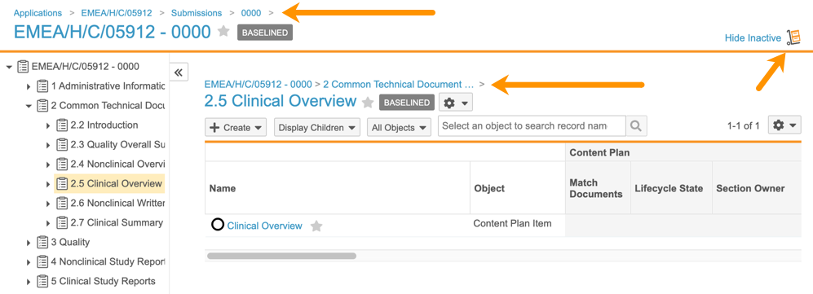
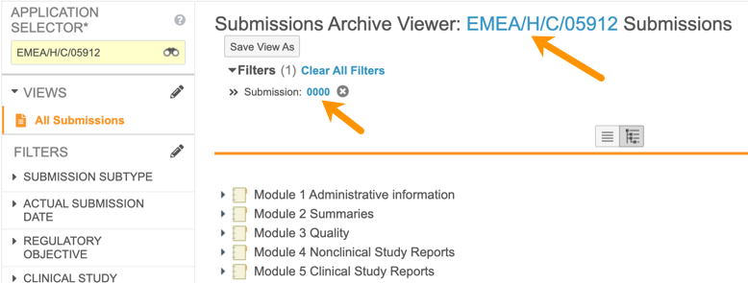
Regulatory Buttons & Breadcrumbs
Automatic
Feature Risk
LOW
Default Impact
VISIBLE TO ALL USERS

Slide 39
Hierarchy Viewer Enhancements for Regulatory
Automatic
Overview
  This release includes enhancements to the Hierarchy Viewer to improve the appearance and usability of the grid pane and the tree pane in RIM vaults
    In the grid pane, the Name column will remain frozen and the scroll bar will always remain visible as users scroll horizontally and users can adjust the height of each row
    In the tree pane, each record’s text will wrap and users will have an Actions gear menu
Business Justification
  Improves usability of the Hierarchy Viewer for both Content Plans and XEVMPD Product Reports
Feature Risk
N/A
Default Impact
VISIBLE TO ALL USERS

Slide 40
Open Record Details in the Pop-out Viewer from the Hierarchy Viewer
Automatic
Overview
  Users can now open, view, and take action on object record detail pages in a pop-out viewer directly from the Hierarchy Viewer grid pane
Business Justification
  Allows users to easily access and perform actions on records within the Hierarchy Viewer for both Content Plans and XEVMPD Product Reports, without navigating away from the overall structure
Feature Risk
N/A
Default Impact
VISIBLE TO ALL USERS

Slide 41
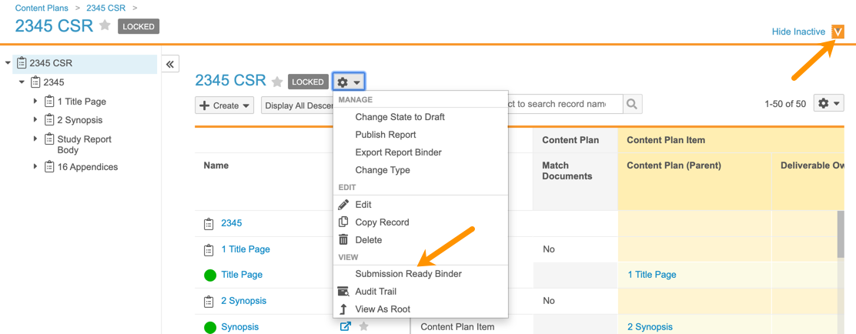
Simplified Navigation to the Submission
Ready Binder
Automatic
Overview
  A new View Submission Ready Binder icon and action allow users to navigate to a published report level content plan’s Submission Ready binder directly from the Hierarchy Viewer or from Content Plan and Report Level Content Plan object records
Business Justification
  Provides easy navigation between the Content Plan and the binder containing the published output
Feature Risk
N/A
Default Impact
VISIBLE TO ALL USERS

Slide 42
Merge Published Documents into a Single PDF
Configurable
Overview
  Vault can now merge published PDF documents into a single PDF file as part of report level publishing
Business Justification
  Speeds the authoring process by allowing users to create documents separately and merge them later
Considerations
  Merged documents can include up to 20,000 pages and the merged file can be up to 1.8 GB in size
  In addition to ensuring that all files are valid PDFs, the merging process will convert relative path links and bookmarks to internal document links. There is a limitation of 5,000 links in the merged PDF
  The merged PDF will be automatically loaded to the Submission Ready binder in addition to any documents that were not included in the merge
  The merged PDF will be named based on the name of the root Content Plan record
  The original source files matched to the Content Plan are added as Source References to the merged PDF
Feature Risk
MEDIUM
Default Impact
VISIBLE TO ADMINS ONLY

Slide 43
Create Inactive Records Using Content Plan Template Constraints
Configurable
Overview
  This feature extends existing Content Plan Template Constraint functionality by allowing users to create Content Plan records in the Inactive status in addition to excluding records from content plan creation
Business Justification
  Creating Inactive records via constraints provides users with an easy option to update the content plan if a section needs to be included in the content plan later
Considerations
  Export and import content plan constraints using the RIM Maintenance tab
  Use these terms in the Constraint Option column of the exported spreadsheet:
  Include to include the section or item
  Inactive to create the section or item in an Inactive status
  Exclude to exclude the section or item
Feature Risk
MEDIUM
Default Impact
VISIBLE TO ADMINS ONLY

Slide 44
Validation Results Archiving
Automatic
Overview
  Introduces a standard job that will create an archive package ZIP file containing Submission Validation Results and add them as an attachment to the Submission or Report Level Content Plan record. Previously archived records will then be deleted
Business Justification
  Allows users to easily locate and access previous validation results without cluttering the RIM Vault with unnecessary records
Considerations
  Automatically available for RIM Submissions and RIM Submissions Publishing Vaults that have already enabled Inline Validation Results. Contact Veeva Support to enable Inline Validation Results
  The job will execute the Submission Validation Results archive for any submission completed more than 365 days in the past
  No Submission Validation Results records for an individual Submission or Report Level Content Plan will be deleted from Vault until they are all successfully archived
Feature Risk
MEDIUM
Default Impact
VISIBLE TO ALL USERS

Slide 45
Dynamic Linking for Publishing
Automatic
Overview
  Provides the ability to create links in source content for resolution during the publishing process in RIM Publishing vaults
Business Justification
  Users can create pre-defined hyperlinks to the updated content as it changes during the authoring and submission publishing process
Considerations
  Auto-on in Vaults configured for Dynamic Linking with report level content plans
  Admin > Settings > Application Settings > Submissions Features: RIM Dynamic Linking
Feature Risk
MEDIUM
Default Impact
VISIBLE TO ALL USERS

Slide 46
Updates to On-Demand Publishing & Hyperlink Handling
Automatic
Overview
  When users run on-demand publishing, Vault now publishes and runs validation on all documents that contain links to the published document
Business Justification
  This change allows Vault to keep all document links current throughout the on-demand publishing process
Feature Risk
LOW
Default Impact
VISIBLE TO ALL USERS

Slide 47
Canada XSD 2.2 & Validation
Configurable
Overview
  With this release, RIM Submissions Publishing vaults support the CA HC v2.2 (XSD 2.2) specification
Business Justification
  Users can now create content plans and generate submissions that are compliant with CA HC v2.2 specifications
Considerations
  Vault validates the Canadian eCTD submissions based on the corresponding CA HC v4.4 Validation Profile
Feature Risk
HIGH
Default Impact
VISIBLE TO ADMINS ONLY

Slide 48
Canada Submission Gateway Support
Configurable
Overview
  Provides the ability to use the FDA Gateway Profile to send Submissions to the Health Canada (HC) Center directly from a Submission record in Vault, and to automatically receive and store gateway responses
Business Justification
  Allows for seamless dispatch of published CA eCTD submissions to Health Canada from within Vault
Considerations
  Because Health Canada uses the FDA’s Gateway to receive submissions, sponsor companies must create an account and receive the necessary certificates from FDA prior to configuration in Vault
  Using the sponsor account information, Admins must configure the US FDA ESG gateway profile under
  Admin > Settings > Gateway Profiles
Feature Risk
HIGH
Default Impact
VISIBLE TO ADMINS ONLY

Slide 49
EU EMA ESUB Gateway Integration
Configurable
Overview
  Provides the ability for users to send centralised procedure eCTD submissions to the European Medicines Agency (EMA) Electronic Submissions (eSUB) Gateway directly from a Submission record in Vault, and to automatically receive and store gateway responses
Business Justification
  Allows for seamless dispatch of published EU centralised eCTD submissions to the EMA from within Vault
Considerations
  Sponsor companies must create an account and receive the necessary certificates from EMA prior to configuration in Vault
  Using the sponsor account information, Admins must configure the EU EMA ESUB gateway profile under
  Admin > Settings > Gateway Profiles
Feature Risk
HIGH
Default Impact
VISIBLE TO ADMINS ONLY

Slide 50
Dossier Review Mode
Automatic
Overview
  When users open documents from the Submissions Archive Viewer tab, the dossier’s outline now displays in a left panel on the Doc Info page
Business Justification
  Allows users to easily traverse content in the submission tree without having to navigate back and forth to the Archive Viewer
Considerations
  Users must return to the Viewer tab to change filters
  Tree navigation panel will be collapsed by default
  Navigation panel does not appear if user is in full screen viewing mode
  Fewer buttons available in Dossier Review Mode, but users can click on the document name/title at the top to return to normal Vault document viewing
Feature Risk
LOW
Default Impact
VISIBLE TO ALL USERS

Slide 51
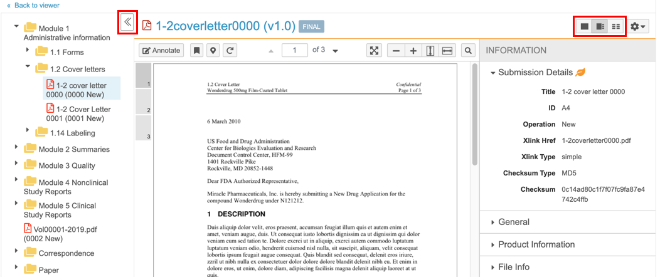
Dossier Review Mode
Automatic
Feature Risk
LOW
Default Impact
VISIBLE TO ALL USERS

Slide 52

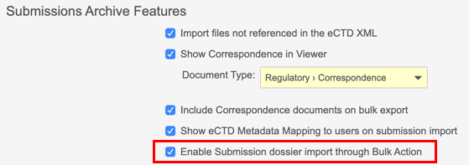
Dossier Import to Multiple Submissions
Admin Checkbox
Overview
  When the same dossier files are applicable for multiple submissions, users can now import the dossier to all submissions using a single bulk action
Business Justification
  For some submission types, the exact same dossier is provided to multiple health authorities under different application numbers with no change to the content
Considerations
  The bulk action can be launched from a
  Submissions-based report or from a list
  of Submission records
  Users are prompted to locate the
  submission on FTP or via Upload Now,
  as with single import
  A summary of successful and failed imports is provided in Notifications
  Does not apply to US grouped submissions - import into primary submission and user will be prompted for related submission(s)
Feature Risk
MEDIUM
Default Impact
VISIBLE TO ADMINS ONLY

Slide 53
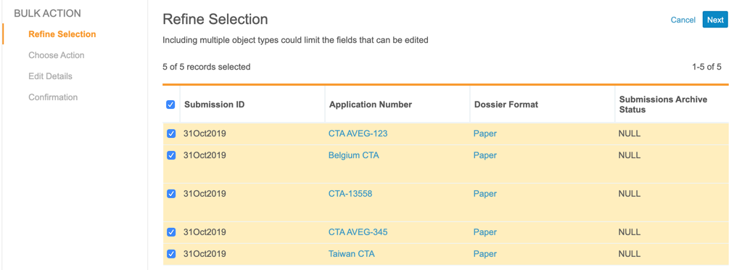
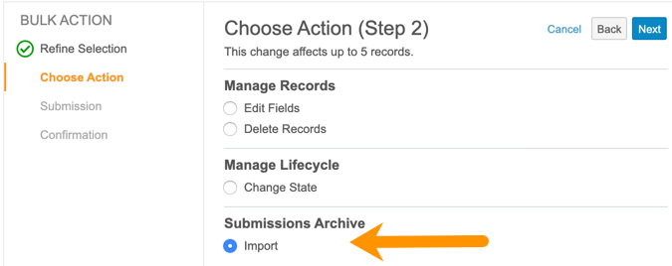
Dossier Import to Multiple Submissions
Admin Checkbox
Feature Risk
MEDIUM
Default Impact
VISIBLE TO ADMINS ONLY

Slide 54
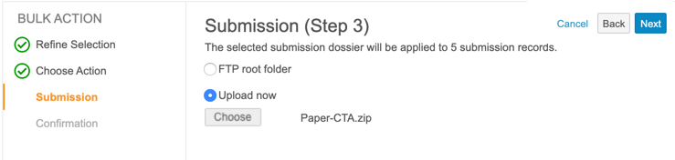
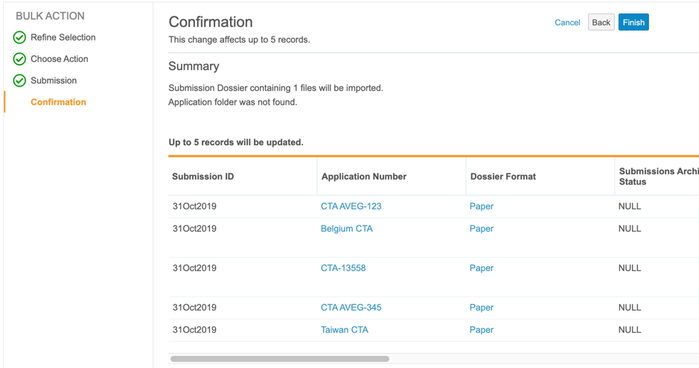
Dossier Import to Multiple Submissions
Admin Checkbox
Feature Risk
MEDIUM
Default Impact
VISIBLE TO ADMINS ONLY

Slide 55
Update EDL Item Tracking Fields When Batch Update Is No/Blank
Automatic
Overview
  Users can now see the accurate progress for new EDL Item/Content Plan Item records even when the Batch Update field is set to No or left blank, as long as the EDL matching job is active and has run at least once
Business Justification
  Previously, Vault would only update the tracking fields via the continuous EDL Matching job when the Batch Update field was set to Yes, resulting in inconsistent progress indicators in a set of related EDL Items. Now, manual document matches on EDL Items with Batch Update set to No/blank will trigger the update to the tracking fields
Considerations
  Vault will not update tracking fields on existing records where Batch Update is set to No or left blank unless a user updates the EDL Item/Content Plan Item record or the matched document, triggering continuous matching
  To update all existing EDL Item/Content Plan Item records, contact Veeva Support
Feature Risk
MEDIUM
Default Impact
VISIBLE TO ALL USERS

Slide 56
Webinar Poll – Streamlined Processes

Slide 57
Working with Documents

Slide 58
Allow Multi-select on Standard Document Fields
Support
Overview
  Certain standard document fields can be configured to allow multi-select. These fields are:
    drug_substance__v
    clinical_study__v
    excipient__v
    manufacturer__v
    nonclinical_study__v
    drug_product__v
    product_detail__v
    country__v
    therapeutic_indication__v
Business Justification
  This update provides additional flexibility to support different customer use cases
Considerations
  Customers who have configured custom multi-select fields can continue to use those; however, future functionality may be created based on these standard multi-select fields
Feature Risk
LOW
Default Impact
NONE

Slide 59
Disable Enhanced Checkout for All Vaults
Automatic
Overview
  The Enhanced Checkout Java Applet has been completely disabled
Business Justification
  Modern browsers do not support Java applets, and keeping the correct Java version installed on client machines has been problematic
Considerations
  Replay: Retirement of Enhanced Checkout & Adoption of Vault File Manager
  Available Alternatives
    Vault File Manager
    Provides an efficient way to check out, edit, and check in Vault documents (Windows only)
    Checkout to Office Online or new Collaborative Authoring
    Available to Office 365 subscribers (Mac and Windows)
    Basic Checkout
    Vault relies on your browser to handle the download and upload (Mac and Windows)
Feature Risk
N/A
Default Impact
VISIBLE TO ALL USERS

Slide 60
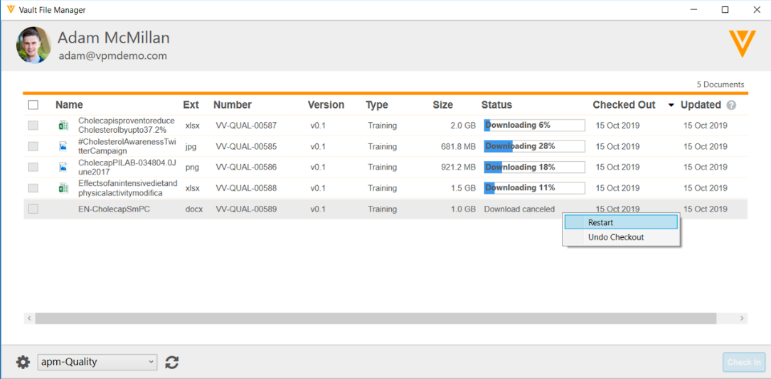
Improved File Transfer for Vault File Manager
Automatic
Overview
  We have enhanced the file transfer process for Vault File Manager:
    Download and upload up to 8 files at the same time instead of one at a time
    Displays progress bar and % complete for each file being checked in/out
    Ability to skip or cancel downloads/uploads
    Addition of Ext and Size columns
Business Justification
  Improves file transfer functionality for files larger than 100mb, up to the Vault limit of 4GB per file
Feature Risk
LOW
Default Impact
VISIBLE TO ALL USERS

Slide 61
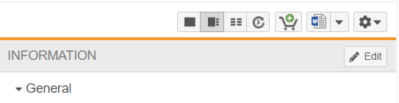
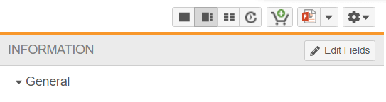
Relabel Doc Info Page Edit Button
Automatic
Overview
  The “Edit” button on the Doc Info page is now labeled "Edit Fields"
Business Justification
  This supports the addition of a new Edit button for the ‘Collaborative Authoring with Microsoft Office’ feature
Considerations
  May need to update screenshots within training materials to reflect new button label
BEFORE
AFTER
Feature Risk
LOW
Default Impact
VISIBLE TO ALL USERS

Slide 62

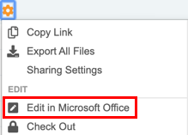
Collaborative Authoring with Microsoft Office
Configurable
Overview
  We are adding a new way to work on Microsoft Word documents by enabling the collaborative authoring functionality. With this feature, customers who leverage an Azure / Office 365 tenant can work simultaneously on the same document
Business Justification
  Document editors can easily check out and check in MS Word documents to Office 365 using their desktop client, allowing multiple users to edit a document at the same time
Considerations
  Only Microsoft Word documents (*.docx) are
  supported as of the 19R3 release
  Azure / Office 365 tenant setup is required before
  configuring in Vault
  All users with Edit permission can collaborate on the document
  so it’s critical to have communication between authors
  It is no longer possible to create a draft of a checked-out
  document. When viewing a checked-out document, the
  Create Draft option will not appear in the Actions menu
Feature Risk
MEDIUM
Default Impact
VISIBLE TO ADMINS ONLY

Slide 63
Collaborative Authoring with Microsoft Office – Technical Enablement Q&A
Thursday, 12-Dec at 8 a.m. PT / 11 a.m. ET / 4 p.m. GMT
If you are interested in enabling Collaborative Authoring with Microsoft Office:
  Identify your organization’s Azure / Microsoft 365 administrators
  Ask them to join a live technical enablement Q&A session with the Veeva Product, Customer Success and Services team.
This webinar is geared towards current Azure / Office 365 and Vault Administrators responsible for configuring the Vault Collaborative Authoring and Azure / Office 365 connection.
Key topics for discussion will include:
  Overview of Collaborative Authoring with Microsoft Office Capability
  Review of Prerequisites to Enable Collaborative Authoring
  Review of Published Knowledge Articles and Resources
  Open Q&A
Advanced registration required
Notes:
Webinar registration link: https://veeva.zoom.us/webinar/register/WN_vPUjT9C6S023iysRYETtBg

Slide 64
Vault RIM Community Webinar
Collaborative Authoring
December 17, 2019
17:00 – 18:00 CET
11:00 – 12:00 ET
08:00 – 09:00 PT
Register here
Notes:
Zoom registration link: https://veeva.zoom.us/webinar/register/WN_gqZ9R000QWKBzFanK7TP3A

Slide 65
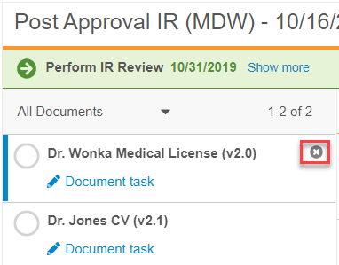
Multi-Document Workflow: Remove Documents from Envelope
Automatic
Overview
  Workflow initiator is able to remove a document from an active multi-document workflow (MDW)
  Enables documents to be removed from the envelope to be revised while the other documents can continue on the MDW
Business Justification
  More efficient multi-document approval
Considerations
  Only the workflow initiator can remove the documents
  Removed documents return to the workflow cancel state
  There must be at least one document in the envelope
Feature Risk
MEDIUM
Default Impact
VISIBLE TO ALL USERS
Notes:
Often times, customers use the MDW envelope to review and approve groups of documents
While some are ready for approval, other may need to be removed from the envelope to be revised by the authors
In this case, the business needs the ability to remove the documents needing revisions while the others can continue on the workflow
Another use case is when a document is included in an envelope by mistake or is no longer relevant
Before 19R3, the workflow had to be cancelled, revised, and then restarted without the document
Now, we are able to easily remove the documents from the envelope
As you can see in the screenshot here, it’s as easy as clicking on the x

Slide 66
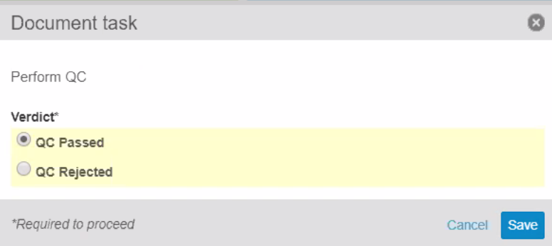
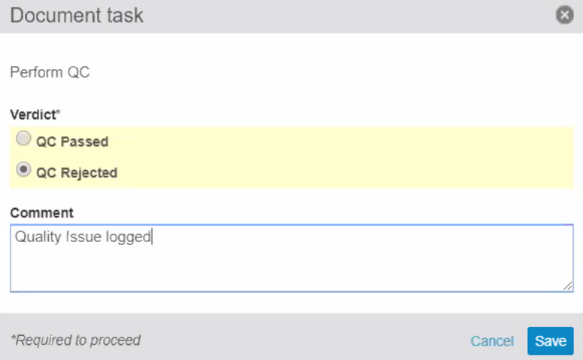
Multi-Document Workflow:
Verdict-Based Prompt for Comments and Reasons
Configurable
Overview
  Admins can now configure a multi-document workflow task step to prompt for comments or reasons only if the task owner selects a specific verdict
Business Justification
  Ability to configure verdicts to require comments (text field) or reasons (picklist)
Feature Risk
MEDIUM
When Task Owner selects the Reject verdict, they can provide a comment
Default Impact
VISIBLE TO ADMINS ONLY

Slide 67
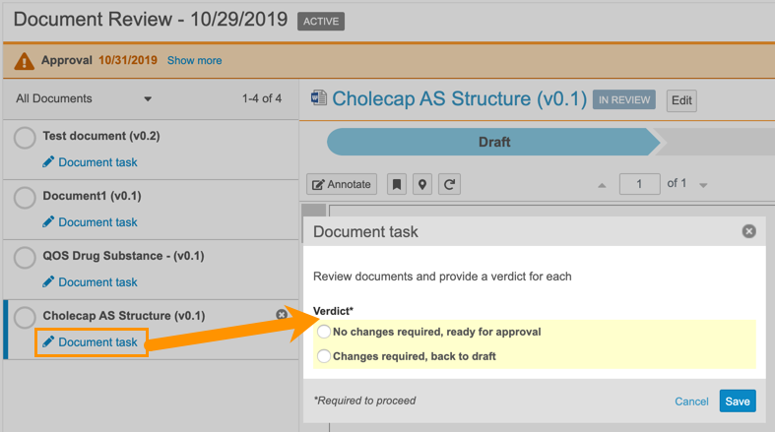
Multi-Document Workflow:
Updated Envelope Viewer
Automatic
Overview
  The Multi-Document Workflow Envelope Viewer has been updated to open a dialog to prompt for configured input beyond a simple verdict
Business Justification
  In order to accommodate configuring reasons for verdicts, the MDW Viewer has been updated to collect all verdicts and/or prompts in a dialog
Considerations
  Prior to this release, task owners selected verdicts for each document directly from the list of documents in the viewer. They now need to click on the “Document Task” link to provide all of the required input
  When hovering over the document name, users can see the selected verdict and any provided reasons/comments without having to open the dialog
Feature Risk
N/A
Default Impact
VISIBLE TO ALL USERS

Slide 68
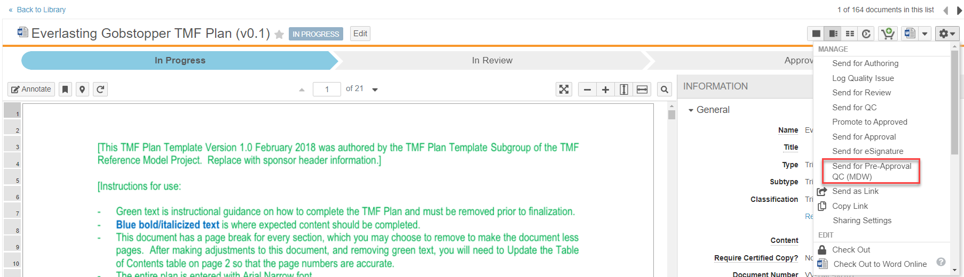
Start Multi-Document Workflow on a Single Document
Configurable
Overview
  Multi-document workflows can be started for a single document from Doc Info
  One workflow definition supports both single and multi-document use cases
Business Justification
  Ensures consistency between multi-document and single document use cases
  Enable documents to leverage many of the features of multi-document and object workflows
Considerations
  Workflow must be configured for a specific lifecycle (not “Any document lifecycle”)
Feature Risk
MEDIUM
Default Impact
VISIBLE TO ADMINS ONLY
Notes:
Admins can configure and workflow initiators can start multi-document workflows for a single document.

Slide 69
Constrain Multi-Document Workflow Based on Document Status & Field Values
Configurable
Overview
  Prevent documents from being included in a Multi-Document Workflow (MDW) based on document status and field values
  For example:
    Prevent Approved documents from being included in MDW that would allow documents to be modified, only allow Draft documents to go on “Route for Approval” workflow
Business Justification
  Streamline MDW and prevent potential errors
Considerations
  Workflow must be configured as a “specific lifecycle” workflow – Not “Any Document Lifecycle”
  Requires configuration of document user action in the relevant document state with required conditions
  NOTE: Existing specific-lifecycle workflow configured since 19R2 now require the configuration of a Document Lifecycle User Action for the MDW so that the workflow will appear on Doc Info page and from the Library
Feature Risk
MEDIUM
Default Impact
VISIBLE TO ADMINS ONLY
Notes:
In this feature, multi-doc workflow is able to prevent documents from being included in an envelope if they do not meet document status and field value criteria
Before 19R3, a specific MDW would be available on the Library, Reports, and Binder sections even if a user action was not configured in specific states
A couple of use cases:
If you do not want Approved documents to be included in a MDW envelope that allows documents to be modified, an Admin would configure the Approved state to not include Approved documents
Furthermore, for specific-lifecycle MDW to show up on the Library, etc. you MUST configure a Document Lifecycle User Action on the relevant Lifecycle State with conditions if relevant. If no conditions are needed, then use “Always” in the User Action.

Slide 70
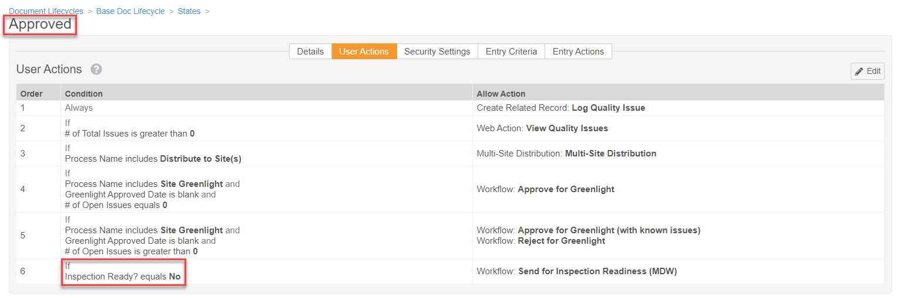
Constrain Multi-Document Workflow Based on Document Status & Field Values
Configurable
This prevents documents that are already Inspection Ready from being included in this MDW
Feature Risk
MEDIUM
Default Impact
VISIBLE TO ADMINS ONLY
Notes:
In this screenshot, we see an example of how to constrain MDW
It is based on the Approved document status and the field value of Inspection Ready? is no
In other words, this will prevent any documents that are Approved and already Inspection Ready from being sent on a Post-Approval inspection readiness MDW again

Slide 71
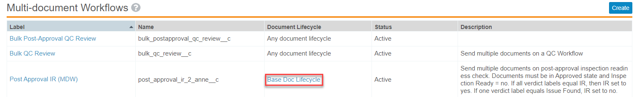
Constrain Multi-Document Workflow Based on Document Status & Field Values
Configurable
Specific Document Lifecycle (not “Any document lifecycle”)
Feature Risk
MEDIUM
Default Impact
VISIBLE TO ADMINS ONLY

Slide 72
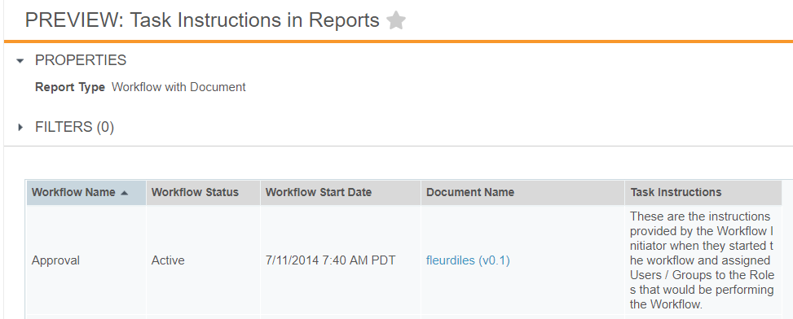
Task Instructions in Reports
Automatic
Overview
  Task Instructions can now be included in Workflow with Document reports
Business Justification
  Users will be able to view previous document workflow task instructions, providing context to later steps, actions, and decisions
Considerations
  Instructions can be viewed only after a document workflow has been initiated
Feature Risk
LOW
Default Impact
VISIBLE TO ALL USERS

Slide 73
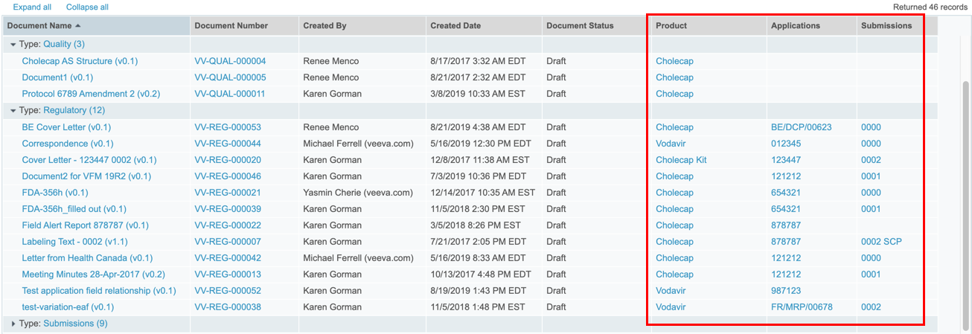
Display Object Reference Fields as Links in Reports
Automatic
Overview
  All object reference fields in a report will display as clickable links
Business Justification
  Users will be able to click on object reference fields when viewing report results
Considerations
  Both single value and multi-value reference fields will appear as links
Feature Risk
LOW
Default Impact
VISIBLE TO ALL USERS

Slide 74
Improved Handling for Multiple Action Bookmarks
Automatic
Overview
  This feature improves Vault’s handling of multi-action bookmarks in PDF source documents to inspect all actions on the bookmark and enable navigation for the first supported action
Business Justification
  Ensures that all bookmarks will be displayed in viewable renditions. Previously, Vault only inspected the first action of a multi-action bookmark, and if the application did not support that action, Vault did not display the bookmark
Considerations
  Additionally, Vault displays all bookmarks, including those with no supported actions, and maintains the correct nested structure in keeping with the structure of bookmarks in the source PDF
Feature Risk
LOW
Default Impact
VISIBLE TO ALL USERS

Slide 75
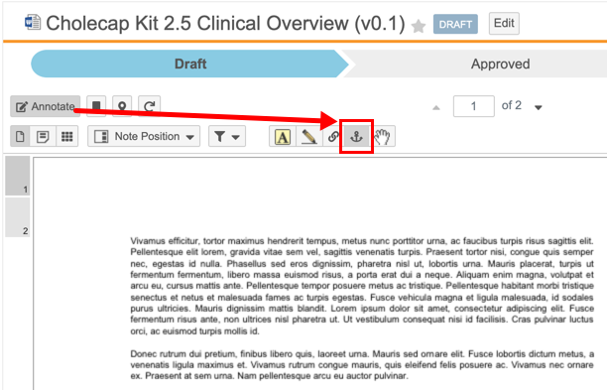
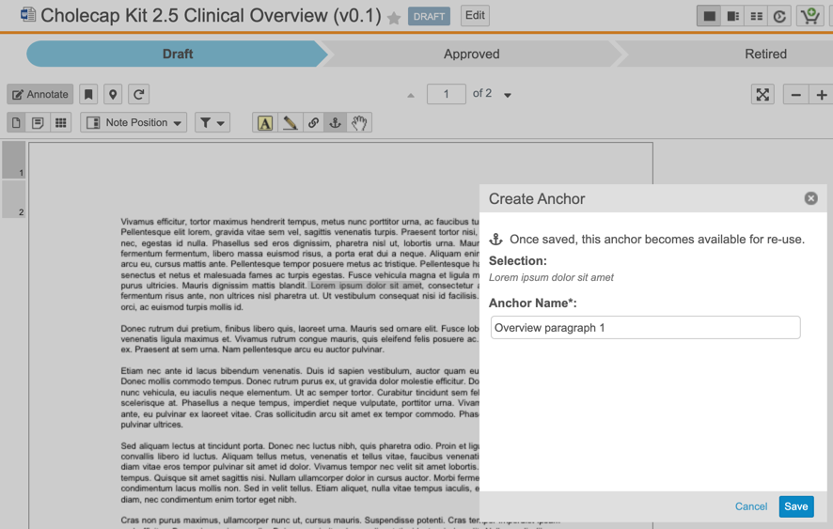
Create Anchors
Automatic
Overview
  This new tool enables users with the proper permissions (including the new Create Anchors permission) to create anchors on documents directly
Business Justification
  Streamlines anchor creation and gives Admins the ability to control who can create anchors, leading to a cleaner and more accurate anchor database
Considerations
  Anchors created with the Create Anchor tool can be either text or image selections
  Created anchors are available for selection when creating Link Annotations
  To use the Create Anchor tool, users must have View Document, View Content, Annotate, and Create Anchors permissions on the target document
New ‘Create Anchor’ tool
Feature Risk
MEDIUM
Default Impact
VISIBLE TO ALL USERS

Slide 76
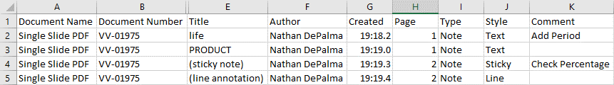
Download Notes to CSV
Automatic
Overview
  Users can download annotations from vault documents as a CSV file
Business Justification
  When documents contain many annotations, users can Download Notes to review comments information in a concise, easy to read CSV file
Considerations
  The action is available to users with View Content permission whenever the document has a viewable rendition and one or more annotations
Feature Risk
LOW
Default Impact
VISIBLE TO ALL USERS

Slide 77
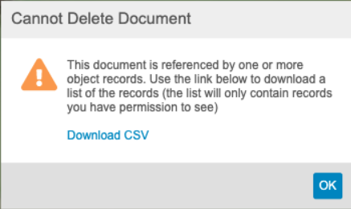
Download List of Records Blocking Document Deletion
Automatic
Overview
  When a user cannot delete a document that is referenced by an object record, they can now click on a link to download a CSV file containing the a list of records blocking document deletion
Business Justification
  Easier to delete document knowing which object records are blocking the deletion
Feature Risk
N/A
Default Impact
VISIBLE TO ALL USERS

Slide 78
Additional Working with Documents Features
Feature | Description | Feature Risk | Default Impact
Prevent Report Re-execution On Export | Vault now prevents a report from re-executing upon export if the report was recently run by the same user. This change will not introduce any difference in functionality, but should improve performance when exporting reports. | N/A | Visible to All Users
Remove Deprecated Re-Render Options | Removes several re-render options that are no longer applicable | N/A | Visible to All Users
Pareto Charts | Pareto charts are now a supported Vault Dashboard chart type. They are similar to column charts, but always display groups in descending order and include a cumulative percentage line | Low | Visible to All Users
Optimizations for Merge Fields | The syntax for the WHERE clause has been simplified to use the familiar object relationship structure. In addition, Merge Field tokens now retrieve a maximum of 1,000 entries | N/A | Visible to All Users
Document Workflow: Add Participants to Unselected Optional Tasks | Participant groups for optional tasks now appear in the Add Workflow Participants dialog window even if the associated optional task was not assigned when originally starting the workflow | Medium | None

Slide 79
Prevent Report Re-Execution On Export
Automatic
Overview
  Tabular reports will no longer re-execute upon export if the report was recently run (within 8 hours) by the same user
Business Justification
  This behavior change reduces server load, and exports will render faster since reports will not have to re-execute
Considerations
  No visible changes to end user experience when exporting
  Upon opening a report, click Refresh to ensure that you are seeing the most recent data
Feature Risk
N/A
Default Impact
VISIBLE TO ALL USERS

Slide 80
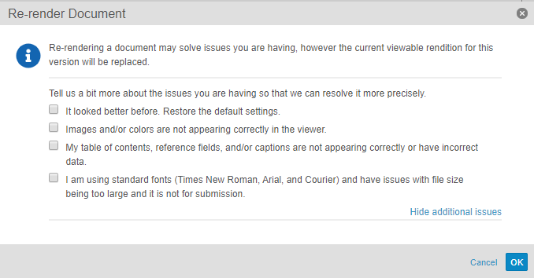
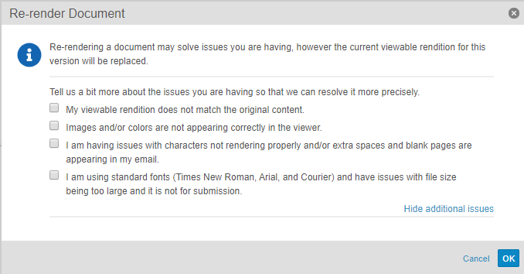
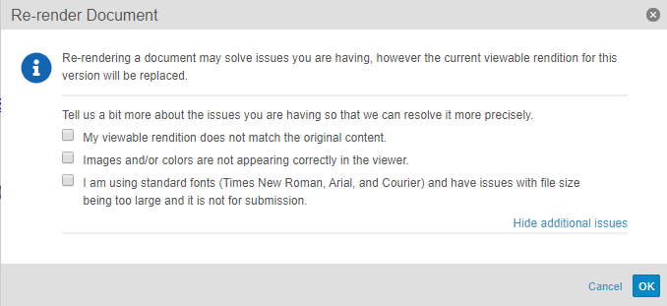
Remove Deprecated Re-Render Options
Automatic
Overview
  Removes several re-render options that are no longer applicable
  Other options that control rendition settings remain available in the Re-render Document dialog and are shown below
Business Justification
  Lays the groundwork for future enhancements and stops dependency on 3rd party rendering capabilities
For Word Doc
For Email Doc
For HTML
Feature Risk
N/A
Default Impact
VISIBLE TO ALL USERS

Slide 81
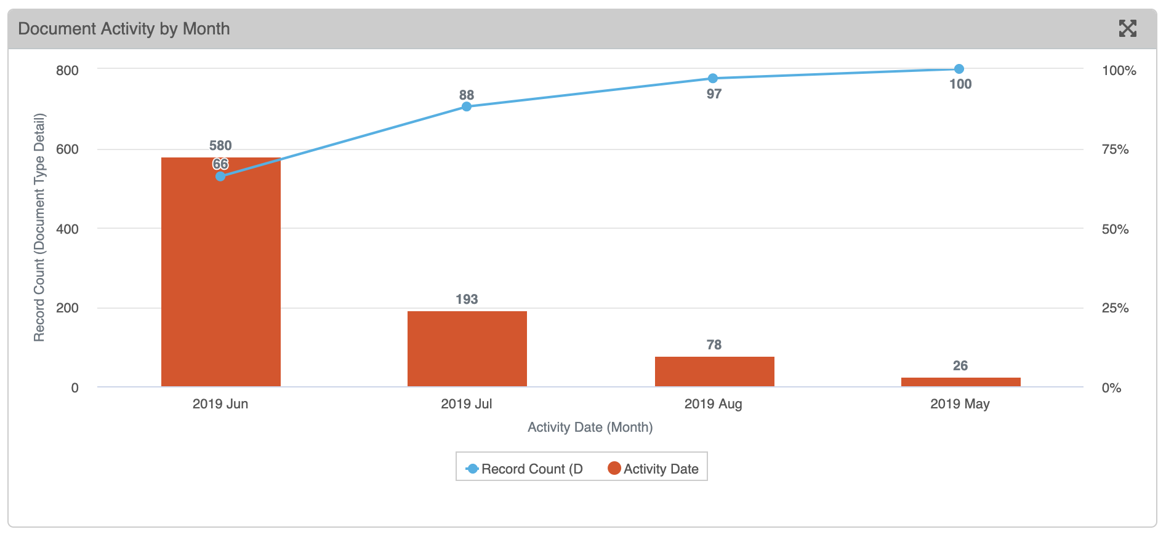
Pareto Charts
Automatic
Overview
  Pareto charts are now a supported Vault Dashboard chart type. They are similar to column charts, but always display groups in descending order and include a cumulative percentage line
Business Justification
  These charts are commonly used in quality control processes
The y-axis will either be the count of the primary, down or up objects, or an aggregate field calculation (e.g., 580 (June) + 193 (July) = 773, 773/877 (Total) = 88%)
The x-axis will be determined by the grouping
Feature Risk
LOW
Default Impact
VISIBLE TO ALL USERS

Slide 82
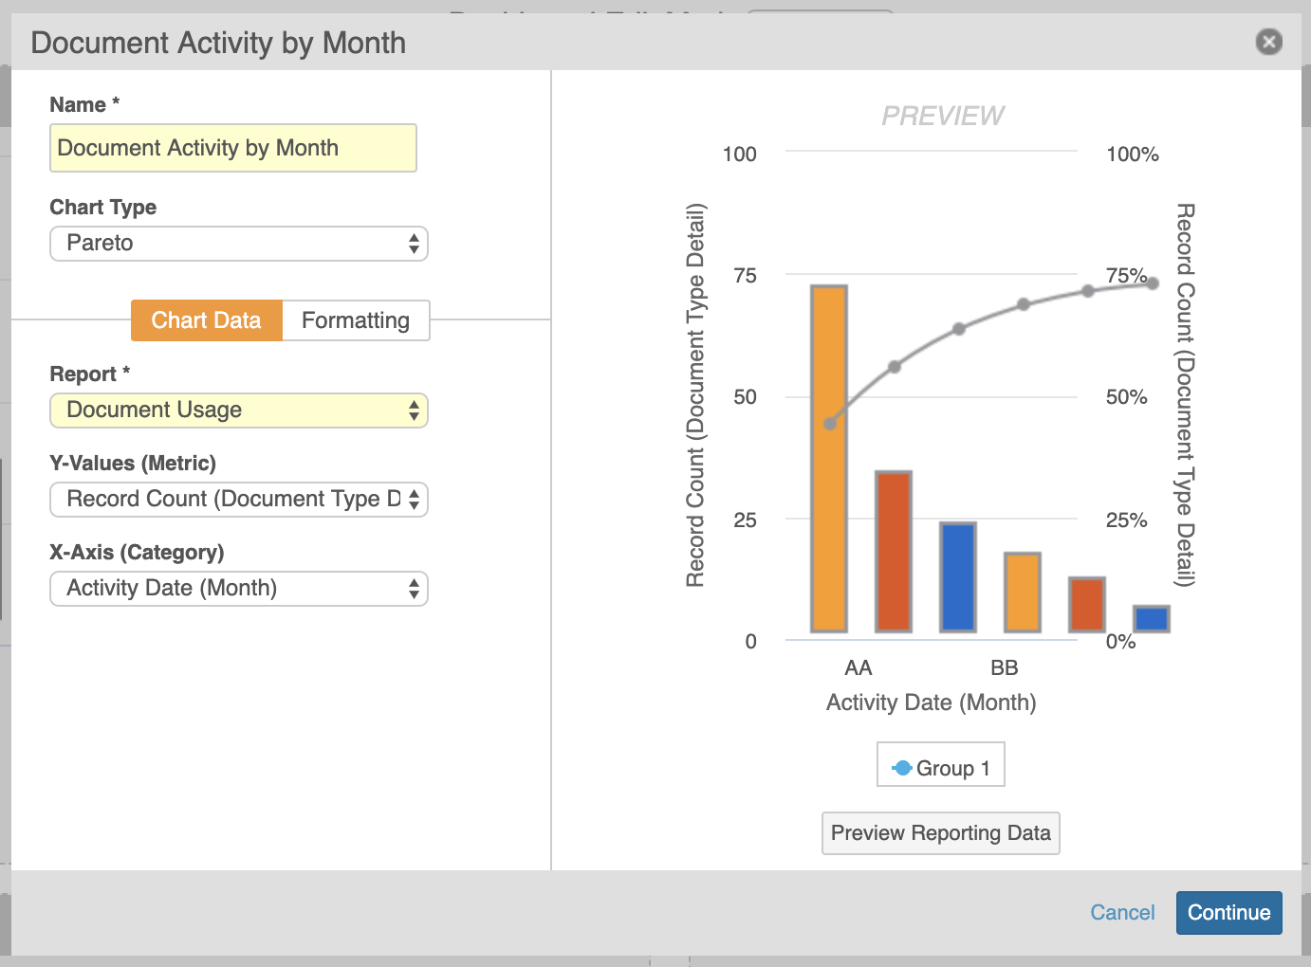
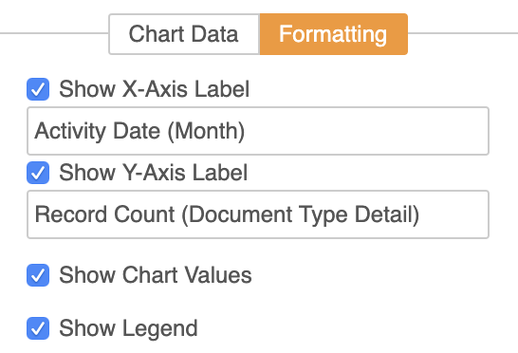
Pareto Charts
Automatic
Considerations
  Pareto charts will be available as an option when bar or column charts are available for selection
  Unlike a standard column chart, a ‘Group By’ option will not be visible for the Pareto chart
  When formatting the Pareto chart, the Cumulative % line is not editable
Feature Risk
LOW
Default Impact
VISIBLE TO ALL USERS

Slide 83
Optimizations for Merge Fields
Automatic
Overview
  The syntax for the WHERE clause has been simplified to use the familiar object relationship structure. In addition, Merge Field tokens now retrieve a maximum of 1,000 entries
Business Justification
  Includes new optimizations for Merge Fields that improve the performance and increase its ease of use
Considerations
  When using the WHERE clause, you cannot filter on the root object
  You can only filter on objects with outbound relationships
Feature Risk
N/A
Default Impact
VISIBLE TO ALL USERS

Slide 84
Document Workflow: Add Participants to Unselected Optional Tasks
Support
Overview
  Participant groups for optional tasks now appear in the Add Workflow Participants dialog window even if the associated optional task was not assigned when originally starting the workflow
Business Justification
  Previously, if the workflow initiator needed to add participants to optional tasks after a workflow has already started, they had to cancel the workflow and restart. Now, even if an optional reviewer/approver was not selected at the workflow start, they can still be added from the Add Workflow Participant action
Considerations
  You can add participants as long as the other parallel tasks have not yet been completed and the workflow has not proceeded beyond the tasks relevant to those participant groups
Add optional task participants
Feature Risk
MEDIUM
Default Impact
NONE

Slide 85
Webinar Poll – Working with Documents

Slide 86
System Administration

Slide 87
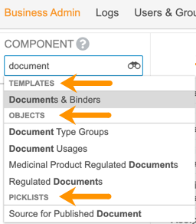
Enhanced Business Admin Navigation
Automatic
Overview
  This feature provides improved navigation in Admin > Business Admin, leveraging many of the search capabilities that users enjoy in custom object tabs
Business Justification
  Users with access to Business Admin can now use additional search options, apply filters, and save views, making it easier to locate elements housed in the Business Admin menu
Considerations
  The Admin > Configuration > Business Admin Menu page to configure the order has been removed, as the order is no longer necessary
  The dropdown selector returns results across templates, objects, and picklists
  A new element named All Picklists is available to navigate to the list of Picklists
  May require update of Business Admin training material
Feature Risk
LOW
Default Impact
VISIBLE TO ADMINS ONLY

Slide 88
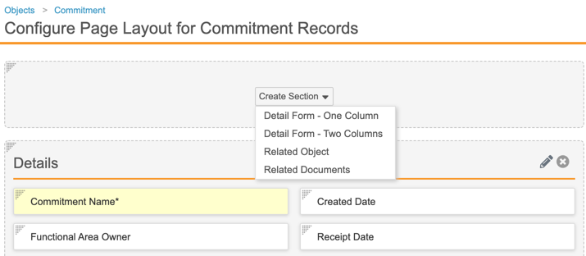
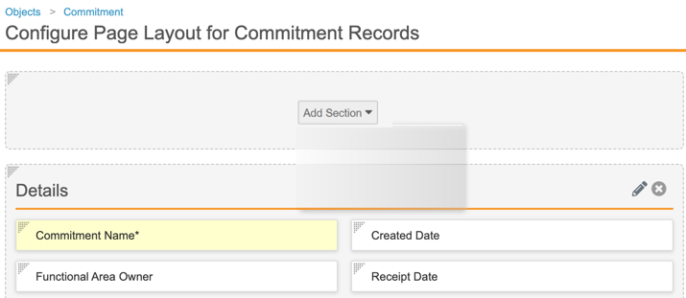
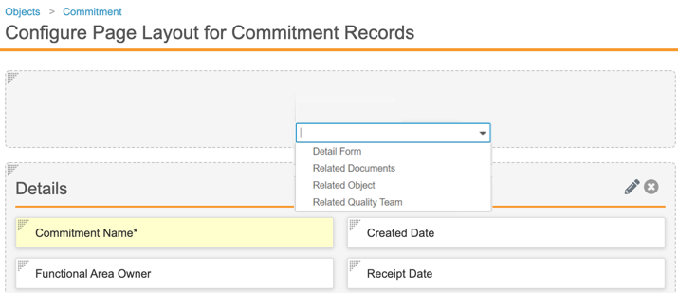
UI Changes in Object Page Layout Editor
Automatic
Overview
  When editing an object page layout
  The Create Section button is now labeled Add Section
  Two options under Add Section (Single Column Detail Form and Two Column Detail Form) have been consolidated into a single item (Detail Form)
Considerations
  This feature is not visible in Pre-Release Vaults, but will be Auto-on in the General Release
BEFORE 19R3
AFTER 19R3
Feature Risk
N/A
Default Impact
VISIBLE TO ADMINS ONLY

Slide 89
Object & Document Audit History Filters Enhancements
Automatic
Overview
  With this new feature more filtering options are available in the object and document audit histories
    Filter the Document Audit History by Time, Event and User in any order
    Filter the Object Audit History by Time, Event, User and Object in any order
Business Justification
  Customers often need to locate specific records in the audit trail, but are forced to export it in order to find what they are looking for. Locating specific activity is far more accessible with the additional filtering options
Considerations
  Filters are only available in the admin audit history
  Only 3 filters may be applied at a time for the object audit history
Feature Risk
LOW
Default Impact
VISIBLE TO ADMINS ONLY

Slide 90
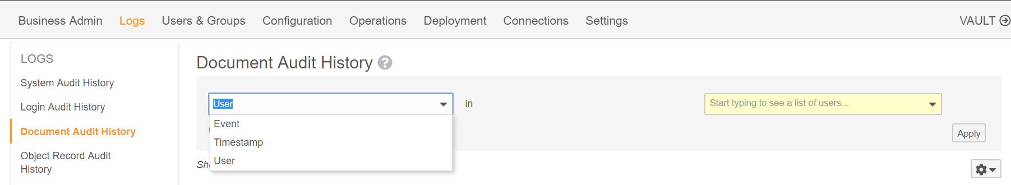
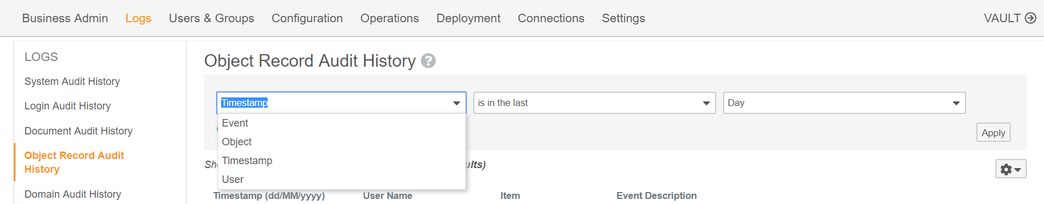
Object & Document Audit History Filters Enhancements
Automatic
Further filtering options are now available under Document Audit History
Feature Risk
LOW
Further filtering options are now available under Object Record Audit History
Default Impact
VISIBLE TO ADMINS ONLY

Slide 91
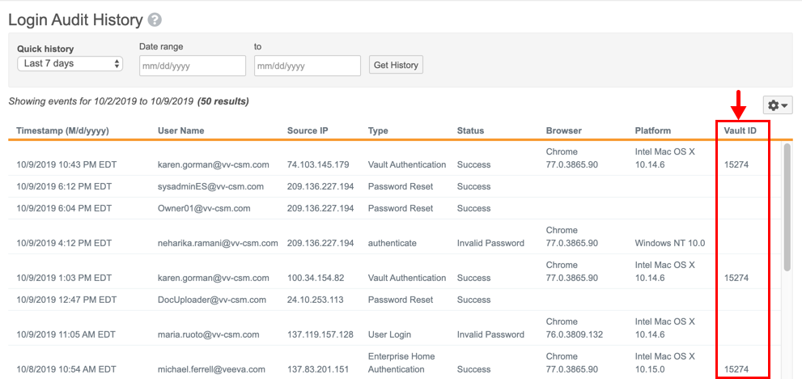
Add Vault ID Field to Login History UI
Automatic
Overview
  This feature exposes the Vault ID field in the Login Audit History
Business Justification
  Admins can now quickly understand to which Vault an Audit entry relates without exporting the Audit History
Feature Risk
HIGH
Default Impact
VISIBLE TO ADMINS ONLY

Slide 92
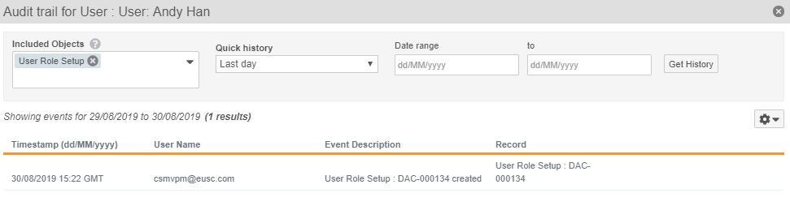
System Objects Supported in Related Record Audit Trails
Automatic
Overview
  Related object record audit entries are now supported to include system objects, such as User
Business Justification
  Provides an easier way to identify all related system activities related to a user. For instance, you can query from a User record all of the User Role Setup objects audit history. Previously you would have to go to the User Role Setup object to see it’s audit history
Considerations
  Created By and Last Modified By are not included due to not being true object references
Feature Risk
HIGH
Included Objects such as User Role Setup are visible within the user object record audit trail
Default Impact
VISIBLE TO ALL USERS

Slide 93
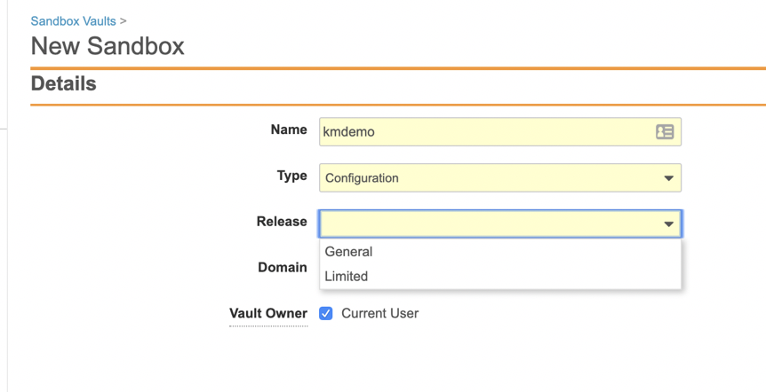
Limited Release Sandbox
Support
Overview
  Customers will now be able to create a Limited Release sandbox from a Vault on General Release
Business Justification
  Allows customers the ability to manage their own Limited Release sandbox to be able to more proactively assess new functionality ahead of each General Release
Considerations
  Allowed number of sandboxes for each customer will remain the same
  Configuration migration from Limited Release Vault to General Release Vault will not work (i.e. features won’t exist in General Release or the data models may differ)
Feature Risk
MEDIUM
Default Impact
NONE

Slide 94
Self-Serve Pre-Release Vaults
Automatic
Overview
  In past releases, Veeva has cloned customer Vault configurations to create a Pre-Release Vault with each release
  Starting in the 20R1 Pre-Release window, customers will be able to create, refresh, and manage their Pre-Release Vaults for each release
Business Justification
  This change will give customers greater control over their Pre-Release environments, particularly helpful in scenarios where a refresh is needed or a Pre-Release needs to be created from a Sandbox (when Production is not yet provisioned)
Considerations
  This feature is auto-on in 19R3 as the code changes required to update this process are occurring with 19R3
  This functionality will be enabled by Vault Operations:
    6 weeks ahead of General Release for the designated Early POD
    4 weeks ahead of General Release for all other PODs
  Each customer is entitled to 1 Pre-Release Vault for every Production Vault. If no Production exists, the entitlement will be 1 Pre-Release for the initial Sandbox Vault
Feature Risk
MEDIUM
Default Impact
VISIBLE TO ADMINS ONLY

Slide 95


Self-Serve Pre-Release Vaults
Automatic
Feature Risk
MEDIUM
Default Impact
VISIBLE TO ADMINS ONLY
Notes:
Vault Operations will enable the pre-release sandbox creation during the pre-release window ahead of each release. Customers will at that time be able to provision or refresh their pre-release Vault.

Slide 96

Self-Serve Pre-Release Vaults
Automatic
Feature Risk
MEDIUM
Default Impact
VISIBLE TO ADMINS ONLY
Notes:
The “Prerelease Available” column will change to zero once the Pre-Release vault is building or refreshing

Slide 97

User Pending State
Configurable
Overview
  This feature adds a new Pending state to the Vault Membership lifecycle so that Admins can assign new users to groups and sharing settings prior to granting the user access to the Vault
Business Justification
  Allows Admins time to set up new users appropriately and delay activation until training requirements are met or the user is fully set up
Considerations
  Admins can update the User record page layout to display the Activation fields
Feature Risk
MEDIUM
Default Impact
VISIBLE TO ADMINS ONLY

Slide 98

Delegate Access: Restrict Delegate Selection
Configurable
Overview
  Allows users to delegate access only to other members within a certain group defined by the organization
Business Justification
  Ensures only delegates in a defined group have the ability to perform user actions
Considerations
  In order to configure in Groups, the setting must first be enabled by checking “Delegate access allowed only among group members”
  Users still need to have the "Allow as delegate" permission in order to be selected as delegate (in addition to their group assignment)
Feature Risk
HIGH
Default Impact
VISIBLE TO ADMINS ONLY

Slide 99


Delegate Access: Restrict Delegate Selection
Configurable
Enable: Admin > Settings > General > Delegate Access
Activate: Admin > Users & Groups > Groups
Feature Risk
HIGH
Default Impact
VISIBLE TO ADMINS ONLY

Slide 100

Enhanced Delegate Access Experience
Automatic
Overview
  This feature improves the experience for delegate users by allowing them to return to their own Vault access via a banner link
Business Justification
  Provides simpler navigation between delegate and primary user account access
Considerations
  When logged in as another user who has access to multiple vaults, you can switch between the vaults to which you have access using the vault selector; however, the My Vaults page link will not be available
  The list of vaults in the vault selector will contain all vaults the user is able to access as the delegated user
Feature Risk
HIGH
Default Impact
VISIBLE TO ALL USERS

Slide 101
Global ID & Link Fields for Documents/Versions
Automatic
Overview
  Users can now uniquely refer to every document and version with a new Global ID and Global Version ID, which are unique across all vaults, using new Link and Version Link text fields
Business Justification
  The Global IDs help identify the exact document or document version in integrations between vaults or with other external systems while the Link and Version Link fields can be used to reference Vault global document IDs to connect them in integrations
Considerations
  We are adding these fields to the Base Document. While the Global ID fields are non-editable, Admins can control the Link fields’ edit permission like existing text fields
  The Global ID and Link fields will be visible in the General information section, customers can decide to change the security override setting after release
  All documents will have the Global ID and Global Version ID fields populated at the time of the 19R3 upgrade
  The Global ID fields cannot be used as merge field tokens
Feature Risk
LOW
Default Impact
VISIBLE TO ALL USERS

Slide 102
Additional System Admin Features
Feature | Description | Feature Risk | Default Impact
API Usage Logs to Include Request Duration | This feature adds a Duration column to the API Usage Logs, which shows the time it takes an API request to execute in Vault, measured in milliseconds. Note the duration does not include transport times between Vault and the client. | N/A | Visible to Admins Only
Include Seconds in Audit Trail Export Timestamp Column | This feature adds seconds to audit entry Timestamp columns, which are available when exporting from an individual audit trail or from Admin > Logs. | Medium | Visible to All Users
Java SDK Message Catalog: Admin UI | With this feature, Admins can use the UI to create and manage the Vault Java SDK message catalog. *This feature may not be validated in pre-release vaults. | N/A | Visible to Admins Only
Job Processors | Admins will see a new Job Processors section in Admin > Configuration > Vault Java SDK. Admins will also see SDK Job as an available Type when creating jobs in Admin > Operations > Job Definitions. | Low | Visible to Admins Only
Record ID & Object Label Column in Object Audit Exports | Object record audit exports now include a Record ID field, and exports to CSV and Text will contain the Object Label field. | Medium | Visible to All Users

Slide 103
Additional System Admin Features
Feature | Description | Feature Risk | Default Impact
Platform Data Model Changes | Added the following fields to all new and existing objects, documents, and document versions: Global ID (global_id_sys) and Link (link_sys) Added the following fields to the User object: Activation Date (activation_date_sys), Inactivation Date (inactivation_date_sys), Send Welcome Email (send_welcome_email_sys) | N/A | Visible to All Users
Spark Message Processor Label Clarification | Throughout the Vault UI, "Message Processor" has been changed to "Spark Message Processor". In Vault Java SDK, the Vault extension "MessageProcessor" will not be renamed. | N/A | Visible to Admins Only
Spark User Exceptions | This feature allows developers building Spark Integrations to track, route, and resolve any exceptions that require the attention of a Business Admin. | N/A | Visible to Admins Only
Link Formula Fields | Admins can define clickable URLs using formula fields with a Link return type. The Link can be a Vault to Vault URL, or a simple external URL | Medium | Visible to Admins Only

Slide 104
Additional System Admin Features
Feature | Description | Feature Risk | Default Impact
Update Label to PHI or PII Field | The Encrypt Field Value setting on object fields will be relabeled as Contains Protected Health Information (PHI) or Personally Identifiable Information (PII) to better reflect the intended usage for the setting. | High | Visible to Admins Only
Restrict Adding Users to Active Workflows with SDK-Managed Participants | When an object workflow configuration includes the option to use custom actions (created using Vault Java SDK) to define participants, the participant group is no longer available in the Add Participants dialog. This prevents users from manually changing the membership for participant groups defined by custom Vault Java SDK code. *Auto-on in vaults where a configured workflow uses the Record Workflow Action with SDK Managed Participants. | N/A | Visible to All Users
Correct Currency Format in Merge Fields & Formatted Output | Vault now displays proper formatting for currency fields within documents with merge fields and formatted output documents. | N/A | Visible to All Users

Slide 105
Additional System Admin Features
Feature | Description | Feature Risk | Default Impact
Uniqueness Update | Vault now applies changes to the Values must be unique setting asynchronously and blocks certain actions on the affected field while processing these changes, including deleting the field and modifying the Maximum Length setting. | Low | Visible to Admins Only
Global ID & Link Fields for Object Records | This feature introduces two new fields, Global ID and Link, to every object in Vault to uniquely identify object records and support integrations. Vault doesn't audit the addition of these two system fields in the System Audit History. | Medium | Visible to All Users
Spark Integration Management | This feature enhances Spark Integrations by allowing Admins to define groupings of business processes, called Integration Points, that work together to achieve the integration goals. | Low | Visible to Admins Only
Object State Types | This feature allows Admins to create or modify object state types and associate them to specific or all available object lifecycles | Medium | Visible to Admins Only
Increase Formula Field Limit for Objects | Each object may now have up to ten (10) formula fields | N/A | Visible to Admins Only

Slide 106
API Usage Logs to Include Request Duration
Automatic
Overview
  This feature adds a Duration column to the API Usage Logs
Business Justification
  The column provides Administrators the ability to determine the time it takes an API request to execute in Vault
Considerations
  The Duration does not include transport times between Vault and the client
Feature Risk
N/A
Default Impact
VISIBLE TO ADMINS ONLY

Slide 107

Include Seconds in Audit Trail Export
Timestamp Column
Automatic
Overview
  This feature adds seconds to the audit entry Timestamp column when exporting an audit trail from an individual document or record, or from the Admin > Logs page
Business Justification
  Makes audit exports from the user interface consistent with audit exports from the API, which already included seconds
Considerations
  The user interface shows seconds when hovering over a time stamp in the Timestamp column
Feature Risk
MEDIUM
Default Impact
VISIBLE TO ALL USERS

Slide 108
Java SDK Message Catalog: Admin UI
Automatic
Overview
  Vault Admins now have the option to add and manage Vault Java SDK custom messages through the Message Catalog User Interface
Business Justification
  Once added, developers can use the message in their Vault Java SDK code
Considerations
  Admins can coordinate message translation into any Vault supported language using the Bulk Translation tool
Feature Risk
N/A
Default Impact
VISIBLE TO ADMINS ONLY

Slide 109


Job Processors
Automatic
Overview
  Admins will see a new Job Processors section in Admin > Configuration > Vault Java SDK
Business Justification
  Admins have visibility to the list of Job Processors created by using the Vault Java SDK
Considerations
  Admins will also see ‘SDK Job’ as an available Type when creating jobs
  in Admin > Operations > Job Definitions
Feature Risk
LOW
Default Impact
VISIBLE TO ADMINS ONLY

Slide 110

Record ID & Object Label Column in Object Audit Exports
Automatic
Overview
  A Record ID field is now included within the object record audit exports, providing a way to uniquely identify the related record. In addition, exports to CSV and Text will contain the Object Label field
Business Justification
  Ensures consistency across the audit trail user interface and the exported data
Considerations
  Audit trails export as TXT when the multilingual document handling setting is enabled, and as CSV when this setting is disabled
Feature Risk
MEDIUM
Both Record ID and Object Label are now included within the export
Default Impact
VISIBLE TO ALL USERS

Slide 111
Platform Data Model Changes
Automatic
Overview
  With the 19R3 release, we have added the following fields to all new and existing objects, documents, and document versions: Global ID (global_id_sys) and Link (link_sys)
  In addition, the following fields have been added to the User object: Activation Date (activation_date_sys), Inactivation Date (inactivation_date_sys), Send Welcome Email (send_welcome_email_sys)
Business Justification
  With every release, we update the data model to better support evolving needs and new feature functionality
Considerations
  These data model updates are automatically included in all Platform vaults, but Admins must make configuration changes to make them available
Feature Risk
N/A
Default Impact
VISIBLE TO ALL USERS

Slide 112

Spark Message Processor Label Clarification
Automatic
Overview
  Throughout the Vault UI, the “Message Processor” label has been changed to “Spark Message Processor”
Business Justification
  This will help distinguish Spark message processors from other types of messages within Vault
Considerations
  In Vault Java SDK, the Vault extension "MessageProcessor” will not be renamed
Feature Risk
N/A
Default Impact
VISIBLE TO ADMINS ONLY

Slide 113
Spark User Exceptions
Configurable
Overview
  This feature allows developers building Spark Integrations to track, route, and resolve any exceptions that require the attention of a Business Admin
Business Justification
  Developers are now able to use User Exception objects and create their specific Lifecycle in order to manage handling exceptions encountered during a process
Considerations
  The objects are User Exception Message and User Exception Item
  You must have Integration Points configured in order to leverage User Exception Messages
Feature Risk
N/A
Default Impact
VISIBLE TO ADMINS ONLY

Slide 114
Link Formula Fields
Configurable
Overview
  Admins can define clickable URLs using formula fields with a Link return type. The Link can be a Vault to Vault URL, or a simple external URL
Business Justification
  With Vault to Vault integrations in place, this provides seamless two-way navigation between objects in different Vaults. Without integrations, this allows navigation to external sites or to a static document in another Vault. For example, with the Registrations Spark Connection, admins could configure a link from the Event record in Vault Registrations to the Change record in Vault QMS
Considerations
  Link fields are read-only for end users
  Links can be configured to open in the same window or a new window
  A user-friendly label can be displayed, rather than showing the full URL
  New Link formula functions are Hyperlink and Urlencode
Feature Risk
MEDIUM
Default Impact
VISIBLE TO ADMINS ONLY

Slide 115
Link Formula Fields
Configurable
Vault to Vault URL with Connection
Feature Risk
MEDIUM
External URL
Default Impact
VISIBLE TO ADMINS ONLY

Slide 116


Update Label to PHI or PII Field
Automatic
Overview
  The Encrypt Field Value setting on object fields is relabeled to Contains Protected Health Information (PHI) or Personally Identifiable Information (PII)
Business Justification
  This label change better reflects the intended usage of the setting, which allows Admins to add a secondary level of protection to highly sensitive information associated to an object record
Considerations
  The field was originally released in 19R2, and there is no change to existing functionality
Feature Risk
HIGH
Feature Label in 19R2
Feature Label in 19R3
Default Impact
VISIBLE TO ADMINS ONLY

Slide 117
Restrict Adding Users to Active Workflows with SDK-Managed Participants
Automatic
Overview
  When an object workflow configuration includes the option to use custom actions (create using Vault Java SDK) to define participants, the participant group is no longer available in the Add Participants dialog
Business Justification
  This restriction prevents users from manually changing the membership for participant groups defined by custom Vault Java SDK code
Considerations
  Even though this feature is listed as auto-on, the feature only has an impact for customers who have installed a Java SDK using a custom action to define participants
Feature Risk
N/A
Default Impact
VISIBLE TO ALL USERS

Slide 118
Correct Currency Format in Merge Fields & Formatted Output
Automatic
Overview
  Vault now displays currency values in merge fields and formatted output documents, using the format specified by the selected local currency
Business Justification
  Ensure currency values display with the correct formatting
Feature Risk
NA
Default Impact
VISIBLE TO ALL USERS

Slide 119
Uniqueness Update
Automatic
Overview
  Vault now applies changes to the ‘Values must be unique’ setting asynchronously and blocks certain actions on the affected object field while processing these changes, including deleting the field and modifying the Maximum Length setting
Business Justification
  Following a different underlying architecture for Uniqueness will allow to make the field uniqueness more robust
Feature Risk
LOW
Default Impact
VISIBLE TO ADMINS ONLY

Slide 120
Global ID & Link Fields for Object Records
Automatic
Overview
  Users can now reference every object record by a Global ID, which is unique across all vaults, through a new Link text field
Business Justification
  The Global ID helps identify the exact record in integrations between vaults or with other external systems while the Link field can be used to reference Vault global record IDs or external system IDs to connect them in integrations
Considerations
  We are adding both of these fields to every object. While the global ID is non-editable, Admins can control the Link field’s edit permission like existing text fields
  Global ID is not populated for existing records upon Release. Instead, whenever an existing record is edited, the Global ID field will be populated at that time. Admins can also request Veeva Support to run an action to populate Global ID values in an existing object in Vault
  All newly created records for all objects will have Global ID populated at the time of creation
Feature Risk
MEDIUM
Default Impact
VISIBLE TO ALL USERS

Slide 121
Spark Integration Management
Configurable
Overview
  This feature enhances Spark Integrations by allowing Admins to define groupings of business processes, called Integration Points, that work together to achieve the integration goals
Business Justification
  Administrators are now able to create the relevant objects that support an integration directly in the Vault UI
Considerations
  The business layer to support the processes and the objects is written using Vault Java SDK
  The objects are Integration and Integration Point
Feature Risk
LOW
Default Impact
VISIBLE TO ADMINS ONLY

Slide 122


Object State Types
Configurable
Overview
  This feature allows Admins to create or modify object state types and associate them to specific or all available object lifecycles
Business Justification
  Prior to 19R3, only Initial and Complete were available state types within object lifecycles. This feature allows Admins to assign additional state types to objects
Considerations
  Vault Compare and Vault Configuration Reports may show state type lifecycle components have changed even though there is no functional difference
  Admins can specify if the State Type is required, and if the scope:
  Applies to all lifecycles
  is Available to all lifecycles
  is for a Specific lifecycle
Feature Risk
MEDIUM
Default Impact
VISIBLE TO ADMINS ONLY

Slide 123
Increase Formula Field Limit for Objects
Automatic
Overview
  Each object may now have up to ten (10) formula fields
Business Justification
  Extends the number of formula fields from 5 to 10 per object allowing for greater use of formula fields
Considerations
  Formula fields can be used for text, date, Yes/No, number, icon, links
Feature Risk
N/A
Default Impact
VISIBLE TO ADMINS ONLY

Slide 124
Webinar Poll – System Administration

Slide 125
Additional Information

Slide 126
19R3 Developer Release Deep Dive
Thursday, 14-Nov at 7 a.m. PT / 10 a.m. ET / 3 p.m. GMT
Join Veeva Customer Success and Product teams for an education session on new features in the Veeva Vault developer-focused toolkit
This webinar is geared towards current users of the Vault Developer toolkit (API)
Key topics for discussion will include:
  Detailed explanation of new features
  Spark Integration Services
  Java SDK updates
  Considerations for using new features, and impacts features may have
  on your Vault or end users
Advanced registration required
Notes:
Webinar registration link: https://veeva.zoom.us/webinar/register/WN_50Miz-GsRNSMsGsVIpEMFw

Slide 127

Best Practices for Managing Vault Releases
This video contains:
Information About Vault General Releases
Recommended General Release Strategy
  Step 1: Auto-On Features
  Step 2: Configurable Features
Sample Demonstration of a Release Process
Link to Presentation Video *
*(Support Portal Login Required)
Notes:
https://support.veeva.com/hc/en-us/articles/360003528094-Veeva-Vault-Best-Practices-Knowledge-Collection

