Slide 1

19R3 Vault Quality
Release Preview and Planning
Revision: 06-Nov-2019
Please use ‘Q&A’ to ask a question

Slide 2





Vault Quality 19R3 Presenters
Bob Kenney
Enterprise Quality Customer Success
North America bob.kenney@veeva.com
Jason Cox
Enterprise Quality Customer Success
Manager, North America
jason.cox@veeva.com
Jessica Kelley
Enterprise Quality Customer Success
North America jessica.kelley@veeva.com
Mike Holland
Enterprise Quality Customer Success
Europe
mike.holland@veeva.com
Neelam Sidhu
Enterprise Quality Customer Success
Manager, Europe neelam.sidhu@veeva.com
Sapan Modi
SMB Quality Customer Success
North America sapan.modi@veeva.com

Slide 3
Foreword
The content of this presentation is subject to change prior to the 19R3 Release
Please note the revision date on the title slide
Veeva encourages you to always reference Release documentation from our Release pages to ensure you are using the latest information
Help → Release Notes → About the 19R3 Release

Slide 4
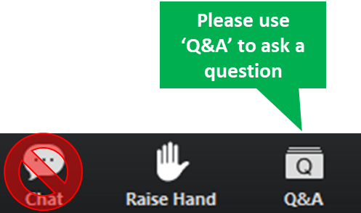
Interact With Us!

Slide 5
Planning for the 19R3 Release
Logistics
Announcements
Features
Identify key
release dates
Promote awareness of Veeva events
Review new features
based on themes
Note: Keep Alert for Polling!

Slide 6
Logistics

Slide 7
19R3 Release Calendar
Customer Validation
Sun | Mon | Tue | Wed | Thu | Fri | Sat
27 | 28 | 29 | 30 19R3 Release Webinars | 31 19R3 Release Webinars | 1 | 2
3 | 4 Pre-Release Vaults | 5 Validation docs 19R3 Release Webinars | 6 19R3 Release Webinars | 7 | 8 QMS Executed OQ Scripts | 9
10 | 11 | 12 | 13 | 14 | 15 | 16
17 | 18 | 19 | 20 | 21 | 22 Upgrade - VV1-12, VV1-1065, VV1-1069 | 23
24 | 25 | 26 | 27 | 28 | 29 | 30
1 | 2 | 3 | 4 | 5 | 6 Upgrade - all remaining PODs | 7
OCT
NOV
DEC
Notes:
Looking at some of the key dates for the release, we have this general release calendar
Next week we will release the pre-release vaults and will have access to your validations documentation which will be added to our Compliance Docs vault
We will be talking more about this at the end of this call to talk about managing vault released
But always feel free to reach out to your CSM or Managed Services Consultant for additional
As we move through the next few weeks, this is your opportunity to perform any change control or validations per your policies and SOPs
On Aug 2nd, we will be upgrading VV1-8
On Aug 9th, we upgrade all the remaining PODs
Note that all customers are upgraded to 19R3 and applies to Production, Test, and Sandbox Vaults
Downtime will be approximately 7 hours and we will have additional details at the end of this call
If you need help locating which number POD you are on, it is located in Vault help as well as on the admin side of Vault in Settings > General Settings > Vault Information

Slide 8
Pre-Release Environments
We have changed our approach to provisioning Pre-Release environments
All customers will continue to receive a Pre-Release environment, including new Production Vaults provisioned post-19R2 Pre-Release
Customers who have used Pre-Release in last two releases will be refreshed with Production configuration
Customers who haven’t used Pre-Release in the last two releases will not be refreshed with Production configuration
  Refresh can be requested via Support ticket
Pre-Release Vaults include:
  Configuration
  Vault Owners
  Object Data referenced in configuration rules
  NO documents or transactional data

Slide 9
Sandbox POD Separation
Majority of sandbox POD moves have
been completed, remaining will
be done prior to Nov 22
Schedule communicated via Service Availability setting
Customers should ensure IP whitelisting is done by domain or IP range
More information can be found on Vault Help
19R3: Sandbox PODs will be upgraded up to
8 hours before production vaults
Schedule communicated via Service Availability setting

Slide 10
19R3 Go Live
All customers upgraded to 19R3
  Applies to Production, Test, and Sandbox Vaults
NOVEMBER
Friday 22
PODs VV1-12, VV1-1065,
VV1-1069
Date | POD | Start Time | Duration
Nov 22 2019 | US POD VV1-1069 Sandbox POD | 1:00 pm PT | Up to 4 hours*
 | All PODs – Authentication service update | 5:00 pm PT | 1 hour
 | US POD VV1-12, VV1-1065 | 6:00 pm PT | Up to 4 hours*
DECEMBER
Friday 06
Date | POD | Start Time | Duration
Dec 06 2019 | APAC POD VV3-3064 APAC & EU Sandbox PODs | 10:00 am PT | Up to 4 hours*
 | US Sandbox PODs | 2:00 pm PT | Up to 4 hours*
 | US PODs (except Nov 22nd PODs) EU PODs APAC POD VV3-34 | 5:00 pm PT | Up to 4 hours*
All Other PODs
* On November 1 2019, http://trust.veeva.com will be updated with final downtime durations

Slide 11




19R3 Release Webinar Series
Product-specific webinars focused on the use cases and impact of key features
  The same webinars are presented at multiple times
  One webinar per product will be recorded and available after the series via …
  Help > Release Notes > About the 19R3 Release
Platform
Oct 30 at 12 PM EDT
Oct 31 at 3 PM EDT
Nov 5 at 8 AM EDT
Nov 6 at 9 AM EDT
Oct 30 at 8 AM EDT
Oct 31 at 9 AM EDT
Nov 5 at 12 PM EDT
Nov 6 at 3 PM EDT
Oct 30 at 9 AM EDT
Oct 31 at 8 AM EDT
Nov 5 at 3 PM EDT
Nov 6 at 3 PM EDT
Oct 31 at 12PM EDT
Nov 5 at 9 AM EDT
go.veeva.com/19R3_clinical
go.veeva.com/19R3_quality
go.veeva.com/19R3_rim
go.veeva.com/19R3_platform
Notes:
We do offer webinars for each of our application suites
We are here today to cover Clinical, but you are also welcome to attend any of the other webinars
We do record the webinars and make the slides and recording available on our 19R3 help site, so you will have the ability to go back and review these

Slide 12
Announcements

Slide 13
Early POD Upgrade Schedule
The early POD designation will no longer be variable
The schedule for early POD in future releases is as follows:
Release | Early PODs
R1 - April | VV1-2, VV1-1065, VV1-1055
R2 - August | VV1-8, VV1-1065, VV1-1068
R3 - December | VV1-12, VV1-1065, VV1-1069
Vaults on the designated early POD will receive access to Pre-Release 2 weeks earlier than other PODs

Slide 14
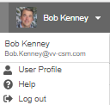
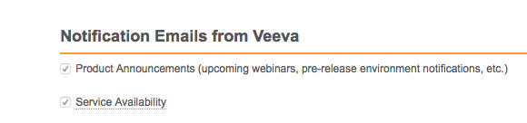
Notification Emails from Veeva
Opt-in to Product Announcements in User Profile to be contacted about:
  Initial release announcement (RIA)
  Release webinar invites
  Pre-release and validation document availability
  Go-live & key date reminders
Opt-in to Service Availability notifications in User Profile to be contacted about:
  Planned system maintenance
  Service disruptions

Slide 15
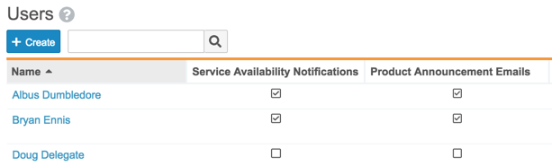
Administer Communications
Admins can manage who receives communications for each vault
  Service Availability Notifications can be configured using one or both of the following methods:
  1. Provide an email address for an individual, or a distribution list for multiple people, in each Vault
    Admin > Settings > General Settings > Service Availability Notifications
  2. Enable Service Availability and Product Notifications for an individual user, or use Bulk Action to setup for multiple users at once
    Admin > Business Admin > Users
Customers can report on the User object to:
  Determine who opted in to Product Announcements and Service Availability notifications
  Use Bulk Actions to set or remove this option for multiple Users

Slide 16
Internet Explorer™ 11 on Windows™ 7
In January 2020, Veeva will no longer support the combination of
Internet Explorer™ 11 on Windows™ 7
  Internet Explorer™ 11 is still a supported browser on other operating systems
We encourage all Veeva customers to upgrade to a newer browser
Learn more about supported browsers for Vault

Slide 17
Register Now
700+
140+
attendees from life sciences
life science companies
Join our European R&D Community
Share Best Practices
Develop New Industry Partnerships
Network with Peers
18 – 20 May 2020 | Barcelona, Spain

Slide 18
Features

Slide 19






Vault Quality Release Themes
Quality Processes
Document Management
User
Experience
Access
Control
System Administration
Development
Toolkit

Slide 20

Vault Quality Release Key Takeaways
Station Manager for iOS
Vault Spark for Variation Management in QMS / Registrations
Instructor (Classroom) Training
Collaborative Authoring with Microsoft Office
Self-Serve
Pre-Release Vaults
Limited Release Sandbox
Notes:
Quality Teams
Admin
General Availability
Process Visibility Improvements
Lifecycle Stages
Configurable Tab Filters
Reporting
Multi-Pass Reporting
Report Type: Document with Created by User

Slide 21
Feature Personas
Viewer
Admin
Power User
Developer
Viewers access approved docs and records
Power Users manage docs and records
through their lifecycles
using application-specific business processes
Business and System Admins maintain data,
security, and configurations
Developers build
data models, business process configurations,
system integrations, and data migrations

Slide 22

Feature Enablement Detail
Auto-On Features
Configurable Features
Auto-On
Admin Checkbox
Configuration
Support
Turned On Day 1
Automatically available, some setup may be required
Turned Off
Requires enablement
Turned Off
Requires enablement
Requires
configuration
Turned Off
Requires enablement
Product Support Request

Slide 23
Quality Processes

Slide 24

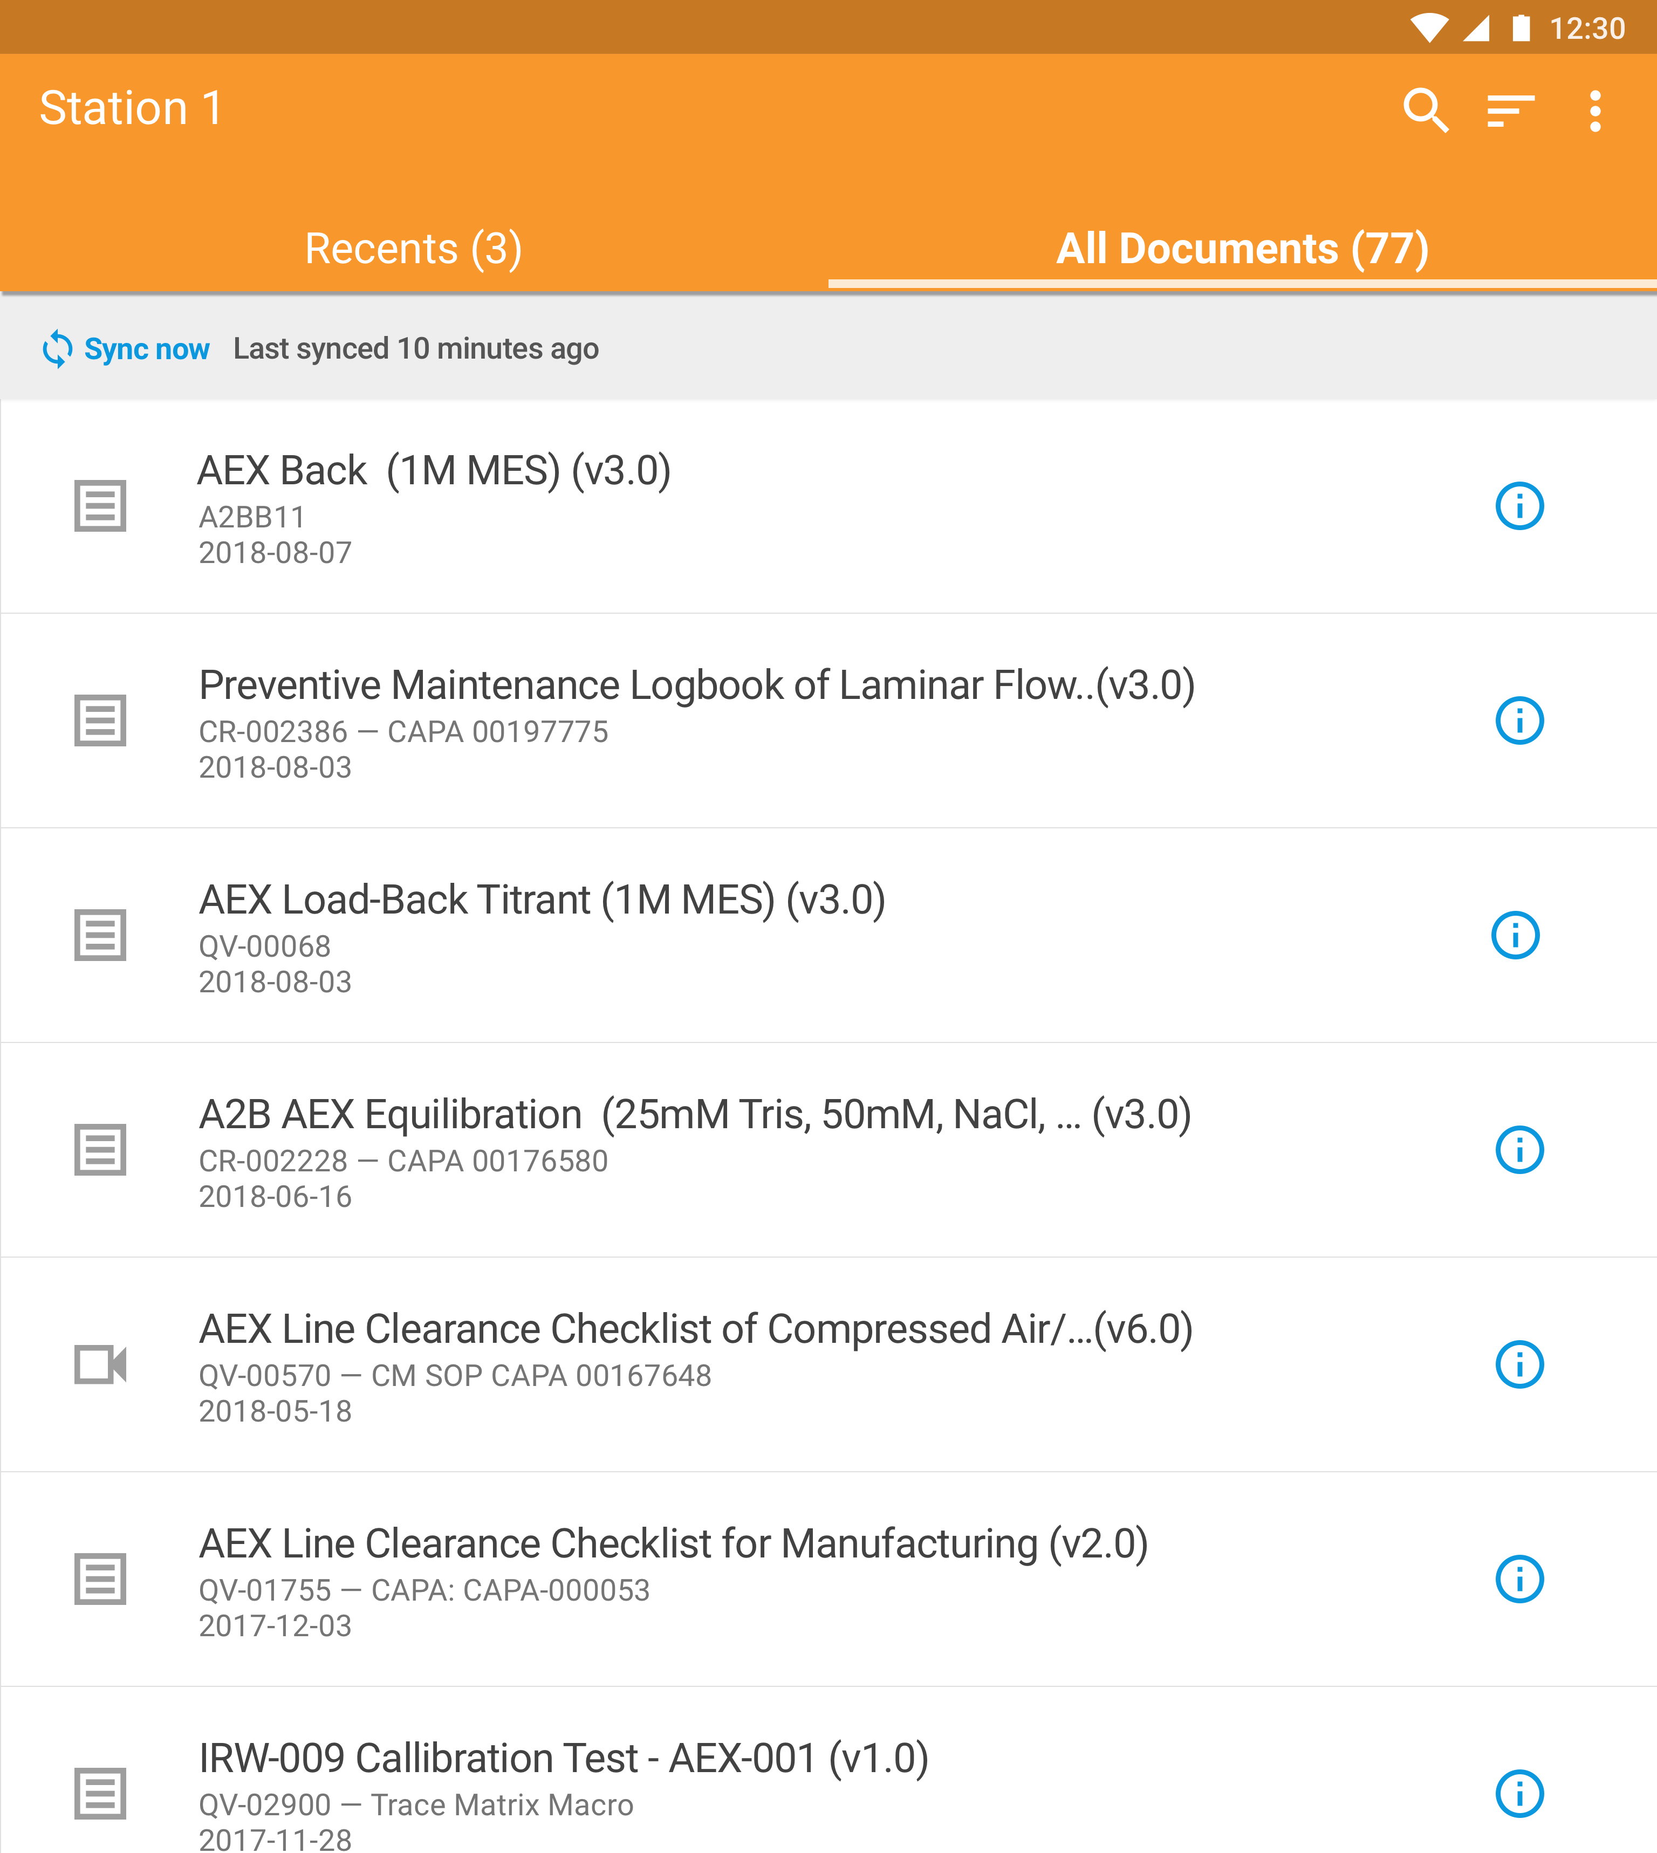
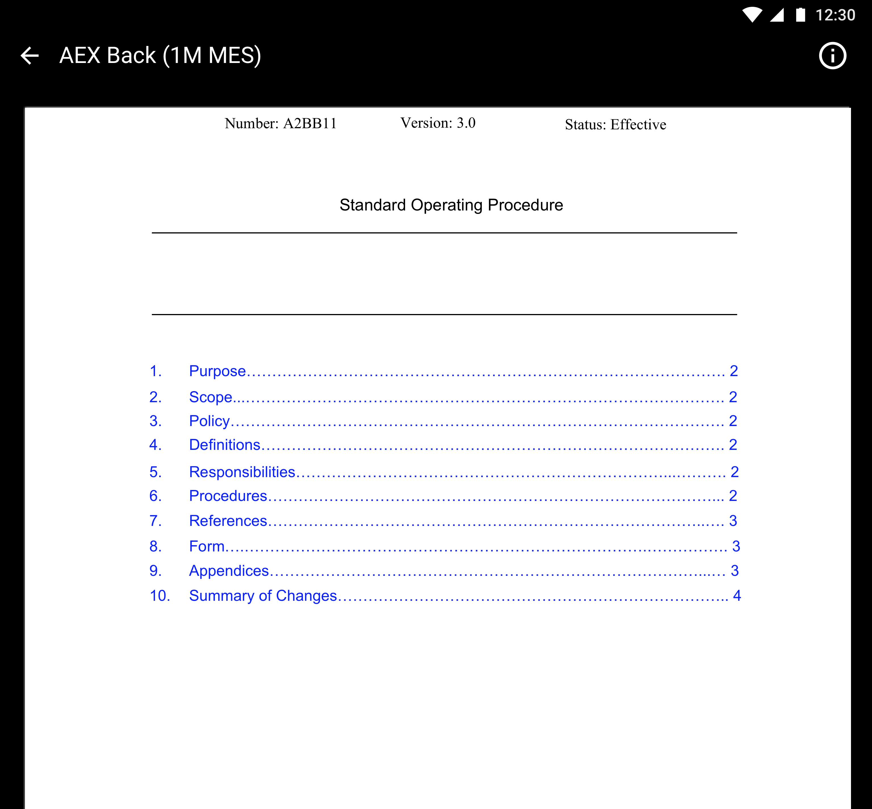
Station Manager for iOS
Support
Overview
  New iOS mobile app that allows users to view Quality documents and videos stored in QualityDocs
  Fast, offline, 24 x 7, full screen access using shared iPads
Business Justification
  Provide electronic access to the latest effective versions of specific documents, reducing the need for paper controlled copies
  Applicable to manufacturing and lab environments
Considerations
  Fit for purpose – e.g. minimize “pinching” for personnel wearing gloves
  Only available for Early Adopters
  iOS Station Manager will be validated in pre-release Vaults
  Early Adopter Application
Setup by:
Admin
for use by:
Viewer
Feature Risk
MEDIUM
Default Impact
NONE

Slide 25



Vault Station Manager
Support
  Early Adopter Application
Site Business Administrator
Vault web application user that associates documents with Stations
Setup by:
Admin
for use by:
Viewer
Site IT
Sets up Station Manager by logging in and associating a tablet with a Station
Logs out of Station Manager when the tablet needs to be re-purposed (e.g. moved to another station)
Site Manufacturing User
Accesses a tablet’s/Station’s specific documents to perform their job
Already trained on the Station’s documents (training tracked in LMS)
Feature Risk
MEDIUM
Default Impact
NONE
This Photo by Unknown Author is licensed under CC BY-SA

Slide 26
QMS Spark Connection: Change Control & Variation Management
Support
Overview
  Enables organizations using QMS and Registrations Vaults to automate sharing data about change events throughout the change management process
Spark Connections
Quality Vault
RIM Vault
  Early Adopter Feature
Perform Regulatory Impact Assessment
Change Impact Assessment
Regulatory Impact Assessment
Setup by:
Admin
for use by:
Power User
Build & Approve Change Plan
Business Justification
  Streamline the variation process for manufacturing change controls
  Increase stakeholder visibility throughout the process
  Eliminate duplication of data across Vaults
Execute Approved Change
Regulatory Filing Updates
Implement Change Plan
Considerations
  Only available to Early Adopters
  QMS and Registrations applications will include the pre-built integration points
  Fields are mapped between Vaults
Feature Risk
MEDIUM
Update Status of Regulatory Filing Activities
Execute Approved Change
Regulatory Country Approvals
Default Impact
NONE
Change Complete
Notes:
When a QMS Vault user initiates a change control impact assessment on a Quality Event record, the Spark Connection creates a corresponding Event record in the Registrations Vault, with the associated details (metadata) about the change.
A Registrations Vault user performs a regulatory impact assessment using the Event record to determine the necessary regulatory filing activities. When the regulatory impact assessment is complete, and the Registration Vault’s Event record is moved to the next state, the Spark Connection notifies QMS Vault users to complete and approve the associated change plan.
When QMS Vault users approve the Quality Event change plan, the Spark Connection changes the status of the related Registration Vault’s Event record to start implementation of the change plan.
As regulatory filing activities associated with the Registration Vault’s Event record are updated with information from Health Authorities, the Spark Connection updates the related records in the QMS Vault so QMS users can track the filing status for each market.
When the change is complete, and a QMS user closes the Quality Event record, the Spark Connection automatically closes the related Registrations Vault’s Event record.

Slide 27

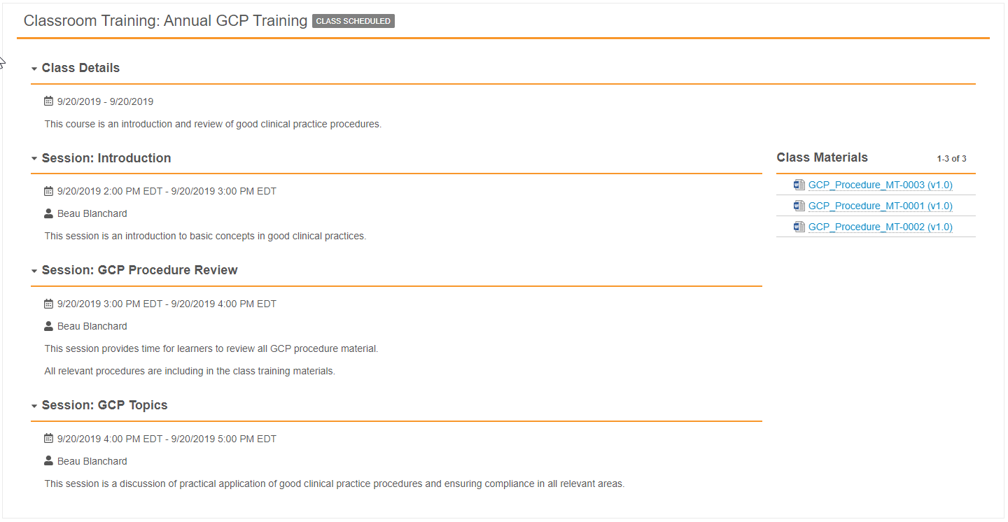
Instructor-Led Training
Configurable
Overview
  Vault now supports the tracking of Instructor-Led Training in a classroom or group setting. Instructor-Led Training enables organizations to:
  Create a training class
  Capture sessions, locations and times
  Select materials taught in a class
  Build a class roster of Learners
  Track Learner attendance
  Issue quizzes to assess competency
Business Justification
  Provide role based learning to ensure learners are trained, organizations are audit ready, and can demonstrate compliance
Considerations
  Requires Training Requirement Impact Assessment process configuration
Setup by:
Admin
for use by:
Viewer
Feature Risk
HIGH
Default Impact
VISIBLE TO ADMINS ONLY

Slide 28

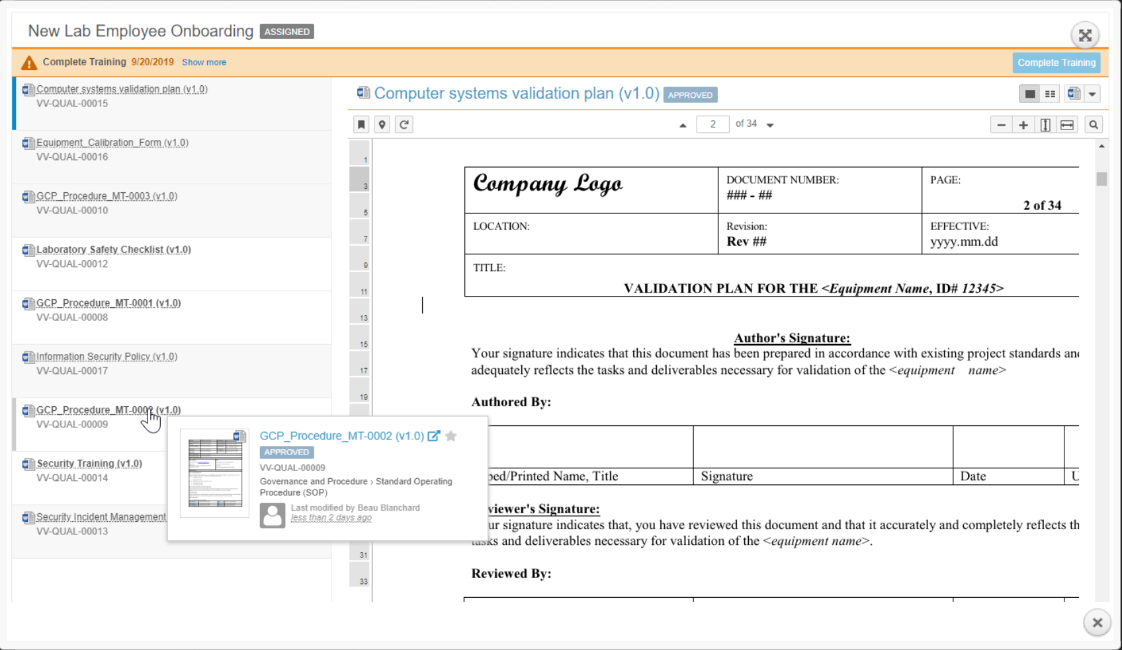
Learner Task Page for Document Training Assignments
Automatic
Overview
  The user experience has been enhanced for Learners completing document training in Vault …
4
6
Support for multi-doc training & visual indicators to track docs already viewed
Configurable ordered-reading lists - option to force Learner to read in order
Toggle between reading content & metadata (includes doc relationships and version history)
Task descriptions & due dates
Hovercard to open two documents at the same time
Complete Training or Take Quiz available after Learner opens every document
Setup by:
N/A
for use by:
Viewer
1
3
2
Feature Risk
HIGH
5
Default Impact
VISIBLE TO ALL USERS
Notes:
Support for multi-document training, providing a list of documents included as part of the Training Assignment, including visual indications to help learners keep track of which documents they have read
Visual indications for Learners who have been assigned training on content that they are unable to see because of security settings
Configurable ordered-reading lists to guide learners to read the documents in a Training Assignment in a specific order
The ability for Learners to toggle between reading the document’s content and viewing the document metadata or version history while completing document training
Introduction of a task information bar at the top of the Learner’s task page, including task descriptions and due date color treatments
Hovering over a training item listed in the Document Selector of the Learner’s Task page displays a hovercard, which Learners can use to open two documents within the same assignment for side-by-side learning.
The Complete Training or Take Quiz button is unavailable until the Learner has at least opened every document assigned to them as part of the assignment

Slide 29

Quality Processes Poll
Based on what you know about the Quality Process applications and features we just covered, which ones do you think you will use?
Station Manager for iOS
QMS Spark Connection: Change Control & Variation Management
Vault Training with Instructor-Led Training and New Learner Task Page for Document Training Assignments

Slide 30
Other Quality Process Features
Station Manager (Android): Additional Supporting Documents Relationship
Quality Teams: Cancel Role-Assigned Task When User is Removed from Role
Vault Training
  Training Requirement Recurrence Enhancement (i.e. absolute due date - annually, every August 1st)
  Multi-Document Training Requirements (i.e. one training requirement for an SOP and its forms, or related SOPs)
  Copy Custom Fields (i.e. copy Department from a Training Requirement to Learners’ Training Assignments)
  Job Logging (Improves readability of the actions automatically performed by the Update Training Assignments job )
  Data Model Changes for Training Assignment Checklist Lifecycle (FYI)

Slide 31
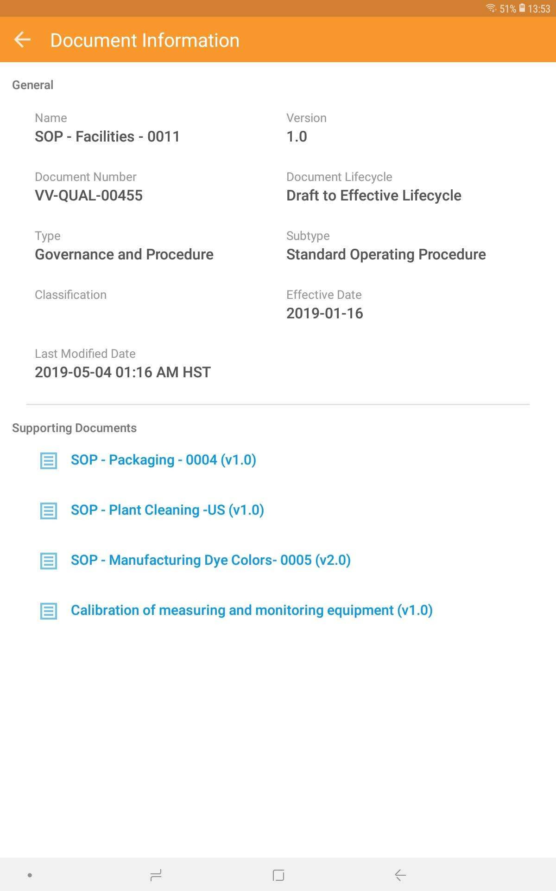
Additional Supporting Documents Relationship
Support
Overview
  The Station Manager mobile app allows users can see/navigate to a document’s related Supporting Documents
  This release extends the Android mobile app’s ability to show Supporting Documents for certain kinds of Supporting Document relationships (see Considerations)
Business Justification
  Allows users to understand how a document relates to other documents
Considerations
  Applies to supporting_documents__c relationship (previous release only applied to supporting_documents__vs)
  Station Manager is only available for Early Adopters
  Android Station Manager will not be validated in prerelease Vaults
Setup by:
Admin
for use by:
Viewer
Feature Risk
N/A
Default Impact
NONE

Slide 32
Quality Teams: Cancel Role-Assigned Task When User is Removed from Role
Automatic
Overview
  When a user is assigned a workflow task via a Quality Team Role …
  and later that user is removed from the Quality Team Role, Vault will automatically cancel their task
  and later replaced with another user in the Quality Team Role, Vault will automatically reassign their task
  NOTE: Vault already automatically adds a user to a Quality Team role’s workflow task when the user is added to the Quality Team role
Business Justification
  Eliminates the manual step to cancel or reassign a user’s task, after they are removed or replaced from a Quality Team role
Considerations
  Automatically enabled for all customers using the Quality Teams feature
  Applies when a workflow task is issued to all members of a specific Quality Team role
  This feature also cancels/reassigns a user’s Quality Team workflow tasks on related child records when a Quality Team Role is configured to cascade it’s membership to child records
  Consider adding decision steps in workflows to address situations where a workflow task is cancelled and there was only one user assigned to the task when the user was removed from the Quality Team role
Setup by:
N/A
for use by:
Power User
Feature Risk
MEDIUM
Default Impact
VISIBLE TO ALL USERS

Slide 33
Training Requirement Recurrence Enhancement
Configurable
Overview
  The new “Absolute” Training Requirement recurrence option issues training tasks to Learners on a fixed date
  Example: Issue a training task for the “Insider Trading Policy” Training Requirement on August 1st every year
Business Justification
  Support recurring training that occurs on a fixed date
Considerations
  Applies to the following Training Requirement types:
  Vault Document
  Classroom
Setup by:
Admin
for use by:
Viewer
Feature Risk
HIGH
Default Impact
VISIBLE TO ADMINS ONLY

Slide 34
Multi-Document Training Requirements
Automatic
Training Assignments
Overview
  Allow multiple documents to be included in a single Training Requirement and related Training Assignments
  Training administrators can configure …
  which document versions to include in a Training Requirement
  the order in which those documents will be presented to the Learner
  whether or not to force the Learner to read documents in a specific order
Business Justification
  Send Learners a single training task with multiple related SOPs, and optionally require a single quiz to confirm competency with information conveyed in all documents
Considerations
  Prohibits modification of documents on Training Requirements in the Retired or Available lifecycle states
  A Training Requirements Impact Assessment process must be configured to use this feature
Setup by:
N/A
for use by:
Viewer
Feature Risk
MEDIUM
Default Impact
VISIBLE TO ALL USERS

Slide 35
Multi-Document Training Requirements
Automatic
Training Requirement Impact Assessments
Overview
  Vault is capable of starting a Training Requirement Impact Assessment process
Business Justification
  Ensure trainers make informed decisions about updating Training Requirements and Quizzes when documents change
  Training Impact Assessors (role on a document) receive a task that describes:
  the Training Requirement impacted
  the associated document versions
  the quiz currently in use
  a suggested set of new document versions
  Training Impact Assessors complete the task, and select a verdict to proceed as follows:
  Update the Training Requirement with the changes specified
  Retire the Training Requirement
  Pause the impact assessment to wait for additional documents to become available
  End the impact assessment with no impact to the Training Requirement
Setup by:
Admin
for use by:
Power User
Feature Risk
MEDIUM
Default Impact
VISIBLE TO ALL USERS

Slide 36
Copy Custom Fields
Configurable
Overview
  This new Vault Training feature allows custom fields’ data values to be copied from Training Requirement records to identically named fields on Training Assignment records
Business Justification
  This feature allows customers to give access to Training Assignment records beyond the Learner role
  Example: Copy the user in a Training Requirement’s Quality Manager field to related Training Requirement records so the user can view the Training Assignment records
Considerations
  Grant access to Training Assignment records by configuring Dynamic Access Control (DAC) Custom Sharing Rules or Matching Sharing Rules on Training Assignment records using the custom field values copied from Training Requirements
  The following field types cannot be copied
  Formula
  Currency
  Lookup
Setup by:
Admin
for use by:
Viewer
Feature Risk
HIGH
Default Impact
VISIBLE TO ADMINS ONLY

Slide 37
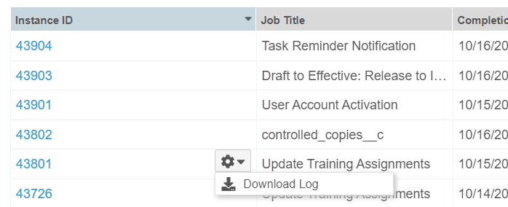
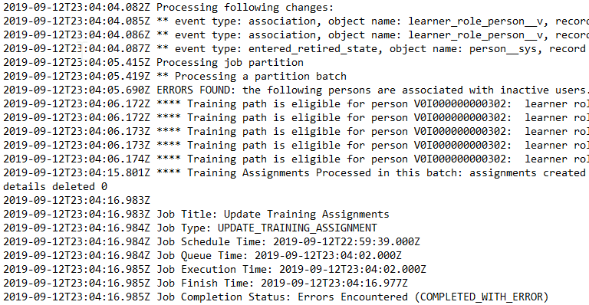
Job Logging
Automatic
Overview
  The Vault Training application’s Update Training Assignments job automates creation and distribution of assignments and tasks
  This feature enhances the information captured in the job’s log file as follows:
  count of changes that were flagged for processing
  changes that were successfully processed
  errors that occurred, if any
Business Justification
  Improves readability of the actions automatically performed by the Update Training Assignments job
  Enables your Administrator staff to troubleshoot issues and take appropriate actions
Setup by:
N/A
for use by:
Admin
Feature Risk
LOW
Default Impact
VISIBLE TO ADMINS ONLY

Slide 38
Data Model Changes for Training Assignment
Checklist Lifecycle
Automatic
Overview
  Entry Actions were added for the TA Checklist Lifecycle >> Passed lifecycle state
  Added a condition to execute existing Entry Actions if Quiz Issuance Tracker is blank
  The Copy Field To Related Object Entry Action was replaced with Update Related Record Field
Business Justification
  There is no functional impact to this change
Considerations
  These changes were made to be consistent with additional Entry Actions that were added as part of the Instructor-Led Training feature
Setup by:
N/A
for use by:
Admin
Feature Risk
MEDIUM
Default Impact
VISIBLE TO ADMINS ONLY

Slide 39
Business Strategy Poll
Risk Assessment Poll
If your organization is using (or considering) the Quality Risk Management process in QMS, what risk assessment methodologies do you prefer to leverage?
FMEA
Other
I don’t know
Not planning to use Quality Risk Management in QMS

Slide 40
Document Management

Slide 41

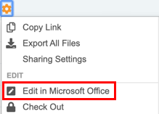
Collaborative Authoring with Microsoft Office
Configurable
Overview
  We are adding a new way to work on Microsoft Word documents by enabling the collaborative authoring functionality. With this feature, customers who leverage an Azure / Office 365 tenant can work simultaneously on the same document
Business Justification
  Document editors can easily check out and check in MS Word documents to Office 365 using their desktop client, allowing multiple users to edit a document at the same time
Considerations
  Only Microsoft Word documents (*.docx)
  are supported as of the 19R3 release
  Azure / Office 365 tenant setup is required
  before configuring in Vault
  All users with Edit permission can collaborate
  on the document so it’s critical to have
  communication between authors
Setup by:
Admin
for use by:
Power User
IN EDIT
Feature Risk
MEDIUM
Default Impact
VISIBLE TO ADMINS ONLY

Slide 42
Collaborative Authoring with Microsoft Office – Technical Enablement Q&A
Thursday, 12-December at 8 a.m. PT / 11 a.m. ET / 4 p.m. GMT
If you are interested in enabling Collaborative Authoring with Microsoft Office:
  Identify your organization’s Azure / Microsoft 365 administrators
  Ask them to join a live technical enablement Q&A session with the Veeva Product, Customer Success and Services team.
This webinar is geared towards current Azure / Office 365 and Vault Administrators responsible for configuring the Vault Collaborative Authoring and Azure / Office 365 connection.
Key topics for discussion will include:
  Overview of Collaborative Authoring with Microsoft Office Capability
  Review of Prerequisites to Enable Collaborative Authoring
  Review of Published Knowledge Articles and Resources
  Open Q&A
Advanced registration required
Notes:
Webinar registration link: https://veeva.zoom.us/webinar/register/WN_vPUjT9C6S023iysRYETtBg

Slide 43
Disable Enhanced Checkout for All Vaults
Automatic
Overview
  The Enhanced Checkout Java Applet has been completely disabled
Business Justification
  Modern browsers do not support Java applets, and keeping the correct Java version installed on client machines has been problematic
Considerations
  Available alternatives include:
    Vault File Manager
    Provides an efficient way to check out, edit, and check in Vault documents (Windows only)
    Checkout to Office Online or new Collaborative Authoring
    Available to Office 365 subscribers (Mac and Windows)
    Basic Checkout
    Vault relies on your browser to handle the download and upload (Mac and Windows)
  Replay: Retirement of Enhanced Checkout & Adoption of Vault File Manager
Setup by:
N/A
for use by:
Power User
Feature Risk
N/A
Default Impact
VISIBLE TO ALL USERS

Slide 44
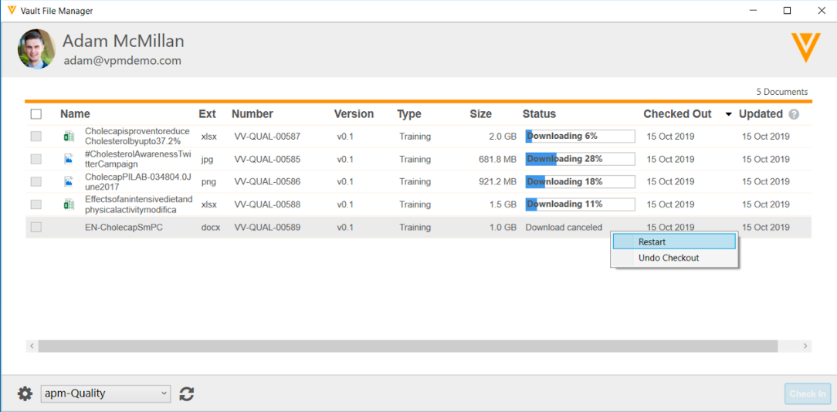
Improved File Transfer for Vault File Manager
Automatic
Overview
  Download and upload up to 8 files at the same time instead of one at a time
  Displays progress bar and % complete for each file being checked in/out
  Ability to skip or cancel downloads/uploads
  Addition of new columns: New vs opened file status (not shown) and file size
Setup by:
N/A
for use by:
Power User
Business Justification
  Improves file transfer functionality for files >100mb and up to 4GB
Considerations
  Windows only (No Mac)
  No resumable download/upload (Planned for future release)
Feature Risk
LOW
Default Impact
VISIBLE TO ALL USERS

Slide 45
Constrain Multi-Document Workflow Based on Document Status & Field Values
Configurable
Overview
  Prevent inclusion of documents in a Multi-Document Workflow (MDW) based on
  document status
  document field values
  For example: only allow Effective documents to be included in a Periodic Review for Multi-Document Workflow
Business Justification
  Streamline MDW and prevent potential errors
Considerations
  Workflow must be configured as a “specific lifecycle” workflow – Not “Any Document Lifecycle”
  Requires configuration of document user action in the relevant document state with required conditions
  NOTE: Existing specific-lifecycle workflow configured since 19R2 now require the configuration of a Document Lifecycle User Action for the MDW so that the workflow will show up on Doc Info page and on the Library
Setup by:
Admin
for use by:
Power User
Feature Risk
MEDIUM
Default Impact
VISIBLE TO ADMINS ONLY
Notes:
In this feature, multi-doc workflow is able to prevent documents from being included in an envelope if they do not meet document status and field value criteria
Before 19R3, a specific MDW would be available on the Library, Reports, and Binder sections even if a user action was not configured in specific states
A couple of use cases:
If you do not want Approved documents to be included in a MDW envelope that allows documents to be modified, an Admin would configure the Approved state to not include Approved documents
Another use case is if you have Approved documents that you would like to perform an inspection readiness check on
In this case, you would only want to include Approved documents that have an inspection readiness field value of no
You would not want to include Approved documents that are already inspection ready
As part of our demo, we will be able to see how this works
Furthermore, for specific-lifecycle MDW to show up on the Library, etc. You MUST configure a Document Lifecycle User Action on the relevant Lifecycle State with conditions if relevant. If no conditions are needed, then use “Always” in the User Action.

Slide 46
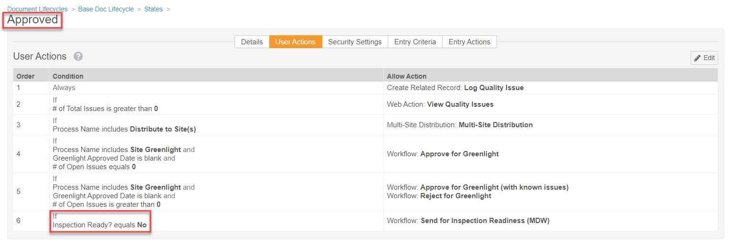
Constrain Multi-Document Workflow Based on Document Status & Field Values
Configurable
This prevents documents that are already Inspection Ready from being included in this MDW
Setup by:
Admin
for use by:
Power User
Feature Risk
MEDIUM
Default Impact
VISIBLE TO ADMINS ONLY
Notes:
In this screenshot, we see an example of how to constrain MDW
It is based on the Approved document status and the field value of Inspection Ready? is no
In other words, this will prevent any documents that are Approved and already Inspection Ready from being sent on a Post-Approval inspection readiness MDW again

Slide 47
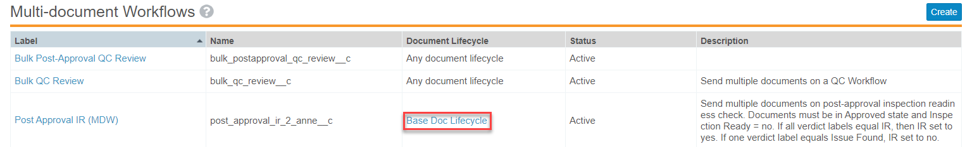
Constrain Multi-Document Workflow Based on Document Status & Field Values
Configurable
Specific Document Lifecycle (not “Any document lifecycle”)
Setup by:
Admin
for use by:
Power User
Feature Risk
MEDIUM
Default Impact
VISIBLE TO ADMINS ONLY

Slide 48
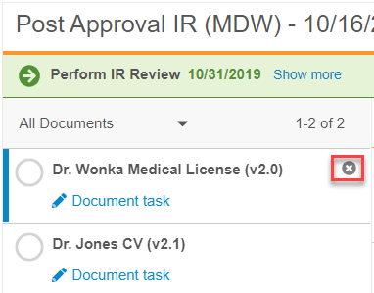
Remove Documents from Envelope
Automatic
Overview
  Workflow initiator is able to remove a document from an active multi-document workflow (MDW)
Business Justification
  Enable documents to be removed from the MDW envelope, while other documents continue on the MDW
Considerations
  Only the workflow initiator can remove the documents
  Removed documents return to the workflow cancel state
Setup by:
N/A
for use by:
Power User
Feature Risk
MEDIUM
Default Impact
VISIBLE TO ALL USERS
Notes:
Often times, customers use the MDW envelope to review and approve groups of documents
While some are ready for approval, other may need to be removed from the envelope to be revised by the authors
In this case, the business needs the ability to remove the documents needing revisions while the others can continue on the workflow
Another use case is when a document is included in an envelope by mistake or is no longer relevant
Before 19R3, the workflow had to be cancelled, revised, and then restarted without the document
Now, we are able to easily remove the documents from the envelope
As you can see in the screenshot here, it’s as easy as clicking on the x

Slide 49
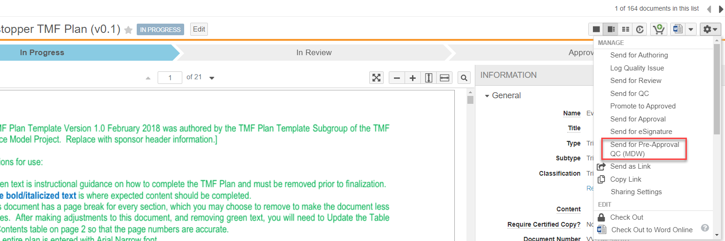
Start Multi-Document Workflow on a Single Document
Configurable
Overview
  Multi-document workflows can be started for a single document from the Doc Info page
  One workflow definition supports both single and multi-document use cases
Setup by:
Admin
for use by:
Power User
Business Justification
  Consistency between multi-document and single document use cases
  Enable documents to leverage many of the features of multi-document and object workflows
    e.g. Require a comment when a reviewer indicates the document is not ready for approval
Considerations
  Workflow must be configured for a specific lifecycle (i.e. not “any document lifecycle”)
Feature Risk
MEDIUM
Default Impact
VISIBLE TO ADMINS ONLY
Notes:
Admins can configure and workflow initiators can start multi-document workflows for a single document.
Some features in SDW are not available in MDW (i.e. short circuit)

Slide 50
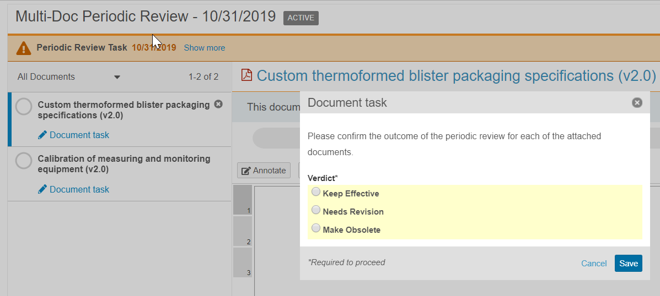
Multi-Document Workflow:
Updated Envelope Viewer
Automatic
Overview
  The Multi-Document Workflow Envelope Viewer has been updated to open a dialog to prompt for configured input beyond a simple verdict
Business Justification
  In order to accommodate configuring reasons or comments for verdicts, the MDW Viewer has been updated to collect verdicts
Setup by:
N/A
for use by:
Power User
Considerations
  Prior to this release, task owners selected verdicts for each document directly from the list of documents in the viewer
Feature Risk
N/A
  Task owners now need to click on the “Document Task” link to provide all of the required input
  When hovering over the document name, users can see the selected verdict and any provided reasons / comments without having to open the dialog
Default Impact
VISIBLE TO ALL USERS

Slide 51
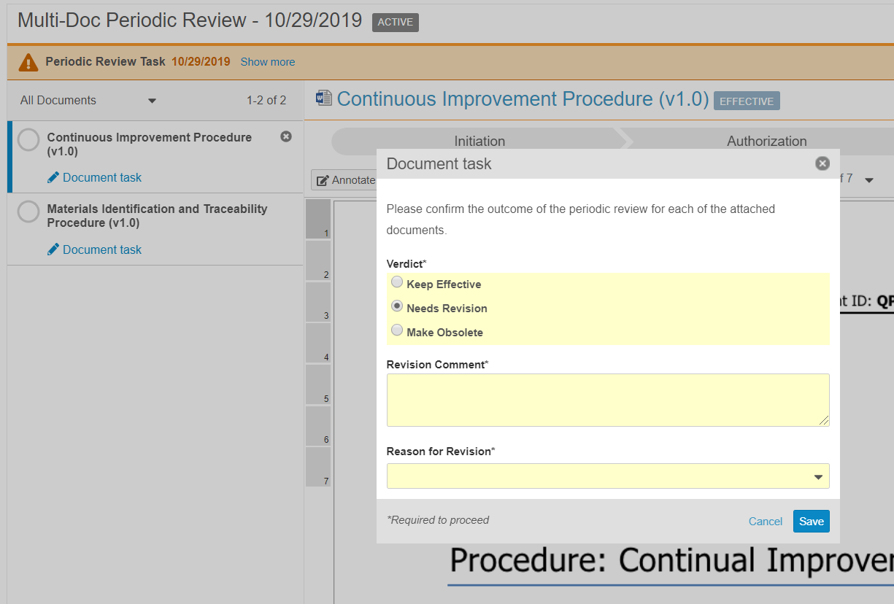
Multi-Document Workflow:
Verdict-Based Prompt for Comments and Reasons
Configurable
Overview
  Admins can now configure a multi-document workflow task step to prompt for comments or reasons only if the task owner selects a specific verdict
Business Justification
  Ability to configure verdicts to collect optional or mandatory comments (text field), and optional or mandatory reasons (picklist)
Setup by:
Admin
for use by:
Power User
Considerations
  Comments and reasons provided by task owners are tracked in a document’s audit trail
Feature Risk
MEDIUM
Default Impact
VISIBLE TO ADMINS ONLY

Slide 52
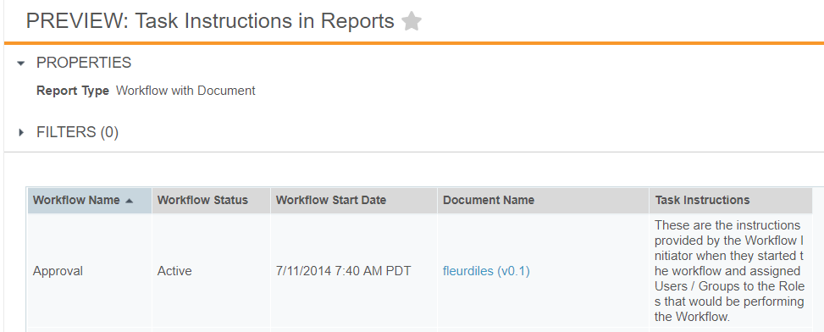
Task Instructions in Reports
Automatic
Overview
  Task Instructions can now be included in Workflow with Document reports
Business Justification
  Users will be able to view previous document workflow task instructions, providing context to later steps, actions, and decisions
Considerations
  Instructions can be viewed only after a document workflow has been initiated
Setup by:
N/A
for use by:
Power User
Feature Risk
LOW
Default Impact
VISIBLE TO ALL USERS

Slide 53
Document Management Poll
Based on what you know about the Document Management features we just covered, which ones do you think you will use?
Collaborative Authoring with Microsoft Office
File Manager
Multi-Document Workflow
Include Task Instructions in Document Workflow Reports

Slide 54
Other Document Management Features
Create Anchors
Improved Handling for Multiple Action Bookmarks
Remove Deprecated Re-Render Options
Scalable Overlay Processing
Download Notes to CSV
Document Workflow: Add Participants to Unselected Optional Tasks
Download List of Records Blocking Document Deletion

Slide 55
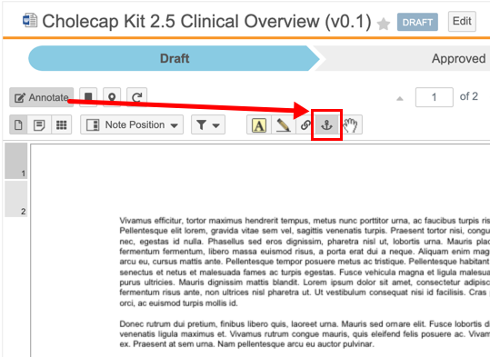
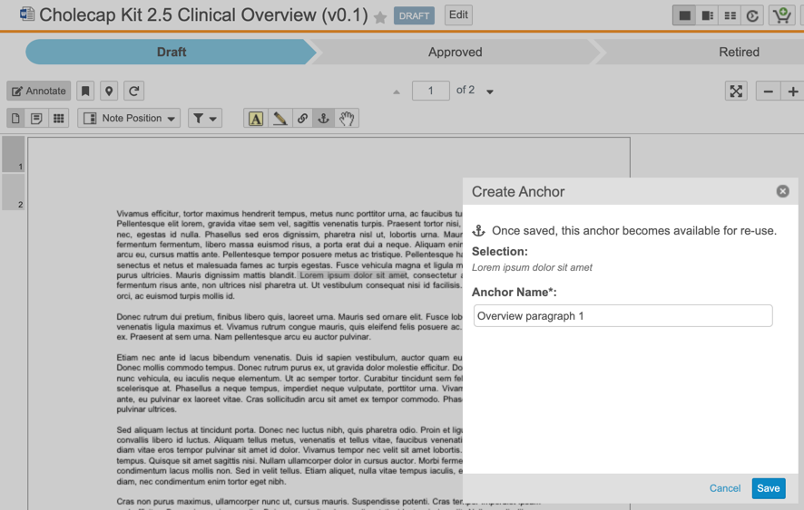
Create Anchors
Automatic
Overview
  This new tool enables users with the proper permissions (including the new Create Anchors permission) to create anchors on documents directly
Business Justification
  Streamlines anchor creation and gives Admins the ability to control who can create anchors, leading to a cleaner and more accurate anchor database
Considerations
  Anchors created with the Create Anchor tool can be either text or image selections
  Created anchors are available for selection when creating Link Annotations
  To use the Create Anchor tool, users must have View Document, View Content, Annotate, and Create Anchors permissions on the target document
Setup by:
N/A
for use by:
Power User
New ‘Create Anchor’ tool
Feature Risk
MEDIUM
Default Impact
VISIBLE TO ALL USERS

Slide 56
Improved Handling for Multiple Action Bookmarks
Automatic
Overview
  This feature improves Vault’s handling of multi-action bookmarks in PDF source documents to inspect all actions on the bookmark and enable navigation for the first supported action
Business Justification
  Ensures that all bookmarks will be displayed in viewable renditions. Previously, Vault only inspected the first action of a multi-action bookmark, and if the application did not support that action, Vault did not display the bookmark
Considerations
  Additionally, Vault displays all bookmarks, including those with no supported actions, and maintains the correct nested structure in keeping with the structure of bookmarks in the source PDF
Setup by:
N/A
for use by:
Power User
Feature Risk
LOW
Default Impact
VISIBLE TO ALL USERS

Slide 57
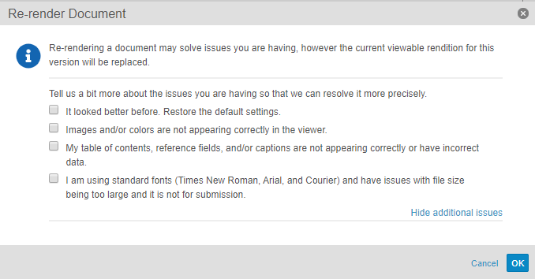
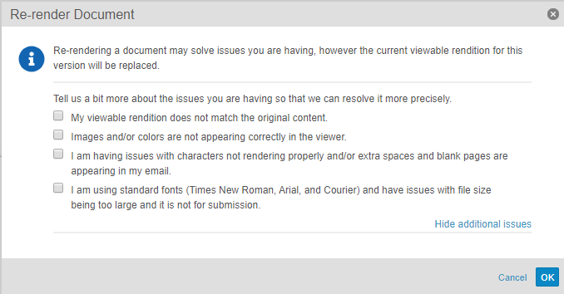
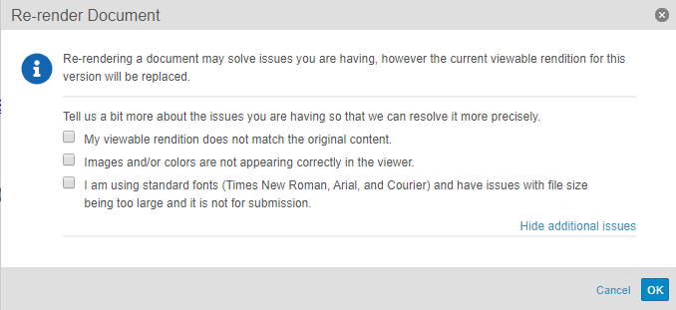
Remove Deprecated Re-Render Options
Automatic
Overview
  Removes several re-render options that are no longer applicable
  Other options that control rendition settings remain available in the Re-render Document dialog (shown below)
Business Justification
  Lays the groundwork for future enhancements, and eliminates dependency on 3rd party rendering capabilities
Setup by:
N/A
for use by:
Power User
For Word Doc
For Email Doc
For HTML
Feature Risk
N/A
Default Impact
VISIBLE TO ALL USERS

Slide 58
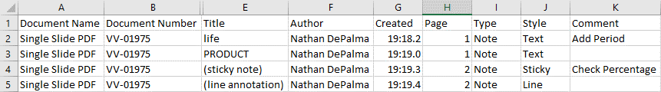
Download Notes to CSV
Automatic
Overview
  Users can download annotations from vault documents as a CSV file
Business Justification
  When documents contain many annotations, users can Download Notes to review comments information in a concise, easy to read CSV file
Considerations
  The action is available to users with View Content permission whenever the document has a viewable rendition and one or more annotations
Setup by:
N/A
for use by:
Power User
Feature Risk
LOW
Default Impact
VISIBLE TO ALL USERS

Slide 59
Document Workflow: Add Participants to Unselected Optional Tasks
Support
Overview
  Participant groups for optional tasks now appear in the Add Workflow Participants dialog window even if the associated optional task was not assigned when originally starting the workflow
Business Justification
  Previously, if the workflow initiator needed to add participants to optional tasks after a workflow has already started, they had to cancel the workflow and restart. Now, even if an optional reviewer/approver was not selected at the workflow start, they can still be added from the Add Workflow Participant action
Considerations
  You can add participants as long as the other parallel tasks have not yet been completed and the workflow has not proceeded beyond the tasks relevant to those participant groups
Setup by:
Admin
for use by:
Power User
Add optional task participants
Feature Risk
MEDIUM
Default Impact
NONE

Slide 60
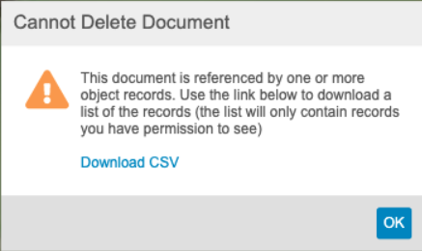
Download List of Records Blocking Document Deletion
Automatic
Overview
  When a user cannot delete a document that is referenced by an object record, they can now click on a link to download a CSV file containing the a list of records blocking document deletion
Business Justification
  Easier to delete document knowing which object records are blocking the deletion
Setup by:
N/A
for use by:
Power User
Feature Risk
N/A
Default Impact
VISIBLE TO ALL USERS

Slide 61
Business Strategy Poll
Electronic Forms Poll
How interested are you in making forms fully electronic (eForms) and log books (eLogs)?
Highly interested
Somewhat interested
Not interested
Not applicable

Slide 62
User Experience

Slide 63
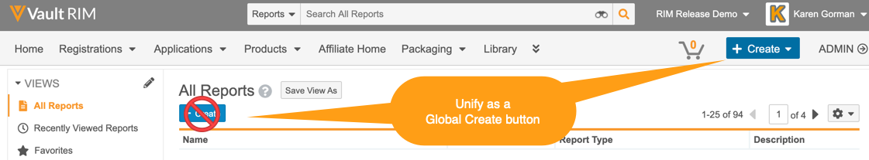
Coming in 2020: Create Button Unification
In early 2020, we will unify Vault Create buttons and use the Global Create button across document, object, report, and custom tabs.
  The ‘Global Create’ button will be contextual – i.e. dynamic based on the context of the action
  Introduces ‘Most Recent’ create action options
  Merges document create actions – i.e. Create from Template, Create Binder, and Upload Document etc. under one option
  Removes the inline Create button from Object Tabs and Reports
The Unified Global Create button will be designated as ‘Auto-on’
  No action required for 19R3
  Planned for 20R1

Slide 64
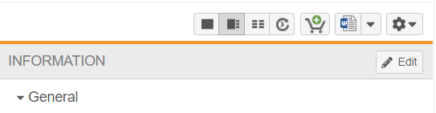
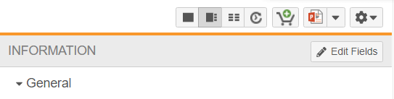
Relabel Doc Info Page Edit Button
Automatic
Overview
  The “Edit” button on the Doc Info page is now labeled "Edit Fields"
Business Justification
  This supports the addition of a new Edit button for the ‘Collaborative Authoring with Microsoft Office’ feature
Considerations
  May need to update screenshots within training materials to reflect new button label
Setup by:
N/A
for use by:
Power User
BEFORE
AFTER
Feature Risk
LOW
Default Impact
VISIBLE TO ALL USERS

Slide 65
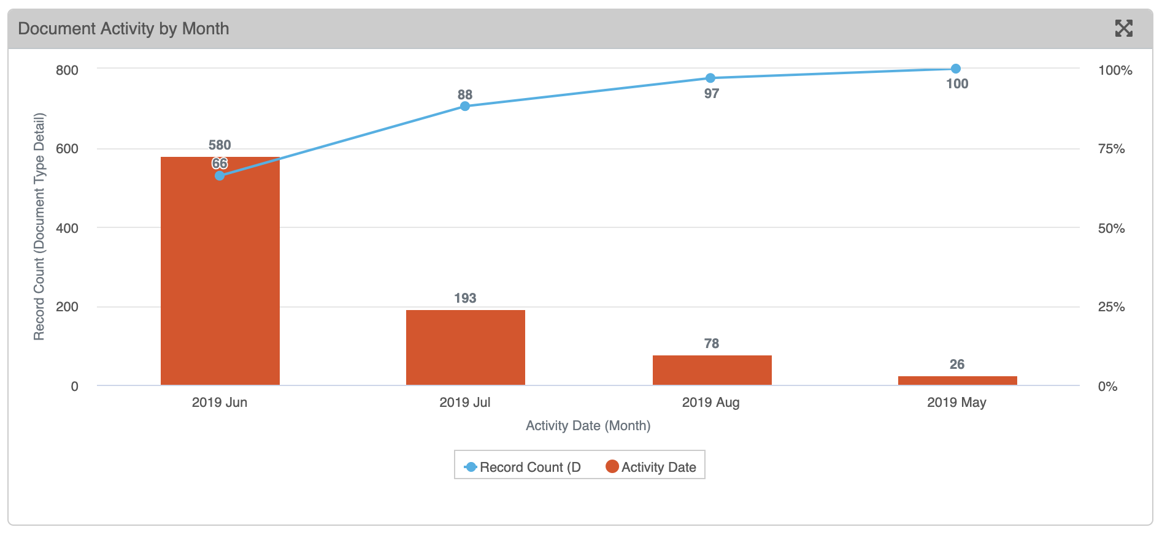
Pareto Charts
Automatic
Overview
  New Vault Dashboard chart type, similar to column charts, but always …
  Displays groups in descending order
  Includes a cumulative percentage line
Business Justification
  These charts are commonly used in quality control processes
Setup by:
N/A
for use by:
Power User
Feature Risk
LOW
Default Impact
VISIBLE TO ALL USERS

Slide 66
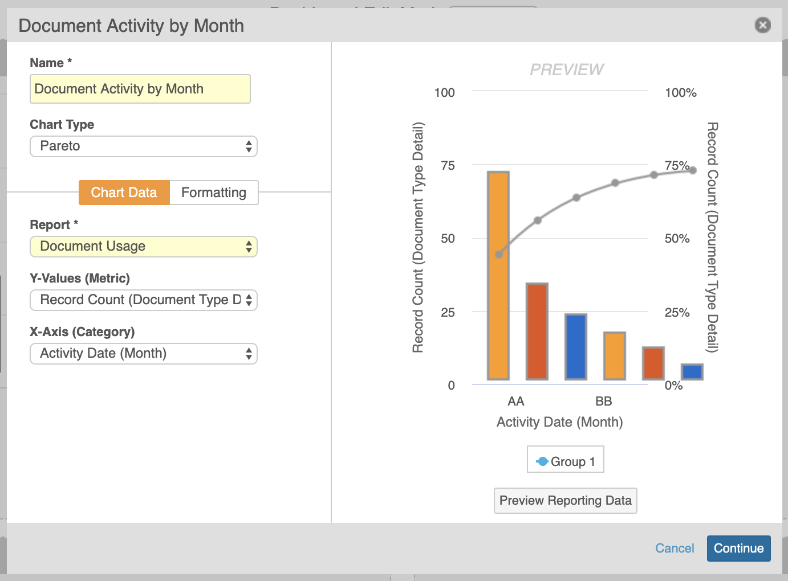
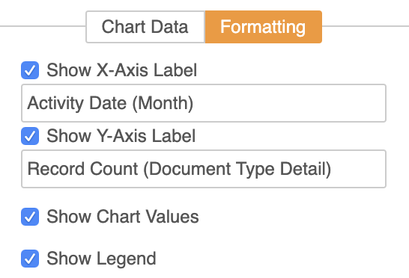
Pareto Charts
Automatic
Considerations
  Pareto charts will be available as an option when bar or column charts are available for selection
  Unlike a standard column chart, a ‘Group By’ option will not be visible for the Pareto chart
  When formatting the Pareto chart, the Cumulative % line is not editable
Setup by:
N/A
for use by:
Power User
Feature Risk
LOW
Default Impact
VISIBLE TO ALL USERS

Slide 67
Prevent Report Re-Execution On Export
Automatic
Overview
  Tabular reports no longer re-execute upon export if the report was recently run (within 8 hours) by the same user
Business Justification
  Reduces server load, and exports will render faster since reports will not have to re-execute
Considerations
  No visible changes to end user experience when exporting
  Upon opening a report, click Refresh to ensure that you are seeing the most recent data
Setup by:
N/A
for use by:
Power User
Feature Risk
N/A
Default Impact
VISIBLE TO ALL USERS

Slide 68
Other User Experience Features
Audit Trail
  System Objects Supported in Related Record Audit Trails
  Include Seconds in Audit Trail Export Timestamp Column
  Record ID & Object Label Column in Object Audit Exports
Display Object Reference Fields as Links in Reports
Update EDL Item Tracking Fields When Batch Update Is No/Blank
Correct Currency Format in Merge Fields & Formatted Output
Download List of Unrelated Parent Records
Relate Multiple Records: Complex Join Related Sections
Simple Join Objects Include Lifecycle State Fields

Slide 69
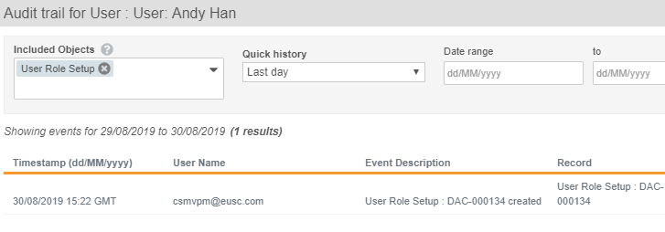
System Objects Supported in Related Record Audit Trails
Automatic
Overview
  Now it is possible to view a system object record’s related object record audit trail entries
  Example: Select a User (system object record), and display the audit trail history for the selected User’s related User Role Setup records
Setup by:
N/A
for use by:
Viewers
  Now it is also possible to view a non-system object record’s related system object record audit trail entries
  Example: Select an Office Location (custom object record), and display the audit trail history for the related User object records
Business Justification
  Provides an easier way to identify activities for system object records
Feature Risk
HIGH
Default Impact
VISIBLE TO ALL USERS

Slide 70
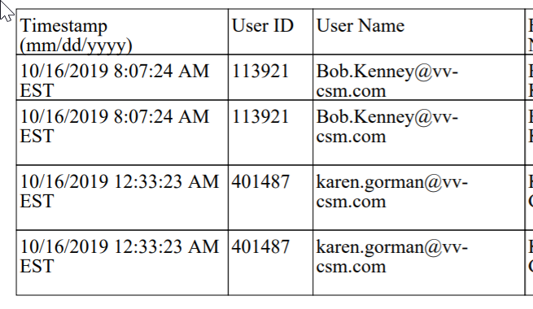
Include Seconds in Audit Trail Export
Timestamp Column
Automatic
Overview
  This feature adds seconds to the audit entry Timestamp column when exporting an audit trail from an individual document or record, or from the Admin > Logs page
Business Justification
  Makes audit exports from the user interface consistent with audit exports from the API, which already included seconds
Considerations
  The user interface shows seconds when hovering over a time stamp in the Timestamp column
Setup by:
N/A
for use by:
Viewers
Feature Risk
MEDIUM
Default Impact
VISIBLE TO ALL USERS

Slide 71
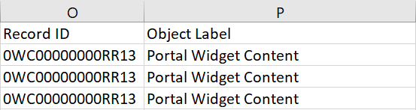
Record ID & Object Label Column in Object Audit Exports
Automatic
Overview
  A Record ID field is now included within the object record audit exports, providing a way to uniquely identify a record
  Exports to CSV and Text will contain the Object Label field
Business Justification
  Ensures consistency across the audit trail user interface and the exported data
Considerations
  Audit trails export as TXT when the multilingual document handling setting is enabled, and as CSV when this setting is disabled
Setup by:
N/A
for use by:
Viewers
Feature Risk
MEDIUM
Both Record ID and Object Label are now included within the export
Default Impact
VISIBLE TO ALL USERS

Slide 72
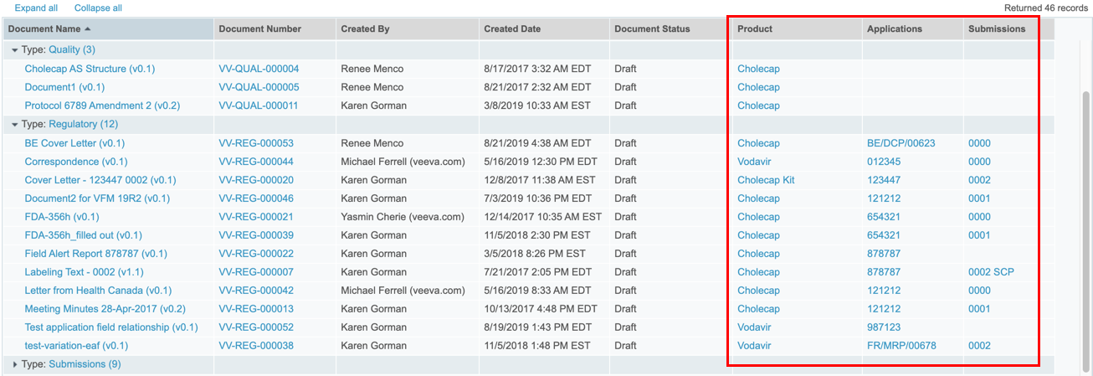
Display Object Reference Fields as Links in Reports
Automatic
Overview
  All object reference fields in a report will display as clickable links
Business Justification
  Users will be able to click on object reference fields when viewing report results
Considerations
  Both single value and multi-value reference fields will appear as links
Setup by:
N/A
for use by:
Power User
Feature Risk
LOW
Default Impact
VISIBLE TO ALL USERS

Slide 73
Update EDL Item Tracking Fields When Batch Update Is No/Blank
Automatic
Overview
  Users can now see the accurate progress for new EDL Item records even when the Batch Update field is set to No or left blank, as long as the EDL matching job is active and has run at least once
Business Justification
  Previously, Vault would only update the tracking fields via the continuous EDL Matching job when the Batch Update field was set to Yes, resulting in inconsistent progress indicators in a set of related EDL Items. Now, manual document matches on EDL Items with Batch Update set to No/blank will trigger the update to the tracking fields
Considerations
  Vault will not update tracking fields on existing records where Batch Update is set to No or left blank unless a user updates the EDL Item record or the matched document, triggering continuous matching
  To update all existing EDL Item records, contact Veeva Support
Setup by:
N/A
for use by:
Power User
Feature Risk
MEDIUM
Default Impact
VISIBLE TO ALL USERS

Slide 74
Correct Currency Format in Merge Fields & Formatted Output
Automatic
Overview
  Vault now displays currency values in merge fields and formatted output documents, using the format specified by the selected local currency
Business Justification
  Ensure currency values display with the correct formatting
Setup by:
N/A
for use by:
Viewer
Feature Risk
N/A
Default Impact
VISIBLE TO ALL USERS

Slide 75
Download List of Unrelated Parent Records
Automatic
Overview
  From simple join Related Object sections, users can now click a link to download a CSV file containing a list of parent records that Vault could not relate to the current record
Business Justification
  Prior to 19R3, if records were not related successfully, it failed silently
  This feature will allow users to see a list of records that could not be related with the reason of the failure
Setup by:
N/A
for use by:
Power User
Feature Risk
N/A
Default Impact
VISIBLE TO ALL USERS

Slide 76
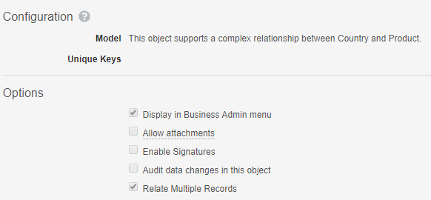
Relate Multiple Records: Complex Join Related Sections
Configurable
Overview
  Admins can configure the ability to relate multiple objects records through a complex join from the Related Object section
Business Justification
  Users can now quickly relate multiple object records in a complex join Related Object section on a parent object record page, similar to simple join sections
Considerations
  Vault automatically creates complex join records
  in the background
  Records that are already related are shown with
  an indicator but can be selected again
  From complex join sections, users can also click
  a link to download a CSV file containing a list of
  parent records that Vault could not relate to the
  current record
Setup by:
Admin
for use by:
Power User
Feature Risk
LOW
Default Impact
VISIBLE TO ADMINS ONLY

Slide 77
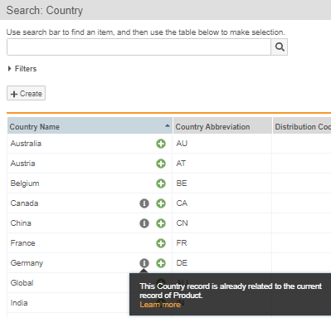
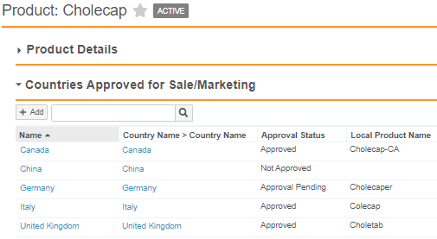
Relate Multiple Records: Complex Join Related Sections
Configurable
Setup by:
Admin
for use by:
Power User
Feature Risk
LOW
Default Impact
VISIBLE TO ADMINS ONLY

Slide 78
Simple Join Objects Include Lifecycle State Fields
Automatic
Overview
  When Admins add a lifecycle to a simple join object, the object will now remain a simple join object
Business Justification
  This allows users to multi-select multiple related records and show the parent records in a simple join related object section for join objects that have a lifecycle
Considerations
  If an existing complex join has only Lifecycle fields in addition to the System fields, Vault shows the Add button instead of the Create button
Setup by:
Admin
for use by:
Power User
Feature Risk
LOW
Default Impact
VISIBLE TO ALL USERS

Slide 79
Business Strategy Poll
FDA Audit Poll
Have you already used Vault Quality to manage your organization’s activities related to an FDA audit?
Yes
No
I don’t know

Slide 80
Access Control

Slide 81
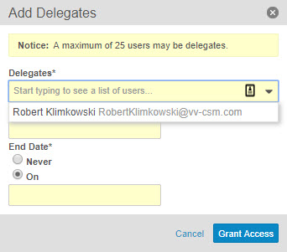
Delegate Access: Restrict Delegate Selection
Configurable
Overview
  Allows users to delegate access only to other users that are members of a certain group
Business Justification
  Allows organizations to create a short-list of users that are eligible to be delegates
Setup by:
Admin
for use by:
Power User
Considerations
  An Admin must enable this feature in order to designate a Group to be used as a controlled list of delegates
  Users still need to have the "Allow as delegate" permission in a Permission Set associated to a user’s Security Profile to be a delegate
Feature Risk
HIGH
Default Impact
VISIBLE TO ADMINS ONLY

Slide 82
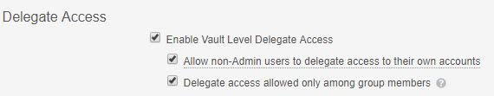
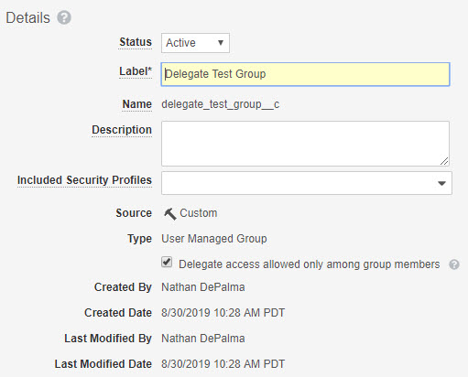
Delegate Access: Restrict Delegate Selection
Configurable
Enable: Admin > Settings > General > Delegate Access
Setup by:
Admin
for use by:
Power User
Activate: Admin > Users & Groups > Groups
Feature Risk
HIGH
Default Impact
VISIBLE TO ADMINS ONLY

Slide 83
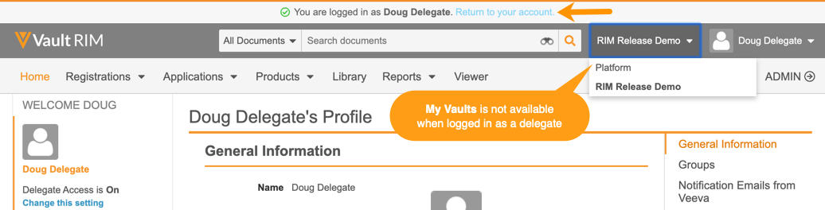
Enhanced Delegate Access Experience
Automatic
Overview
  This feature improves the experience for a delegate user
  The Vault Selector will only display Vaults available to the delegate user’s account
  A banner at the top of the screen allows a delegate user to return to their own Vault account
Business Justification
  Provides simpler navigation between delegate and primary user account access
Setup by:
N/A
for use by:
Power User
Feature Risk
HIGH
Default Impact
VISIBLE TO ALL USERS

Slide 84
Delegate Access Poll
If your organization is currently NOT using the Delegate Access feature, will you begin using it now that it is possible to restrict which users can be delegates?
Yes
No
I don’t know
I already use the Delegate Access feature

Slide 85
Business Strategy Poll
Partner Collaboration Poll
Are you planning to extend access to your Quality Vault for any of the following business partners?
CMO
Health Authority
Auditor
Consultant
Other
None

Slide 86
System Administration

Slide 87
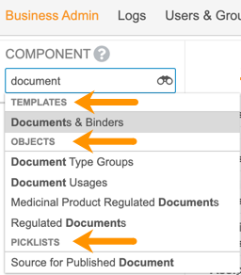
Enhanced Business Admin Navigation
Automatic
Overview
  This feature provides improved navigation in Admin > Business Admin, leveraging many of the search capabilities that users enjoy in custom object tabs
Business Justification
  Users with access to Business Admin can now use additional search options, apply filters, and save views, making it easier to locate elements housed in the Business Admin menu
Considerations
  The Admin > Configuration > Business Admin Menu page to configure the order has been removed, as the order is no longer necessary
  The dropdown selector returns results across templates, objects, and picklists
  A new element named All Picklists is available to navigate to the list of Picklists
Setup by:
N/A
for use by:
Admin
Feature Risk
LOW
Default Impact
VISIBLE TO ADMINS ONLY

Slide 88
Self-Serve Pre-Release Vaults
Automatic
Overview
  In past General Releases, Veeva cloned Production Vault configurations to create a Pre-Release Vault
  Starting with 20R1, customers will be able to create, refresh, and manage their own Pre-Release Vaults
Business Justification
  Gives customers greater control over their Pre-Release environments
  Refresh the Pre-Release Vault from Production
  Create a Pre-Release Vault from a Sandbox (i.e. Production Vault not yet provisioned)
Considerations
  Auto-on in 19R3 so that customers can us this feature for their 20R1 Pre-Release Vault
  This functionality will be enabled by Vault Operations
  6 weeks ahead of a General Release for Vaults on the designated Early POD
  4 weeks ahead of a General Release for Vaults on all other PODs
  Each customer is entitled to 1 Pre-Release Vault for every Production Vault
  If no Production Vault exists, the entitlement will be 1 Pre-Release Vault for the initial Sandbox Vault
Setup by:
N/A
for use by:
Admin
Feature Risk
MEDIUM
Default Impact
VISIBLE TO ADMINS ONLY
Notes:
Still taken away 4 weeks after General Release?
How will customers be notified when they can create their pre-release?

Slide 89
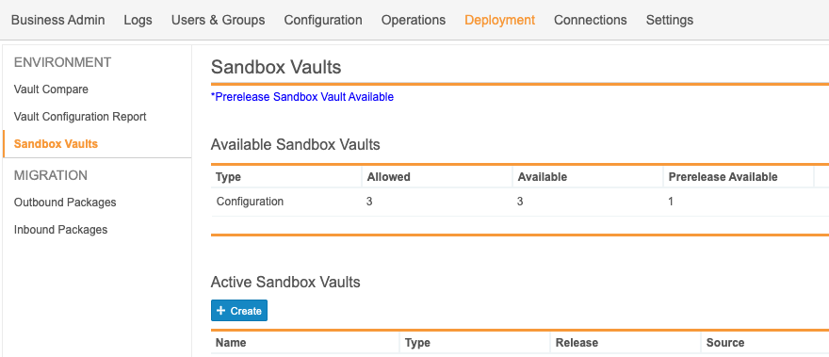
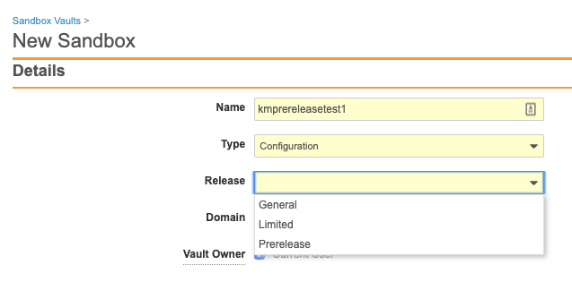
Self-Serve Pre-Release Vaults
Automatic
Setup by:
N/A
for use by:
Admin
Feature Risk
MEDIUM
Default Impact
VISIBLE TO ADMINS ONLY
Notes:
Vault Operations will enable the pre-release sandbox creation during the pre-release window ahead of each release. Customers will at that time be able to provision or refresh their pre-release Vault.

Slide 90
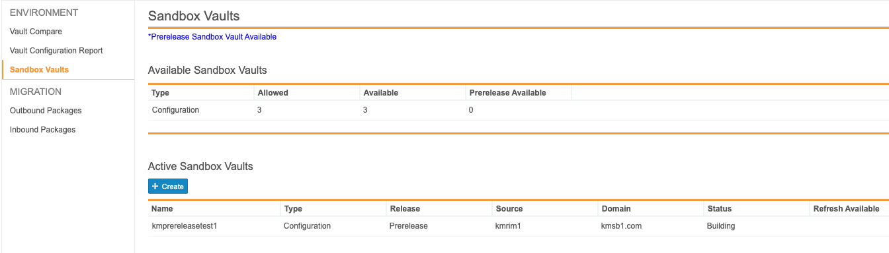
Self-Serve Pre-Release Vaults
Automatic
Setup by:
N/A
for use by:
Admin
Feature Risk
MEDIUM
Default Impact
VISIBLE TO ADMINS ONLY
Notes:
The “Prerelease Available” column will change to zero once the Pre-Release vault is building or refreshing

Slide 91
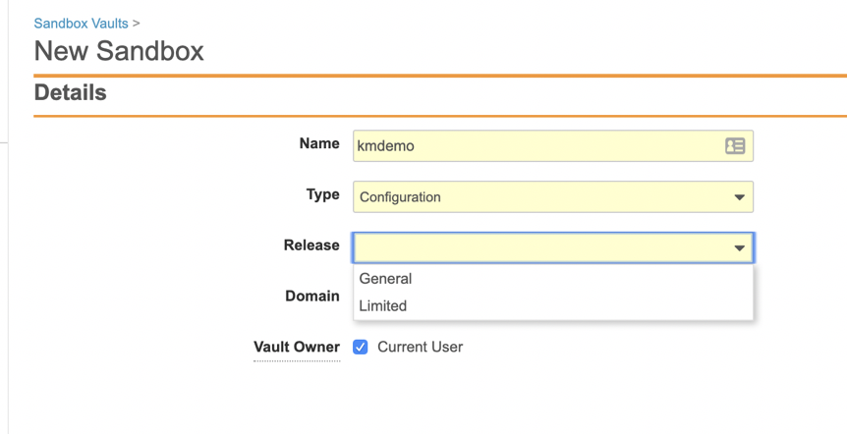
Limited Release Sandbox
Support
Overview
  Customers will now be able to create a sandbox on a Limited Release schedule, from a Vault on General Release schedule
Business Justification
  Allows customers the ability to create their own Limited Release sandbox to proactively assess new functionality ahead of each General Release
Setup by:
Admin
for use by:
Admin
Considerations
  Allowed number of sandboxes for each customer will remain the same
  Configuration migration from a Limited Release Vault, back to a General Release Vault, will not work because new features won’t exist in the General Release Vault, and the data models may differ
Feature Risk
MEDIUM
Default Impact
NONE

Slide 92
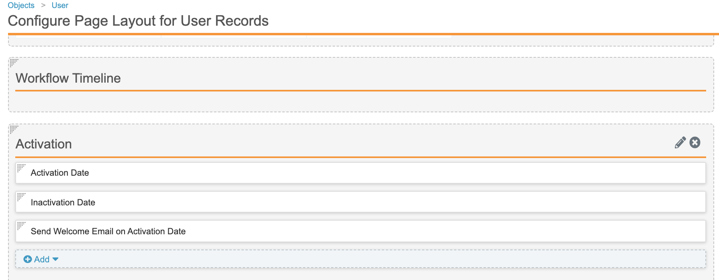
User Pending State
Configurable
Overview
  This feature adds a new Pending state to the Vault Membership lifecycle so that Admins can assign new users to groups and sharing settings prior to granting the user access to the Vault
Business Justification
  Allows Admins time to set up new users appropriately and delay activation until training requirements are met or the user is fully set up
Considerations
  Admins can update the User record page layout to display the Activation fields
Setup by:
Admin
for use by:
Admin
Feature Risk
MEDIUM
Default Impact
VISIBLE TO ADMINS ONLY

Slide 93
System Administration Poll
Based on what you know about the System Administration features we just covered, which of the following features do you think you will use?
Self-Serve Pre-Release Vaults – to assess impact of features in a General Release
Limited Release Sandbox – to evaluate features in a Limited Release
User Pending State – to setup users ahead of activating them in Vault

Slide 94
Other System Administration Features
Audit Trail Features
  Object & Document Audit History Filters Enhancements
  Add Vault ID Field to Login Audit History UI
Checklists
  Optional Checklist Category in User & Entry Actions
  Synchronize Checklist Design & Related Records
  Three Levels of Dependent Questions for Checklists
Miscellaneous Features
  UI Changes in Object Page Layout Editor
  Multi-Pass Reporting Enhancements
  Link Formula Fields
  Platform Data Model Changes
  Increase Formula Field Limit for Objects
  Optimizations for Merge Fields
  API Usage Logs to Include Request Duration
  Update Label to PHI or PII Field
  Object State Types
  Uniqueness Update

Slide 95


Object & Document Audit History Filters Enhancements
Automatic
Overview
  With this new feature more filtering options are available in the object and document audit histories
  Filter the Document Audit History by Time, Event and User in any order
  Filter the Object Audit History by Time, Event, User and Object in any order
Business Justification
  Reduces the need to export an audit trail in order to search for specific records in the audit trail
Considerations
  Filters are only available in the admin audit history
  Only 3 filters may be applied at a time for the object audit history
Setup by:
N/A
for use by:
Admin
Feature Risk
LOW
Default Impact
VISIBLE TO ADMINS ONLY

Slide 96

Add Vault ID Field to Login Audit History UI
Automatic
Overview
  This feature exposes the Vault ID field in the Login Audit History
Business Justification
  Admins can now quickly understand which Vault an Audit entry relates to without exporting the Audit History
Setup by:
N/A
for use by:
Admin
Feature Risk
HIGH
Default Impact
VISIBLE TO ADMINS ONLY

Slide 97
Optional Checklist Category in User & Entry Actions
Configurable
Overview
  Vault uses object record fields, specified by an Admin, to determine which Checklist to start for a user
  This feature allows all of the matching fields specified by an Admin to be configured in a single location on the Checklist Type definition
Business Justification
  This feature simplifies how the Start Checklist User Action and Entry Action are configured
Considerations
  Example: If an Admin does not want to use the Checklist Type picklist as a matching field value, and only wants to use Facility as a matching field, the Start Checklist User Action is configured so that Checklist Type is set to “Not Applicable”, and the matching field Facility is added when the Checklist Type is configured
  If an Admin does want would like to use the Checklist Type picklist as another matching field, this field can be added to the Checklist Type definition of matching field values, rather than being defined in the User Action or Entry Action
Setup by:
Admin
for use by:
Admin
Feature Risk
MEDIUM
Default Impact
VISIBLE TO ADMINS ONLY

Slide 98
Synchronize Checklist Design & Related Records
Configurable
Overview
  Admins can configure a new User Action called Sync Checklist Design Lifecycle States
  This User Action will change the lifecycle state of the Checklist Design record, and all of its related Sections, Questions, Answers, and Dependencies
  Example: Synchronize lifecycle states for related records when a Checklist Design is approved for use, made inactive, or reverted to the draft state
Business Justification
  Previously, a change state User Action and many Entry Actions were needed to keep the lifecycle states across all of the Checklist Design records in sync
  Addresses a platform limitation when more than 1,000 state changes were kicked off via Entry Actions on a Checklist Design record’s Section, Question, Answer, and Dependency records
Setup by:
Admin
for use by:
Admin
Feature Risk
MEDIUM
Default Impact
VISIBLE TO ADMINS ONLY

Slide 99
Three Levels of Dependent Questions for Checklists
Configurable
Overview
  This feature increases the limit from a maximum of two to three levels of dependent questions
  Q1: Are you a member of the Quality Community?
  Q1.1: Did you attend the last Quality Community meeting?
  Q1.1.1: Would you recommend the Quality Community meeting to colleagues?
  Q1.1.1.1: Would you like to provide your colleagues email addresses?
Business Justification
  Provides additional flexibility for complex checklists that rely on dependent questions
Considerations
  There are no changes to the way dependent questions are configured for a multiple question design record
Setup by:
Admin
for use by:
Power User
Dependent
Questions
Level 3 Dependent Question
Feature Risk
MEDIUM
Default Impact
VISIBLE TO ADMINS ONLY

Slide 100



UI Changes in Object Page Layout Editor
Automatic
Overview
  When editing an object page layout …
  The Create Section button is now labeled Add Section
  Two options under Add Section (Single Column Detail Form and Two Column Detail Form) have been consolidated into a single item (Detail Form)
Considerations
  This feature is not visible in Pre-Release Vaults, but will be Auto-on in the General Release
Setup by:
N/A
for use by:
Admin
BEFORE 19R3
AFTER 19R3
Feature Risk
N/A
Default Impact
VISIBLE TO ADMINS ONLY

Slide 101
Multi-Pass Reporting Enhancements
Configurable
Overview
  The 19R3 release introduces multiple enhancements to Multi-Pass Reporting:
  Create Report Views from Workflow Reports
  Add groups to Report Views
  Join Report Views by text fields
  Define conditional fields in both Report Views and Multi-Pass Reports
  Select inner join in addition to left join when joining Report Views
  Ability to filter on aggregate fields defined in Report Views
Business Justification
  Allows Admins to create and join reports with more options and flexibility
Considerations
  Left join - Vault returns all records from the Report View on the left side, and only records with matching fields from the Report View on the right side
  Inner join (new in 19R3) - Vault returns records that have matching values from both Report Views
Setup by:
Admin
for use by:
Power User
Feature Risk
LOW
Default Impact
VISIBLE TO ADMINS ONLY

Slide 102
Link Formula Fields
Configurable
Overview
  Admins can define clickable URLs using formula fields with a Link return type
  The Link can be a Vault-to-Vault URL, or a simple external URL
Business Justification
  With Vault-to-Vault integrations in place, this provides seamless two-way navigation between objects in different Vaults
  Without integrations, this allows navigation to external sites or to a static document in another Vault
Considerations
  Link fields are read-only for end users
  Links can be configured to open in the same window or a new window
  A user-friendly label can be displayed, rather than showing the full URL
  New Link formula functions are Hyperlink and Urlencode
Setup by:
Admin
for use by:
Viewer
Feature Risk
MEDIUM
Default Impact
VISIBLE TO ADMINS ONLY

Slide 103
Link Formula Fields
Configurable
Setup by:
Admin
for use by:
Viewer
Vault to Vault URL with Connection
Feature Risk
MEDIUM
External URL
Default Impact
VISIBLE TO ADMINS ONLY

Slide 104
Platform Data Model Changes
Automatic
Overview
  The following fields have been added to the User object
  Activation Date (activation_date_sys): A User remains in a Pending state until the selected date, when the User becomes automatically activated (Active state) by the User Account Activation job (runs daily)
  Inactivation Date (inactivation_date_sys): A User becomes automatically inactive (Inactive state) on the selected date by the User Account Activation job (runs daily)
  Send Welcome Email (send_welcome_email_sys): Specifies whether Vault sends a welcome email to newly created users on the User’s activation date (does not affect existing users added to a domain)
Business Justification
  These fields support automating activation / deactivation of Vault User accounts
Considerations
  These fields are automatically included in all Vaults, but Admins must make configuration changes to make them available for use on User records
  Refer to slides on Global ID and Link fields for more information on these data model changes
Setup by:
Admin
for use by:
Admins
Feature Risk
N/A
Default Impact
VISIBLE TO ALL USERS

Slide 105
Increase Formula Field Limit for Objects
Automatic
Overview
  Each object may now have up to ten (10) formula fields
Business Justification
  Extends the number of formula fields from 5 to 10 per object allowing for greater use of formula fields
Considerations
  Formula fields can be used for text, date, Yes/No, number, icon, links
Setup by:
N/A
for use by:
Admin
Feature Risk
N/A
Default Impact
VISIBLE TO ADMINS ONLY

Slide 106
Optimizations for Merge Fields
Automatic
Overview
  The syntax for the WHERE clause has been simplified to use the familiar object relationship structure
  Merge Field tokens now retrieve a maximum of 1,000 entries
Business Justification
  Includes new optimizations for Merge Fields that improve performance, and increase ease of use
Considerations
  When using the WHERE clause, you cannot filter on the root object
  You can only filter on objects with outbound relationships
Setup by:
N/A
for use by:
Admin
Feature Risk
N/A
Default Impact
VISIBLE TO ALL USERS

Slide 107
API Usage Logs to Include Request Duration
Automatic
Overview
  This feature adds a Duration column to the API Usage Logs
Business Justification
  The column provides Administrators the ability to determine the time it takes an API request to execute in Vault
Considerations
  The Duration does not include transport times between Vault and the client
Setup by:
N/A
for use by:
Admin
Feature Risk
N/A
Default Impact
VISIBLE TO ADMINS ONLY

Slide 108


Update Label to PHI or PII Field
Automatic
Overview
  The Encrypt Field Value setting on object fields is relabeled to Contains Protected Health Information (PHI) or Personally Identifiable Information (PII)
Business Justification
  This label change better reflects the intended usage of the setting, which allows Admins to add a secondary level of protection to highly sensitive information associated to an object record
Considerations
  The field was originally released in 19R2, and there is no change to existing functionality
Setup by:
N/A
for use by:
Admin
Feature Risk
HIGH
Feature Label in 19R2
Feature Label in 19R3
Default Impact
VISIBLE TO ADMINS ONLY

Slide 109


Object State Types
Configurable
Overview
  This feature allows Admins to create or modify object state types, and associate them to specific or all available object lifecycles
Business Justification
  Prior to 19R3, only Initial and Complete were available state types within object lifecycles
  This feature allows Admins to assign additional state types to objects
Considerations
  Vault Compare and Vault Configuration Reports may show state type lifecycle components have changed, even though there is no functional difference
  Admins can specify if the State Type is required, and if the scope:
  Applies to all lifecycles
  is Available to all lifecycles
  is for a Specific lifecycle
Setup by:
Admin
for use by:
Admin
Feature Risk
MEDIUM
Default Impact
VISIBLE TO ADMINS ONLY

Slide 110
Uniqueness Update
Automatic
Overview
  Vault now applies changes to the ‘Values must be unique’ setting asynchronously and blocks certain actions on the affected object field while processing these changes, including deleting the field and modifying the Maximum Length setting
Business Justification
  Following a different underlying architecture for Uniqueness will allow to make the field uniqueness more robust
Setup by:
Admin
for use by:
Admin
Feature Risk
LOW
Default Impact
VISIBLE TO ADMINS ONLY

Slide 111
Developer Toolkit

Slide 112

Global ID & Link Fields for Documents/Versions
Automatic
Global ID Fields
Overview
  This release introduces two new document fields whose values are populated when a document is created:
  global_id__sys: system-generated id that uniquely identifies a document across all Vaults
  global_version_id__sys: system-generated id that uniquely identifies a document version across all Vaults
Business Justification
  The Global ID fields provide Vault-to-Vault integrations, and Vault-to-external system integrations, with a single identifier for documents and document versions
Setup by:
N/A
for use by:
Developer
Considerations
  Global ID fields will be populated for all documents at the time of the 19R3 General Release
  Global ID fields are non-editable
  Global ID fields will be visible in the General section (required for customers with integrations that need read only access to all fields) - customers can hide the fields for all but the integration user after the release
  Global ID fields cannot be used as Merge Field tokens in document content
Feature Risk
LOW
Default Impact
VISIBLE TO ALL USERS

Slide 113
Global ID & Link Fields for Documents/Versions
Automatic
Link Fields
Overview
  This release introduces two new document text fields:
  link__sys: can be used to reference the Global ID of another document
  version_link__sys: can be used to reference the Global ID of another document version
Business Justification
  The Link fields can be used by integrations to track a source object record, source document, or source document version, brought into a Vault from an external system or another Vault
Setup by:
N/A
for use by:
Developer
Considerations
  Default value is null
  Link fields will be visible in the General section (required for customers with integrations that need read only access to all fields) - customers can hide the fields for all but the integration user after the release
  Admins can control which document roles have edit permission to Link fields
Feature Risk
LOW
Default Impact
VISIBLE TO ALL USERS

Slide 114
Developer Toolkit Features
Global ID & Link Fields for Object Records
SDK Features
  Restrict Adding Users to Active Workflows with SDK-Managed Participants
  Java SDK Message Catalog: Admin UI
  Job Processors
Spark Features
  Spark Integration Management
  Spark User Exceptions
  Spark Message Processor Label Clarification

Slide 115
19R3 Developer Release Deep Dive
Thursday, 14-Nov at 7 a.m. PT / 10 a.m. ET / 3 p.m. GMT
Join Veeva Customer Success and Product teams for an education session on new features in the Veeva Vault developer-focused toolkit
This webinar is geared towards current users of the Vault Developer toolkit (API)
Key topics for discussion will include:
  Detailed explanation of new features
  Spark Integration Services
  Java SDK updates
  Considerations for using new features, and impacts features may have
  on your Vault or end users
Advanced registration required
Notes:
Webinar registration link: https://veeva.zoom.us/webinar/register/WN_50Miz-GsRNSMsGsVIpEMFw

Slide 116
Restrict Adding Users to Active Workflows with SDK-Managed Participants
Automatic
Overview
  When an object workflow configuration includes the option to use custom actions (create using Vault Java SDK) to define participants, the participant group is no longer available in the Add Participants dialog
Business Justification
  This restriction prevents users from manually changing the membership for participant groups defined by custom Vault Java SDK code
Considerations
  Even though this feature is listed as auto-on, the feature only has an impact for customers who have installed a Java SDK using a custom action to define participants
Setup by:
Admin
for use by:
Power User
Feature Risk
N/A
Default Impact
VISIBLE TO ALL USERS

Slide 117
Java SDK Message Catalog: Admin UI
Automatic
Overview
  This release introduces the option to add and manage Vault Java SDK custom messages through the Message Catalog User Interface
Business Justification
  Once added, Developer can use the message in their Vault Java SDK code
Considerations
  Admins can coordinate message translation into any Vault supported language using the Bulk Translation tool
Setup by:
Admin
for use by:
Developer
Feature Risk
N/A
Default Impact
VISIBLE TO ADMINS ONLY

Slide 118


Job Processors
Automatic
Overview
  Admins will see a new Job Processors section in Admin > Configuration > Vault Java SDK
Business Justification
  Admins have visibility to the list of Job Processors created by developers using the Vault Java SDK
Considerations
  Admins will also see ‘SDK Job’ as an available Type when creating jobs
  in Admin > Operations > Job Definitions
Setup by:
Admin
for use by:
Developer
Feature Risk
LOW
Default Impact
VISIBLE TO ADMINS ONLY

Slide 119
Spark Integration Management
Configurable
Overview
  This feature enhances Spark Integrations by allowing Admins to define
  an Integration object that represents a system integration
  Integration Point objects that represent various business process flows that work together to implement the system integration
Business Justification
  Developers leverage the Integration and Integration Point object records to create specific business processing rules, and route user exception messages to the appropriate personnel for resolution
Considerations
  The business layer to support the processes, and the objects, is written using Vault Java SDK
Setup by:
Admin
for use by:
Developer
Feature Risk
LOW
Default Impact
VISIBLE TO ADMINS ONLY

Slide 120
Spark User Exceptions
Configurable
Overview
  This feature allows developers building Spark Integrations to track, route, and resolve any exceptions that require the attention of a Business Admin
Business Justification
  Developers are now able to use User Exception objects and create their specific Lifecycle in order to manage handling exceptions encountered during a process
Considerations
  The objects are User Exception Message and User Exception Item
  You must have Integration Points configured in order to leverage User Exception Messages
Setup by:
Admin
for use by:
Developer
Feature Risk
N/A
Default Impact
VISIBLE TO ADMINS ONLY

Slide 121

Spark Message Processor Label Clarification
Automatic
Overview
  Throughout the Vault UI, the “Message Processor” label has been changed to “Spark Message Processor”
Business Justification
  This will help distinguish Spark message processors from other types of messages within Vault
Considerations
  In Vault Java SDK, the Vault extension "MessageProcessor” will not be renamed
Setup by:
N/A
for use by:
Admin
Feature Risk
N/A
Default Impact
VISIBLE TO ADMINS ONLY

Slide 122
Global ID & Link Fields for Object Records
Automatic
Global ID Fields
Overview
  This release introduces a new object field whose value is populated when an object record is created:
  global_id__sys: system-generated id that uniquely identifies an object record across all Vaults
Business Justification
  The Global ID field provides Vault-to-Vault integrations, and Vault-to-external system integrations, with a single identifier for an object record
Considerations
  The Global ID field is non-editable
  The 19R3 release will not populate existing object records’ Global ID field, and the 19R3 release will NOT make the field visible (customers can add to object page layouts after the release)
    Whenever an existing record is edited, the Global ID field will be populated
    Admins can request Veeva Support populate the Global ID field on existing object records
  All newly created records for all objects will have Global ID populated at the time of creation
  An object record’s Global ID field cannot be used as a Merge Field token in the content of a document that references the object record
Setup by:
N/A
for use by:
Developer
Feature Risk
MEDIUM
Default Impact
VISIBLE TO ALL USERS

Slide 123
Global ID & Link Fields for Object Records
Automatic
Link Fields
Overview
  This release introduces a new object text field:
  link__sys: can be used to reference the Global ID of another document
Business Justification
  The Link field can be used by integrations to track a source object record, or source document, brought into a Vault from an external system or another Vault
Considerations
  Default value is null
  The 19R3 release will NOT make the field visible (customers can add to object page layouts after the release)
  Admins can control which object lifecycle roles have edit permission to the Link field
Setup by:
N/A
for use by:
Developer
Feature Risk
MEDIUM
Default Impact
VISIBLE TO ALL USERS

Slide 124
Additional Information
General Release Resources
&
Quality Community

Slide 125



Best Practices for Managing Vault Releases
Schedule
Around Key
Release Dates
Assess
New
Features
Prepare
Change
Control
Best Practices for Managing Vault Releases is available
in the Customer Support Portal*
https://support.veeva.com/hc/en-us/articles/360003528094-Veeva-Vault-Best-Practices-Knowledge-Collection

Slide 126

Best Practices for Managing Vault Releases
This video contains:
Information About Vault General Releases
Recommended General Release Strategy
  Step 1: Auto-On Features
  Step 2: Configurable Features
Sample Demonstration of a Release Process
Best Practices for Managing Vault Releases is available
in the Customer Support Portal*
https://support.veeva.com/hc/en-us/articles/360003528094-Veeva-Vault-Best-Practices-Knowledge-Collection

Slide 127
Pre-Release Vault
The Pre-Release Environment
  Starting October 21st, Veeva began refreshing customers’ existing Pre-Release Vaults with their current Production configuration
    Pre-Release environments for VV1-12 Production Vaults were refreshed on October 10
  Starting October 24th, Veeva began cloning newer Production Vaults for the 19R3 Pre-Release environments
  A new Vault with a copy of your Production Environment
    Vault Owners users are provisioned
    CSM and Managed Services consultant are included in System Admin role
    Production Configuration
    No Documents or transactional data
  Based on IQ/OQ qualified 19R3 Release
  Available up to 4 weeks after your Production and Sandbox Vaults are upgraded to 19R3
NOVEMBER
Monday 4th
Notes:
Existing customer Pre-Release Vaults that were used in the past 2 releases are refreshed from their Production Vault configuration BEFORE they are upgraded to the next release.
Existing customer Pre-Release Vaults that were not used in the past 2 releases will simply be upgraded to the latest limited release, i.e. 19R1.4. Customers can request a refresh from Production configuration
The cloning/refresh process takes place about 2–3 weeks before the Pre-Release Vaults are scheduled to be available. This timing is important to consider if customers are planning to make configuration changes to their Production Vaults around this time frame to determine if the changes will be included in their Pre-Release Vault.
** If you had a Pre-Release Vault from a previous upgrade, all users that were in the previous Pre-Release Vault will be available in the new Pre-Release Vault.

Slide 128
Validation & Supporting Docs
Veeva Compliance Docs
  Validation Project Plan
  IOQ Protocols
  Business Requirement Documents
  Traceability Matrices
  System Release Memo
  Release Notes
  Summary Reports
  Executed OQ Scripts
    QMS executed OQ scripts available November 8th
    Unexecuted in Word format available upon request
Supporting Documents available on the 19R3 Release page in Vault Help
  19R3 Release Impact Assessment
NOVEMBER
Tuesday 5th
NOVEMBER
Friday 8th

Slide 129

Vault Quality Event Communications
https://go.veeva.com/Quality_EmailOptIn

Slide 130


Quality Community Linkedin Group
LinkedIn Group
Veeva Quality Community
Users: Veeva customers and ex-customers, and industry leaders
Purpose: Connect with other quality peers and ask non-support questions
Example: How do you manage forms? Does anyone manage lab books in Vault QualityDocs or Vault QMS?
https://www.linkedin.com/groups/13680559/

