Slide 1

19R3
Release Preview and Planning
Revision: 05 Nov 2019
Please use ‘Q&A’ to ask a question

Slide 2




Vault Platform 19R3 Presenters
Jason Cox
Manager, Quality & RIM Customer Success
jason.cox@veeva.com
Erin Sliwinski
Customer Success Manager erin.sliwinski@veeva.com
Michael Ferrell
Manager, SMB Customer Success
michael.ferrell@veeva.com
Sapan Modi
Customer Success Manager
sapan.modi@veeva.com

Slide 3
Foreword
The content of this presentation is subject to change prior to the 19R3 Release
Please note the revision date on the title slide
Veeva encourages you to always reference Release documentation from our Release pages to ensure you are using the latest information
Help → Release Notes → About the 19R3 Release

Slide 4
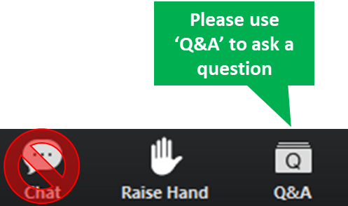
Interact With Us!

Slide 5
Planning for the 19R3 Release
Logistics
Announcements
Features
Identify key
release dates
Promote awareness of Veeva events
Review new features
based on themes
Note: Keep Alert for Polling!

Slide 6
Logistics

Slide 7
19R3 Release Calendar
Customer Validation
Sun | Mon | Tue | Wed | Thu | Fri | Sat
27 | 28 | 29 | 30 19R3 Release Webinars | 31 19R3 Release Webinars | 1 | 2
3 | 4 Pre-Release Vaults | 5 Validation docs 19R3 Release Webinars | 6 19R3 Release Webinars | 7 | 8 | 9
10 | 11 | 12 | 13 | 14 | 15 | 16
17 | 18 | 19 | 20 | 21 | 22 Upgrade - VV1-12, VV1-1065, VV1-1069 | 23
24 | 25 | 26 | 27 | 28 | 29 | 30
1 | 2 | 3 | 4 | 5 | 6 Upgrade - all remaining PODs | 7
OCT
NOV
DEC
Notes:
Looking at some of the key dates for the release, we have this general release calendar
Next week we will release the pre-release vaults and will have access to your validations documentation which will be added to our Compliance Docs vault
We will be talking more about this at the end of this call to talk about managing vault released
But always feel free to reach out to your CSM or Managed Services Consultant for additional
As we move through the next few weeks, this is your opportunity to perform any change control or validations per your policies and SOPs
On Aug 2nd, we will be upgrading VV1-8
On Aug 9th, we upgrade all the remaining PODs
Note that all customers are upgraded to 19R3 and applies to Production, Test, and Sandbox Vaults
Downtime will be approximately 7 hours and we will have additional details at the end of this call
If you need help locating which number POD you are on, it is located in Vault help as well as on the admin side of Vault in Settings > General Settings > Vault Information

Slide 8
Early POD Upgrade Schedule
The early POD designation will no longer be variable
The schedule for early POD in future releases is as follows:
Release | Early PODs
R1 - April | VV1-2, VV1-1065, VV1-1055
R2 - August | VV1-8, VV1-1065, VV1-1068
R3 - December | VV1-12, VV1-1065, VV1-1069
Vaults on the designated early POD will receive access to Pre-Release 2 weeks earlier than other PODs

Slide 9
Pre-Release Environments
We have changed our approach to provisioning Pre-Release environments
All customers will continue to receive a Pre-Release environment, including new Production Vaults provisioned post-19R2 Pre-Release
Customers who have used Pre-Release in last two releases will be refreshed with Production configuration
Customers who haven’t used Pre-Release in the last two releases will not be refreshed with Production configuration
  Refresh can be requested via Support ticket
Pre-Release Vaults include:
  Configuration
  Vault Owners
  NO Transactional Object Data
  NO Documents

Slide 10
Pre-Release Vault
The Pre-Release Environment
  Starting October 21st, Veeva began refreshing customers’ existing Pre-Release Vaults with their current Production configuration
    Pre-Release environments for VV1-12 Production Vaults were refreshed on October 10
  Starting October 24th, Veeva began cloning newer Production Vaults for the 19R3 Pre-Release environments
  A new Vault with a copy of your Production Environment
    Vault Owners users are provisioned
    CSM and Managed Services consultant are included in System Admin role
    Production Configuration
    No Documents or transactional data
  Based on IQ/OQ qualified 19R3 Release
  Available up to 4 weeks after your Production and Sandbox Vaults are upgraded to 19R3
NOVEMBER
Monday 4th
Notes:
Existing customer Pre-Release Vaults that were used in the past 2 releases are refreshed from their Production Vault configuration BEFORE they are upgraded to the next release.
Existing customer Pre-Release Vaults that were not used in the past 2 releases will simply be upgraded to the latest limited release, i.e. 19R1.4. Customers can request a refresh from Production configuration
The cloning/refresh process takes place about 2–3 weeks before the Pre-Release Vaults are scheduled to be available. This timing is important to consider if customers are planning to make configuration changes to their Production Vaults around this time frame to determine if the changes will be included in their Pre-Release Vault.
** If you had a Pre-Release Vault from a previous upgrade, all users that were in the previous Pre-Release Vault will be available in the new Pre-Release Vault.

Slide 11
Validation & Supporting Docs
Veeva Compliance Docs
  Validation Project Plan
  IOQ Protocols
  Business Requirement Documents
  Traceability Matrices
  System Release Memo
  Release Notes
  Summary Reports
  Executed OQ Scripts (unexecuted in Word format available upon request)
Supporting Documents available on the 19R3 Release page in Vault Help
  19R3 Release Impact Assessment
NOVEMBER
Tuesday 5th

Slide 12
19R3 Go Live
All customers upgraded to 19R3
  Applies to Production, Test, and Sandbox Vaults
NOVEMBER
Friday 22
PODs VV1-12, VV1-1065,
VV1-1069
Date | POD | Start Time | Duration
Nov 22 2019 | US POD VV1-1069 Sandbox POD | 1:00 pm PT | Up to 4 hours*
 | All PODs – Authentication service update | 5:00 pm PT | 1 hour
 | US POD VV1-12, VV1-1065 | 6:00 pm PT | Up to 4 hours*
DECEMBER
Friday 06
Date | POD | Start Time | Duration
Dec 06 2019 | APAC POD VV3-3064 APAC & EU Sandbox PODs | 10:00 am PT | Up to 4 hours*
 | US Sandbox PODs | 2:00 pm PT | Up to 4 hours*
 | US PODs (except Nov 22nd PODs) EU PODs APAC POD VV3-34 | 5:00 pm PT | Up to 4 hours*
All Other PODs
* On November 1 2019, http://trust.veeva.com will be updated with final downtime durations

Slide 13
Sandbox POD Separation
Majority of sandbox POD moves have
been completed, remaining will
be done prior to Nov 22
Schedule communicated via Service Availability setting
Customers should ensure IP whitelisting is done by domain or IP range
More information can be found on Vault Help
19R3: Sandbox PODs will be upgraded up to
8 hours before production vaults
Schedule communicated via Service Availability setting

Slide 14




19R3 Release Webinar Series
Product-specific webinars focused on the use cases and impact of key features
  The same webinars are presented at multiple times
  One webinar per product will be recorded and available after the series via …
  Help > Release Notes > About the 19R3 Release
Platform
Oct 30 at 12 PM EDT
Oct 31 at 3 PM EDT
Nov 5 at 8 AM EDT
Nov 6 at 9 AM EDT
Oct 30 at 8 AM EDT
Oct 31 at 9 AM EDT
Nov 5 at 12 PM EDT
Nov 6 at 3 PM EDT
Oct 30 at 9 AM EDT
Oct 31 at 8 AM EDT
Nov 5 at 3 PM EDT
Nov 6 at 3 PM EDT
Oct 31 at 12PM EDT
Nov 5 at 9 AM EDT
go.veeva.com/19R3_clinical
go.veeva.com/19R3_quality
go.veeva.com/19R3_rim
go.veeva.com/19R3_platform
Notes:
We do offer webinars for each of our application suites
We are here today to cover Clinical, but you are also welcome to attend any of the other webinars
We do record the webinars and make the slides and recording available on our 19R3 help site, so you will have the ability to go back and review these

Slide 15
Announcements

Slide 16
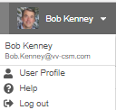
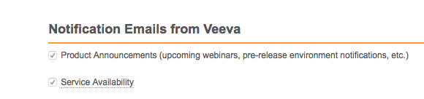
Notification Emails from Veeva
Opt-in to Product Announcements in User Profile to be contacted about:
  Initial release announcement (RIA)
  Release webinar invites
  Pre-release and validation document availability
  Go-live & key date reminders
Opt-in to Service Availability notifications in User Profile to be contacted about:
  Planned system maintenance
  Service disruptions

Slide 17
Internet Explorer™ 11 on Windows™ 7
In January 2020, Veeva will no longer support the combination of
Internet Explorer™ 11 on Windows™ 7
  Internet Explorer™ 11 is still a supported browser on other operating systems
We encourage all Veeva customers to upgrade to a newer browser
Learn more about supported browsers for Vault

Slide 18
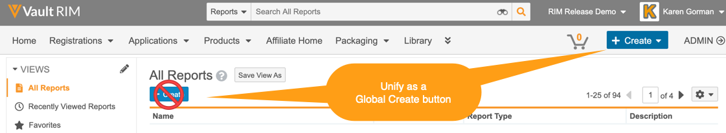
Coming in 2020: Create Button Unification
In early 2020, we will unify Vault Create buttons and use the Global Create button across document, object, report, and custom tabs.
  The ‘Global Create’ button will be contextual – i.e. dynamic based on the context of the action
  Introduces ‘Most Recent’ create action options
  Merges document create actions – i.e. Create from Template, Create Binder, and Upload Document etc. under one option
  Removes the inline Create button from Object Tabs and Reports
The Unified Global Create button will be designated as ‘Auto-on’
  No action required for 19R3
  Planned for 20R1

Slide 19
Register Now
700+
140+
attendees from life sciences
life science companies
Join our European R&D Community
Share Best Practices
Develop New Industry Partnerships
Network with Peers
18 – 20 May 2020 | Barcelona, Spain

Slide 20

Feature Enablement Detail
Auto-On Features
Configurable Features
Auto-On
Admin Checkbox
Configuration
Support
Turned On Day 1
Automatically available, some setup may be required
Turned Off
Requires enablement
Turned Off
Requires enablement
Requires
configuration
Turned Off
Requires enablement
Product Support Request

Slide 21
19R3 Platform Features

Slide 22






19R3 Vault Platform Themes
User
Experience
Security
Document Management
Data Management
Reporting
System Administration

Slide 23
User Experience

Slide 24

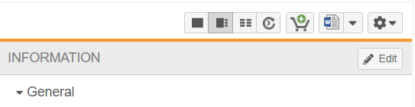
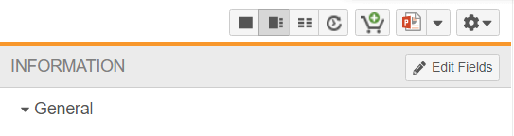
Relabel Doc Info Page Edit Button
Automatic
Overview
  The “Edit” button on the Doc Info page is now labeled "Edit Fields"
Business Justification
  This supports the addition of a new Edit button for the ‘Collaborative Authoring with Microsoft Office’ feature
Considerations
  May need to update screenshots within training materials to reflect new button label
BEFORE
AFTER
Feature Risk
LOW
Default Impact
VISIBLE TO ALL USERS
Notes:
To support the addition of this new button we have also relabeled the Edit button on the document information page with Edit Fields to distinguish these 2 actions.
It is an automatic change, so the customers who have used screenshots with the old Label in their training materials, may want to update them to reflect this UI change.

Slide 25
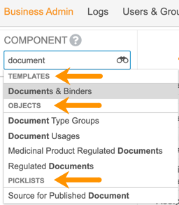
Enhanced Business Admin Navigation
Automatic
Overview
  This feature provides improved navigation in Admin > Business Admin, leveraging many of the search capabilities that users enjoy in custom object tabs
Business Justification
  Users with access to Business Admin can now use additional search options, apply filters, and save views, making it easier to locate elements housed in the Business Admin menu
Considerations
  The Admin > Configuration > Business Admin Menu page to configure the order has been removed, as the order is no longer necessary
  The dropdown selector returns results across templates, objects, and picklists
  A new element named All Picklists is available to navigate to the list of Picklists
Feature Risk
LOW
Default Impact
VISIBLE TO ADMINS ONLY
Notes:
This feature provides improved navigation in Admin > Business Admin, leveraging many of the search capabilities that users enjoy in custom object tabs
Users with access to Business Admin can now use additional search options, apply filters, and save views, making it easier to locate elements housed in the Business Admin menu
As part of the update, the Configuration > Business Admin Menu page to configure the order has been removed, as the order is no longer necessary
The dropdown selector returns results across templates, objects, and picklists
A new element named All Picklists is available to navigate to the list of Picklists

Slide 26
Demo
Notes:
Navigate to Admin > Business Admin
Say:
The long and unsortable list of these Business Admin items on the left that Admins used to see until this release, now gives room to the familiar search tools
The Component Selector allows to lookup the name of a Business Admin item rather than scrolling to find its name in a list
Note that when opening the Business Admin tab, the Selector will automatically default to the item that was last viewed by the user
Navigate to Component Selector and left-click to expose the drop-down list
Say:
You can navigate to the required item from the drop-down list
You can also find the required item by typing its name in the selector
Let’s say I want to find all Study Organization Roles object records
Navigate to Component Selector and type Organization
Pick Study Organization Roles
Click Enter
Say:
The selected object page opens to show the list of all existing object records
I can further search for a specific record in the page contents by the name in the search bar on the top
Type Pharmacy
Click Enter
Click on the binoculars in the top Search bar
Say:
Advanced Search is available as well
Navigate to Component Selector
Say
I can also find the required item by using the binoculars icon to open a search dialog
Let’s say I am a Business Admin and working on my TMF Milestone templates
Click the binoculars icon
Type Milestone
Click Template Milestones
Say
Notice the Filters section on your left
The new UI now allows Admins to apply filters to the records just like they would in any other object tab
Admins can create and save their custom views based on the selected filters
As an Admin I do manage the Milestone Templates as well as their related EDLs so I have created and saved custom views for myself for IR Milestones, Ad Hoc events and Monitoring Visit Milestones SORT BY SEQUENCE IN COLUMNS
The filters are always component specific - you will be seeing different filters available based on which object page you open
So when I navigate away to work on my EDL templates, you notice that the filters availability is different for this object
Navigate to Component Select and type EDL
Pick Template EDLs
Click Enter
Say
I have filtered and grouped my Template EDLs as reflected in these saved views for Study, Country and Site level EDLs
This enhancement lets me quickly navigate to the list of the templates and do my work faster and more efficiently

Slide 27
Security

Slide 28
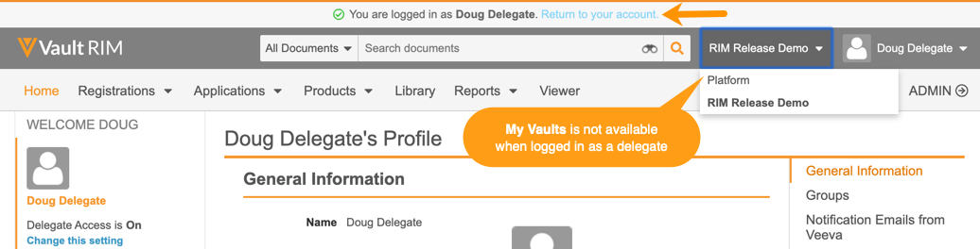
Enhanced Delegate Access Experience
Automatic
Overview
  This feature improves the experience for delegate users by allowing them to return to their own Vault access via a banner link
Business Justification
  Provides simpler navigation between delegate and primary user account access
Considerations
  When logged in as another user who has access to multiple vaults, you can switch between the vaults to which you have access using the vault selector; however, the My Vaults page link will not be available
  The list of vaults in the vault selector will contain all vaults the user is able to access as the delegated user
Feature Risk
HIGH
Default Impact
VISIBLE TO ALL USERS
Notes:
This feature improves the experience for delegate users by providing simpler navigation between delegate and primary user account access
When logged in as another user who has access to multiple vaults, users can now switch between the vaults to which they have access as the delegated user using the vault selector
However, the My Vaults page link will not be available
Improves security around delegating access

Slide 29

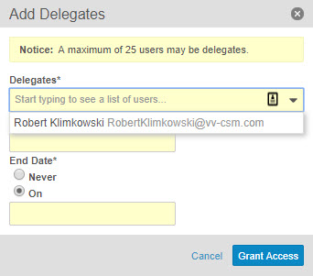
Delegate Access: Restrict Delegate Selection
Slide 1 of 2
Configurable
Overview
  Allows users to delegate access only to other members within a certain group defined by the organization
Business Justification
  Ensures only delegates in a defined group have the ability to perform user actions
Considerations
  In order to configure in Groups, the setting must first be enabled by checking “Delegate access allowed only among group members”
  Users still need to have the "Allow as delegate" permission in order to be selected as delegate (in addition to their group assignment)
Feature Risk
HIGH
Default Impact
VISIBLE TO ADMINS ONLY
Notes:
We now have an enhancement to our Delegate Access functionality. As of 19R3 you can restrict the delegates that are available when delegating access to a user account. Organizations can define groups of users who can delegate access only among themselves. For example, a user in the Data Management group can only delegate access to other members of that group.

Slide 30
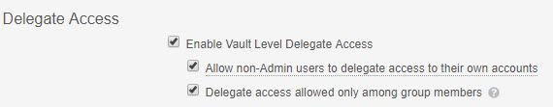
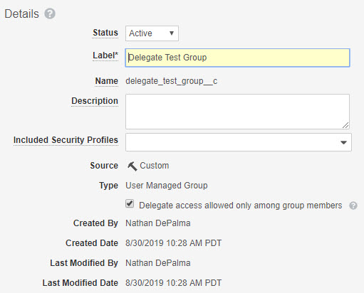
Delegate Access: Restrict Delegate Selection
Slide 2 of 2
Configurable
Enable: Admin > Settings > General > Delegate Access
Activate: Admin > Users & Groups > Groups
Feature Risk
HIGH
Default Impact
VISIBLE TO ADMINS ONLY
Notes:
Here we can see how to go about enabling the restricted delegate selection settings. Once you select the option to only delegate access among group members you will also need to check the corresponding box within the Group itself.

Slide 31
Document Management

Slide 32

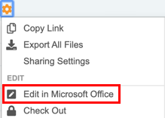
Collaborative Authoring with Microsoft Office
Configurable
Overview
  We are adding a new way to work on Microsoft Word documents by enabling the collaborative authoring functionality. With this feature, customers who leverage an Azure / Office 365 tenant can work simultaneously on the same document
Business Justification
  Document editors can easily check out and check in MS Word documents to Office 365 using their desktop client, allowing multiple users to edit a document at the same time
Considerations
  Only Microsoft Word documents (*.docx)
  are supported as of the 19R3 release
  Azure / Office 365 tenant setup is required
  before configuring in Vault
  All users with Edit permission can collaborate
  on the document so it’s critical to have
  communication between authors
  It is no longer possible to create a draft of a checked-out
  document. When viewing a checked-out document, the
  Create Draft option will not appear in the Actions menu
Feature Risk
MEDIUM
Default Impact
VISIBLE TO ADMINS ONLY
Notes:
We have also introduced a new way to work on Microsoft Word documents by extending the integration between Vault and MS Office from Office Online to Office 365 server, which provides the collaborative authoring functionality.
Collaborative authoring with Microsoft Office™ allows multiple users to edit a Word document at the same time using the Office desktop software. Unlike the browser-based office online applications, it can now support the critical features such as track changes, custom toolbars, and office macros.
Because collaborative authoring uses Office 365™ server as a work area for collaboration sessions, your organization must have an Office 365 tenant to use this functionality.
Only users with Edit and Download permissions for a document can edit the document with collaborative authoring. Currently, collaborative authoring is only available for Microsoft Word™ *.docx documents.
As part of the Collaborative authoring feature we have added an Edit button next ot the document name that allows us to start a collaborative authoring session.
I'm sure everyone has a lot of questions about configuration that we won't be able to cover in these sessions, so please join the technical Q&A for more details

Slide 33
Demo
Notes:
In this demo Anne and Olga will be collaborating on a TMF Plan in our Vault
We have a fairly active eTMF and we do author a lot of different study documents in our Vault
Anne as a Study Manager has created a TMF Plan for the Cabin Fever Study from template
Anne will now start editing the document in MS Word by clicking the Edit button next to the document name
While the document is being checked out, notice that the familiar Edit button in the document information panel on the right has been relabeled with the Edit Fields button
Anne can now open the document in MS Word on her desktop
Note that documents can now be checked out to MS Office Online via the same Edit button as well
Notice at the top that Olga has opened the same document at the same time on her computer and Anne and Olga are both going to edit it simultaneously
One of our favorite things about this feature is the ability to track changes, so let’s go ahead and turn them on
Anne starts editing the plan and adds the study name for the Cabin Fever study and adds a comment for Olga
At the same time, Olga is making changes to the date and version of the plan
Since the document is open in Olga’s MS Word on her desktop, Olga can also see Anne’s comment and reply to it in the real time
Now that Olga and Anne are both done editing the plan, Anne will go ahead and close Word and return to Vault to see details about this Collaborative Authoring session
Here we see that both Olga and Anne have been working on the document
Others in Vault can see this, too
Now, let’s check our document back in
We can add a description if we’d like and click continue
While this is rendering, let’s look at the audit trail
Notice how the check out and check in are captured here
We can see our document with all of the tracked changes

Slide 34
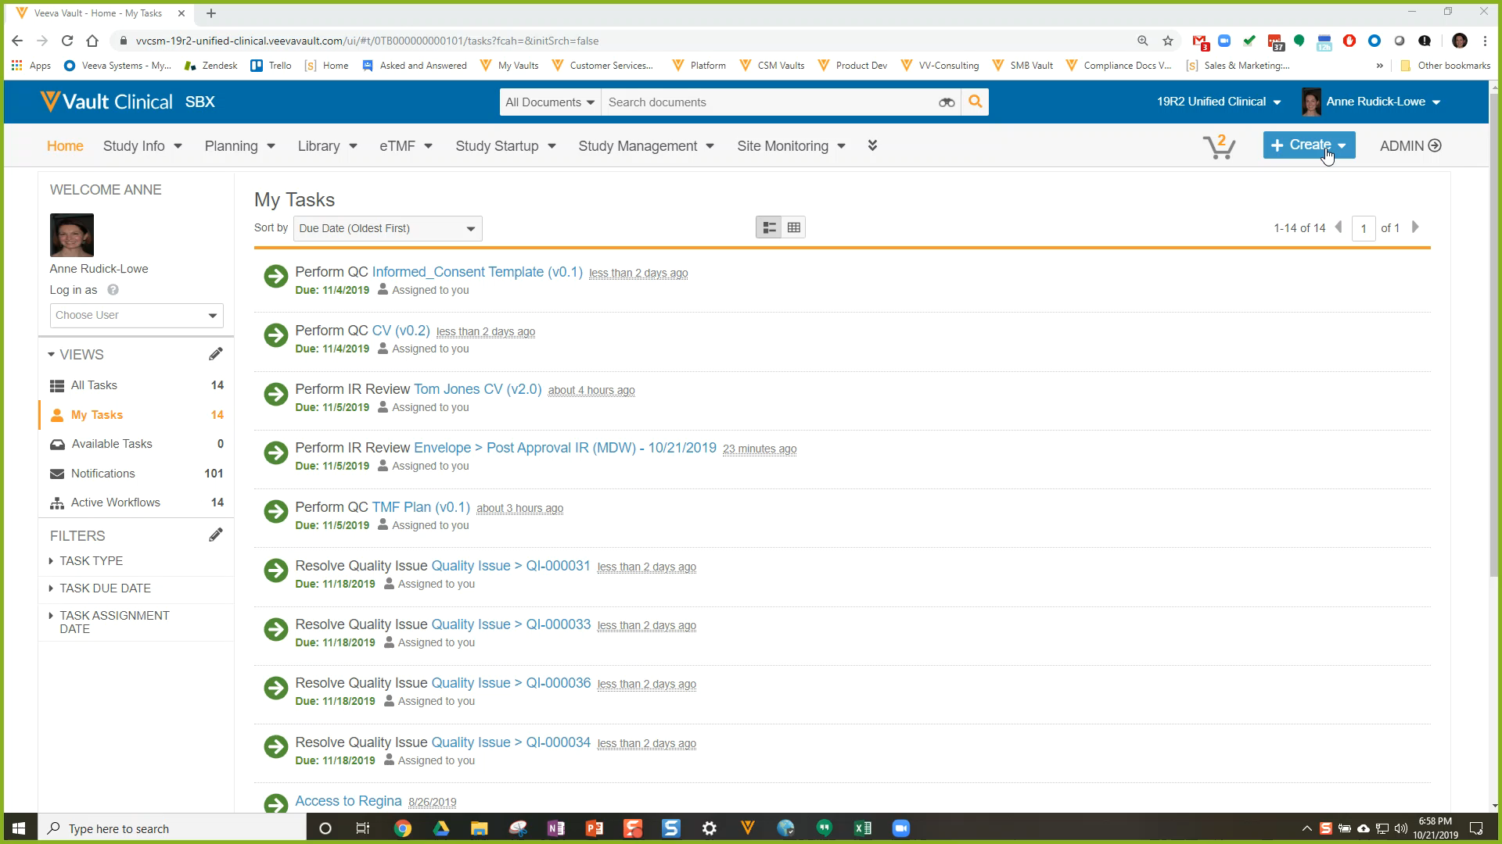
Demo
Notes:
In this demo Anne and Olga will be collaborating on a TMF Plan in our Vault
We have a fairly active eTMF and we do author a lot of different study documents in our Vault
Anne as a Study Manager has created a TMF Plan for the Cabin Fever Study from template
Anne will now start editing the document in MS Word by clicking the Edit button next to the document name
While the document is being checked out, notice that the familiar Edit button in the document information panel on the right has been relabeled with the Edit Fields button
Anne can now open the document in MS Word on her desktop
Note that documents can now be checked out to MS Office Online via the same Edit button as well
Notice at the top that Olga has opened the same document at the same time on her computer and Anne and Olga are both going to edit it simultaneously
One of our favorite things about this feature is the ability to track changes, so let’s go ahead and turn them on
Anne starts editing the plan and adds the study name for the Cabin Fever study and adds a comment for Olga
At the same time, Olga is making changes to the date and version of the plan
Since the document is open in Olga’s MS Word on her desktop, Olga can also see Anne’s comment and reply to it in the real time
Now that Olga and Anne are both done editing the plan, Anne will go ahead and close Word and return to Vault to see details about this Collaborative Authoring session
Here we see that both Olga and Anne have been working on the document
Others in Vault can see this, too
Now, let’s check our document back in
We can add a description if we’d like and click continue
While this is rendering, let’s look at the audit trail
Notice how the check out and check in are captured here
We can see our document with all of the tracked changes

Slide 35
Collaborative Authoring with Microsoft Office – Technical Enablement Q&A
Thursday, 12-December at 8 a.m. PT / 11 a.m. ET / 4 p.m. GMT
If you are interested in enabling Collaborative Authoring with Microsoft Office:
  Identify your organization’s Azure / Microsoft 365 administrators
  Ask them to join a live technical enablement Q&A session with the Veeva Product, Customer Success and Services team.
This webinar is geared towards current Azure / Office 365 and Vault Administrators responsible for configuring the Vault Collaborative Authoring and Azure / Office 365 connection.
Key topics for discussion will include:
  Overview of Collaborative Authoring with Microsoft Office Capability
  Review of Prerequisites to Enable Collaborative Authoring
  Review of Published Knowledge Articles and Resources
  Open Q&A
Advanced registration required
Notes:
Webinar registration link: https://veeva.zoom.us/webinar/register/WN_vPUjT9C6S023iysRYETtBg
I'm sure everyone has a lot of questions about configuration that we won't be able to cover in these sessions, so please join the technical Q&A for more details.

Slide 36
Disable Enhanced Checkout for All Vaults
Automatic
Overview
  The Enhanced Checkout Java Applet has been completely disabled
Business Justification
  Modern browsers do not support Java applets, and keeping the correct Java version installed on client machines has been problematic
Considerations
  Available Alternatives
    Vault File Manager
    Provides an efficient way to check out, edit, and check in Vault documents (Windows only)
    Checkout to Office Online or new Collaborative Authoring
    Available to Office 365 subscribers (Mac and Windows)
    Basic Checkout
    Vault relies on your browser to handle the download and upload (Mac and Windows)
Feature Risk
N/A
Default Impact
VISIBLE TO ALL USERS
Notes:
The Enhanced Checkout Java Applet has been completely disabled
Available Alternatives
Vault File Manager
Provides an efficient way to check out, edit, and check in Vault documents (Windows only)
Checkout to Office Online or new Collaborative Authoring
Available to Office 365 subscribers (Mac and Windows)
Basic Checkout
Vault relies on your browser to handle the download and upload (Mac and Windows)

Slide 37

Document Workflow: Add Participants to Unselected Optional Tasks
Support
Overview
  Participant groups for optional tasks now appear in the Add Workflow Participants dialog window even if the associated optional task was not assigned when originally starting the workflow
Business Justification
  Previously, if the workflow initiator needed to add participants to optional tasks after a workflow has already started, they had to cancel the workflow and restart. Now, even if an optional reviewer/approver was not selected at the workflow start, they can still be added from the Add Workflow Participant action
Considerations
  You can add participants as long as the other parallel tasks have not yet been completed and the workflow has not proceeded beyond the tasks relevant to those participant groups
Add optional task participants
Feature Risk
MEDIUM
Default Impact
NONE
Notes:
Sometimes, during a document review, the reviewer may determine that an additional review is needed. In these cases, the workflow initiator needs to be able to include additional approvals after the workflow has already started
Before this release, if the workflow initiator needed to add participants to optional tasks after a workflow has already started, they had to cancel the workflow and restart
In 19R3, even if an optional reviewer/approver was not selected at the workflow start, they can still be added from the Add Workflow Participant action
Participants can be added as long as the other parallel tasks have not yet been completed and the workflow has not proceeded beyond the tasks relevant to those participant groups

Slide 38
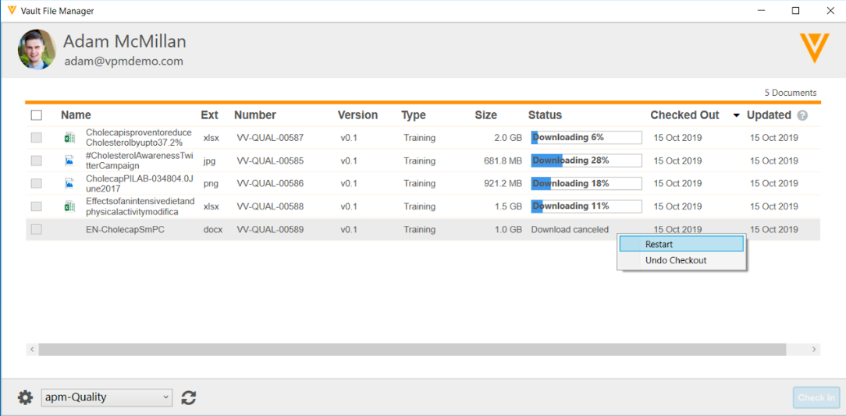
Improved File Transfer for Vault File Manager
Automatic
Overview
  We have enhanced the file transfer process for Vault File Manager:
    Download and upload up to 8 files at the same time instead of one at a time
    Displays progress bar and % complete for each file being checked in/out
    Ability to skip or cancel downloads/uploads
    Addition of Ext and Size columns
Business Justification
  Improves file transfer functionality for files larger than 100mb, up to the Vault limit of 4GB per file
Feature Risk
LOW
Default Impact
VISIBLE TO ALL USERS
Notes:
We continue to improve our document check out tools.
In this release, we have introduced a few enhancements to VFM to improve file transfer functionality for files >100mb and up to 4GB
VFM can now download and upload up to 8 files at the same time instead of one at a time
It displays progress bar and % complete for each file being checked in/out
We added the ability to skip or cancel downloads/uploads
And we added new columns – New vs opened file status and file size

Slide 39
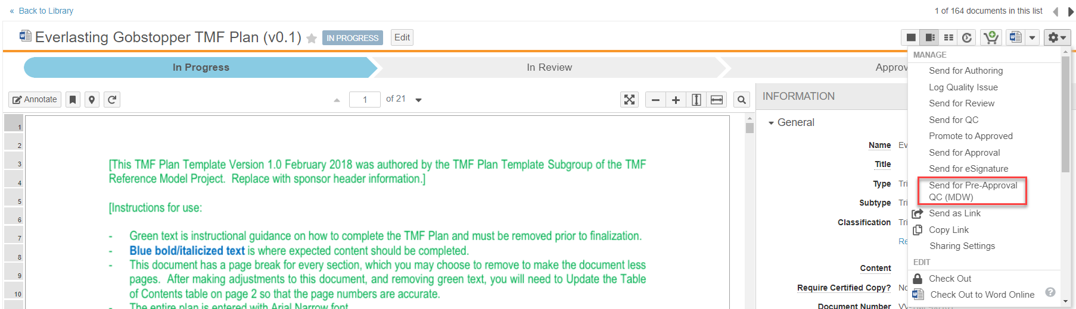
Start Multi-Document Workflow on a Single Document
Configurable
Overview
  Multi-document workflows can be started for a single document from Doc Info
  One workflow definition supports both single and multi-document use cases
Business Justification
  Ensures consistency between multi-document and single document use cases
  Enable documents to leverage many of the features of multi-document and object workflows
Considerations
  Workflow must be configured for a specific lifecycle (not “Any document lifecycle”)
Feature Risk
MEDIUM
Default Impact
VISIBLE TO ADMINS ONLY
Notes:
The first few slides in this theme support our MDW and QI object features that were originally released in 18R3 last year
As the name of this feature implies, Admins can configure and workflow initiators can start multi-document workflows for a single document
The benefits of this feature is to ensure consistency between multi-document and single document use cases and leveraging the features of multi document and object workflows
As seen in this screenshot, we are able to send this single document on a multi-document workflow by choosing it from the action wheel
One consideration of this feature is that it must be configured for a specific lifecycle – not for Any Document Lifecycle
In a few minutes, we will see this and several other features in action

Slide 40
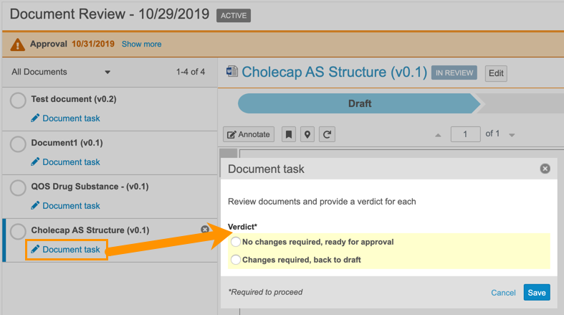
Multi-Document Workflow:
Updated Envelope Viewer
Automatic
Overview
  The Multi-Document Workflow Envelope Viewer has been updated to open a dialog to prompt for configured input beyond a simple verdict
Business Justification
  In order to accommodate configuring reasons for verdicts, the MDW Viewer has been updated to collect all verdicts and/or prompts in a dialog
Considerations
  Prior to this release, task owners selected verdicts for each document directly from the list of documents in the viewer. They now need to click on the “Document Task” link to provide all of the required input
  When hovering over the document name, users can see the selected verdict and any provided reasons/comments without having to open the dialog
Feature Risk
N/A
Default Impact
VISIBLE TO ALL USERS
Notes:
Our next feature is the Updated Envelope Viewer
For those customers who are using MDW, you will notice some changes in the viewer
Before 19R3, task owners selected verdicts like Approved or Rejected directly from the list of documents in the viewer on the left hand side
Now, they will click on the document task button with the pencil icon, enter a verdict, and any comments or reasons (if Vault has been configured that way)
Documents with tasks that are pending will have an open circle icon
Documents with completed tasks will have a checkmark
By hovering over the document name, we can see a hovercard with the task and inputs
In the taskbar, we will see the total number of documents and the number of tasks remaining
Once all tasks are complete, the blue complete button is available

Slide 41
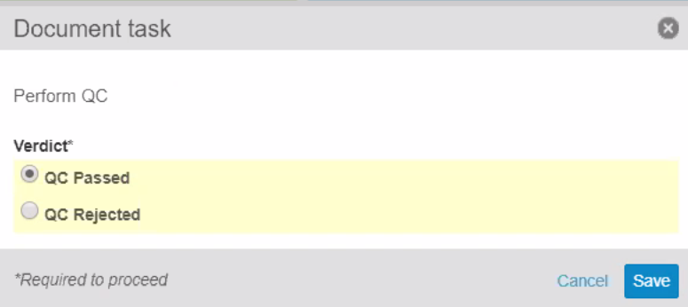
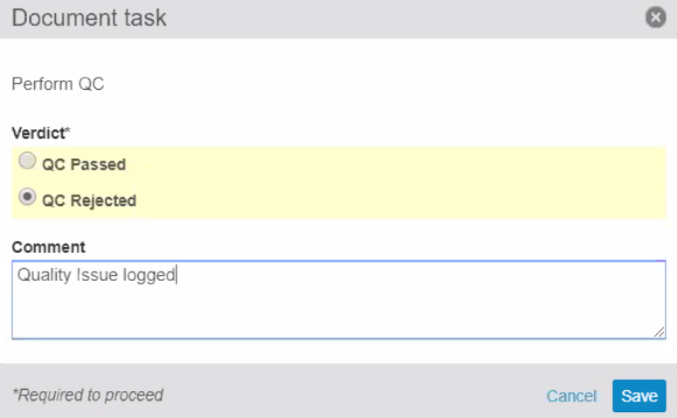
Multi-Document Workflow:
Verdict-Based Prompt for Comments and Reasons
Configurable
Overview
  Admins can now configure a multi-document workflow task step to prompt for comments or reasons only if the task owner selects a specific verdict
Business Justification
  Ability to configure verdicts to require comments (text field) or reasons (picklist)
Feature Risk
MEDIUM
When Task Owner selects the Reject verdict, they can provide a comment
Default Impact
VISIBLE TO ADMINS ONLY
Notes:
This next feature “Verdict-Based Prompt for Comments and Reasons” allows Admins to configure a MDW task step to prompt for reasons or comments when the task owner selects their verdict
This was based on a customer request since they want task owners to provide their justification for rejecting documents
As we saw in the previous slide, once we click on the document task pencil icon this pop up appears
In the screenshot on the left, we can see that the document has passed QC and there are no prompts
But in the screenshot on the right, we see that this document is QC rejected and the comment prompt appears
One thing to note is that both the comment and reasons prompts can be made required fields (and would be highlighted in yellow)
For reason prompts, Admins can create a picklist of values and the Task owner would select the reason from the list

Slide 42
Constrain Multi-Document Workflow Based on Document Status & Field Values
Configurable
Overview
  Prevent documents from being included in a Multi-Document Workflow (MDW) based on document status and field values
  For example:
    Prevent Approved documents from being included in MDW that would allow documents to be modified, only allow Draft documents to go on “Route for Approval” workflow
Business Justification
  Streamline MDW and prevent potential errors
Considerations
  Workflow must be configured as a “specific lifecycle” workflow – Not “Any Document Lifecycle”
  Requires configuration of document user action in the relevant document state with required conditions
  NOTE: Existing specific-lifecycle workflow configured since 19R2 now require the configuration of a Document Lifecycle User Action for the MDW so that the workflow will show up on Doc Info page and on the Library
Feature Risk
MEDIUM
Default Impact
VISIBLE TO ADMINS ONLY
Notes:
In this feature, multi-doc workflow is able to prevent documents from being included in an envelope if they do not meet document status and field value criteria
Before 19R3, a specific MDW would be available on the Library, Reports, and Binder sections even if a user action was not configured in specific states
A couple of use cases:
If you do not want Approved documents to be included in a MDW envelope that allows documents to be modified, an Admin would configure the Approved state to not include Approved documents
Another use case is if you have Approved documents that you would like to perform an inspection readiness check on
In this case, you would only want to include Approved documents that have an inspection readiness field value of no
You would not want to include Approved documents that are already inspection ready
As part of our demo, we will be able to see how this works
Furthermore, for specific-lifecycle MDW to show up on the Library, etc. You MUST configure a Document Lifecycle User Action on the relevant Lifecycle State with conditions if relevant.
If no conditions are needed, then use “Always” in the User Action.

Slide 43
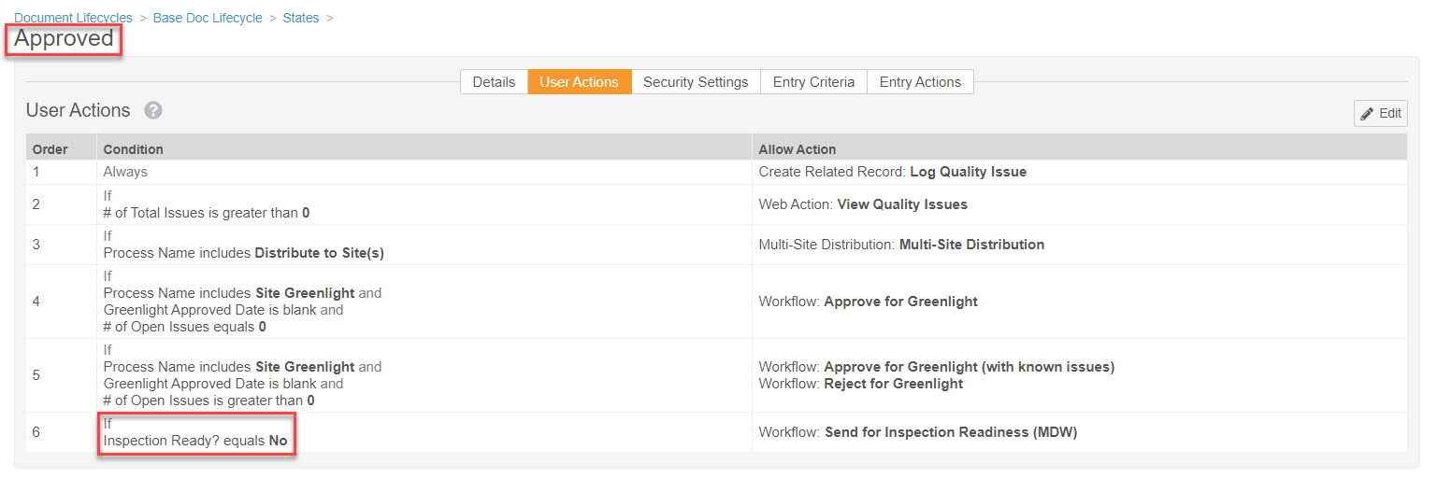
Constrain Multi-Document Workflow Based on Document Status & Field Values
Configurable
This prevents documents that are already Inspection Ready from being included in this MDW
Feature Risk
MEDIUM
Default Impact
VISIBLE TO ADMINS ONLY
Notes:
In this screenshot, we see an example of how to constrain MDW
It is based on the Approved document status and the field value of Inspection Ready? is no
In other words, this will prevent any documents that are Approved and already Inspection Ready from being sent on a Post-Approval inspection readiness MDW a second time (which is a waste of time)

Slide 44
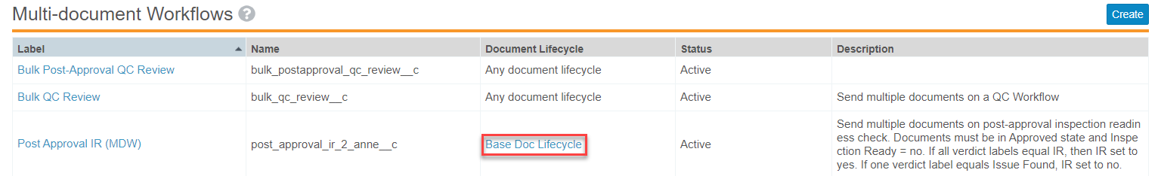
Constrain Multi-Document Workflow Based on Document Status & Field Values
Configurable
Specific Document Lifecycle (not “Any document lifecycle”)
Feature Risk
MEDIUM
Default Impact
VISIBLE TO ADMINS ONLY
Notes:
When configuring this feature, be sure to choose a specific lifecycle like Base Doc Lifecycle and not “Any document lifecycle”

Slide 45
Demo

Slide 46
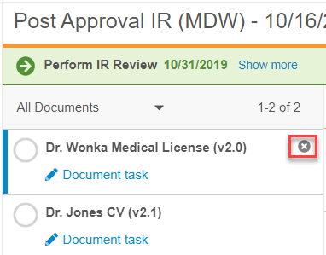
Remove Documents from Envelope
Automatic
Overview
  Workflow initiator is able to remove a document from an active multi-document workflow (MDW)
  Enables documents to be removed from the envelope to be revised while the other documents can continue on the MDW
Business Justification
  More efficient multi-document approval
Considerations
  Only the workflow initiator can remove the documents
  Removed documents return to the workflow cancel state
  There must be at least one document in the envelope
Feature Risk
MEDIUM
Default Impact
VISIBLE TO ALL USERS
Notes:
Often times, customers use the MDW envelope to review and approve groups of documents
While some are ready for approval, other may need to be removed from the envelope to be revised by the authors
In this case, the business needs the ability to remove the documents needing revisions while the others can continue on the workflow
Another use case is when a document is included in an envelope by mistake or is no longer relevant
Before 19R3, the workflow had to be cancelled, revised, and then restarted without the document
Now, we are able to easily remove the documents from the envelope
As you can see in the screenshot here, it’s as easy as clicking on the x

Slide 47
Optimizations for Merge Fields
Automatic
Overview
  The syntax for the WHERE clause has been simplified to use the familiar object relationship structure. In addition, Merge Field tokens now retrieve a maximum of 1,000 entries
Business Justification
  Includes new optimizations for Merge Fields that improve the performance and increase its ease of use
Considerations
  When using the WHERE clause, you cannot filter on the root object
  You can only filter on objects with outbound relationships
Feature Risk
N/A
Default Impact
VISIBLE TO ALL USERS

Slide 48
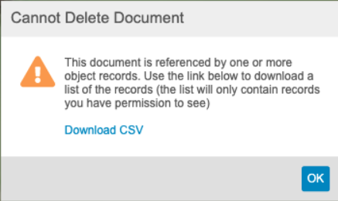
Download List of Records Blocking Document Deletion
Automatic
Overview
  When a user cannot delete a document that is referenced by an object record, they can now click on a link to download a CSV file containing the a list of records blocking document deletion
Business Justification
  Easier to delete document knowing which object records are blocking the deletion
Feature Risk
N/A
Default Impact
VISIBLE TO ALL USERS
Notes:
When trying to delete a document, many of you may have come across an error message stating that the document is referenced by an object record. Prior to this release it was difficult to identify the referenced object records. We will now have the ability to download a CSV file that will contain a list of the records that are preventing us from deleting that document. The link to download the CSV file will be available directly within that error message pop-up (as shown in the image on this slide).

Slide 49
Other Document Management Features
Remove Deprecated Re-Rendering Options
Improved Handling for Multiple Action Bookmarks
Download Notes to CSV
Create Anchors
Scalable Overlay Processing
Notes:
Each of these features have a slide associated with them that will be available in the posted deck after all the webinars are complete

Slide 50
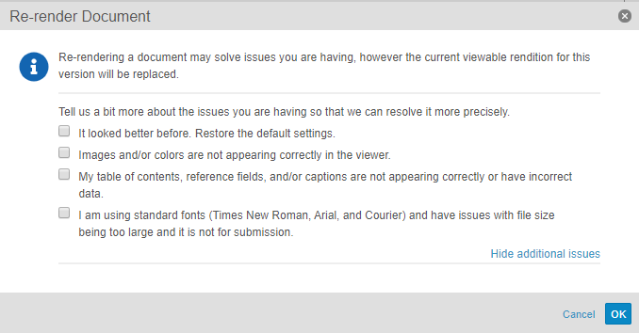
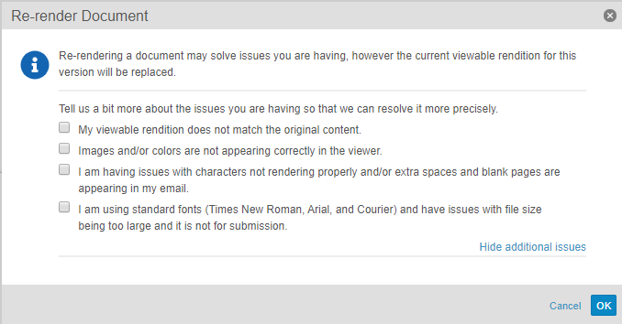
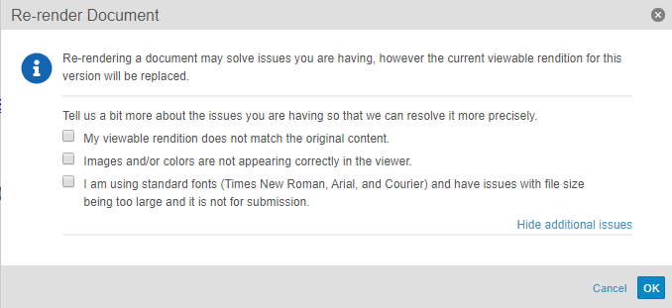
Remove Deprecated Re-Render Options
Automatic
Overview
  Removes several re-render options that are no longer applicable
  Other options that control rendition settings remain available in the Re-render Document dialog and are shown below
Business Justification
  Lays the groundwork for future enhancements and stops dependency on 3rd party rendering capabilities
For Word Doc
For Email Doc
For HTML
Feature Risk
N/A
Default Impact
VISIBLE TO ALL USERS

Slide 51
Improved Handling for Multiple Action Bookmarks
Automatic
Overview
  This feature improves Vault’s handling of multi-action bookmarks in PDF source documents to inspect all actions on the bookmark and enable navigation for the first supported action
Business Justification
  Ensures that all bookmarks will be displayed in viewable renditions. Previously, Vault only inspected the first action of a multi-action bookmark, and if the application did not support that action, Vault did not display the bookmark
Considerations
  Additionally, Vault displays all bookmarks, including those with no supported actions, and maintains the correct nested structure in keeping with the structure of bookmarks in the source PDF
Feature Risk
LOW
Default Impact
VISIBLE TO ALL USERS

Slide 52
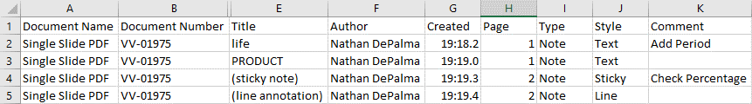
Download Notes to CSV
Automatic
Overview
  Users can download annotations from vault documents as a CSV file
Business Justification
  When documents contain many annotations, users can Download Notes to review comments information in a concise, easy to read CSV file
Considerations
  The action is available to users with View Content permission whenever the document has a viewable rendition and one or more annotations
Feature Risk
LOW
Default Impact
VISIBLE TO ALL USERS

Slide 53
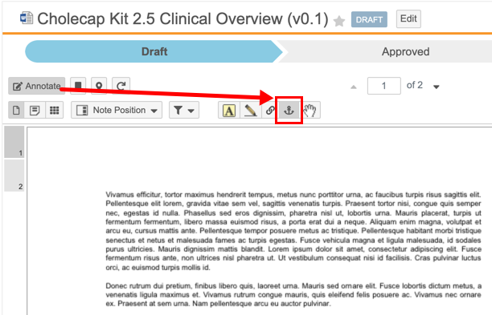
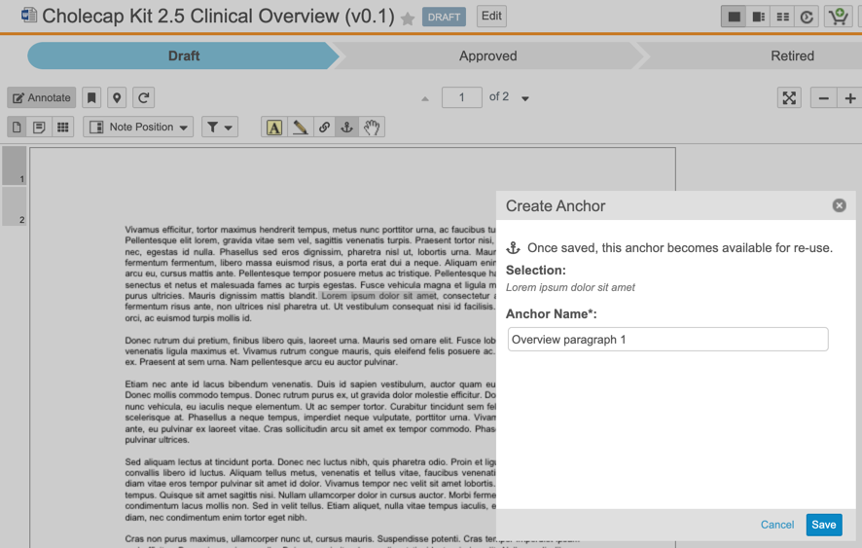
Create Anchors
Automatic
Overview
  This new tool enables users with the proper permissions (including the new Create Anchors permission) to create anchors on documents directly
Business Justification
  Streamlines anchor creation and gives Admins the ability to control who can create anchors, leading to a cleaner and more accurate anchor database
Considerations
  Anchors created with the Create Anchor tool can be either text or image selections
  Created anchors are available for selection when creating Link Annotations
  To use the Create Anchor tool, users must have View Document, View Content, Annotate, and Create Anchors permissions on the target document
New ‘Create Anchor’ tool
Feature Risk
MEDIUM
Default Impact
VISIBLE TO ALL USERS

Slide 54
Scalable Overlay Processing
Automatic
Overview
  Overlay processing will be moved off the POD to a rendition server
Business Justification
  This change will improve scalability when downloading viewable renditions with overlays applied
Considerations
  The new infrastructure will be enabled gradually across PODs
  Signature page processing is not part of this feature and will remain on the POD
Feature Risk
MEDIUM
Default Impact
VISIBLE TO ALL USERS

Slide 55
Data Management

Slide 56
Object & Document Audit History Filters Enhancements
Automatic
Overview
  With this new feature more filtering options are available in the object and document audit histories
    Filter the Document Audit History by Time, Event and User in any order
    Filter the Object Audit History by Time, Event, User and Object in any order
Business Justification
  Customers often need to locate specific records in the audit trail, but are forced to export it in order to find what they are looking for. Locating specific activity is far more accessible with the additional filtering options
Considerations
  Filters are only available in the admin audit history
  Only 3 filters may be applied at a time for the object audit history
Feature Risk
LOW
Default Impact
VISIBLE TO ADMINS ONLY

Slide 57
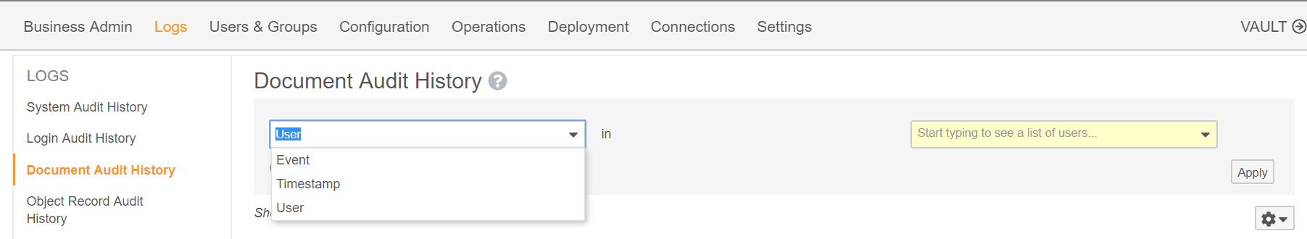
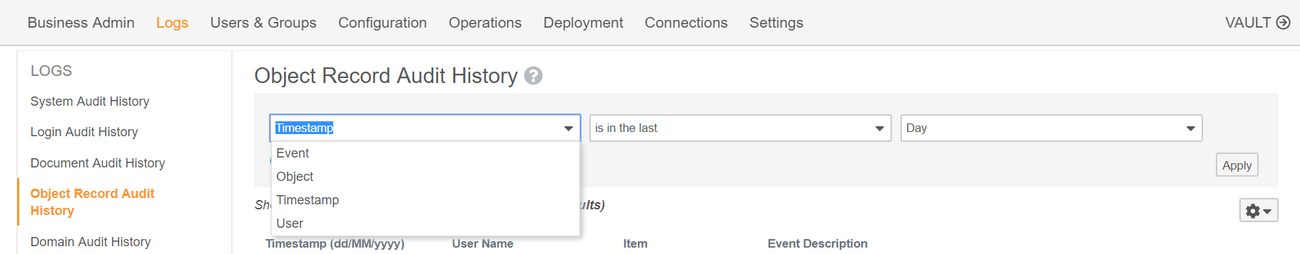
Object & Document Audit History Filters Enhancements
Automatic
Further filtering options are now available under Document Audit History
Feature Risk
LOW
Further filtering options are now available under Object Record Audit History
Default Impact
VISIBLE TO ADMINS ONLY

Slide 58
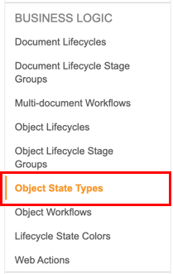
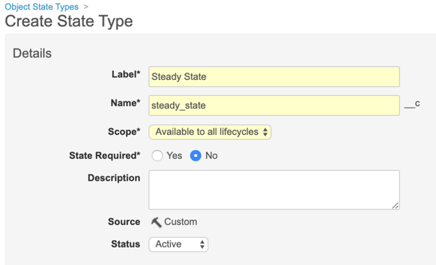
Object State Types
Configurable
Overview
  This feature allows Admins to create or modify object state types and associate them to specific or all available object lifecycles
Business Justification
  Prior to 19R3, only Initial and Complete were available state types within object lifecycles. This feature allows Admins to assign additional state types to objects
Considerations
  Vault Compare and Vault Configuration Reports may show state type lifecycle components have changed even though there is no functional difference
  Admins can specify if the State Type is required, and if the scope:
  Applies to all lifecycles
  is Available to all lifecycles
  is for a Specific lifecycle
Feature Risk
MEDIUM
Default Impact
VISIBLE TO ADMINS ONLY

Slide 59
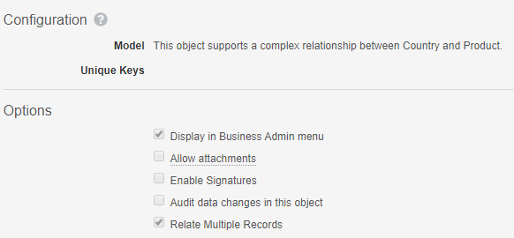
Relate Multiple Records: Complex Join Related Sections
Configurable
Overview
  Admins can configure the ability to relate multiple objects records through a complex join from the Related Object section
Business Justification
  Users can now quickly relate multiple object records in a complex join Related Object section on a parent object record page, similar to simple join sections
Considerations
  Vault automatically creates complex join records
  in the background
  Records that are already related are shown with
  an indicator but can be selected again
  From complex join sections, users can also click
  a link to download a CSV file containing a list of
  parent records that Vault could not relate to the
  current record
Feature Risk
LOW
Default Impact
VISIBLE TO ADMINS ONLY

Slide 60
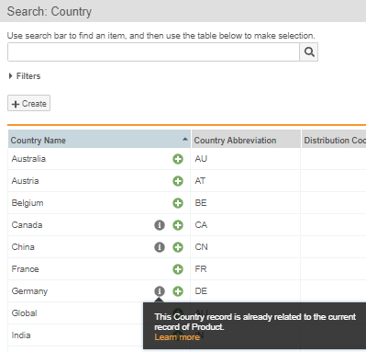
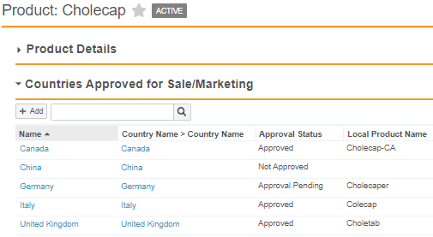
Relate Multiple Records: Complex Join Related Sections
Configurable
Feature Risk
LOW
Default Impact
VISIBLE TO ADMINS ONLY

Slide 61
Update EDL Item Tracking Fields When Batch Update Is No/Blank
Automatic
Overview
  Users can now see the accurate progress for new EDL Item records even when the Batch Update field is set to No or left blank, as long as the EDL matching job is active and has run at least once
Business Justification
  Previously, Vault would only update the tracking fields via the continuous EDL Matching job when the Batch Update field was set to Yes, resulting in inconsistent progress indicators in a set of related EDL Items. Now, manual document matches on EDL Items with Batch Update set to No/blank will trigger the update to the tracking fields
Considerations
  Vault will not update tracking fields on existing records where Batch Update is set to No or left blank unless a user updates the EDL Item record or the matched document, triggering continuous matching
  To update all existing EDL Item records, contact Veeva Support
Feature Risk
MEDIUM
Default Impact
VISIBLE TO ALL USERS

Slide 62
Other Data Management Features
Correct Currency Format in Merge Fields & Formatted Output
Simple Join Objects Include Lifecycle State Fields
Download List of Unrelated Parent Records
Uniqueness Update
Three Levels of Dependent Questions for Checklists
Synchronize Checklist Design & Related Records
Optional Checklist Category in User & Entry Actions

Slide 63
Correct Currency Format in Merge Fields & Formatted Output
Automatic
Overview
  Vault now displays currency values in merge fields and formatted output documents, using the format specified by the selected local currency
Business Justification
  Ensure currency values display with the correct formatting
Feature Risk
NA
Default Impact
VISIBLE TO ALL USERS

Slide 64
Simple Join Objects Include Lifecycle State Fields
Automatic
Overview
  When Admins add a lifecycle to a simple join object, the object will now remain a simple join object
Business Justification
  This allows users to multi-select multiple related records and show the parent records in a simple join related object section for join objects that have a lifecycle
Considerations
  If an existing complex join has only Lifecycle fields in addition to the System fields, Vault shows the Add button instead of the Create button
Feature Risk
LOW
Default Impact
VISIBLE TO ALL USERS

Slide 65
Download List of Unrelated Parent Records
Automatic
Overview
  From simple join Related Object sections, users can now click a link to download a CSV file containing a list of parent records that Vault could not relate to the current record
Business Justification
  Prior to 19R3, if records were not related successfully, it used to fail silently
  This feature will allow users to see a list of records that could not be related with the reason of the failure
Feature Risk
N/A
Default Impact
VISIBLE TO ALL USERS

Slide 66
Uniqueness Update
Automatic
Overview
  Vault now applies changes to the ‘Values must be unique’ setting asynchronously and blocks certain actions on the affected object field while processing these changes, including deleting the field and modifying the Maximum Length setting
Business Justification
  Following a different underlying architecture for Uniqueness will allow to make the field uniqueness more robust
Feature Risk
LOW
Default Impact
VISIBLE TO ADMINS ONLY

Slide 67
Three Levels of Dependent Questions for Checklists
Configurable
Overview
  This feature increases the limit from a maximum of two to three levels of dependent questions
  Q1: Are you a member of the Quality Community?
  Q1.1: Did you attend the last Quality Community meeting?
  Q1.1.1: Would you recommend the Quality Community meeting to colleagues?
  Q1.1.1.1: Would you like to provide your colleagues email addresses?
Business Justification
  Provides additional flexibility for complex checklists that rely on dependent questions
Considerations
  There are no changes to the way dependent questions are configured for a multiple question design record
Level 3 dependent question
Feature Risk
MEDIUM
Default Impact
VISIBLE TO ADMINS ONLY

Slide 68
Synchronize Checklist Design & Related Records
Configurable
Overview
  Admins can configure a new User Action called Sync Checklist Design Lifecycle States
  This User Action which will change the lifecycle state of the Checklist Design record, and all of its related Sections, Questions, Answers, and Dependencies
  Example: Synchronize lifecycle states for related records when a Checklist Design is approved for use, made inactive, or reverted to the draft state
Business Justification
  Previously, a change state User Action and many Entry Actions were needed to keep the lifecycle states across all of the Checklist Design records in sync
  Addresses a platform limitation when more than 1,000 state changes were kicked off via Entry Actions on a Checklist Design record’s Section, Question, Answer, and Dependency records
Feature Risk
MEDIUM
Default Impact
VISIBLE TO ADMINS ONLY

Slide 69
Optional Checklist Category in User & Entry Actions
Configurable
Overview
  Vault uses object record fields, specified by an Admin, to determine which Checklist to start for a user
  This feature allows all of the matching fields specified by an Admin to be configured in a single location on the Checklist Type definition
Business Justification
  This feature simplifies how the Start Checklist User Action and Entry Action are configured
Considerations
  Example: If an Admin does not want to use the Checklist Type picklist as a matching field value, and only wants to use Facility as a matching field, the Start Checklist User Action is configured so that Checklist Type is set to “Not Applicable”, and the matching field Facility is added when the Checklist Type is configured
  If an Admin does want would like to use the Checklist Type picklist as another matching field, this field can be added to the Checklist Type definition of matching field values, rather than being defined in the User Action or Entry Action
Feature Risk
MEDIUM
Default Impact
VISIBLE TO ADMINS ONLY

Slide 70
Reporting

Slide 71
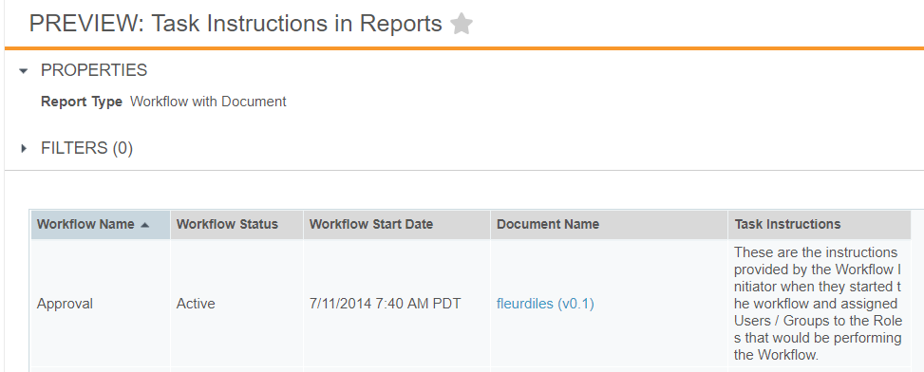
Task Instructions in Reports
Automatic
Overview
  Task Instructions can now be included in Workflow with Document reports
Business Justification
  Users will be able to view previous document workflow task instructions, providing context to later steps, actions, and decisions
Considerations
  Instructions can be viewed only after a document workflow has been initiated
Feature Risk
LOW
Default Impact
VISIBLE TO ALL USERS

Slide 72
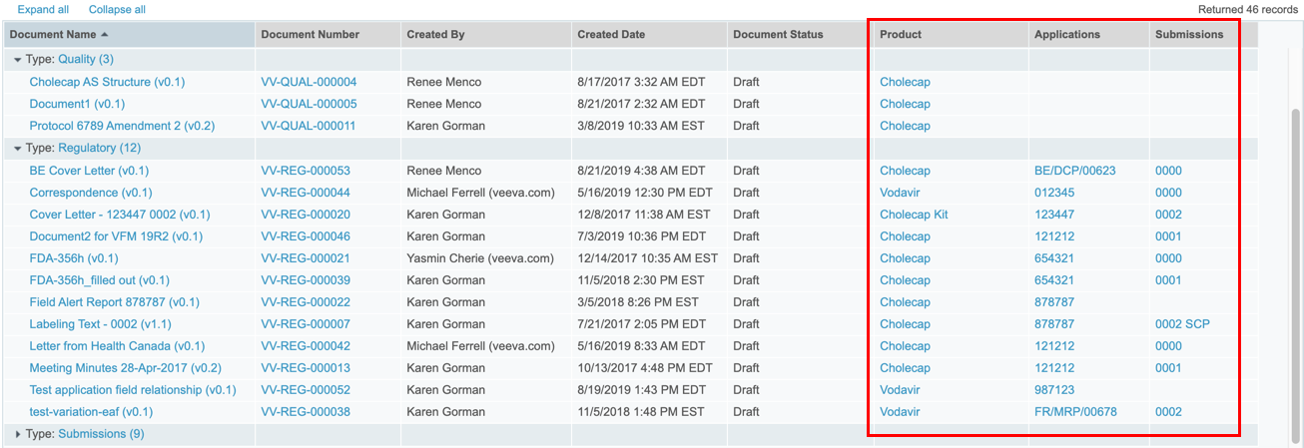
Display Object Reference Fields as Links in Reports
Automatic
Overview
  All object reference fields in a report will display as clickable links
Business Justification
  Users will be able to click on object reference fields when viewing report results
Considerations
  Both single value and multi-value reference fields will appear as links
Feature Risk
LOW
Default Impact
VISIBLE TO ALL USERS

Slide 73
Multi-Pass Reporting Enhancements
Configurable
Overview
  With 19R3 we’ve added multiple enhancements to Multi-Pass Reporting:
    The ability to create report views from Workflow Reports
    Add groups to report views
    Join report views by text fields
    Ability to define conditional fields in both report views and multi-pass reports
    Ability to select inner join in addition to left join when joining report views
    Ability to filter on aggregate fields defined in report views
Business Justification
  Allows Admins to create and join reports with more options and flexibility
Considerations
  Left join - Vault returns all records from the view on the left side and only records with matching fields from the view on the right side
  Inner join (new in 19R3) - Vault returns records that have matching values from both views
Feature Risk
LOW
Default Impact
VISIBLE TO ADMINS ONLY

Slide 74
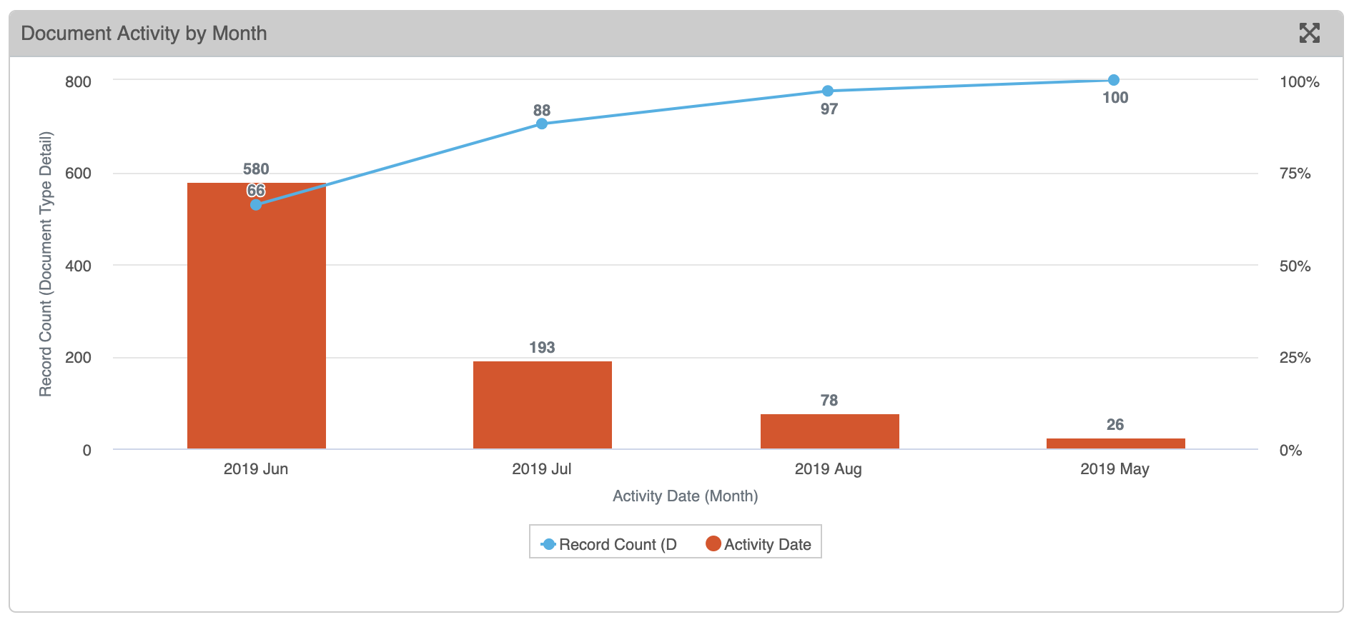
Pareto Charts
Automatic
Overview
  Pareto charts are now a supported Vault Dashboard chart type. They are similar to column charts, but always display groups in descending order and include a cumulative percentage line
Business Justification
  These charts are commonly used in quality control processes
The y-axis will either be the count of the primary, down or up objects, or an aggregate field calculation (e.g., 580 (June) + 193 (July) = 773, 773/877 (Total) = 88%)
The x-axis will be determined by the grouping
Feature Risk
LOW
Default Impact
VISIBLE TO ALL USERS

Slide 75
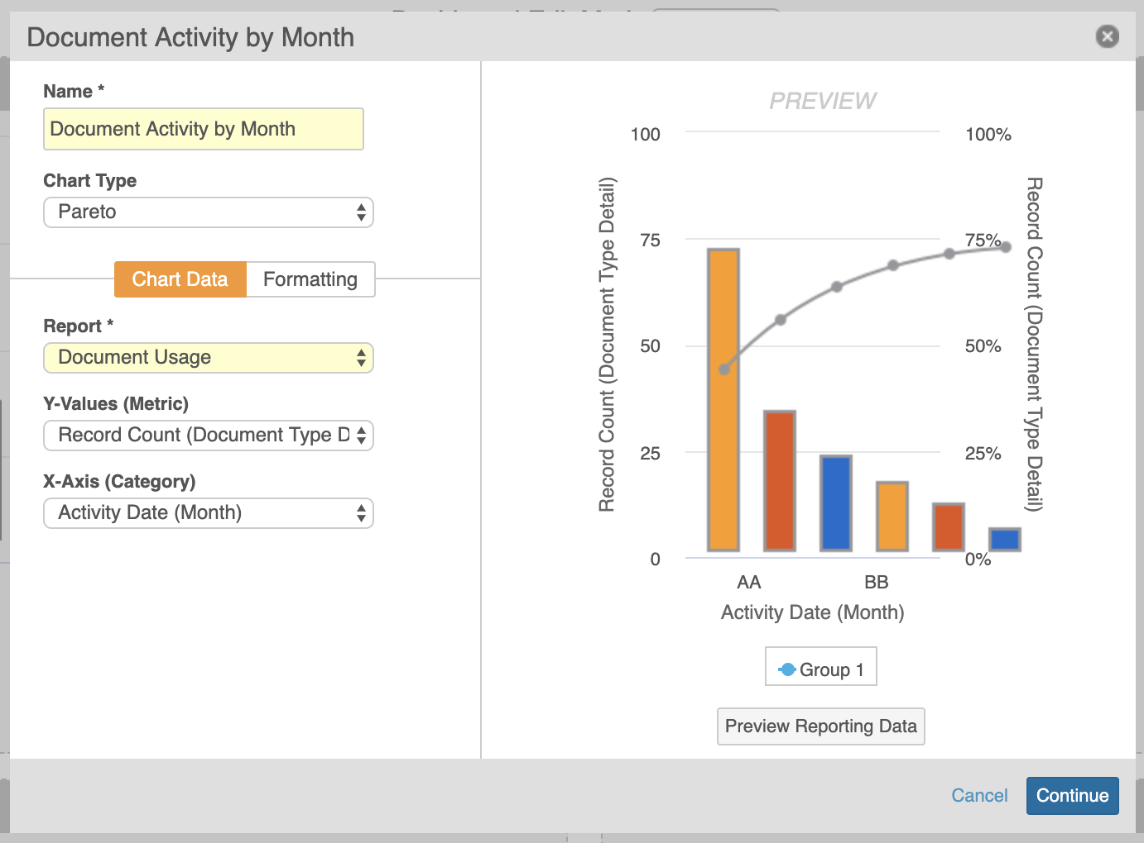
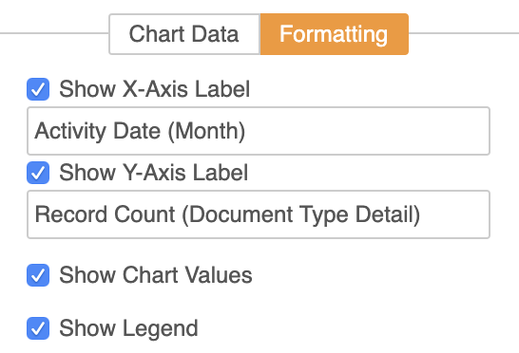
Pareto Charts
Automatic
Considerations
  Pareto charts will be available as an option when bar or column charts are available for selection
  Unlike a standard column chart, a ‘Group By’ option will not be visible for the Pareto chart
  When formatting the Pareto chart, the Cumulative % line is not editable
Feature Risk
LOW
Default Impact
VISIBLE TO ALL USERS

Slide 76
Prevent Report Re-Execution On Export
Automatic
Overview
  Tabular reports will no longer re-execute upon export if the report was recently run (within 8 hours) by the same user
Business Justification
  This behavior change reduces server load, and exports will render faster since reports will not have to re-execute
Considerations
  No visible changes to end user experience when exporting
  Upon opening a report, click Refresh to ensure that you are seeing the most recent data
Feature Risk
N/A
Default Impact
NONE

Slide 77
System Administration

Slide 78
Self-Serve Pre-Release Vaults
Automatic
Overview
  In past releases, Veeva has cloned customer Vault configurations to create a Pre-Release Vault with each release
  Starting in the 20R1 Pre-Release window, customers will be able to create, refresh, and manage their Pre-Release Vaults for each release
Business Justification
  This change will give customers greater control over their Pre-Release environments, particularly helpful in scenarios where a refresh is needed or a Pre-Release needs to be created from a Sandbox (when Production is not yet provisioned)
Considerations
  This feature is auto-on in 19R3 as the code changes required to update this process are occurring with 19R3
  This functionality will be enabled by Vault Operations:
    6 weeks ahead of General Release for the designated Early POD
    4 weeks ahead of General Release for all other PODs
  Each customer is entitled to 1 Pre-Release Vault for every Production Vault. If no Production exists, the entitlement will be 1 Pre-Release for the initial Sandbox Vault
Feature Risk
MEDIUM
Default Impact
VISIBLE TO ADMINS ONLY

Slide 79
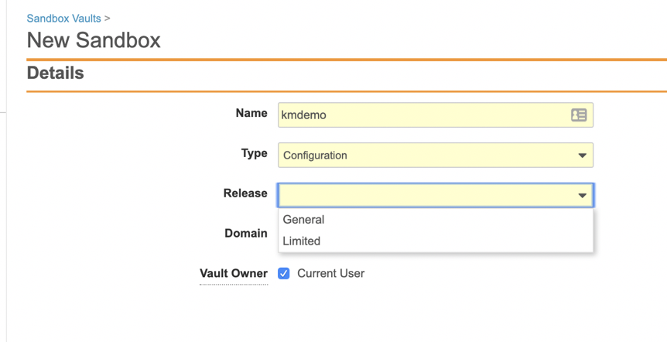
Limited Release Sandbox
Support
Overview
  Customers will now be able to create a sandbox on a Limited Release from a Vault on General Release
Business Justification
  Allows customers the ability to manage their own Limited Release sandbox to be able to more proactively assess new functionality ahead of each General Release
Considerations
  Allowed number of sandboxes for each customer will remain the same
  Configuration migration from Limited Release Vault to General Release Vault will not work (i.e. features won’t exist in General Release or the data models may differ)
Feature Risk
LOW
Default Impact
NONE

Slide 80
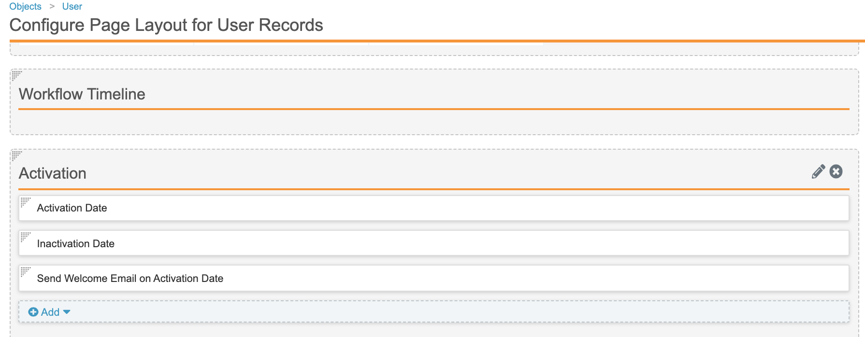
User Pending State
Configurable
Overview
  This feature adds a new Pending state to the Vault Membership lifecycle so that Admins can assign new users to groups and sharing settings prior to granting the user access to the Vault
Business Justification
  Allows Admins time to set up new users appropriately and delay activation until training requirements are met or the user is fully set up
Considerations
  Admins can update the User record page layout to display the Activation fields
Feature Risk
MEDIUM
Default Impact
VISIBLE TO ADMINS ONLY

Slide 81
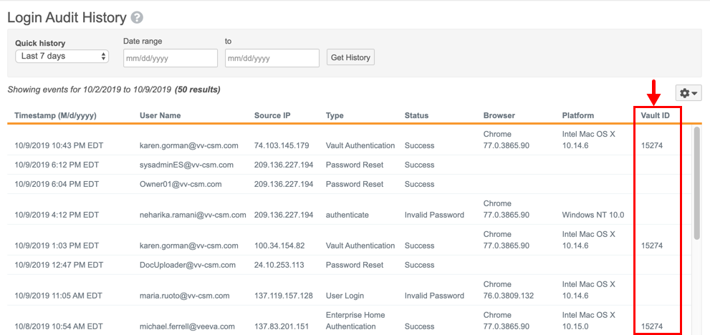
Add Vault ID Field to Login History UI
Automatic
Overview
  This feature exposes the Vault ID field in the Login Audit History
Business Justification
  Admins can now quickly understand to which Vault an Audit entry relates without exporting the Audit History
Feature Risk
HIGH
Default Impact
VISIBLE TO ADMINS ONLY

Slide 82
Increase Formula Field Limit for Objects
Automatic
Overview
  Each object may now have up to ten (10) formula fields
Business Justification
  Extends the number of formula fields from 5 to 10 per object allowing for greater use of formula fields
Considerations
  Formula fields can be used for text, date, Yes/No, number, icon, links
Feature Risk
N/A
Default Impact
VISIBLE TO ADMINS ONLY

Slide 83
Link Formula Fields
Configurable
Overview
  Admins can define clickable URLs using formula fields with a Link return type. The Link can be a Vault to Vault URL, or a simple external URL
Business Justification
  With Vault to Vault integrations in place, this provides seamless two-way navigation between objects in different Vaults. Without integrations, this allows navigation to external sites or to a static document in another Vault
Considerations
  Link fields are read-only for end users
  Links can be configured to open in the same window or a new window
  A user-friendly label can be displayed, rather than showing the full URL
  New Link formula functions are Hyperlink and Urlencode
Feature Risk
MEDIUM
Default Impact
VISIBLE TO ADMINS ONLY

Slide 84
Link Formula Fields
Configurable
Vault to Vault URL with Connection
Feature Risk
MEDIUM
External URL
Default Impact
VISIBLE TO ADMINS ONLY

Slide 85
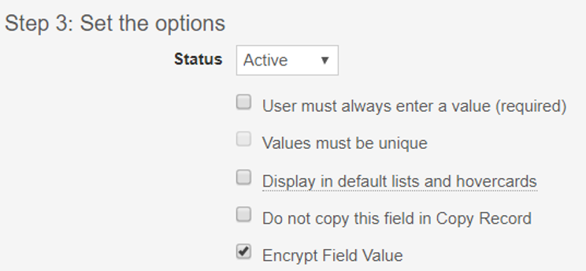
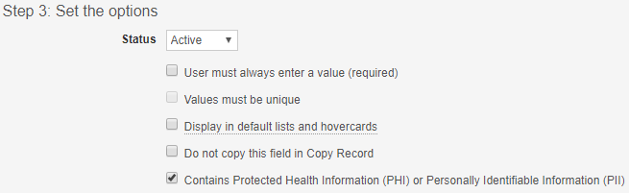
Update Label to PHI or PII Field
Automatic
Overview
  The Encrypt Field Value setting on object fields is relabeled to Contains Protected Health Information (PHI) or Personally Identifiable Information (PII)
Business Justification
  This label change better reflects the intended usage of the setting, which allows Admins to add a secondary level of protection to highly sensitive information associated to an object record
Considerations
  The field was originally released in 19R2, and there is no change to existing functionality
Feature Risk
HIGH
Feature Label in 19R2
Feature Label in 19R3
Default Impact
VISIBLE TO ADMINS ONLY

Slide 86
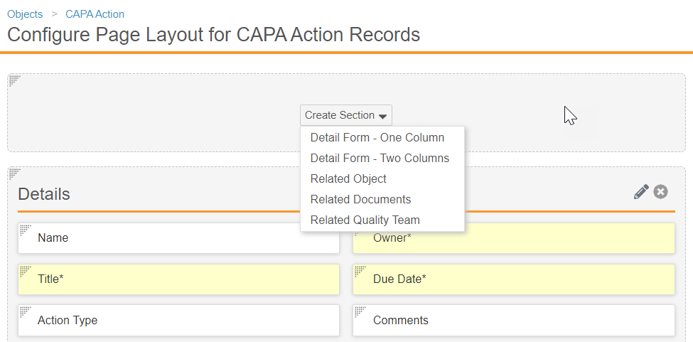
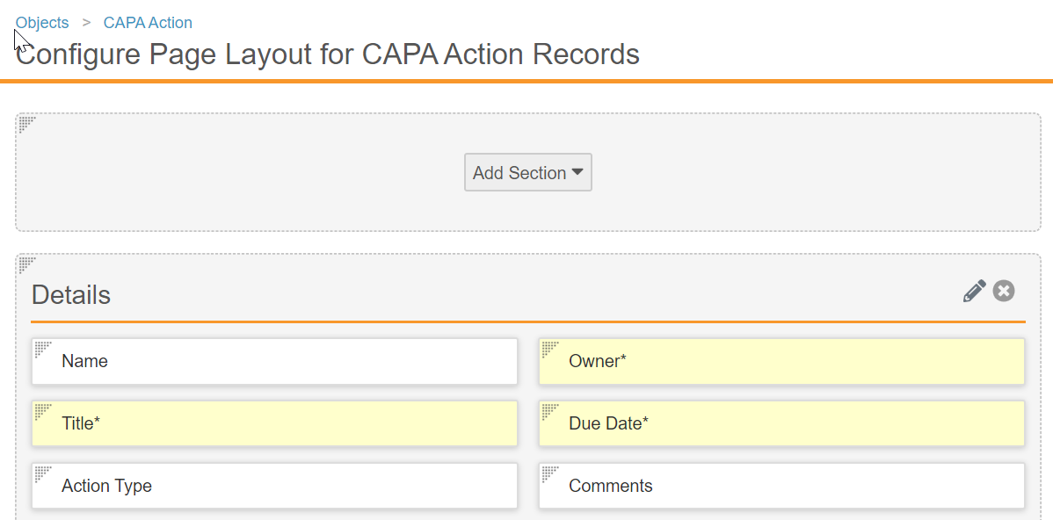
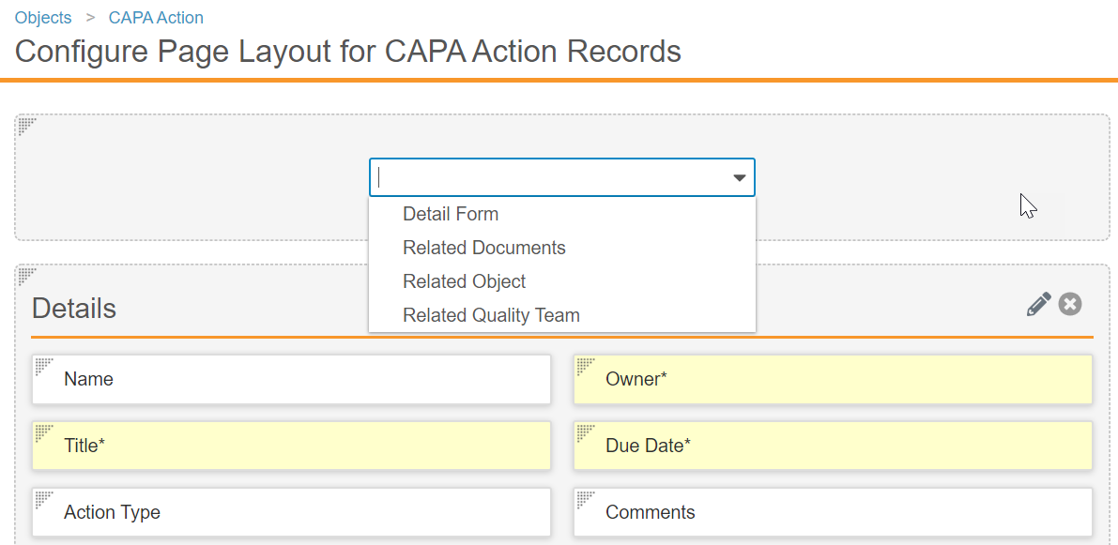
UI Changes in Object Page Layout Editor
Automatic
Overview
  When editing an object page layout …
  The Create Section button is now labeled Add Section
  Two options under Add Section (Single Column Detail Form and Two Column Detail Form) have been consolidated into a single item (Detail Form)
Considerations
  This feature is not visible in Pre-Release Vaults, but will be Auto-on in the General Release
Setup by:
N/A
for use by:
Admin
BEFORE 19R3
AFTER 19R3
Feature Risk
N/A
Default Impact
VISIBLE TO ADMINS ONLY

Slide 87
Other Systems Administration Features
API Usage Logs to Include Request Duration
Platform Data Model Changes
Include Seconds in Audit Trail Export Timestamp Column
Job Logging
Record ID & Object Label Column in Object Audit Exports
System Objects Supported in Related Record Audit Trails

Slide 88
Developer Toolkit Features
Global ID & Link Fields for Object Records
SDK Features
  Restrict Adding Users to Active Workflows with SDK-Managed Participants
  Java SDK Message Catalog: Admin UI
  Job Processors
Spark Features
  Spark Integration Management
  Spark User Exceptions
  Spark Message Processor Label Clarification

Slide 89
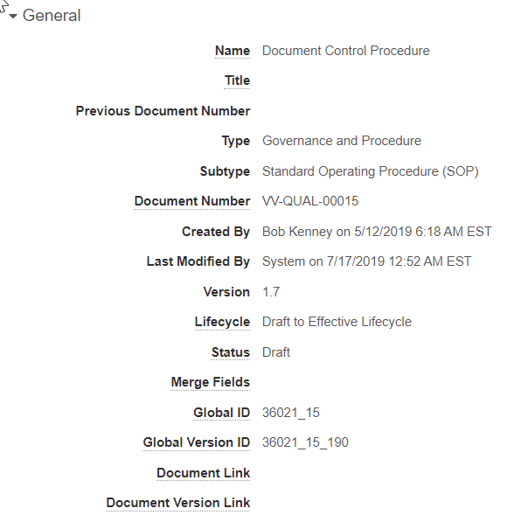
Global ID & Link Fields for Documents/Versions
Automatic
Global ID Fields
Overview
  This release introduces two new document fields whose values are populated when a document is created:
  global_id__sys: system-generated id that uniquely identifies a document across all Vaults
  global_version_id__sys: system-generated id that uniquely identifies a document version across all Vaults
Business Justification
  The Global ID fields provide Vault-to-Vault integrations, and Vault-to-external system integrations, with a single identifier for documents and document versions
Setup by:
N/A
for use by:
Developer
Considerations
  Global ID fields will be populated for all documents at the time of the 19R3 General Release
  Global ID fields are non-editable
  Global ID fields will be visible in the General section (required for customers with integrations that need read only access to all fields) - customers can hide the fields for all but the integration user after the release
  Global ID fields cannot be used as Merge Field tokens in document content
Feature Risk
LOW
Default Impact
VISIBLE TO ALL USERS

Slide 90
Global ID & Link Fields for Documents/Versions
Automatic
Link Fields
Overview
  This release introduces two new document text fields:
  link__sys: can be used to reference the Global ID of another document
  version_link__sys: can be used to reference the Global ID of another document version
Business Justification
  The Link fields can be used by integrations to track a source object record, source document, or source document version, brought into a Vault from an external system or another Vault
Setup by:
N/A
for use by:
Developer
Considerations
  Default value is null
  Link fields will be visible in the General section (required for customers with integrations that need read only access to all fields) - customers can hide the fields for all but the integration user after the release
  Admins can control which document roles have edit permission to Link fields
Feature Risk
LOW
Default Impact
VISIBLE TO ALL USERS

Slide 91
19R3 Developer Release Deep Dive
Thursday, 14-Nov at 7 a.m. PT / 10 a.m. ET / 3 p.m. GMT
Join Veeva Customer Success and Product teams for an education session on new features in the Veeva Vault developer-focused toolkit
This webinar is geared towards current users of the Vault Developer toolkit (API)
Key topics for discussion will include:
  Detailed explanation of new features
  Spark Integration Services
  Java SDK updates
  Considerations for using new features, and impacts features may have
  on your Vault or end users
Advanced registration required
Notes:
Webinar registration link: https://veeva.zoom.us/webinar/register/WN_50Miz-GsRNSMsGsVIpEMFw

Slide 92
Java SDK Message Catalog: Admin UI
Automatic
Overview
  Vault Admins now have the option to add and manage Vault Java SDK custom messages through the Message Catalog User Interface
Business Justification
  Once added, developers can use the message in their Vault Java SDK code
Considerations
  Admins can coordinate message translation into any Vault supported language using the Bulk Translation tool
Feature Risk
N/A
Default Impact
VISIBLE TO ADMINS ONLY

Slide 93
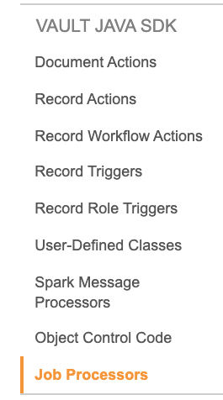

Job Processors
Automatic
Overview
  Admins will see a new Job Processors section in Admin > Configuration > Vault Java SDK
Business Justification
  Admins have visibility to the list of Job Processors created by using the Vault Java SDK
Considerations
  Admins will also see ‘SDK Job’ as an available Type when creating jobs
  in Admin > Operations > Job Definitions
Feature Risk
LOW
Default Impact
VISIBLE TO ADMINS ONLY

Slide 94
Spark Integration Management
Configurable
Overview
  This feature enhances Spark Integrations by allowing Admins to define groupings of business processes, called Integration Points, that work together to achieve the integration goals
Business Justification
  Administrators are now able to create the relevant objects that support an integration directly in the Vault UI
Considerations
  The business layer to support the processes and the objects is written using Vault Java SDK
  The objects are Integration and Integration Point
Feature Risk
LOW
Default Impact
VISIBLE TO ADMINS ONLY

Slide 95

Spark Message Processor Label Clarification
Automatic
Overview
  Throughout the Vault UI, the “Message Processor” label has been changed to “Spark Message Processor”
Business Justification
  This will help distinguish Spark message processors from other types of messages within Vault
Considerations
  In Vault Java SDK, the Vault extension "MessageProcessor” will not be renamed
Feature Risk
N/A
Default Impact
VISIBLE TO ADMINS ONLY

Slide 96
Spark User Exceptions
Configurable
Overview
  This feature allows developers building Spark Integrations to track, route, and resolve any exceptions that require the attention of a Business Admin
Business Justification
  Developers are now able to use User Exception objects and create their specific Lifecycle in order to manage handling exceptions encountered during a process
Considerations
  The objects are User Exception Message and User Exception Item
  You must have Integration Points configured in order to leverage User Exception Messages
Feature Risk
N/A
Default Impact
VISIBLE TO ADMINS ONLY

Slide 97
Restrict Adding Users to Active Workflows with SDK-Managed Participants
Automatic
Overview
  When an object workflow configuration includes the option to use custom actions (create using Vault Java SDK) to define participants, the participant group is no longer available in the Add Participants dialog
Business Justification
  This restriction prevents users from manually changing the membership for participant groups defined by custom Vault Java SDK code
Considerations
  Even though this feature is listed as auto-on, the feature only has an impact for customers who have installed a Java SDK using a custom action to define participants
Feature Risk
N/A
Default Impact
VISIBLE TO ALL USERS

Slide 98
API Usage Logs to Include Request Duration
Automatic
Overview
  This feature adds a Duration column to the API Usage Logs
Business Justification
  The column provides Administrators the ability to determine the time it takes an API request to execute in Vault
Considerations
  The Duration does not include transport times between Vault and the client
Feature Risk
N/A
Default Impact
VISIBLE TO ADMINS ONLY

Slide 99
Platform Data Model Changes
Automatic
Overview
  With the 19R3 release, we have added the following fields to all new and existing objects, documents, and document versions: Global ID (global_id_sys) and Link (link_sys)
  In addition, the following fields have been added to the User object: Activation Date (activation_date_sys), Inactivation Date (inactivation_date_sys), Send Welcome Email (send_welcome_email_sys)
Business Justification
  With every release, we update the data model to better support evolving needs and new feature functionality
Considerations
  These data model updates are automatically included in all Platform vaults, but Admins must make configuration changes to make them available
  This feature is not validated in pre-release Vaults
Feature Risk
N/A
Default Impact
VISIBLE TO ALL USERS

Slide 100

Include Seconds in Audit Trail Export
Timestamp Column
Automatic
Overview
  This feature adds seconds to the audit entry Timestamp column when exporting an audit trail from an individual document or record, or from the Admin > Logs page
Business Justification
  Makes audit exports from the user interface consistent with audit exports from the API, which already included seconds
Considerations
  The user interface shows seconds when hovering over a time stamp in the Timestamp column
Feature Risk
MEDIUM
Default Impact
VISIBLE TO ALL USERS

Slide 101


Job Logging
Automatic
Overview
  The Vault Training application’s Update Training Assignments job automates creation and distribution of assignments and tasks
  This feature enhances the information captured in the job’s log file as follows:
  count of changes that were flagged for processing
  changes that were successfully processed
  errors that occurred, if any
Business Justification
  Improves readability of the actions automatically performed by the Update Training Assignments job
  Enables your Administrator staff to troubleshoot issues and take appropriate actions
Feature Risk
LOW
Default Impact
VISIBLE TO ADMINS ONLY

Slide 102

Record ID & Object Label Column in Object Audit Exports
Automatic
Overview
  A Record ID field is now included within the object record audit exports, providing a way to uniquely identify the related record. In addition, exports to CSV and Text will contain the Object Label field
Business Justification
  Ensures consistency across the audit trail user interface and the exported data
Considerations
  Audit trails export as TXT when the multilingual document handling setting is enabled, and as CSV when this setting is disabled
Feature Risk
MEDIUM
Both Record ID and Object Label are now included within the export
Default Impact
VISIBLE TO ALL USERS

Slide 103

System Objects Supported in Related Record Audit Trails
Automatic
Overview
  Related object record audit entries are now supported to include system objects, such as User
Business Justification
  Provides an easier way to identify all related system activities related to a user. For instance, you can query from a User record all of the User Role Setup objects audit history. Previously you would have to go to the User Role Setup object to see it’s audit history
Considerations
  Created By and Last Modified By are not included due to not being true object references
Feature Risk
HIGH
Included Objects such as User Role Setup are visible within the user object record audit trail
Default Impact
VISIBLE TO ALL USERS

Slide 104
Global ID & Link Fields for Object Records
Automatic
Global ID Fields
Overview
  This release introduces a new object field whose value is populated when an object record is created:
  global_id__sys: system-generated id that uniquely identifies an object record across all Vaults
Business Justification
  The Global ID field provides Vault-to-Vault integrations, and Vault-to-external system integrations, with a single identifier for an object record
Considerations
  The Global ID field is non-editable
  The 19R3 release will not populate existing object records’ Global ID field, and the 19R3 release will NOT make the field visible (customers can add to object page layouts after the release)
    Whenever an existing record is edited, the Global ID field will be populated
    Admins can request Veeva Support populate the Global ID field on existing object records
  All newly created records for all objects will have Global ID populated at the time of creation
  An object record’s Global ID field cannot be used as a Merge Field token in the content of a document that references the object record
Setup by:
N/A
for use by:
Developer
Feature Risk
MEDIUM
Default Impact
VISIBLE TO ALL USERS

Slide 105
Global ID & Link Fields for Object Records
Automatic
Link Fields
Overview
  This release introduces a new object text field:
  link__sys: can be used to reference the Global ID of another document
Business Justification
  The Link field can be used by integrations to track a source object record, or source document, brought into a Vault from an external system or another Vault
Considerations
  Default value is null
  The 19R3 release will NOT make the field visible (customers can add to object page layouts after the release)
  Admins can control which object lifecycle roles have edit permission to the Link field
Setup by:
N/A
for use by:
Developer
Feature Risk
MEDIUM
Default Impact
VISIBLE TO ALL USERS

Slide 106
Additional Information

Slide 107

Best Practices for Managing Vault Releases
This video contains:
Information About Vault General Releases
Recommended General Release Strategy
  Step 1: Auto-On Features
  Step 2: Configurable Features
Sample Demonstration of a Release Process
Link to Presentation *
*(Support Portal Login Required)

