Slide 1

22R2 General Release
Webinar
Vault Training, Station Manager, QualityDocs
Revision: 13 July 2022
Please use ‘Q&A’ to ask a question

Slide 2





Vault, Training, Station Manager, QualityDocs
22R2 Presenters
Jane Wells
Enterprise Quality Customer Success
Europe
jane.wells@veeva.com
Kirstin Dreyfürst
Enterprise Quality Customer Success
Europe
kirstin.dreyfuerst@veeva.com
Bob Kenney
Enterprise Quality Customer Success
North America
bob.kenney@veeva.com
Jason Cox
Enterprise Quality Customer Success
Manager, North America
jason.cox@veeva.com
Sapan Modi
SMB Quality Customer Success
North America
sapan.modi@veeva.com
Brandi Andreas
Enterprise Quality Customer Success
North America
brandi.andreas@veeva.com

Slide 3
Foreword
The content of this presentation is subject to change prior to the 22R2 Release
Please note the revision date on the title slide
Veeva encourages you to always reference Release documentation from our Release page in Vault Help to ensure you are using the latest information
https://rn.veevavault.help/en/gr/about-the-22r2-release/
    A recording of this webinar, and the associated slide deck, will be available on this page at the conclusion of the webinar series

Slide 4

Interact With Us!
Please use ‘Q&A’ to ask a question

Slide 5
Planning for the 22R2 Release
Features
Announcements
Logistics
Review new features
based on themes
Promote awareness of Veeva events
Identify key
release dates
Note: Keep Alert for Polling!

Slide 6

Feature Enablement Detail
Auto-On Features
Configurable Features
Auto-On
Admin Checkbox
Configuration
Support
Turned On Day 1
Automatically available, some setup may be required
Turned Off
Requires enablement
Turned Off
Requires enablement
Requires
configuration
Turned Off
Requires enablement
Product Support Request

Slide 7
QualityDocs

Slide 8

QualityDocs Key Takeaways
Send DCR Notification to Document Owner
Support Document Roles as a Reporting Object
Auto-Accept Document Change Requests and Periodic Review
Add Documents to Expanded Search

Slide 9




Feature Themes for QualityDocs
Document Change Control
Working with Documents
Reporting and Dashboards
Usability and UI Updates

Slide 10
Document Change Control

Slide 11

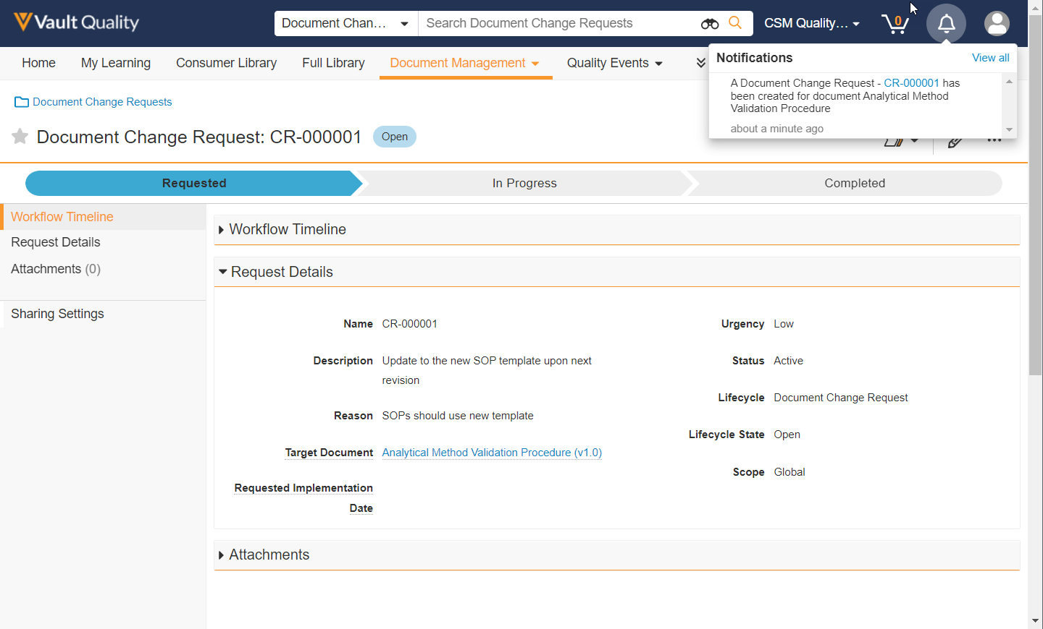
Document Change Request (DCR): Send Notification to Document Owner
Overview
              System Admins can now configure Vault to send a notification to a document’s Owner when a Document Change Request (DCR) is created on the Owner’s document
Business Justification
Improve a document Owner’s awareness of requested document changes
Notification to Target Document’s owner

Slide 12
Document Change Request (DCR): Send Notification to Document Owner
Details
  This feature allows a System Admin to configure a new Event Action on the Document Change Request lifecycle to send a message to the related document’s Owner
  A new notification message template is available to configure the details of the message

Slide 13
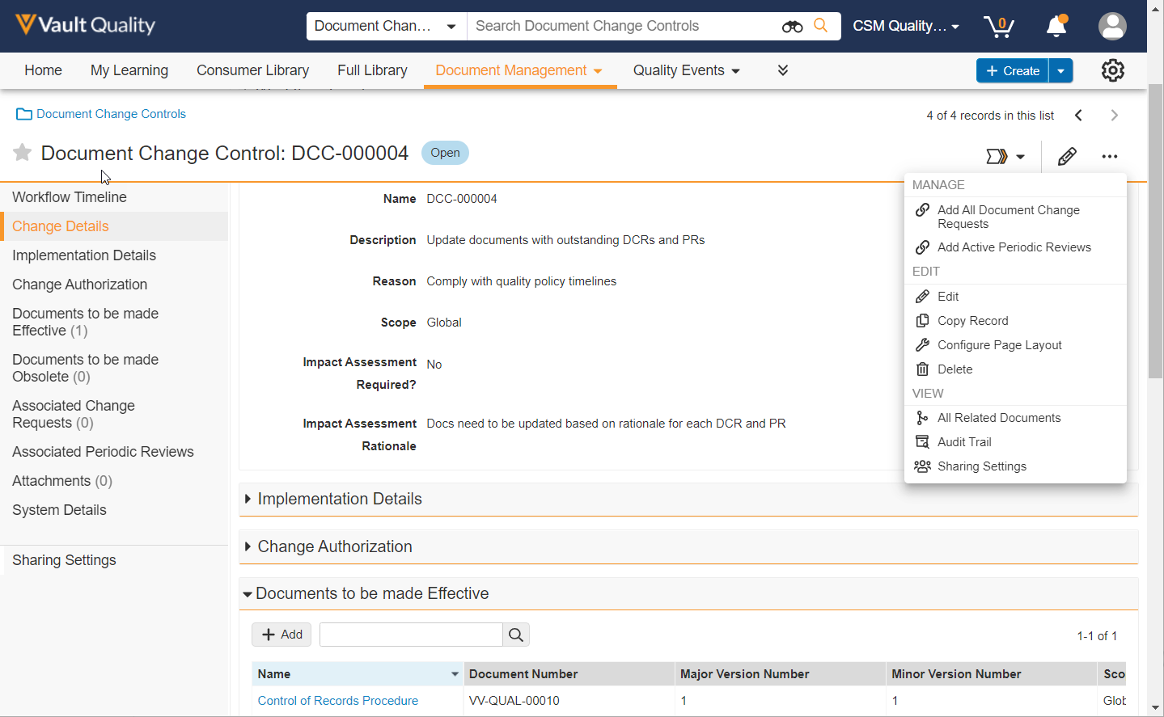
Auto-Accept Document Change Requests and Periodic Review Records into a Document Change Control
Overview
              System Admins can configure Vault to automatically link DCRs when a DCC enters particular states (Entry Action), or when a user selects a menu (User Action)
              System Admins can configure Vault to automatically link PRs that are Needs Revision or Make Obsolete when a DCC enters particular states (Entry Action), or when a user selects a menu (User Action)
Business Justification
Streamline the document change control user experience by reducing manual steps incorporating DCRs and PRs into a DCC
Enable customers to more easily benefit from the DCR and PR processes

Slide 14
Auto-Accept Document Change Requests and Periodic Review Records into a Document Change Control
Details
  DCRs and PRs will only be automatically linked into a DCC if the document associated with the DCRs or PRs is already in the DCC
  DCRs will support a new field that allows users to exclude them from being added automatically, requiring a user to manually add them into a DCC if desired
Considerations
  In order to automatically associated periodic reviews with a DCC, the periodic review process must use the Enhanced Periodic Review feature introduced in 20R2

Slide 15
Reports and Dashboards

Slide 16

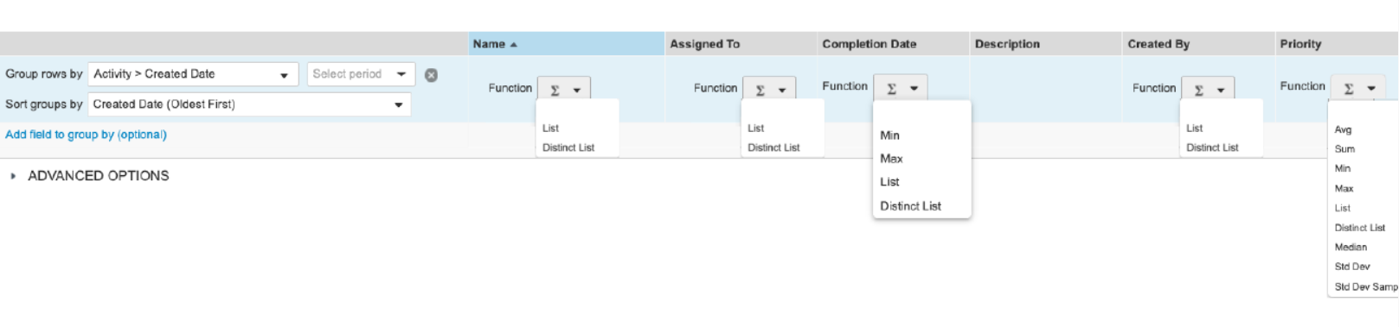

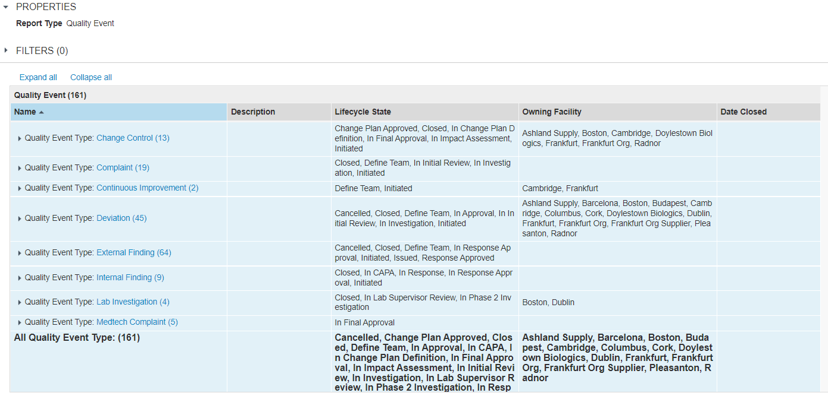
Additional Aggregate Functions in Reports
Overview
              This feature adds addition aggregate functions to Vault reports
              New functions include “List”, “Distinct List”,“Std Dev”, and “Std Dev Samp”
Business Justification
Business requirement to improve reporting functionality, including the ability to concatenate a list of records into a single cell
Considerations
List and Distinct List will be added to all data types except long/rich text fields
Std Dev and Std Dev Samp will be added to number fields
Distinct list of values in a single cell
Distinct list of values in a single cell

Slide 17
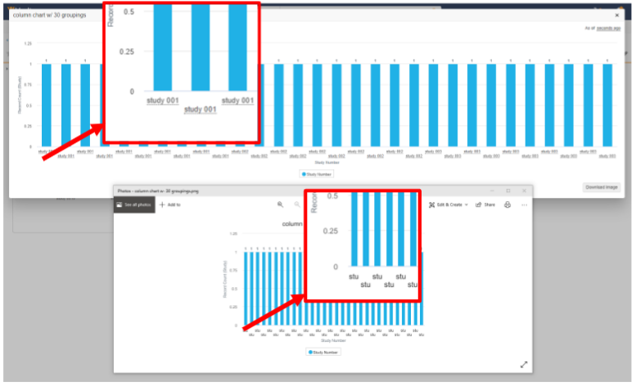


Dashboard exports for large charts
Overview
              The "Download Image" button on expanded dashboard chart is now replaced with two new buttons
Business Justification
Currently dashboard exports are limited to 600 px width. This does not match the width of the expanded chart, which is based on the browser window size
Feature prevents labels being truncated or unreadable for charts with a lot of data
Previous download button
New download buttons

Slide 18
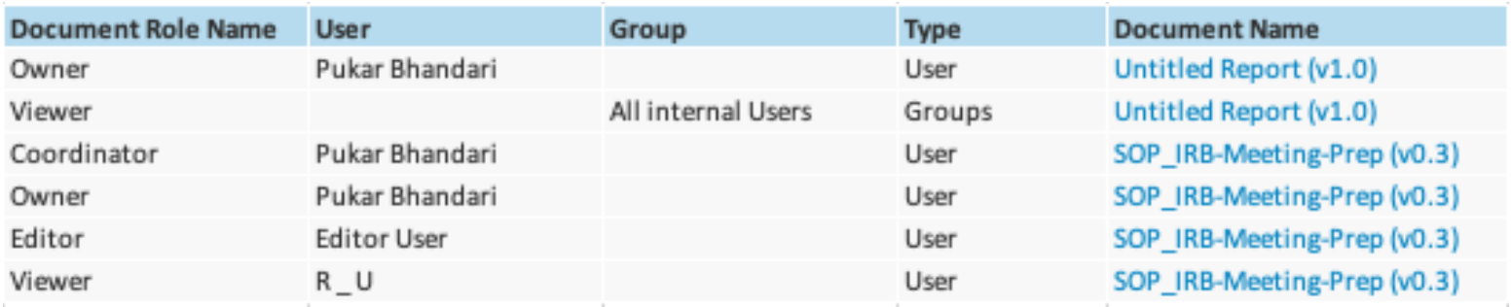
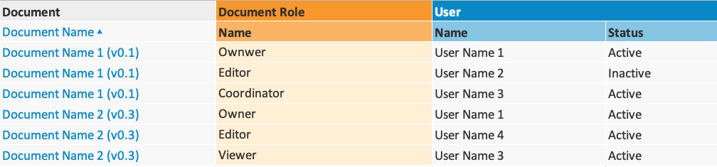
Support Document Roles as Reporting Object
Overview
              This feature enables users to report on documents and their user roles, for example:
                Users and groups assigned to each role on documents
                Documents with specific owners, or reviewers, or approvers, etc.
                Inactive users and their roles on documents
Business Justification
Allow customers to check document access across multiple documents, instead of one by one
Users and Groups assigned to Document Roles for a list of documents
Document Roles and the assigned Users for a list of documents

Slide 19
Support Document Roles as Reporting Object
Details
  This feature introduces a new Document Role Report Type that allows end-users to create standard and multi-pass reports that display document roles, and the users/groups in those roles
  System Admins can use the Document Role report type to create custom report types that join Document and User objects in a report

Slide 20
Usability and UI Updates

Slide 21
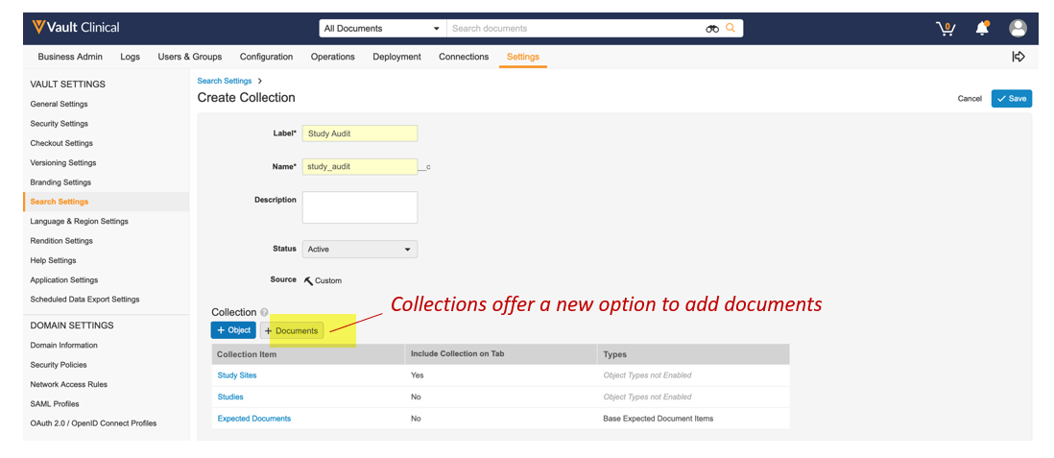
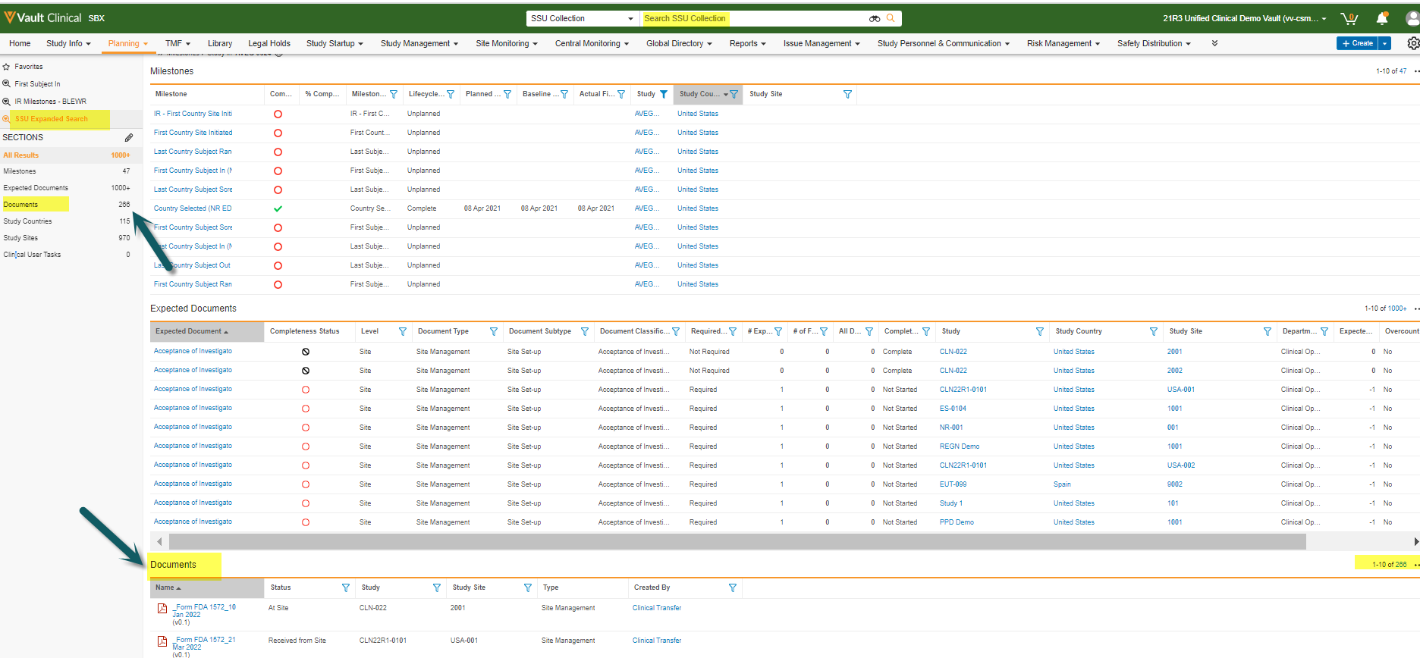
Add Documents to Expanded Search
Overview
              This feature adds the ability to search both documents and objects simultaneously for the first time
              This feature will also improve the user experience by providing a more direct navigation to an Expanded Search
Business Justification
Today only objects can be added to a Search Collection, customers must perform a separate document search to see a complete result set containing a given search term, this feature solves that gap

Slide 22
Add Documents to Expanded Search
Details
  Collections with Documents
    Expanded Searches currently point to a Collection component which will have a new option for document types
    When documents participate in a Collection, documents will be searched along with the objects in that same collection
  Nested Search Context Selector
    The search context selector has been updated to allow direct navigation to expanded searches
    Sub-tabs are nested under menus and Collections are nested under tabs or sub-tabs
    Selections will be reorganized to mirror the tab navigations which will remove adjacent duplicates
Considerations
  Documents are secured in the same way as they are in the Library → No new security needed
  Adding documents is only allowed if the admin has fewer than 15 Collection Items
  Once ‘Documents’ are added to the collection the ‘+Documents’ option will be disabled as they can only be added once

Slide 23
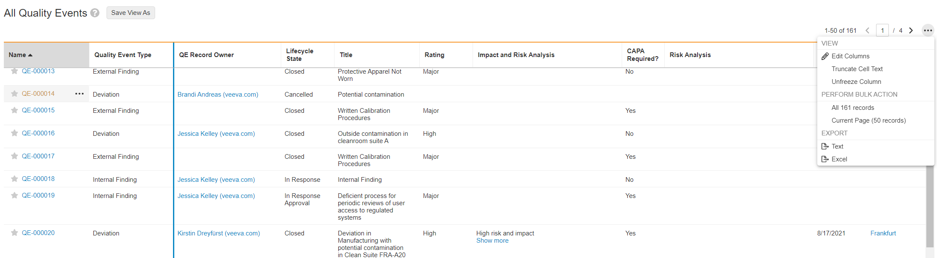
Freeze Column Header and Rows on Object Tabs
Overview
              When viewing records in an object tab, column headers are now frozen so that column names are always visible
              Users can freeze columns to make horizontal scrolling easier
              Search results per page have been increased from 25 to 50 since the column header context is always visible
Business Justification
Make navigation of records in object tabs and search results easier
Freeze n columns
(left of blue line)
Search results per page were increased from 25 to 50

Slide 24
Freeze Column Header and Rows on Object Tabs
Considerations
  Some Vault Clinical objects do not have the new grid enabled to leverage this feature:
    Milestones
    Expected Documents
    Clinical User Tasks
    Monitored Informed Consent Forms
    Monitored Metrics
    Monitored Subjects
    Monitored Visit Participants
    Protocol Deviations
    Trip Report Question / Response
    Monitoring Events

Slide 25
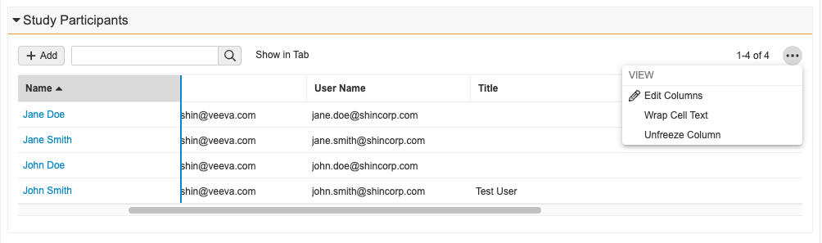
Freeze Column for Related Object Sections
Overview
              With this feature users will be able to freeze any number of columns, starting from the left most column for related object sections
              Users can drag a vertical line to indicate how many columns to freeze while scrolling horizontally
              The change continues to apply when viewing that section for any record
Business Justification
This is a huge usability enhancement, to ease the review of data in Vault

Slide 26
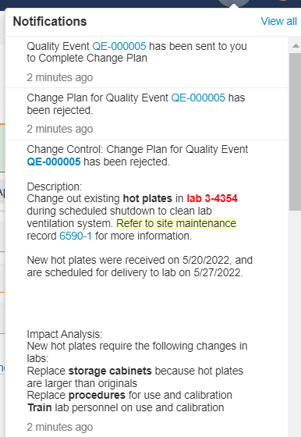
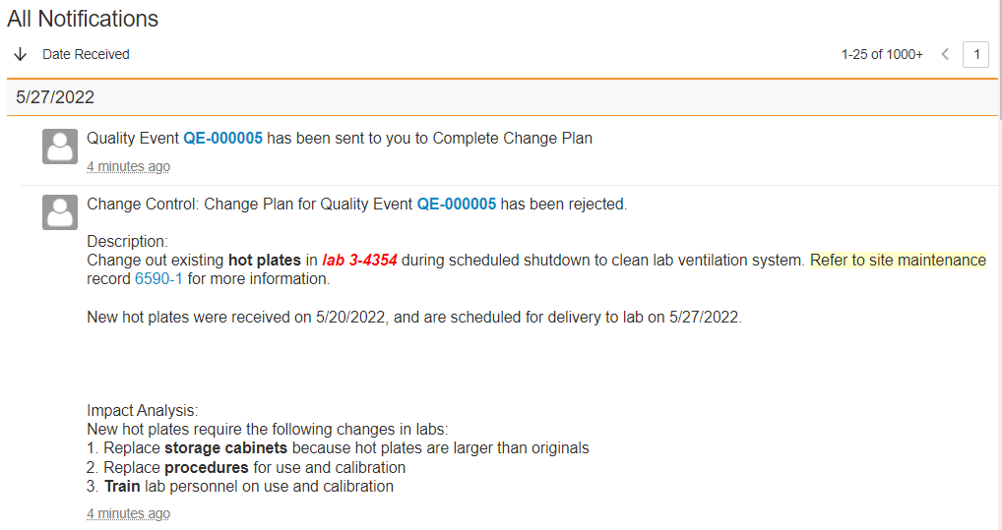
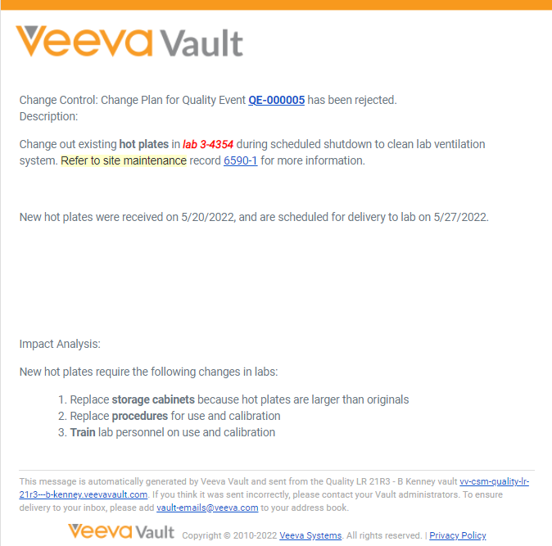
Notifications: Rich Text in Email Body and Notification Text
Vault Notification
Overview
              Enables rich text fields in object records to be displayed in the
                Text in Vault UI notifications
                Email body from Vault notifications
Business Justification
Display rich text object record fields in notifications the way they appear in object records
Email
Notification

Slide 27
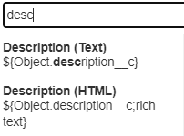
Notifications: Rich Text in Email Body and
Notification Text
Details
  Admins add richtext to a field in a notification template …
  ${Object.description__c;richtext}
Considerations
  After the General Release, notifications containing rich text fields will continue to display as plain text
  Rich text fields are only available in object records / object record notifications

Slide 28
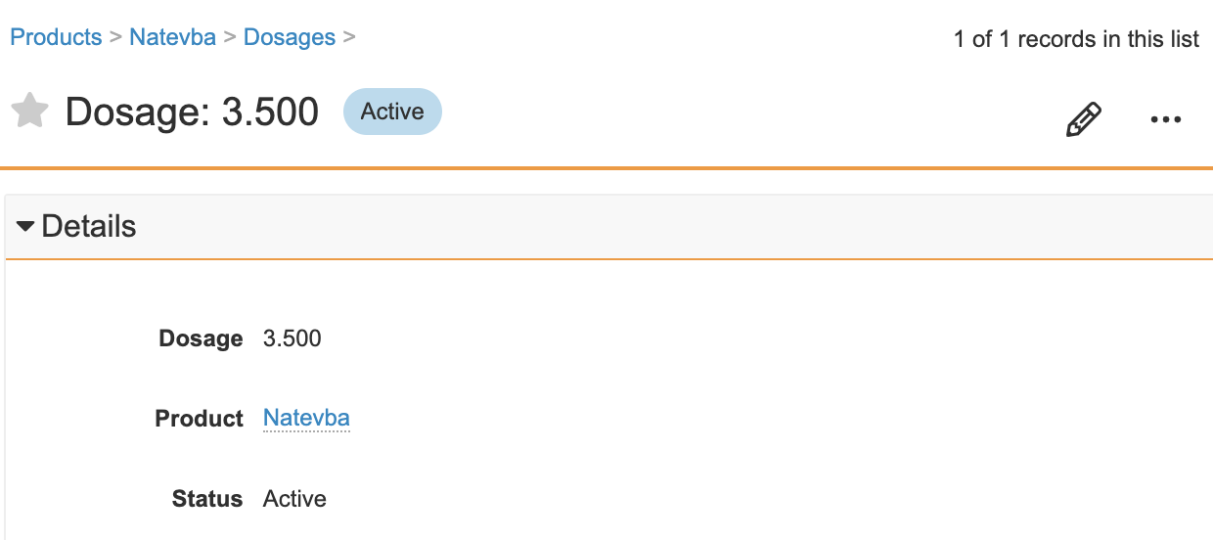
Number Field Decimal Places Enhancement
Overview
              When editing the Number field on an object record, if a user includes decimal places with trailing zeroes (e.g., 165.100), they will no longer appear trimmed when saved in the user interface
Business Justification
This behavior could easily lead to a compliance issue as Vault user may end up changing the precision of several decimal fields on a record without intending to
<Single screenshot only>

Slide 29
Number Field Decimal Places Enhancement
Details
  When creating, viewing or editing an object record, a user shall be able to enter a value into a number field or currency field with trailing zeroes in the decimal point (e.g., 165.50) without the UI trimming it upon save and in future edits
Considerations
  A separate feature will be released to ensure decimal places are stored and displayed consistently across all parts of the Vault Platform for Standard Objects, High Volume Objects, and Documents

Slide 30
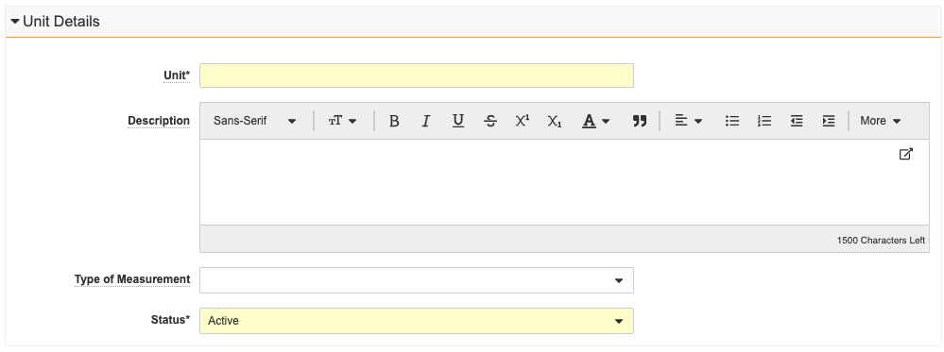
Unit of Measure Object
Overview
              The Quality Suite now includes a Unit object (quality_unit_of_measure__v) that can be used to define a field that describes another field’s quantity with either metric or imperial units
Business Justification
Introduced to support the LIMS application, but this object is available for use in all Quality Suite applications
<Single screenshot only>

Slide 31
Field Display Update for Quality Error Messages
Overview
  All Quality applications (QMS, QualityDocs, Station Manager, Surveillance, Training) now will show the field label in an error message, instead of the “system” field name
  Example
  “You cannot edit the Record Owner”
  Instead of …
  “You cannot edit the record_owner__v”
Business Justification
  Improve the user experience and align with other Vault applications

Slide 32
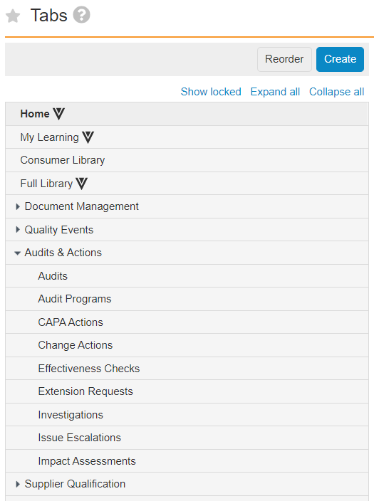
Increase Number of Tabs Allowed
Overview
              Admins can now define up to 20 custom tabs, and up to 20 custom sub-tabs per tab
              Prior to 22R2, the max number of custom tabs/subtabs was 10
Business Justification
As customers deploy more applications in a Vault, they need more tabs to organize access to information
Admins can define up to 20 custom tabs
Admins can define up to 20 custom sub-tabs per tab

Slide 33
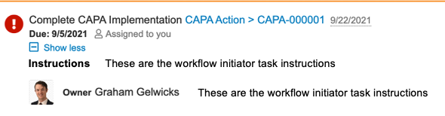
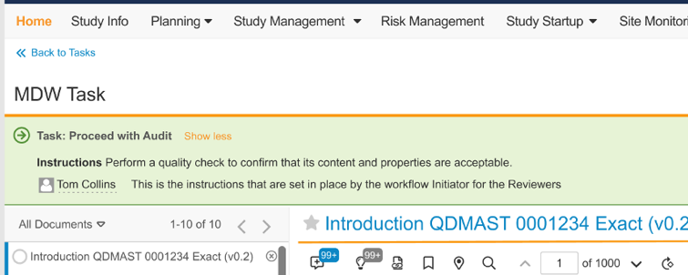
Task Instruction Visibility in OneWorkflow
Configured by Admin
Overview
              Task Instructions from the Workflow Initiator, and Admin configured on the task, are now visible on the Home tab and in the record / document page
Business Justification
Make Task Instructions for OneWorkflows more visible
These instructions are from the admin’s workflow configuration
From Workflow Initiator
Configured by Admin
From Workflow Initiator

Slide 34
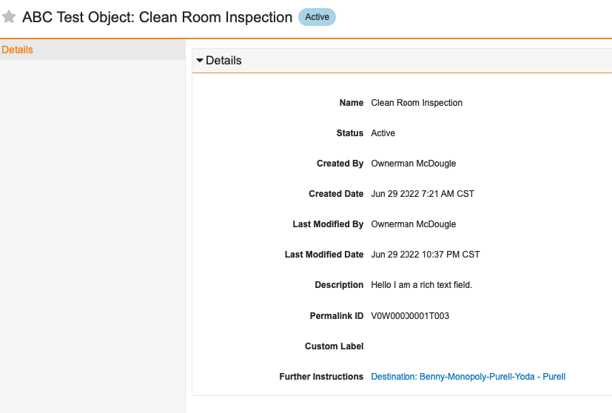
Link Records to Permalinks
Overview
              Allows admins to configure fields on objects that allow end users to link records to permalink targets in documents
Business Justification
Ensures that records are always linked to the latest version of a document, page, bookmark, or destination
<Single screenshot only>
Permalink to document – always link to latest version

Slide 35
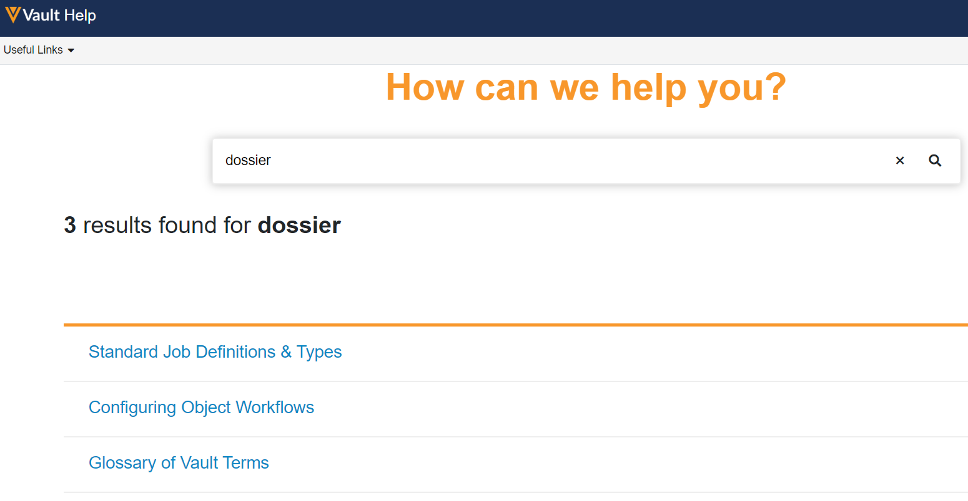
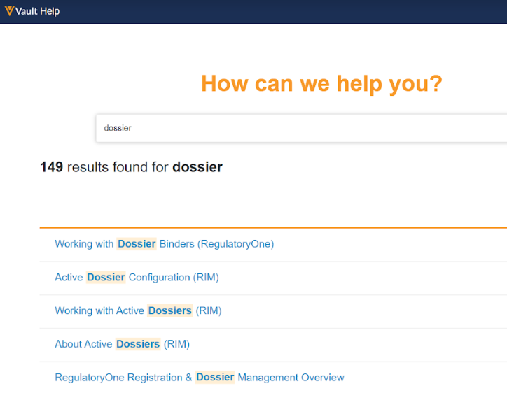
Vault Help: Application-Specific Help Pages
Overview
              Vault Help now contains application specific URLs that will take the user to the information most relevant to each Application Suite
              Vault Help pages for features that are not applicable to a given Application Suite are not returned when a user of that Suite performs a search
Business Justification
Users are able to find content and information related to their Application Suite more quickly and easily
<Single screenshot only>
Results when searching on “dossier” across Quality or Clinical applications
Results when searching on “dossier” across RIM applications

Slide 36
Working with Documents

Slide 37

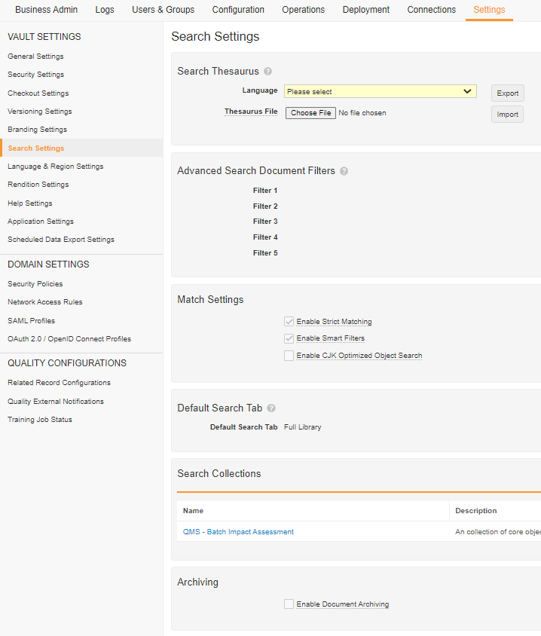
Add Archive Option
to Search Settings
Overview
              Vault allows organizations to move documents, that are no longer relevant for day-to-day use, into an Archive
              Prior to 22R2, customers needed to submit a support ticket to enable the Archive option in a Vault.
              After 22R2, System Administrators can enable the Archive capability in a Vault from Admin > Settings > Search Settings
Business Justification
Allows organizations to more quickly enable the feature

Slide 38

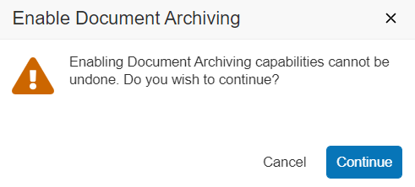
Add Archive Option to Search Settings
Considerations
  This is a one-way enablement – once enabled, this feature cannot be disabled

Slide 39
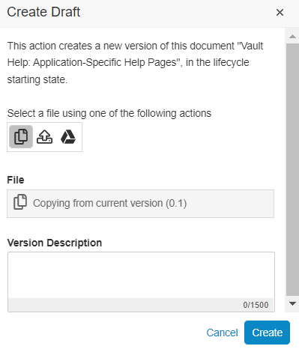
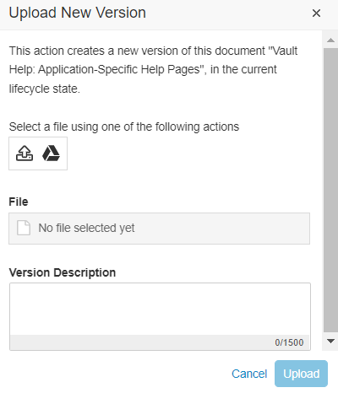
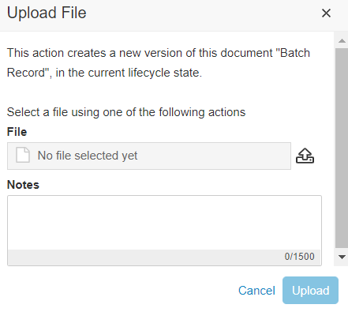
Drag and Drop Source File to Upload Dialog for Create New Draft, Upload New Version, and Upload to Placeholder
Overview
              Users can now drag and drop a file from their computer to the area highlighted by the blue boxes in the screens shown to perform:
                Create Draft
                Upload New Version
                Upload File (into a Placeholder)
Business Justification
Improve the user experience uploading files into Vault

Slide 40
Additional 22R2 Vault Features
Lifecycle & Workflows | Administration | Usability & UI
Automatically Name Envelope Records Flag Exposed in Settings (Admin Checkbox) | Jobs: Audit Logs for External URL Call Jobs (Auto-on) | Localize Vault to Norwegian (Auto-on)
Document Notification Templates in OneWorkflows on Single Documents (Configuration) | Display System-Managed Users in Search & Filters (Auto-on) | Save Task Information (Auto-on)
Increase in Workflow Start Step Rules (Configuration) | Vault Loader: Trailing Zeroes Included in Extracts for Number and Currency Fields (Auto-on) | Vault Platform HTTP/2 Support
 | View Delete Warning when Deleting a Tab (Auto-on) | Action UI for Vault File Manager (Auto-on)
 | Notification Template Tab (Auto-on)
 | Quality Data Model Changes (Auto-on)

Slide 41
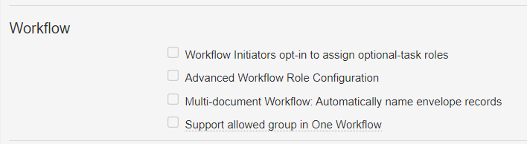
Automatically Name Envelope Records Flag Exposed in Settings
Overview
              Allows admins to enable automatic naming of their envelope records used in OneWorkflows
              Prior to this feature, this flag had to be enabled by support
Business Justification
Some organizations will want Vault to automatically assign Name values
Once this setting is enabled, the details page for each document workflow configuration shows Envelope Details
In the current release, this functionality only supports text strings and the Autonumber token
Navigate to Admin > Settings > General Settings and click Edit.

Slide 42
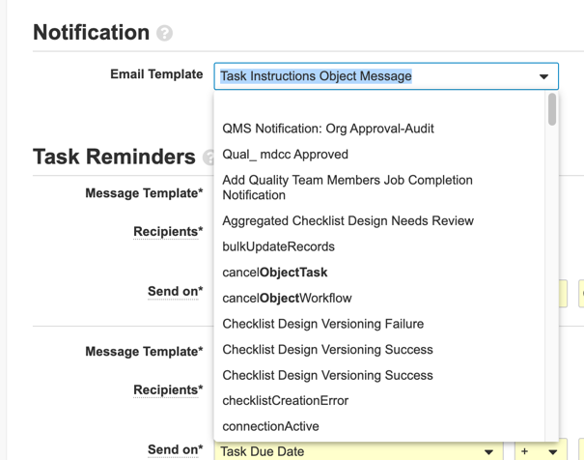
Document Notification Templates in OneWorkflows on Single Documents
Overview
              This feature allows System Admins to configure notifications to participants in OneWorkflows used to route a single document
Business Justification
Close a gap between Legacy workflows and OneWorkflows

Slide 43
Document Notification Templates in OneWorkflows on Single Documents
Details
  A System Admin will have the option of selecting a Notification Template when a document OneWorkflow is configured to route a single document
  A Notification Template can be configured in …
    A document workflow task
    A notification step associated with a document workflow task
    A task reminder notification
    Cancellation action

Slide 44
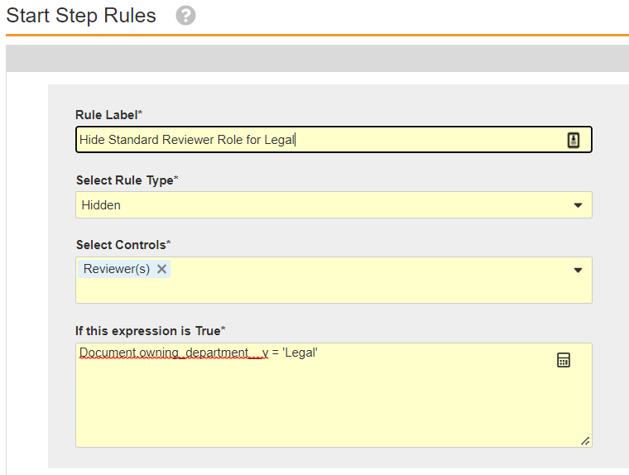
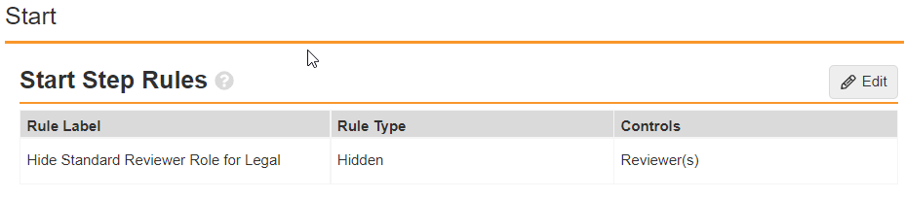
Increase in Workflow Start Step Rules
Overview
              This feature increases the number of Workflow Start Step rules a System Admin can configure in OneWorkflows
Business Justification
Increasing this limit enables customers using the Advanced Workflow Role Configuration feature in Legacy Workflows to transition to Start Step rules in OneWorkflows
This feature increases the number of possible Start Step rules

Slide 45
Increase in Workflow Start Step Rules
Details
  System Admins can now configure …
    Up to 20 Start Step rules in a OneWorkflow that can route multiple documents
    Up to 30 Start Step rules in a OneWorkflow that is configured to route one document at a time
Considerations
  OneWorkflow Start Step rules allow System Admins to make participant roles and other controls on the workflow start screen mandatory or hidden
  A OneWorkflow Start Step rule uses a Vault expression that must evaluate to TRUE to make a control hidden or required, and the expression evaluates the value in document metadata fields within the expression for every document in the workflow
  Learn more about OneWorkflow Start Step rules here
    https://platform.veevavault.help/en/lr/50498/#start-step-rule
  Note: The maximum number of Start Step rules for an Object workflow is 30 (single item workflow)

Slide 46
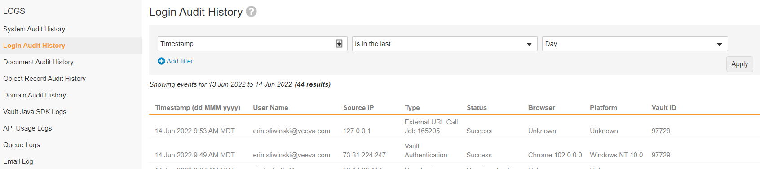

Jobs: Audit Logs for External URL Call Jobs
Overview
              Audit log entries for External URL call jobs now contain the User Name configured as the Run As user for the job
              The Login Audit entry now includes the Job ID
Business Justification
Showing the username on the Audit Log for external URL calls provides visibility into seeing who owns the jobs that are being run
Including the Job ID on Login Audit Logs allows admins to easily trace back to the Job in Vault
JOB ID included under Type in Login Audit Log

Slide 47
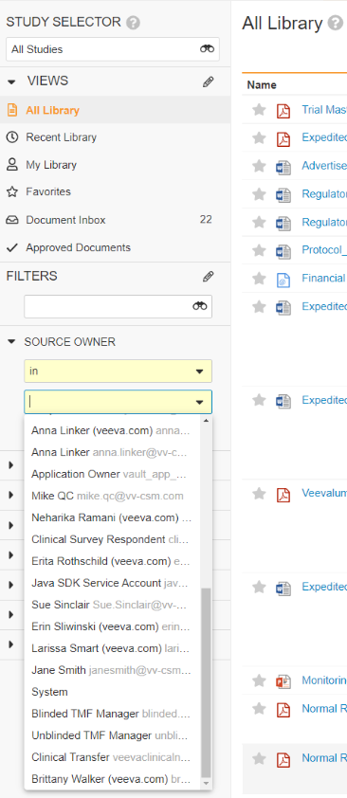
Display System-Managed Users in Search & Filters
Overview
              Standardizes how these System-Managed users are exposed in Vault UI’s:
                System-Managed users no longer appear when selecting user for the purpose of data entry (Documents, Objects records, Configurations)
                System-Managed users are included when selecting users for the purpose of search or data filtering (i.e. Selection of users in Search or when Filtering Audit logs or Reports)
Business Justification
System-Managed users are now exposed in a very consistent way in the UI
System-Managed users showing in search filter for Source Owner in the Library

Slide 48
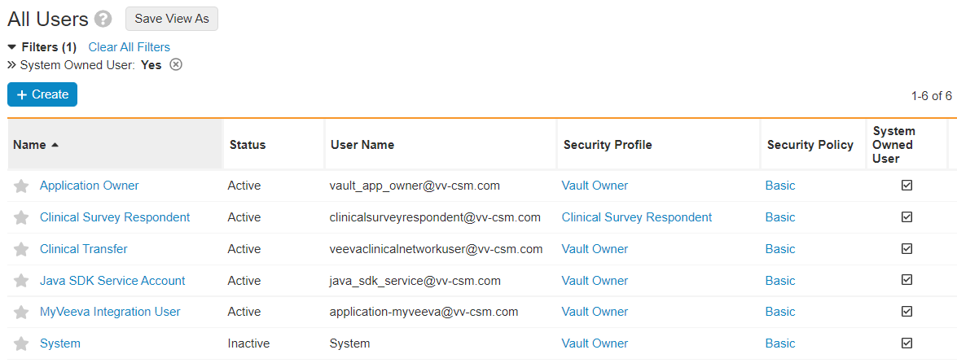
Display System-Managed Users in Search & Filters
Details
  System-Managed users consist of:
    Application Owner
    Clinical Survey Respondent
    Clinical Transfer
    Java SDK Service Account
    MyVeeva Integration User
    System
  System Managed users are created either by the Platform or by Applications.
    We encourage Apps to create as few System Managed user as necessary
  Supports use cases such as:
    Additional System-Managed user created by each product family
    System user used by the TMF Bot in Clinical Vault
Considerations
  “Manager Groups” are no longer created for System-Managed user
  Not possible to create a cross-domain user referencing a System-Managed user from another domain
    Enforced in UI and API
    If a System-Managed user is assigned as a Vault Owner, they do not need field security overrides

Slide 49
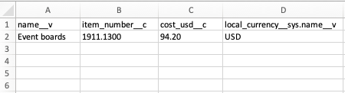
Vault Loader: Trailing Zeroes Included in Extracts for Number and Currency Fields
Overview
              CSVs exported from the Vault Loader UI and Command Line tool (CLI) will now contain trailing zeroes for number and currency fields
                E.g. 100.10
Business Justification
Previously, the Vault Loader extract was trimming trailing zeroes for number and currency fields

Slide 50
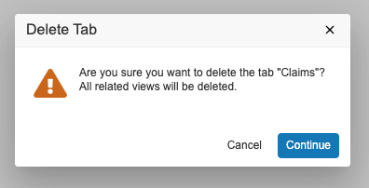
View Delete Warning when Deleting Tab
Overview
To help prevent System Administrators from deleting a tab and its related views in error, Vault now displays a warning message
Business Justification
Provide an additional safeguard for System Administrators to confirm the selected tab, and its related views, should be deleted

Slide 51
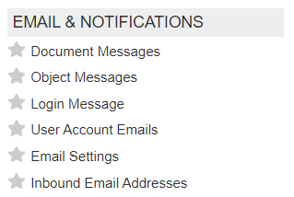
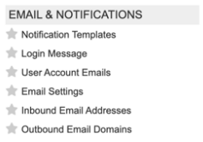
Notification Template Tab
Overview
              This feature combines the Document Messages tab and the Object Messages tab into a single tab called Notification Templates
              The User Interface will allow System Admins to differentiate between Object and Document notification templates
Business Justification
Veeva continues to consolidate separate document and object configurations into a single System Admin experience to align with OneWorkflow
Before 22R2
After 22R2

Slide 52
Quality Data Model Changes
Overview
  With every release, Veeva updates the data model
  The full list of Quality data model changes introduced in this General Release can be found using the What’s New in 22R2 link on the About the 22R2 Release page in Vault Help
Business Justification
  Data model changes enable Veeva to support evolving customer needs and deliver new functionality

Slide 53
Overview
              In 22R1, Vault added support for exporting and importing Norwegian dynamic messaging. In 22R2, Vault will also localize Norwegian static messages
              Note: Veeva provides translation for any labels that cannot be modified by customers. All other labels must be translated by customers users the bulk translation tool.
Localize Vault to Norwegian

Slide 54
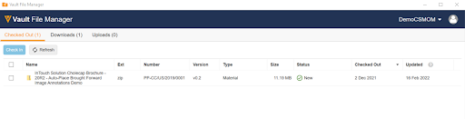
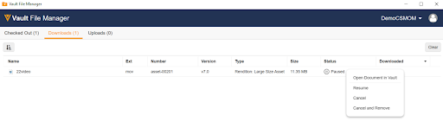
VFM Action UI Look and Feel
Overview
              This feature refreshes the Vault File Manager UI to align with the appearance of the Action UI in Vault
              These visual updates do not change any existing functionality and do not change the locations of common visual elements that users are familiar with
Business Justification
Align user interface for consistency across all Vault related solutions

Slide 55
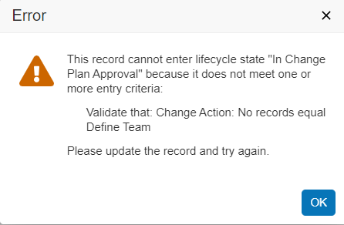
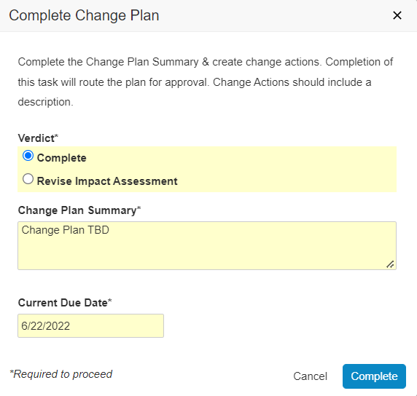
Save Task Information
Overview
              Information entered into a task completion dialog will automatically save until automatic subsequent workflow steps are complete
Business Justification
Previously, if users entered information into the task dialog, but certain entry criteria for a subsequent step were not met, users had to reenter information
Automatically saving task information provides a better user experience, and removes the need for re-work
Text saves even though entry criteria not met

Slide 56
Vault Platform HTTP/2 Support
Vault now uses HTTP/2 as the default protocol to optimize network performance
This update enables faster page loads
Although the older HTTP/1.1 protocol is supported, restricting to only allow HTTP/1.1 traffic is not recommended
We strongly advise reviewing and updating any network configuration and browser policy to ensure HTTP/2.0 is allowed to take advantage of this update

Slide 57
Vault Mobile

Slide 58
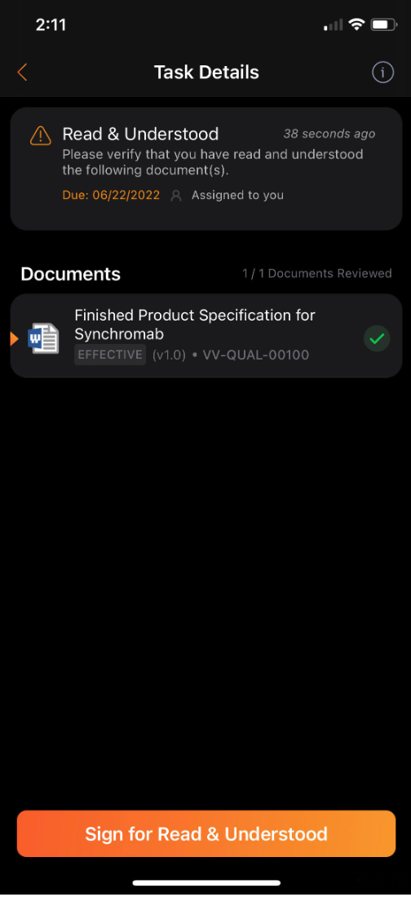
Mobile Workflow Tasks
Overview
              Users can now view and complete all One Workflow Document Tasks in the Mobile App
              Read and Understand (R&U) One Workflow Tasks are now supported via the mobile app
Business Justification
The ability to complete R&U and other One Workflow Document tasks via the mobile app is a core use case of Vault Mobile

Slide 59
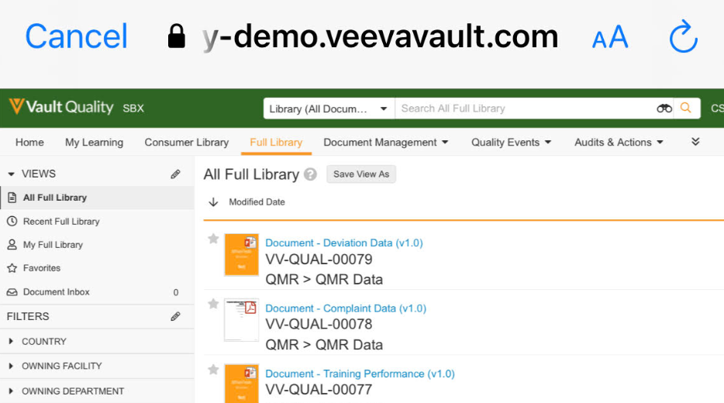
Document Named Views– iOS
Overview
              Allows users to filter their document library by Recent Documents, My Documents, and Favorites
Business Justification
In the initial release of the app, the default and only view of the Document Library was “All Documents” , most app users will mostly care about documents they know of or need to find fast instead of browsing the entire document library.

Slide 60
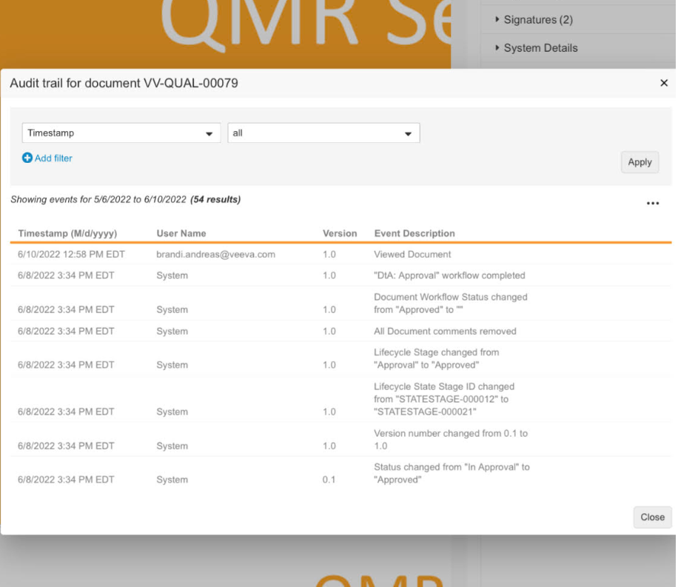
Audit Documents Viewed on Vault Mobile
Overview
              Documents viewed on Vault Mobile will now be logged as a “Viewed Document” event in the Document Audit Logs.
Business Justification
Previously documents viewed were not logged in the Audit Logs which could cause a compliance concern. This enhancement will ensure documents viewed on mobile trigger the same treatment as documents viewed on the web.

Slide 61
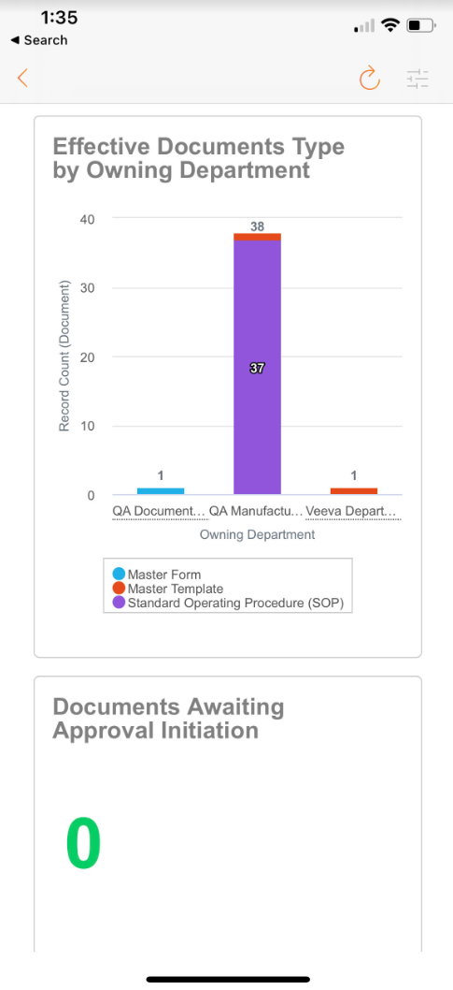
Mobile Dashboards
Overview
              Users can now view Dashboards in the Vault Mobile App
Business Justification
Users can now easily view dashboards on the mobile app when traveling or away from their computer

Slide 62
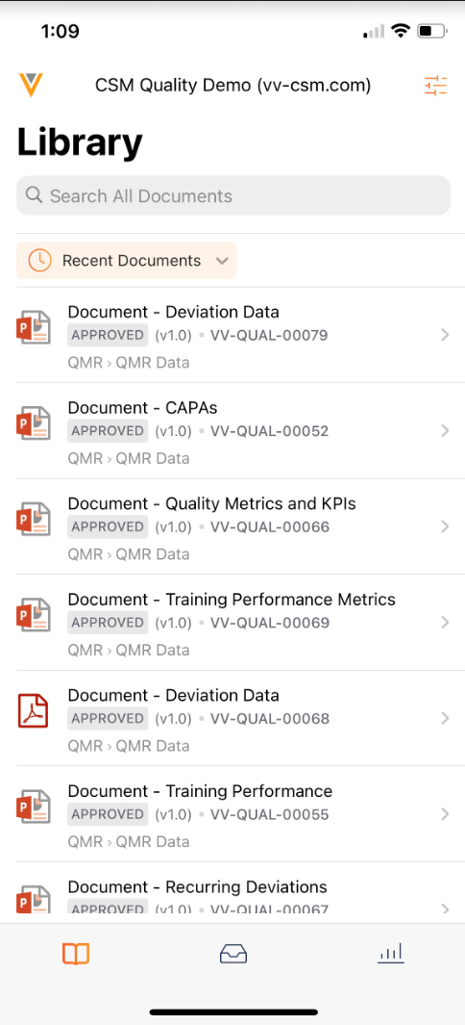
Mobile Tabs
Overview
              Admins can now configure the order and permissions of mobile tabs to control how they are displayed in the mobile app
Business Justification
The Vault Mobile app has a bottom navigation bar that contains different mobile tabs. The current tabs available are Library, Tasks, and Dashboards. Admins can now configure the order of how those tabs are displayed, and also permissions of who can view certain tabs based on a users’ role

Slide 63
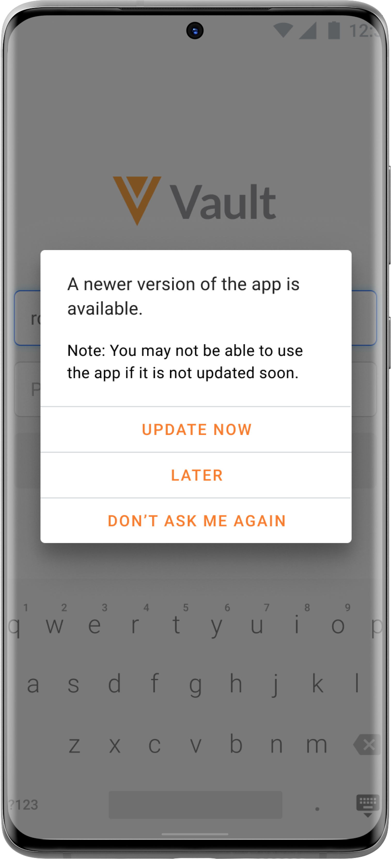
App Version Enforcement: Android Only
Overview
              The Android Vault Mobile app will enforce that users are on a supported version of the mobile app, and prompt users to upgrade the mobile app if needed
Business Justification
Prevent users from experiencing issues in the app caused by using an incompatible, unsupported app version

Slide 64
Vault Training

Slide 65
Classroom Training: Cancel Training Assignments Part Of Class If No Valid Path Exists
Overview
  This features cancels classroom training assignments (part of a class roster) if the training assignments are no longer valid due to changes of the curriculum / training requirement / learner role constellation
Business Justification
  Cancel classroom training assignment that are no longer valid
Details
  If a classroom training assignment is part of a class roster, and the training requirement is removed from the Curriculum or the Curriculum is removed from the Learner role, the classroom training assignment is now cancelled, which was not done previously
Considerations
  If the classroom training assignment is using a superseded document, training assignments are not cancelled as the state of this release

Slide 66
Recurrence: Assign Training Assignment In Advance
Overview
              Allow Training Admins to determine that training assignment shall be assigned some days or months ahead of the recurrence date.
Business Justification
A common use case for training recurrence is to assign a Training Assignment every couple of years i.e. every 2 years
For some use cases training assignment need to be in advance of the yearly cadence,
i.e. 90 days ahead of the recurrence date so training can be completed within the 2 years time frame
First Completion
Reassignment
Due Date
Calculated – recurrence-training
Training period
Recurrence period
Time

Slide 67
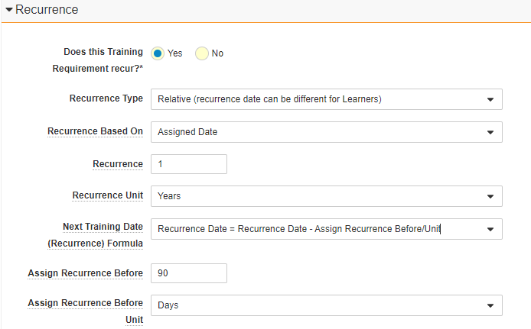
Recurrence: Assign Training Assignment In Advance
Considerations
  Recurrence type of Absolute is not supported
Recurrence will be assigned 90 days before next recurring date

Slide 68

Training Record Actions: Bulk Action Support
Overview
              The following actions are available as Bulk actions:
                Power Delete Training Assignments
  State Change Training Assignments
  Fix Training Assignment Sharing Settings
  Update Training Assignment for Facilitated Training
Business Justification
After migration into Vault Training sometimes massive updates can be required on migrated records
Bulk actions increase efficiency if multiple records need to be updated

Slide 69

Updatable Quiz Design for Individual Training Assignment
Overview
              The Quiz Design reference can now be directly updated on a Training Assignment record
Business Justification
Previously, you could only update the Quiz Design reference by updating the corresponding Training Requirement, which had impact on all Training Assignments
Make it easier and more efficient to update Quiz Design references on individual records without impacting unrelated training assignments

Slide 70

View Related Training Jobs from Update Training Assignment Job History
Overview
              Training creates "children" jobs so that work can be done faster and more efficiently
              With this feature Admins can access jobs which are related to the Update Training Assignment Job from the job history
Business Justification
Allow authorized users to quickly view related training jobs, without having to go to the Training Job Status page
Increases the efficiency of the Administration of Vault Training and the related jobs
New: View Related Training Jobs

Slide 71

Vault Training: Data Model Updates and Visual Impact
Overview
              The LearnerRole-Person join object was made a complex join to support the new Study Training Application
Business Justification
Data model updates to support Study Training

Slide 72
Station Manager

Slide 73

Highlight Recently Added/Updated Documents on Android
Overview
              Documents that are newly added or recently updated are now highlighted in the Station Manager app
              The Highlight Labels are visible for 7 days by default and the duration can be changed if required in EMM
Business Justification
When Station Devices are shared, there was no clear indicator which documents are new or updated
Make users aware of potential updates and changes to processes that they are performing by following these documents
This screenshot is from iOS

Slide 74

Highlight Recently Added/Updated Documents on iOS
Overview
              Documents that are newly added or recently updated are now highlighted in the Station Manager app
              The Highlight Labels are visible for 7 days by default and the duration can be changed if required in EMM
Business Justification
When Station Devices are shared, there was no clear indicator which documents are new or updated
Make users aware of potential updates and changes to processes that they are performing by following these documents

Slide 75

Support Landscape Orientation on Android Station Manager App
Overview
              The Station Manager App on Android now supports landscape orientation
Business Justification
If the device rotation is changed to landscape, then also the Station manager App rotates to landscape format to have better usability

Slide 76
Announcements

Slide 77





Register Now
October 19-20, 2022
Meet
industry leaders
Share
best practices
Discover
latest trends
CLINICAL
QUALITY & MANUFACTURING
REGULATORY
DEVELOPMENT CLOUD & VAULT PLATFORM
SAFETY
•
•
•
•

Slide 78
Engage the Entire Veeva Community
Engage with your community
Build relationships
Talk to
Veeva experts
See product innovations
Learn best practices
Summit exceeded my expectations. Excellent presentations by industry leaders sparked ideas to take back to my own organization. Coupled with the announcements about the ambitious Veeva roadmap, I leave Summit excited about opportunities to improve clinical trial operations going forward.
Stephen Nabarro, Head of Clinical Operations and Data Management

Slide 79

Upcoming Quality Community Events
August 3: Quality Community Meeting
  Product Roadmap and Deep Dive and Recent Feature Highlights, Customer Breakout Sessions by application
September 14: Day in the Life Webinar Series
  Supplier Quality and Audit Management
Stay connected to the Community and join us on LinkedIn!

Slide 80



Validation Management
A Data-Centric, Paperless Validation Solution Optimizing End-to-End Validation Processes
Planning
Execution
Reporting
Configuration
Inventory
Activities
Deliverables
Requirements Mgmt.
Test Authoring
Data-Centric Test Execution
Discrepancy Mgmt.
Automated Trace Matrix
Execution Audit Trail
Dashboards
Inventory Status
Protocol Status
Discrepancy Status
Scheduling
Periodic Review
Best Practices Built-In
Connect Quality processes from QualityDocs, QMS, and other Quality Suite applications within the Vault
Vision for Validation Management.
Not all features may be available for Early Adopters.
Copyright © Veeva Systems 2022. Veeva Confidential.

Slide 81



Unifying QA and QC
Sample tracking from manufacturing to external testing and storage
Data integrity and review by exception workflow design incorporating instrument integration and critical event categorization
User training record driven system access and testing assignments
Effective procedure display for analyst reference during method execution
Unified QMS workflows for lab investigations and batch review
Enterprise interface ready for connecting to ERP, MES, BI platform and more
Vision for Vault LIMS. Not all features may be available for Early Adopters.

Slide 82
Educating customers on managing and using their Vault applications.
https://go.veeva.com/vault-foundations-hub
Vault Foundations

Slide 83


Vault Help Improvements
Easy Access to Applications from Landing Page
Improved Search Capabilities
Updated Videos
Updated Learn More Links
Customers using Classic Vault Help links will need to update these links before the 22R2 Release, as the Classic Vault Help site will be retired

Slide 84
Vault Connections: User Exception Message Behavior Update
Vault now generates multiple User Exception Messages to ensuring Connections scale with our largest customers
Connections transfer chunks of data / documents to ensure a Vault is not overloaded
If a Connection fails to transfer some data / documents in a chunk, Vault creates a User Exception message referring to each record / document that failed to transfer
A User Exception Message with errors in close chronological order should be evaluated to determine if they were caused by the same issue while the chunk was being processed

Slide 85
22R2 Developer Release Deep Dive
Wednesday, July 27 at 8:00 AM PT / 11:00 AM ET / 4:00 PM CET
Join Veeva Customer Success and Product teams for an education session on new features in the Veeva Vault developer-focused toolkit
This webinar is geared towards current users of the Vault Developer toolkit (API)
Key topics for discussion will include:
  Detailed explanation of new features
  Spark Integration Services
  Java SDK updates
  Considerations for using new features, and impacts
  features may have on your Vault or end users
Advanced registration required

Slide 86
Logistics

Slide 87
22R2 Release Calendar
Customer Validation
Sun | Mon | Tue | Wed | Thu | Fri | Sat
3 | 4 | 5 22R2 Release Webinars | 6 22R2 Release Webinars | 7 22R2 Release Webinars | 8 | 9
10 | 11 System Release Memo Pre-release Vaults available | 12 22R2 Release Webinars Compliance Documents | 13 22R2 Release Webinars | 14 22R2 Release Webinars | 15 Executed OQs | 16
17 | 18 | 19 | 20 | 21 | 22 | 23
24 | 25 | 26 | 27 | 28 | 29 Upgrade – Early PODs | 30
31 | 1 | 2 | 3 | 4 | 5 Upgrade – all remaining PODs | 6
JULY
AUG

Slide 88
22R2 Go Live
All customers upgraded to 21R2
  Applies to Production, Test, and Sandbox Vaults
JULY
Friday 29
Date | POD | Start Time | Duration
29 Jul 2022 | US POD VV1-1068 Sandbox POD | 2:00 pm PT | Up to 4 hours
 | US PODs VV1-8, VV1-1065, VV1-1088, VV1-1146 | 6:00 pm PT | Up to 4 hours
PODs VV1-8, VV1-1068,
VV1-1065, VV1-1088
Date | POD | Start Time | Duration
5 Aug 2022 | APAC POD VV3-3064, VV3-3122 APAC & EU Sandbox PODs | 10:00 am PT | Up to 4 hours
 | US Sandbox PODs | 2:00 pm PT | Up to 4 hours
 | US PODs (except Jul 29th PODs) EU PODs APAC POD VV3-34 | 6:00 pm PT | Up to 4 hours
AUGUST
Friday 05
All Other PODs

Slide 89
Early POD Upgrade Schedule
The annual schedule for early POD upgrades is as follows:
Release | Early PODs
 | Production | Sandbox | Agency
R1 - April | VV1-2 | VV1-1055 VV1-1121 | VV1-1065 VV1-1088
R2 - August | VV1-8 | VV1-1068 | VV1-1065 VV1-1088
R3 - December | VV1-12 | VV1-1069 | VV1-1065 VV1-1088
In each release, all Vaults on the designated early PODs will receive access to
Pre-Release 2 weeks earlier than other PODs

Slide 90
Pre-Release Environments
Since 20R1, customers have to provision and refresh their own
Pre-Release Vaults
  Veeva Operations enables Pre-Release 4-6 weeks ahead of each release
  We highly recommend refreshing prior to using the Pre-Release for testing
See Vault Help video for a walk-through of the creation and refresh process
Pre-Release Vaults include:
  Configuration
  Vault Owners
  Object Data referenced in configuration rules
  NO Documents or transactional data

Slide 91




22R2 Release Webinar Series
Product-specific webinars focused on the use cases and impact of key features
  All webinars are presented at multiple times
  One webinar per product set will be recorded and available after the series at:
  https://rn.veevavault.help/en/gr/about-the-22r2-release/
Platform
QDocs, Station Mgr, Training
Jul 6 at 11 AM ET
Jul 12 at 7 AM ET
Jul 13 at 2 PM ET
QMS
Jul 7 at 11 AM ET
Jul 12 at 2 PM ET
Jul 13 at 8 AM ET
Jul 6 at 10 AM ET
Jul 12 at 1 PM ET
Jul 13 at 5 AM ET
Jul 6 at 8 AM ET
Jul 7 at 10 AM ET
Jul 12 at 12 PM ET
Jul 7 at 7 AM ET
Jul 12 at 8 AM ET
Jul 13 at 1 PM ET
Register Here
Register Here
Register Here
Register Here

