Slide 1

22R2 QMS Release
Webinar
Vault QMS
Revision: 12 July 2022
Please use ‘Q&A’ to ask a question

Slide 2





Vault QMS
22R2 Presenters
Kirstin Dreyfürst
Enterprise Quality Customer Success
Europe
kirstin.dreyfuerst@veeva.com
Jane Wells
Enterprise Quality Customer Success
Europe
jane.wells@veeva.com
Jessica Kelley
Enterprise Quality Customer Success
North America
jessica.kelley@veeva.com
Sapan Modi
SMB Quality Customer Success
North America
sapan.modi@veeva.com
Brandi Andreas
Enterprise Quality Customer Success
North America
brandi.andreas@veeva.com
Bob Kenney
Enterprise Quality Customer Success
North America
bob.kenney@veeva.com

Slide 3
Foreword
The content of this presentation is subject to change prior to the 22R2 Release
Please note the revision date on the title slide
Veeva encourages you to always reference Release documentation from our Release page in Vault Help to ensure you are using the latest information
https://rn.veevavault.help/en/gr/about-the-22r2-release/
    A recording of this webinar, and the associated slide deck, will be available on this page at the conclusion of the webinar series

Slide 4

Interact With Us!
Please use ‘Q&A’ to ask a question

Slide 5
Planning for the 22R2 Release
Features
Announcements
Logistics
Review new features
based on themes
Promote awareness of Veeva events
Identify key
release dates
Note: Keep Alert for Polling!

Slide 6

Feature Enablement Detail
Auto-On Features
Configurable Features
Auto-On
Admin Checkbox
Configuration
Support
Turned On Day 1
Automatically available, some setup may be required
Turned Off
Requires enablement
Turned Off
Requires enablement
Requires
configuration
Turned Off
Requires enablement
Product Support Request

Slide 7



22R2 Vault QMS Themes
Quality Processes
Usability and UI Updates
Reporting and Dashboards

Slide 8

Vault QMS Release Key Takeaways
Recurrence Check Enhancements
External Notification Enhancements
Usability Updates
QRM Enhancements
Add Documents to Expanded Search
Quality Team Conditional Role Exclusivity

Slide 9
Quality Processes

Slide 10

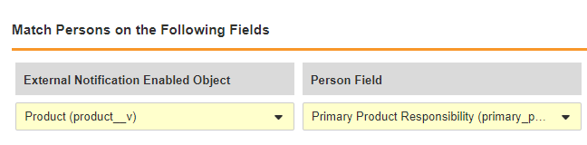
External Notifications: Distribution Group Filter Fields and Membership Automation
Overview
              Constrain distribution groups for external notification based on matching fields between the external notification enabled object like complaints and the Person record
              Automatically fill distribution groups by a lifecycle action
Business Justification
Restrict distribution groups to avoid too many person records in the selection and automatically hide non-relevant person records
Automate assignment of persons to distribution groups to avoid high efforts in manual selections

Slide 11
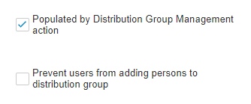
External Notifications: Distribution Group Filter Fields and Membership Automation
Details
  For complex rules that cannot be achieved through configuration, assignments can be handled through custom SDK and a Java SDK API
  A checkbox can be enabled to activate the population of persons in distribution groups by a distribution group management action i.e. in a lifecycle entry action
  A checkbox can be enabled to prevent manual additions of persons in the distribution groups
Considerations
  Object and Picklists are supported for filters
  Maximum number of distribution groups is 5 (was previously 20)
  Maximum number of users per distribution group is 50 (was previously 10)
  Ensure the Create Distribution Group Management action is executed prior to the send external notification action

Slide 12
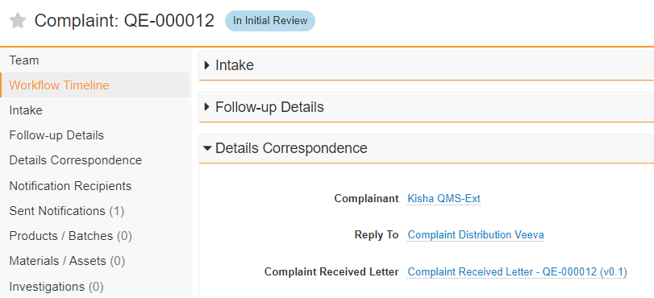
External Notifications: Set Reply To Email Attributes on Complaint and Medtech Emails
Overview
              Users can specify a Person as the Reply To Email address for Complaint and Medtech Complaint External Notifications
Business Justification
For Complaints it might by required to reply back to an email that is sent from the system to add additional information such as pictures and/or batch information

Slide 13
External Notifications: Set Reply To Email Attributes on Complaint and Medtech Emails
Considerations
  For Reply To Persons the “Reply To” flag must be active and set to Yes, a valid email address is required
  Consider a separate object type for the ”Reply To” persons to distinguish from other person records
  Consider automated population of the “Reply To” field based on other metadata
  “Reply To” is only supported for Complaints and Medtech Complaints

Slide 14

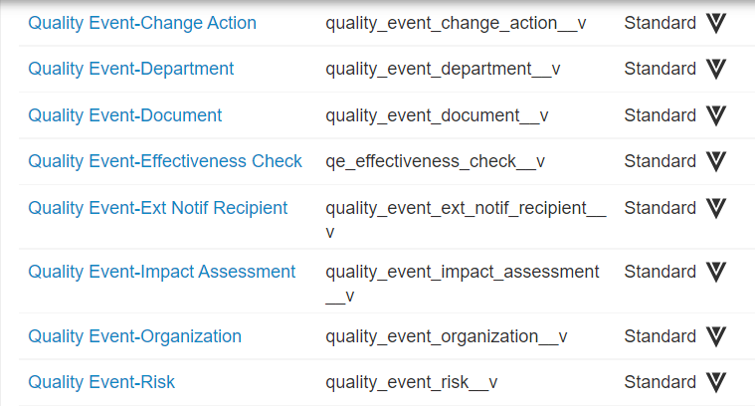
QMS: Additional Standard Fields and Objects
Overview
              Additional standard fields and objects provisioned to the QMS data model to capture simple join relationships between common entities
Business Justification
New Objects and fields, based on common patterns that we see with customers, will reduce the need for custom objects and fields to be created

Slide 15
QMS: Additional Standard Fields and Objects
This enhancement will allow for the following:
  New standard simple join objects will be provisioned to reduce the need to create additional custom objects as part of implementation
  New standard fields on the Quality Event object to replace fields that are currently custom as part of the delivered application
  See Vault Help for a full list of data model updates

Slide 16
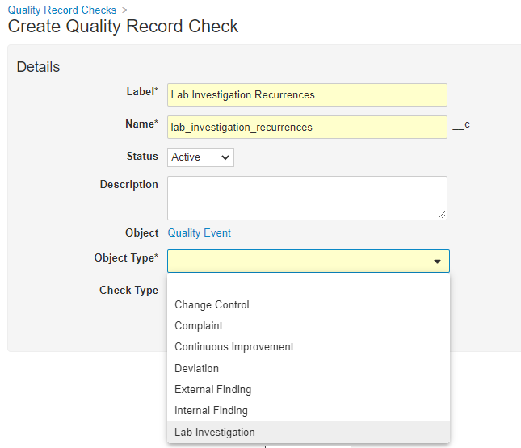
Extend Recurrence Check to Support Standard Object Types on Quality Event
Overview
              The Recurrence Check feature is extended to support all Standard Object Types on Quality Events
Business Justification
Recurrence Checks were supported previously only for Deviations, Complaints and Medtech Complaints, now also use cases i.e. for Quality Events like Findings, Lab Investigations, Change Controls are supported

Slide 17
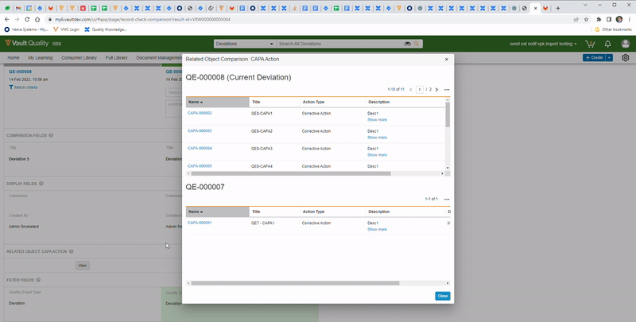
Recurrence Check Related Object UI Enhancements
Overview
              The Synchronize Columns button is now intelligent and will only display if a user has made changes to one of the related object grids in the recurrence check’s related object viewer
Business Justification
This enhancement streamlines the user experience by only showing a button if a change has been made

Slide 18
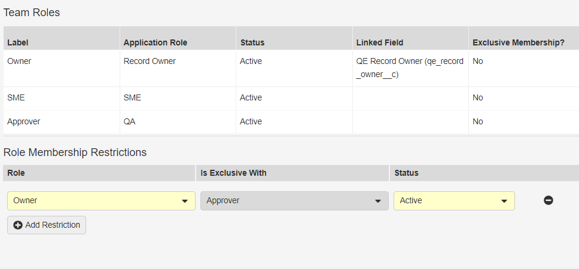
Quality Team Conditional Role Exclusivity
Overview
              A user can be selected for more than one role on a Quality Team but exclusivity can be applied where required
Business Justification
There are situations when a user should be able to be selected for some roles on a record but not available for others
Example: User can be in Owner and SME roles on a Quality Team but not Owner and Approver
Exclusive Role Relationships

Slide 19
Quality Team Conditional Role Exclusivity
Considerations
  Roles configured with Exclusive Membership enabled can not have role membership restriction relationships defined
  If a Role Membership Restriction relationship is defined for a role, Exclusive Membership cannot be enabled until that relationship is deleted
  Available on Quality Teams with at least two, active Quality Teams Roles defined
  Existing team membership on ‘in process’ records may become invalid when role membership restriction relationships are configured

Slide 20
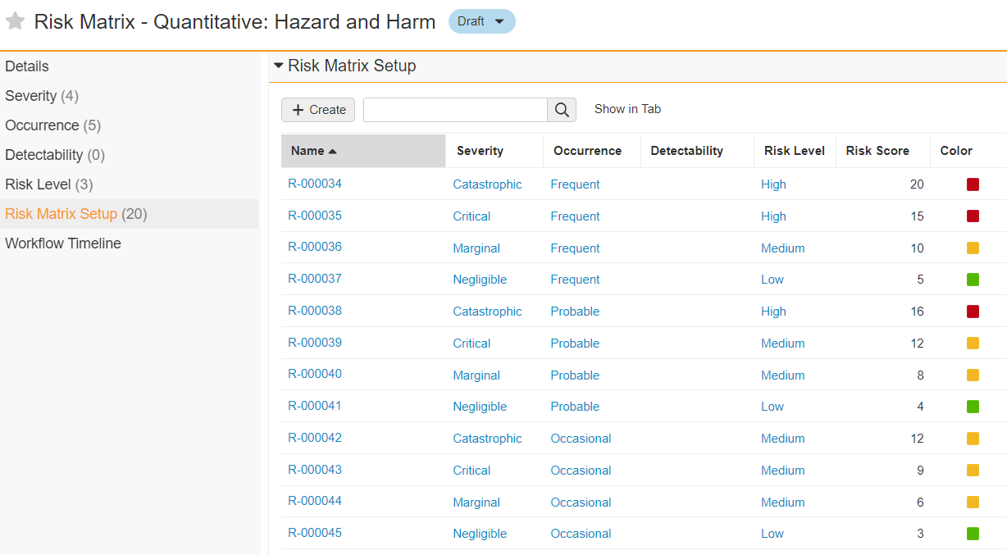
Support for 1/2/3 Risk Dimensions
Overview
              Risk Matrices can be created with a specified number and combination of dimensions (Severity, Occurrence, Detectability)
Business Justification
Provides increased flexibility and support for assessment methodologies that do not require three dimensions
<Single screenshot only>
Risk Scores are calculated using only two of three dimensions

Slide 21
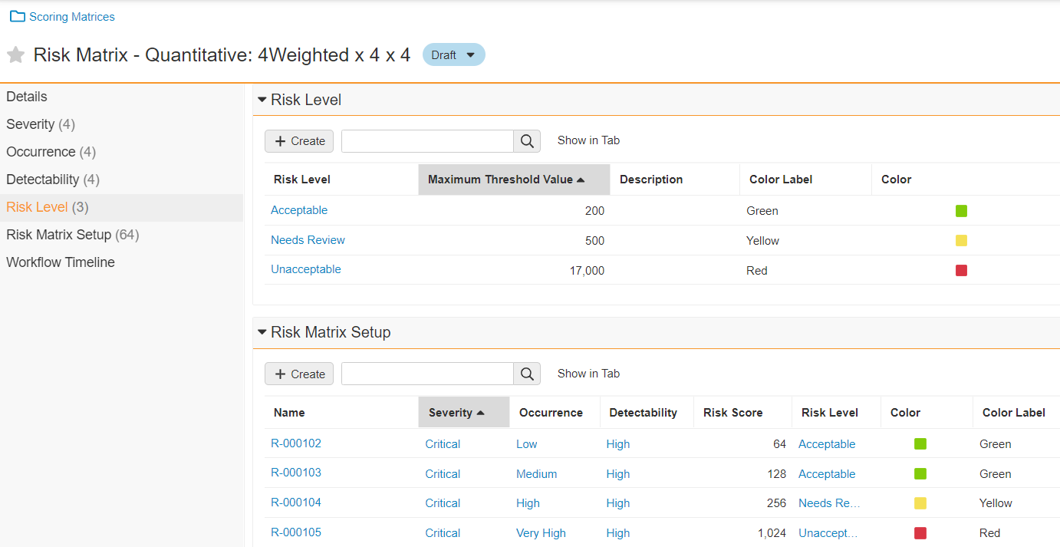
Risk Thresholds
Overview
              Risk Levels and Thresholds can be defined by the user for a Quantitative Risk Matrix
              Vault will automatically assign the Risk Levels to Risk Matrix Setup records
              Risk Levels will automatically be assigned to the Assessment Risk and Risk Event objects based on Risk Score
Business Justification
Risk Level assignment was previously a manual process and can now be automated to reduce time and effort for the user
<Single screenshot only>

Slide 22
Usability and UI Updates

Slide 23
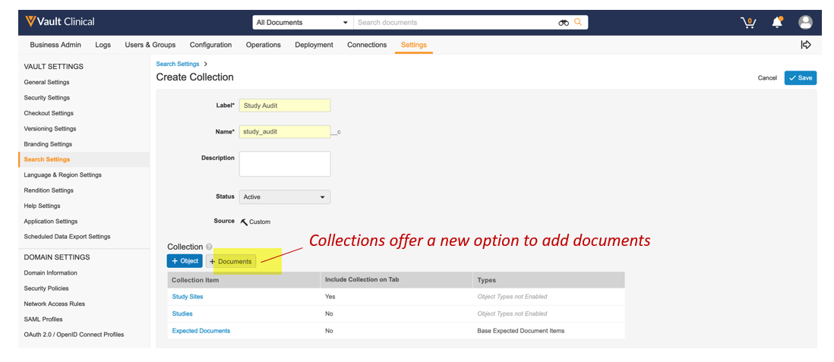
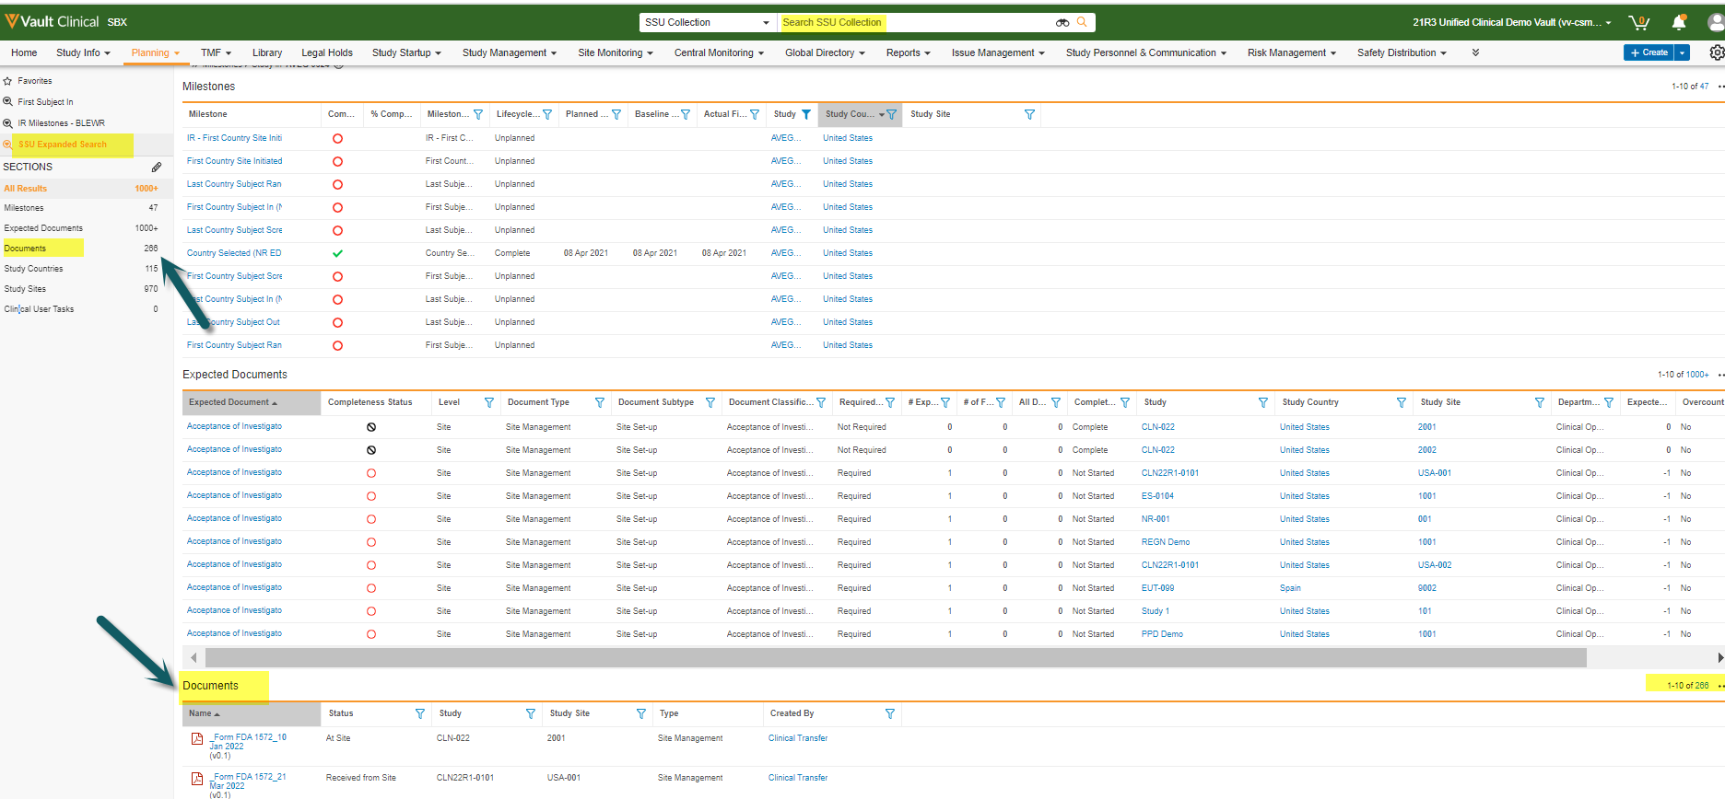
Add Documents to Expanded Search
Overview
              This feature adds the ability to search both documents and objects simultaneously for the first time
              This feature will also improve the user experience by providing a more direct navigation to an Expanded Search
Business Justification
Today only objects can be added to a Search Collection, customers must perform a separate document search to see a complete result set containing a given search term, this feature solves that gap

Slide 24
Add Documents to Expanded Search
Details
  Collections with Documents
    Expanded Searches currently point to a Collection component which will have a new option for document types
    When documents participate in a Collection, documents will be searched along with the objects in that same collection
  Nested Search Context Selector
    The search context selector has been updated to allow direct navigation to expanded searches
    Sub-tabs are nested under menus and Collections are nested under tabs or sub-tabs
    Selections will be reorganized to mirror the tab navigations which will remove adjacent duplicates
Considerations
  Documents are secured in the same way as they are in the Library → No new security needed
  Adding documents is only allowed if the admin has fewer than 15 Collection Items
  Once ‘Documents’ are added to the collection the ‘+Documents’ option will be disabled as they can only be added once

Slide 25
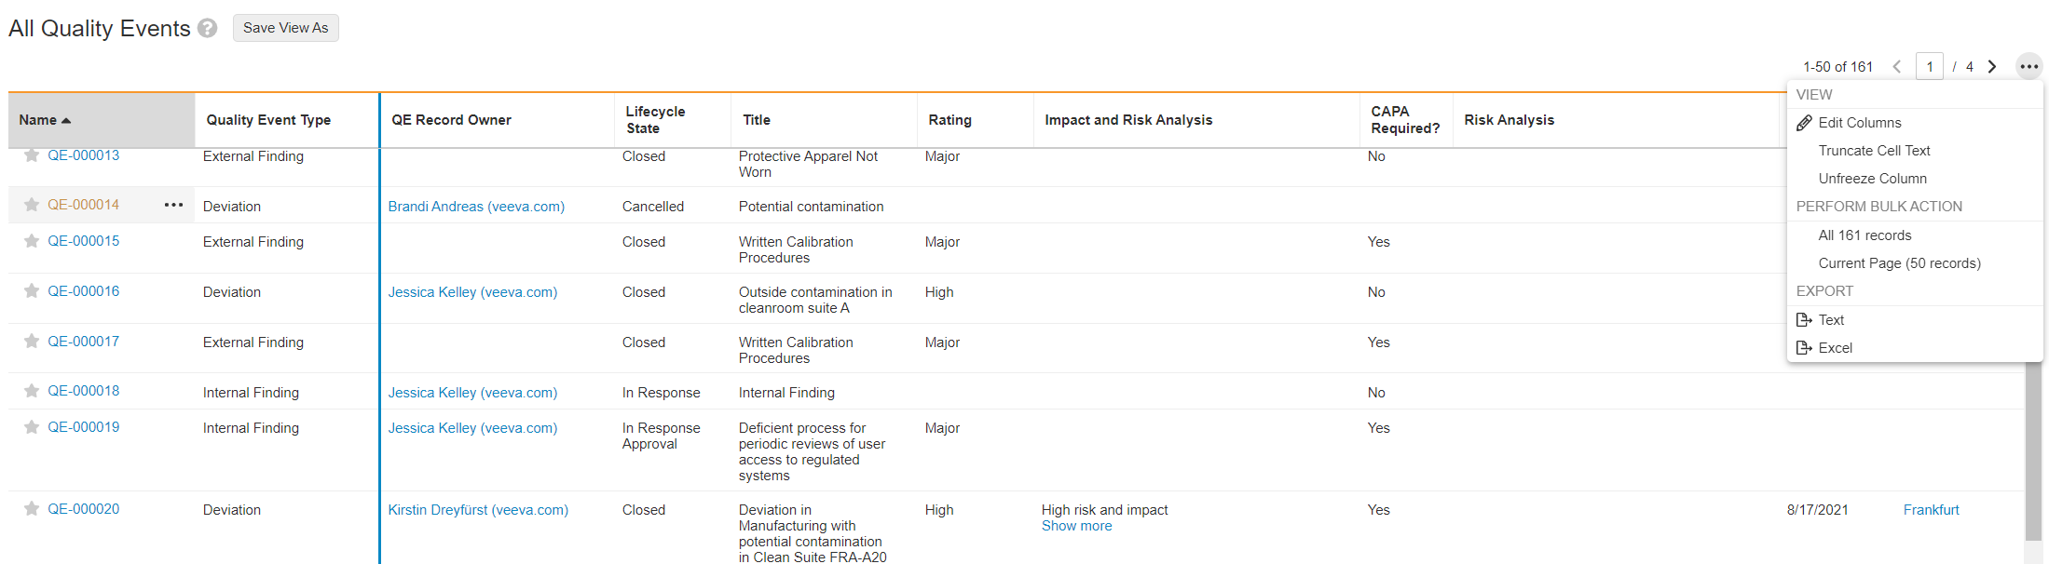
Freeze Column Header and Rows on Object Tabs
Overview
              When Searching records in an object tab, column headers are now frozen so that the names of the columns are always visible.
Business Justification
This enhancement makes navigation of search results easier when scrolling vertically
Users can now freeze additional columns to make scrolling horizontally easier as well
The search results have been increased to 50 since the context will never get lost when scrolling deeper into results
Search results increased from 25 to 50

Slide 26
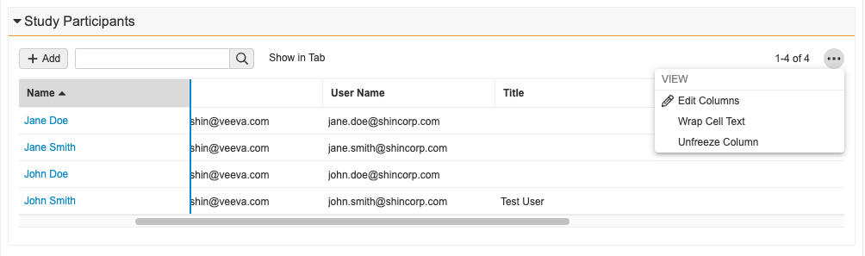
Freeze Column for Related Object Sections
Overview
              With this feature users will be able to freeze any number of columns, starting from the left most column for related object sections
              Users can drag a vertical line to indicate how many columns to freeze while scrolling horizontally
Business Justification
This is a huge usability enhancement, to ease the review of data in Vault

Slide 27
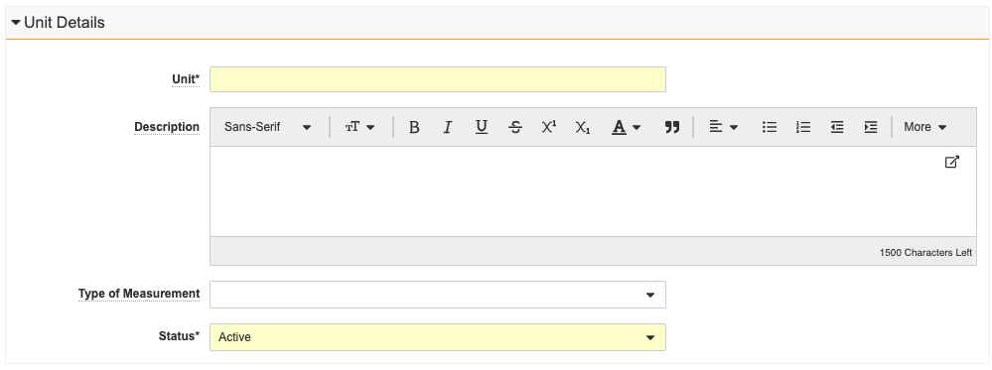
Unit of Measure Object
Overview
              The Quality Suite now includes a Unit object (quality_unit_of_measure__v) that can be used to define a field that describes another field’s quantity with either metric or imperial units
Business Justification
Introduced to support the LIMS application, but this object is available for use in all Quality Suite applications
<Single screenshot only>

Slide 28
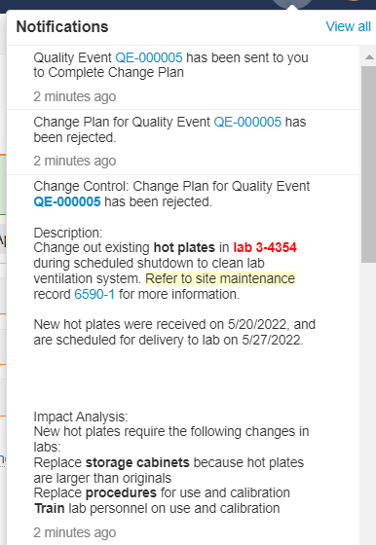
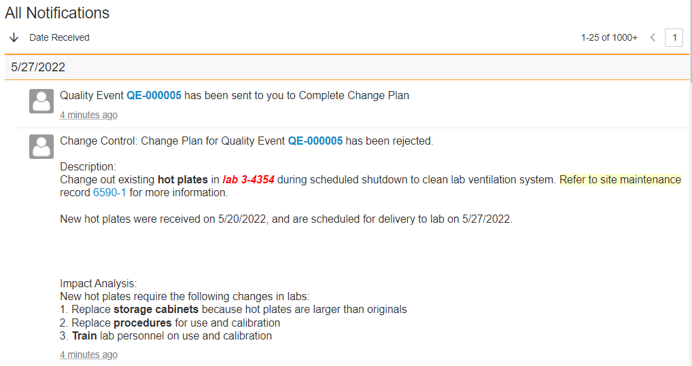
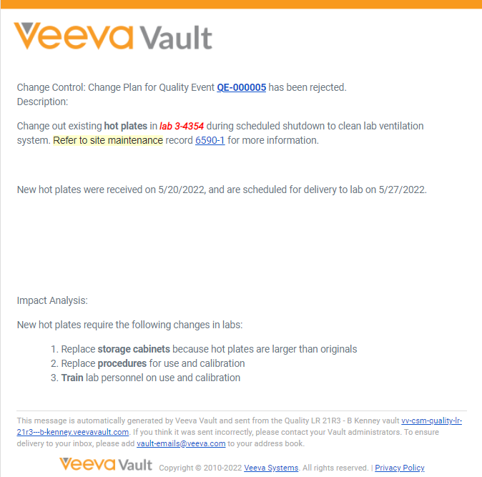
Notifications: Rich Text in Email Body and Notification Text
Vault Notification
Overview
              Enables rich text fields in object records to be displayed in the
                Text in Vault UI notifications
                Email body from Vault notifications
Business Justification
Display rich text object record fields in notifications the way they appear in object records
Email
Notification

Slide 29
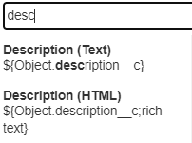
Notifications: Rich Text in Email Body and
Notification Text
Details
  Admins add richtext to a field in a notification template …
  ${Object.description__c;richtext}
Considerations
  After the General Release, notifications containing rich text fields will continue to display as plain text
  Rich text fields are only available in object records / object record notifications

Slide 30
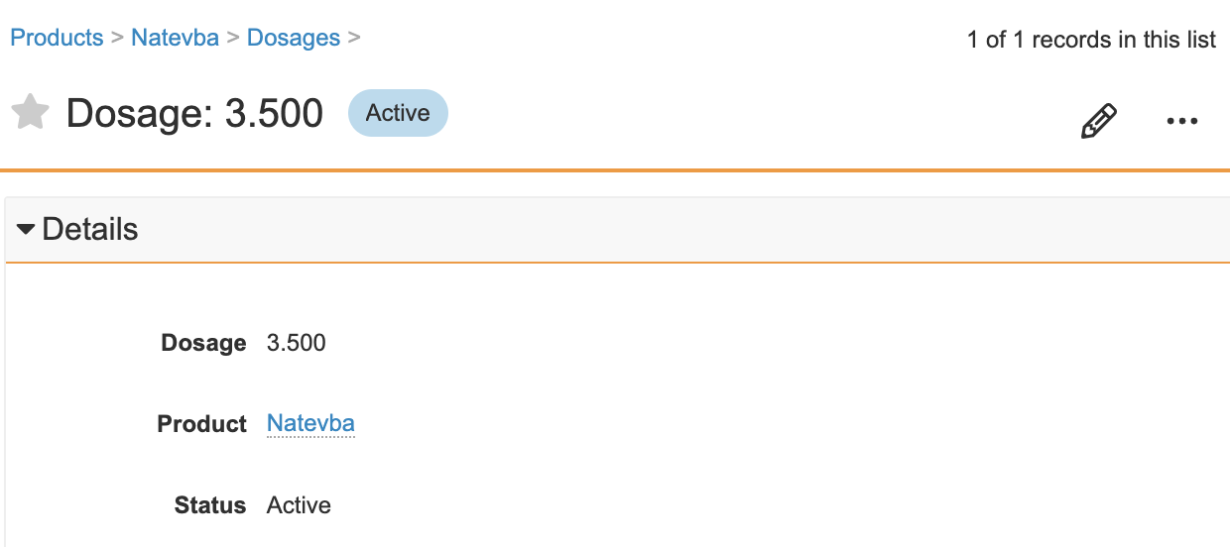
Number Field Decimal Places Enhancement
Overview
              When editing the Number field on an object record, if a user includes decimal places with trailing zeroes (e.g., 165.100), they will no longer appear trimmed when saved in the user interface
Business Justification
This behavior could easily lead to a compliance issue as Vault user may end up changing the precision of several decimal fields on a record without intending to
<Single screenshot only>

Slide 31
Number Field Decimal Places Enhancement
Details
  When creating, viewing or editing an object record, a user shall be able to enter a value into a number field or currency field with trailing zeroes in the decimal point (e.g., 165.50) without the UI trimming it upon save and in future edits
Considerations
  A separate feature will be released to ensure decimal places are stored and displayed consistently across all parts of the Vault Platform for Standard Objects, High Volume Objects, and Documents

Slide 32
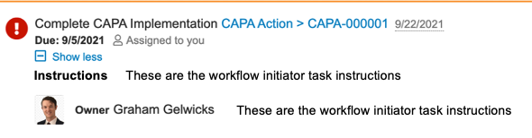
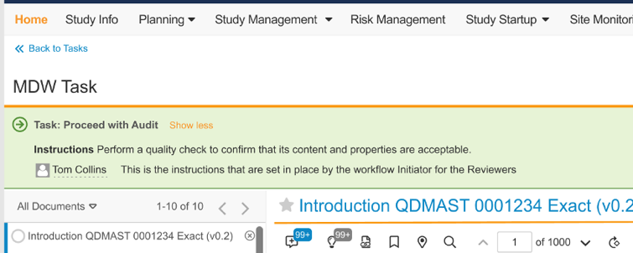
Task Instruction Visibility in OneWorkflow
Configured by Admin
Overview
              Task Instructions from the Workflow Initiator, and Admin configured on the task, are now visible on the Home tab and in the record / document page
Business Justification
Make Task Instructions for OneWorkflows more visible
These instructions are from the admin’s workflow configuration
From Workflow Initiator
Configured by Admin
From Workflow Initiator

Slide 33
Field Display Update for Quality Error Messages
Overview
  All Quality applications (QMS, QualityDocs, Station Manager, Surveillance, Training) now will show the field label in an error message, instead of the “system” field name
  Example
  “You cannot edit the Record Owner”
  Instead of …
  “You cannot edit the record_owner__v”
Business Justification
  Improve the user experience and align with other Vault applications

Slide 34
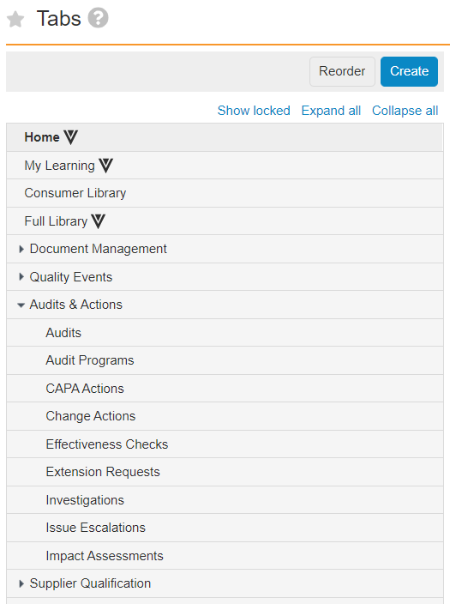
Increase Number of Tabs Allowed
Overview
              Admins can now define up to 20 custom tabs, and up to 20 custom sub-tabs per tab
              Prior to 22R2, the max number of custom tabs/subtabs was 10
Business Justification
As customers deploy more applications in a Vault, they need more tabs to organize access to information
Admins can define up to 20 custom tabs
Admins can define up to 20 custom sub-tabs per tab

Slide 35
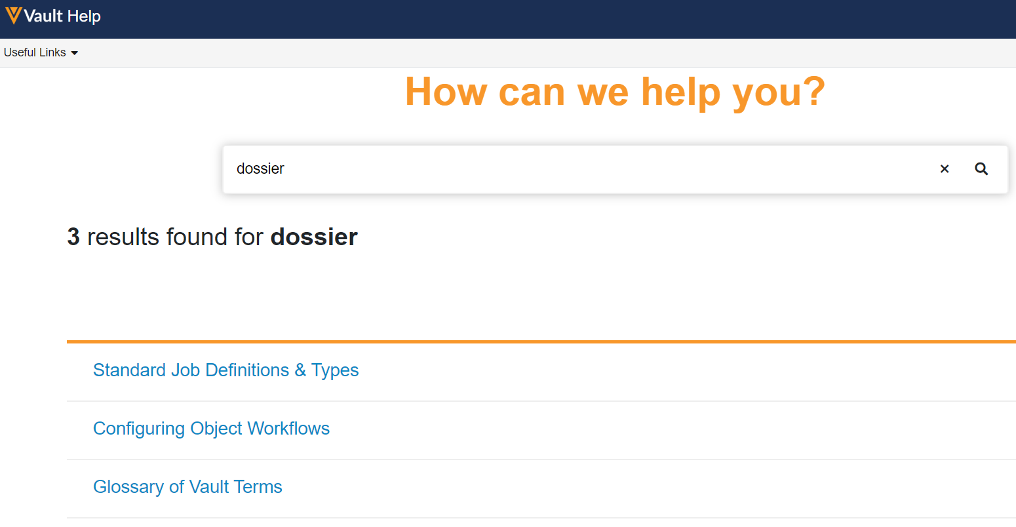
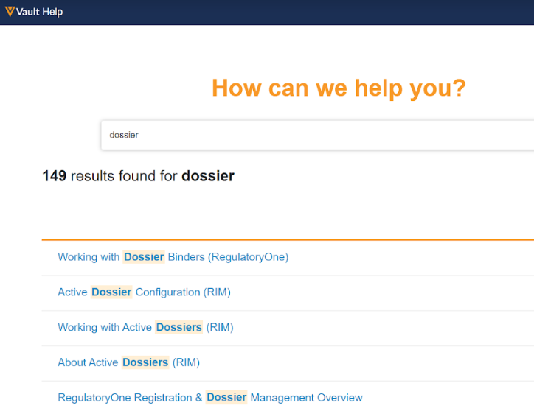
Vault Help: Application-Specific Help Pages
Overview
              Vault Help now contains application specific URLs that will take the user to the information most relevant to each Application Suite
              Vault Help pages for features that are not applicable to a given Application Suite are not returned when a user of that Suite performs a search
Business Justification
Users are able to find content and information related to their Application Suite more quickly and easily
<Single screenshot only>
Results when searching on “dossier” across Quality or Clinical applications
Results when searching on “dossier” across RIM applications

Slide 36
Reporting and Dashboards

Slide 37
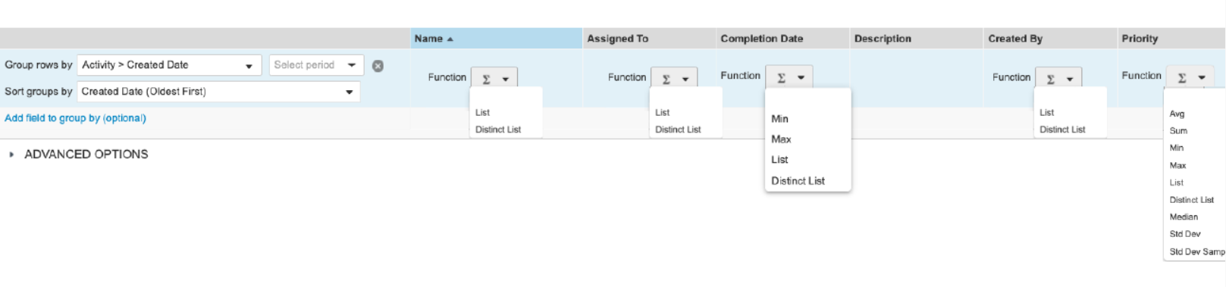

Additional Aggregate Functions in Reports
Overview
              This feature adds addition aggregate functions to Vault reports
              New functions include “List”, “Distinct List”,“Std Dev”, and “Std Dev Samp”
Business Justification
Business requirement to improve reporting functionality , including the need to concatenate a column into a single cell.
Considerations
List and Distinct List will be added to all data types except long/rich text fields
Std Dev and Std Dev Samp will be added to number fields

Slide 38
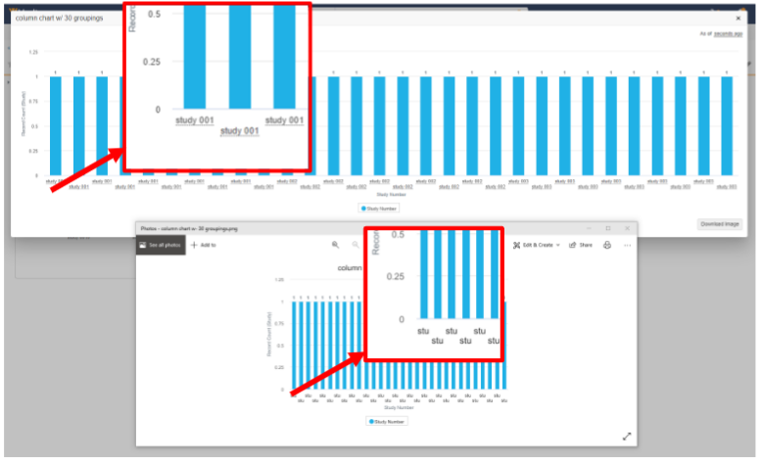


Dashboard exports for large charts
Overview
              The "Download Image" button on expanded dashboard chart is now replaced with two new buttons
Business Justification
Currently dashboard exports are limited to 600 px width. This does not match the width of the expanded chart, which is based on the browser window size
Feature prevents labels being truncated or unreadable for charts with a lot of data
Previous download button
New download buttons

Slide 39
Additional 22R2 Vault Features
Lifecycle & Workflows | Administration | Usability & UI
Automatically Name Envelope Records Flag Exposed in Settings (Admin Checkbox) | Jobs: Audit Logs for External URL Call Jobs (Auto-on) | Localize Vault to Norwegian (Auto-on)
Increase in Workflow Start Step Rules (Configuration) | Display System-Managed Users in Search & Filters (Auto-on) | Save Task Information (Auto-on)
 | Vault Loader: Trailing Zeroes Included in Extracts for Number and Currency Fields (Auto-on) | Vault Platform HTTP/2 Support
 | View Delete Warning when Deleting a Tab (Auto-on)
 | Notification Template Tab (Auto-on)
 | Quality Data Model Changes (Auto-on)

Slide 40
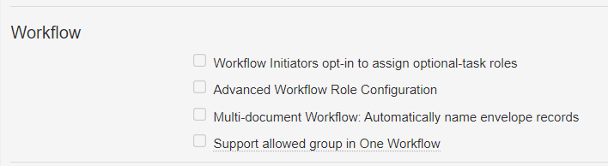
Automatically Name Envelope Records Flag Exposed in Settings
Overview
              Allows admins to enable automatic naming of their envelope records used in OneWorkflows
              Prior to this feature, this flag had to be enabled by support
Business Justification
Some organizations will want Vault to automatically assign Name values
Once this setting is enabled, the details page for each document workflow configuration shows Envelope Details
In the current release, this functionality only supports text strings and the Autonumber token
Navigate to Admin > Settings > General Settings and click Edit.

Slide 41
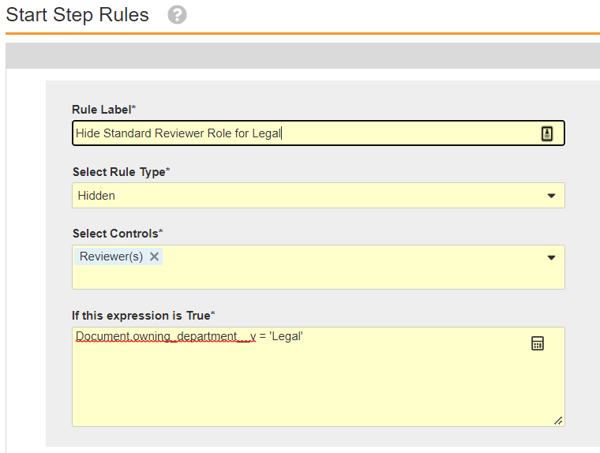
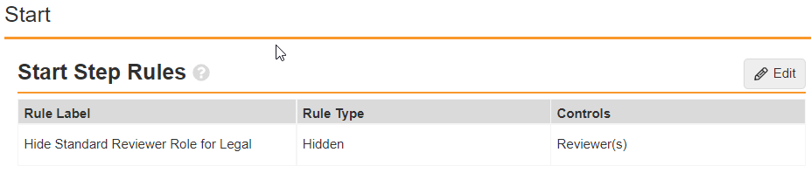
Increase in Workflow Start Step Rules
Overview
              This feature increases the number of Workflow Start Step rules a System Admin can configure in OneWorkflows
Business Justification
Increasing this limit enables customers using the Advanced Workflow Role Configuration feature in Legacy Workflows to transition to Start Step rules in OneWorkflows
This feature increases the number of possible Start Step rules

Slide 42
Increase in Workflow Start Step Rules
Details
  System Admins can now configure …
    Up to 20 Start Step rules in a OneWorkflow that can route multiple documents
    Up to 30 Start Step rules in a OneWorkflow that is configured to route one document at a time
Considerations
  OneWorkflow Start Step rules allow System Admins to make participant roles and other controls on the workflow start screen mandatory or hidden
  A OneWorkflow Start Step rule uses a Vault expression that must evaluate to TRUE to make a control hidden or required, and the expression evaluates the value in document metadata fields within the expression for every document in the workflow
  Learn more about OneWorkflow Start Step rules here
    https://platform.veevavault.help/en/lr/50498/#start-step-rule
  Note: The maximum number of Start Step rules for an Object workflow is 30 (single item workflow)

Slide 43
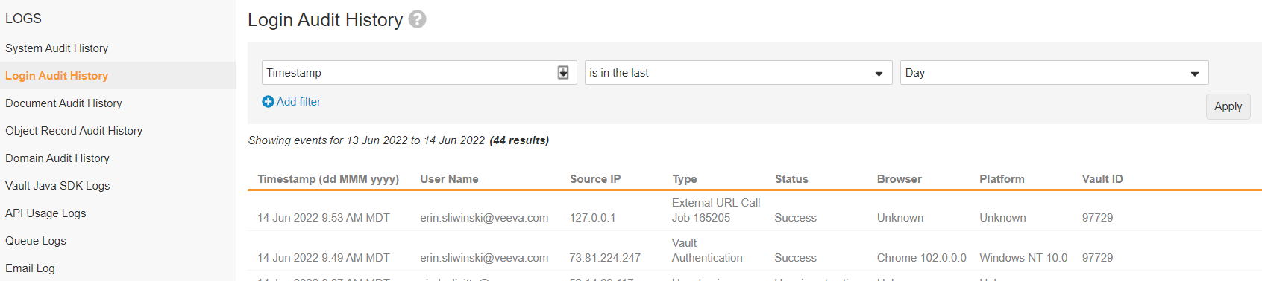

Jobs: Audit Logs for External URL Call Jobs
Overview
              Audit log entries for External URL call jobs now contain the User Name configured as the Run As user for the job
              The Login Audit entry now includes the Job ID
Business Justification
Showing the username on the Audit Log for external URL calls provides visibility into seeing who owns the jobs that are being run
Including the Job ID on Login Audit Logs allows admins to easily trace back to the Job in Vault
JOB ID included under Type in Login Audit Log

Slide 44
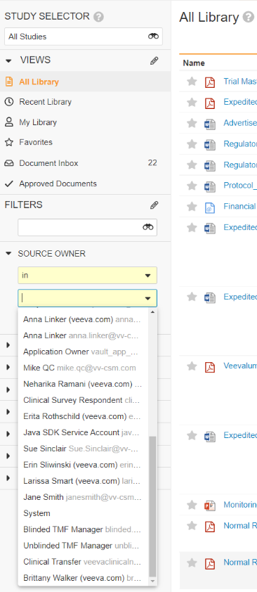
Display System-Managed Users in Search & Filters
Overview
              Standardizes how these System-Managed users are exposed in Vault UI’s:
                System-Managed users no longer appear when selecting user for the purpose of data entry (Documents, Objects records, Configurations)
                System-Managed users are included when selecting users for the purpose of search or data filtering (i.e. Selection of users in Search or when Filtering Audit logs or Reports)
Business Justification
System-Managed users are now exposed in a very consistent way in the UI
System-Managed users showing in search filter for Source Owner in the Library

Slide 45
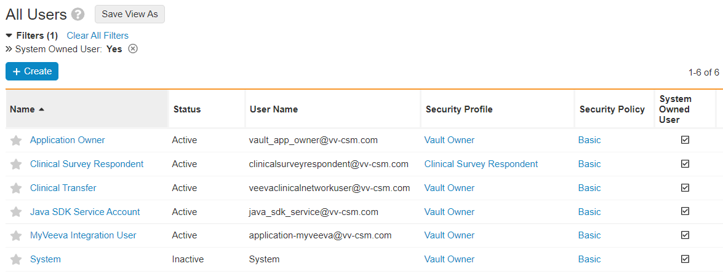
Display System-Managed Users in Search & Filters
Details
  System-Managed users consist of:
    Application Owner
    Clinical Survey Respondent
    Clinical Transfer
    Java SDK Service Account
    MyVeeva Integration User
    System
  System Managed users are created either by the Platform or by Applications.
    We encourage Apps to create as few System Managed user as necessary
  Supports use cases such as:
    Additional System-Managed user created by each product family
    System user used by the TMF Bot in Clinical Vault
Considerations
  “Manager Groups” are no longer created for System-Managed user
  Not possible to create a cross-domain user referencing a System-Managed user from another domain
    Enforced in UI and API
    If a System-Managed user is assigned as a Vault Owner, they do not need field security overrides

Slide 46
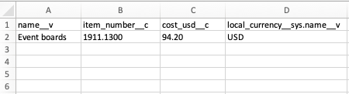
Vault Loader: Trailing Zeroes Included in Extracts for Number and Currency Fields
Overview
              CSVs exported from the Vault Loader UI and Command Line tool (CLI) will now contain trailing zeroes for number and currency fields
                E.g. 100.10
Business Justification
Previously, the Vault Loader extract was trimming trailing zeroes for number and currency fields

Slide 47
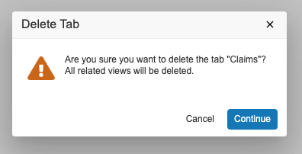
View Delete Warning when Deleting Tab
Overview
To help prevent System Administrators from deleting a tab and its related views in error, Vault now displays a warning message
Business Justification
Provide an additional safeguard for System Administrators to confirm the selected tab, and its related views, should be deleted

Slide 48
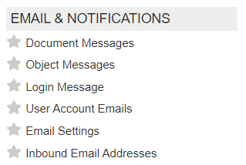
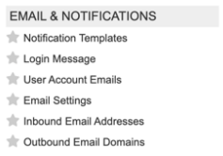
Notification Template Tab
Overview
              This feature combines the Document Messages tab and the Object Messages tab into a single tab called Notification Templates
              The User Interface will allow System Admins to differentiate between Object and Document notification templates
Business Justification
Veeva continues to consolidate separate document and object configurations into a single System Admin experience to align with OneWorkflow
Before 22R2
After 22R2

Slide 49
Quality Data Model Changes
Overview
  With every release, Veeva updates the data model
  The full list of Quality data model changes introduced in this General Release can be found using the What’s New in 22R2 link on the About the 22R2 Release page in Vault Help
Business Justification
  Data model changes enable Veeva to support evolving customer needs and deliver new functionality

Slide 50
Overview
              In 22R1, Vault added support for exporting and importing Norwegian dynamic messaging. In 22R2, Vault will also localize Norwegian static messages
              Note: Veeva provides translation for any labels that cannot be modified by customers. All other labels must be translated by customers users the bulk translation tool.
Localize Vault to Norwegian

Slide 51
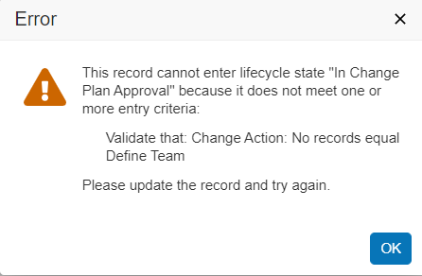
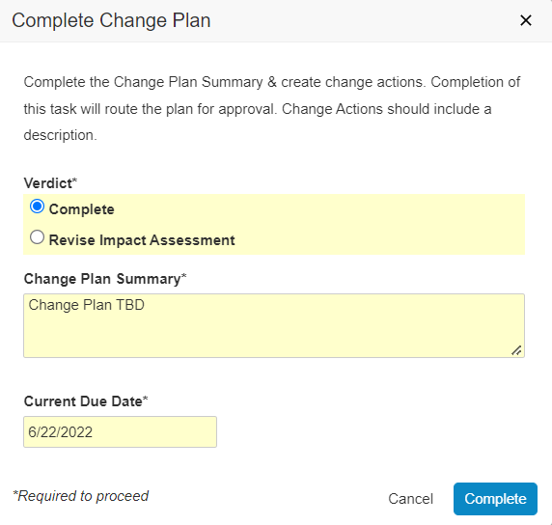
Save Task Information
Overview
              Information entered into a task completion dialog will automatically save until automatic subsequent workflow steps are complete
Business Justification
Previously, if users entered information into the task dialog, but certain entry criteria for a subsequent step were not met, users had to reenter information
Automatically saving task information provides a better user experience, and removes the need for re-work
Text saves even though entry criteria not met

Slide 52
Vault Platform HTTP/2 Support
Vault now uses HTTP/2 as the default protocol to optimize network performance
This update enables faster page loads
Although the older HTTP/1.1 protocol is supported, restricting to only allow HTTP/1.1 traffic is not recommended
We strongly advise reviewing and updating any network configuration and browser policy to ensure HTTP/2.0 is allowed to take advantage of this update

Slide 53
Announcements

Slide 54
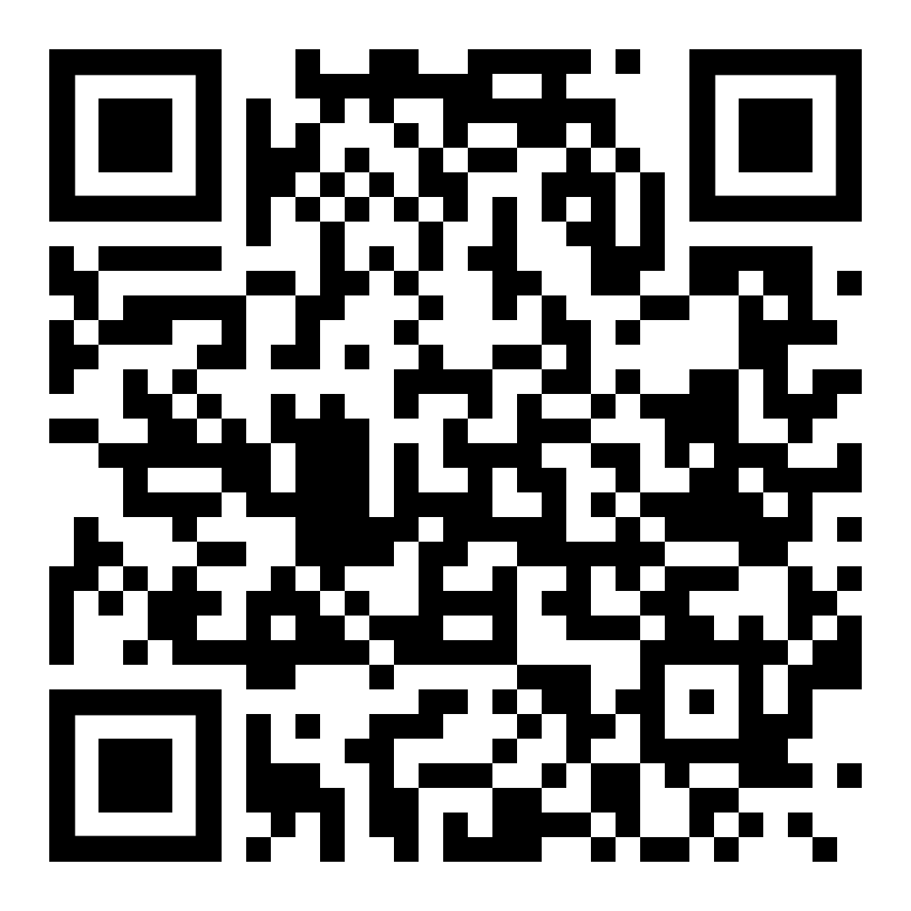




Register Now
October 19-20, 2022
Meet
industry leaders
Share
best practices
Discover
latest trends
CLINICAL
QUALITY & MANUFACTURING
REGULATORY
DEVELOPMENT CLOUD & VAULT PLATFORM
SAFETY
•
•
•
•

Slide 55
Engage the Entire Veeva Community
Engage with your community
Build relationships
Talk to
Veeva experts
See product innovations
Learn best practices
Summit exceeded my expectations. Excellent presentations by industry leaders sparked ideas to take back to my own organization. Coupled with the announcements about the ambitious Veeva roadmap, I leave Summit excited about opportunities to improve clinical trial operations going forward.
Stephen Nabarro, Head of Clinical Operations and Data Management

Slide 56

Upcoming Quality Community Events
August 3: Quality Community Meeting
  Product Roadmap and Deep Dive and Recent Feature Highlights, Customer Breakout Sessions by application
September 14: Day in the Life Webinar Series
  Supplier Quality and Audit Management
Stay connected to the Community and join us on LinkedIn!

Slide 57



Validation Management
A Data-Centric, Paperless Validation Solution Optimizing End-to-End Validation Processes
Planning
Execution
Reporting
Configuration
Inventory
Activities
Deliverables
Requirements Mgmt.
Test Authoring
Data-Centric Test Execution
Discrepancy Mgmt.
Automated Trace Matrix
Execution Audit Trail
Dashboards
Inventory Status
Protocol Status
Discrepancy Status
Scheduling
Periodic Review
Best Practices Built-In
Connect Quality processes from QualityDocs, QMS, and other Quality Suite applications within the Vault
Vision for Validation Management.
Not all features may be available for Early Adopters.
Copyright © Veeva Systems 2022. Veeva Confidential.

Slide 58


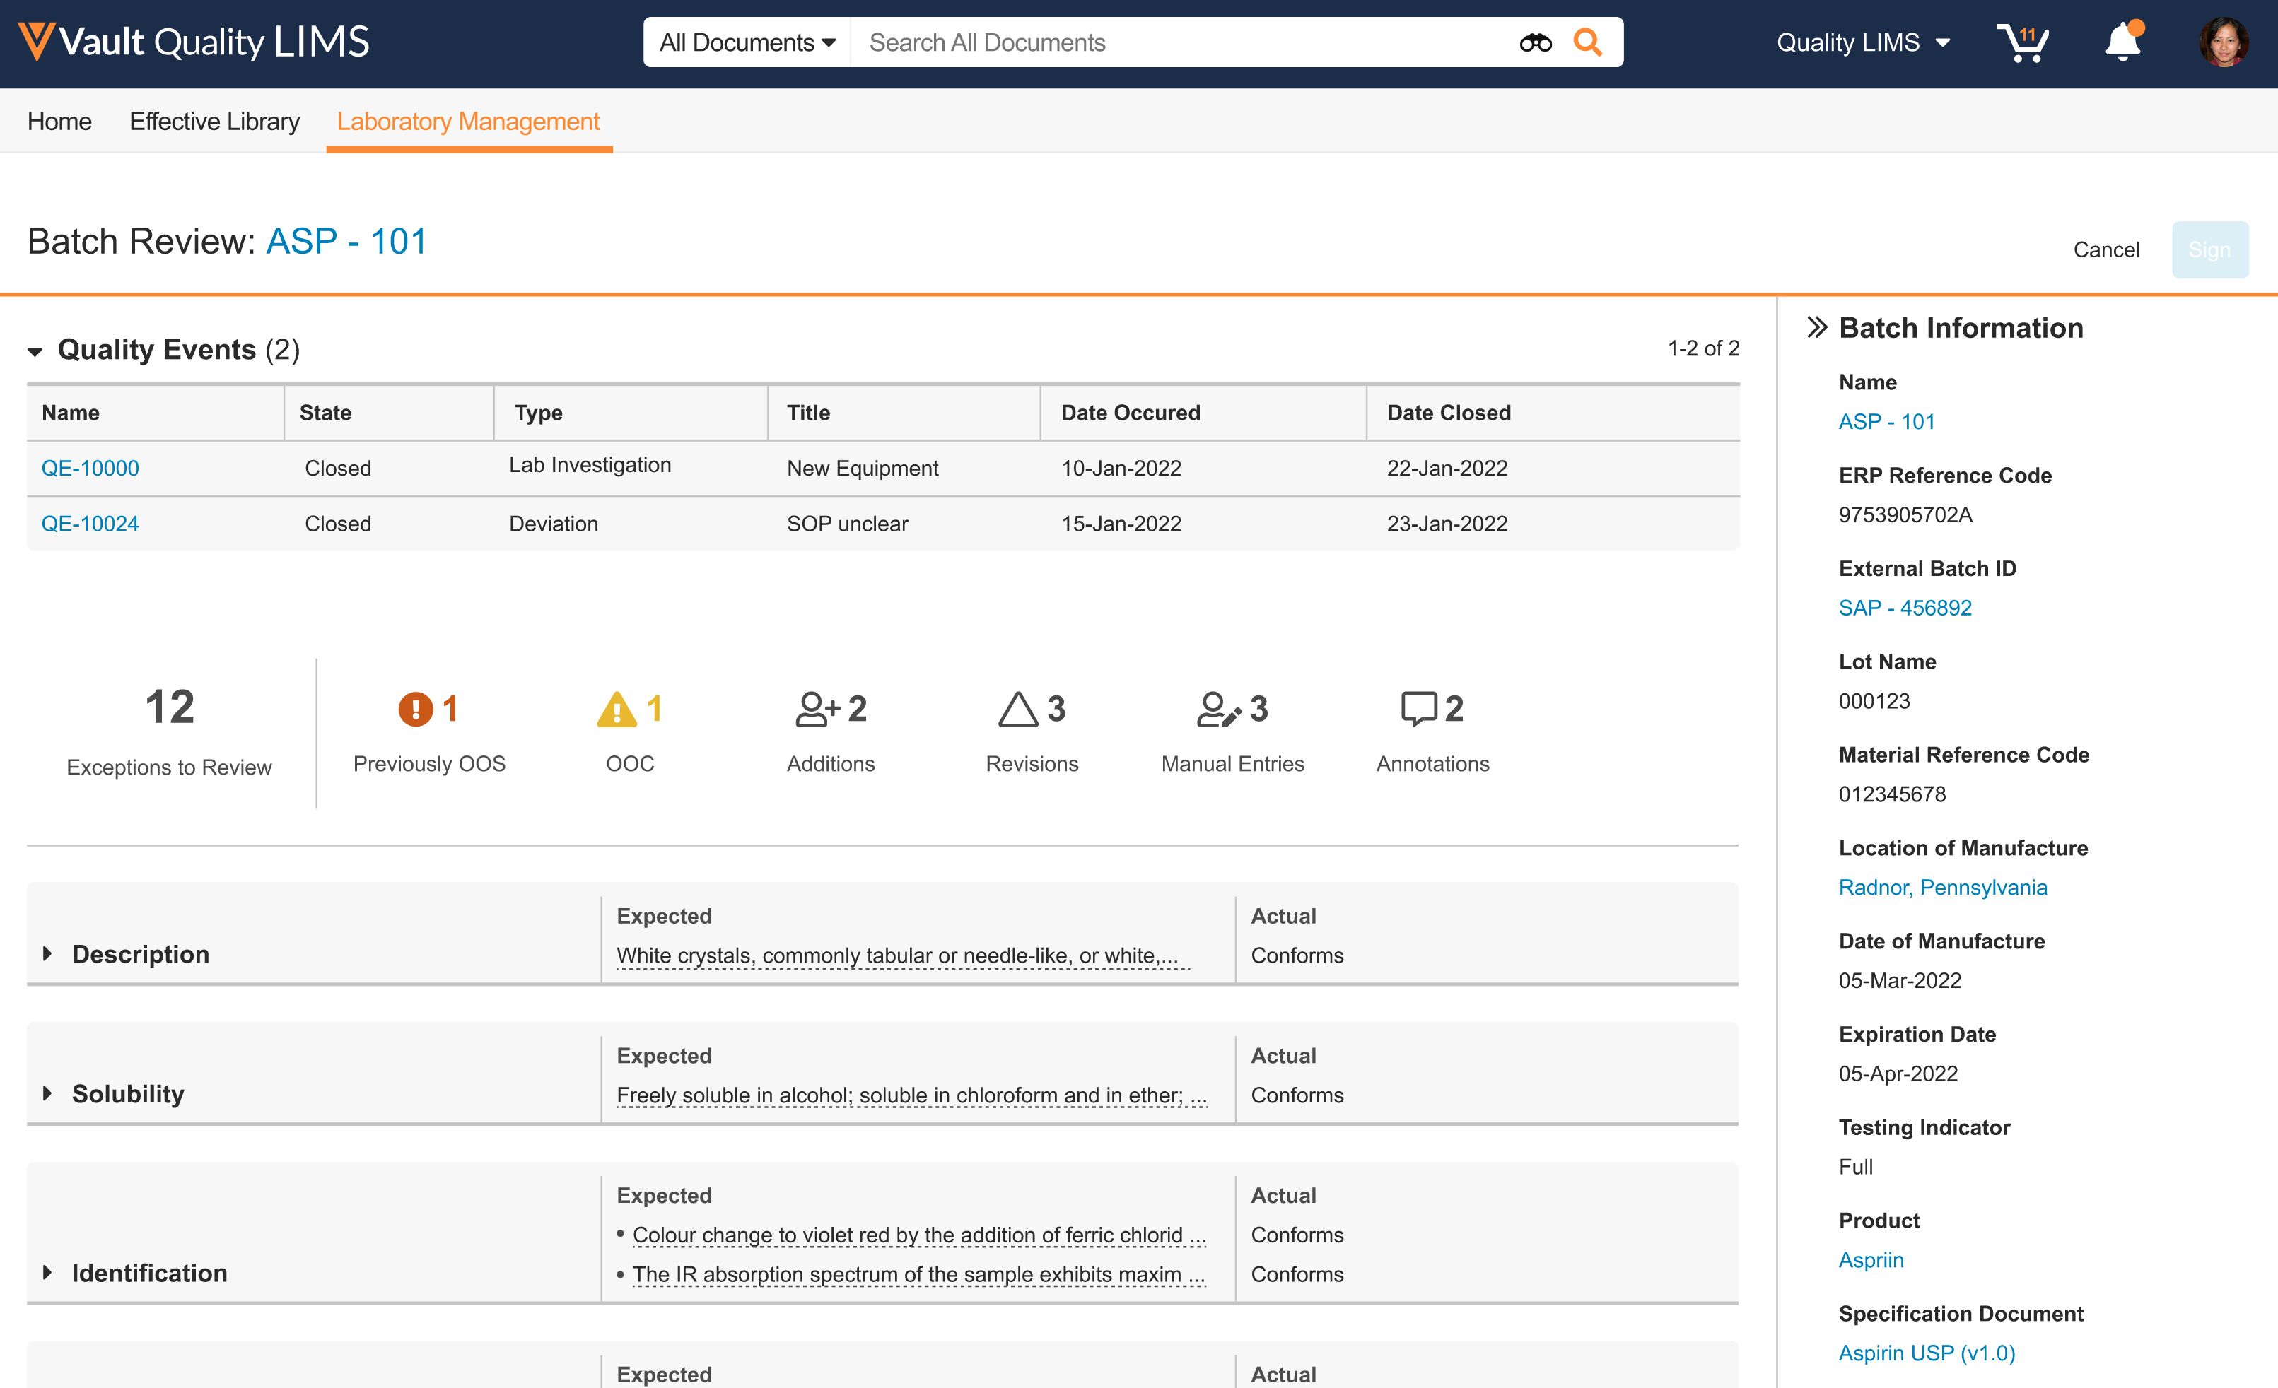
Unifying QA and QC
Sample tracking from manufacturing to external testing and storage
Data integrity and review by exception workflow design incorporating instrument integration and critical event categorization
User training record driven system access and testing assignments
Effective procedure display for analyst reference during method execution
Unified QMS workflows for lab investigations and batch review
Enterprise interface ready for connecting to ERP, MES, BI platform and more
Vision for Vault LIMS. Not all features may be available for Early Adopters.

Slide 59
Educating customers on managing and using their Vault applications.
https://go.veeva.com/vault-foundations-hub
Vault Foundations

Slide 60
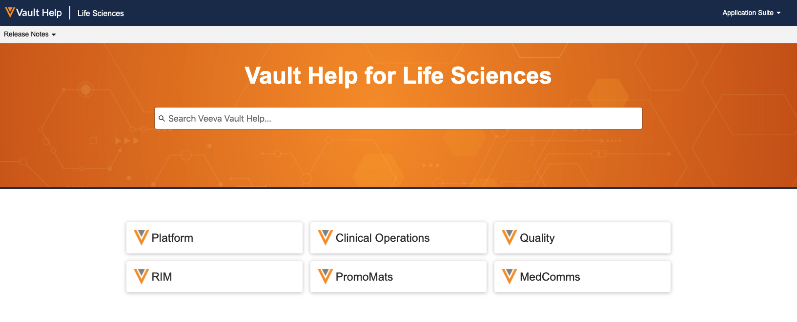

Vault Help Improvements
Easy Access to Applications from Landing Page
Improved Search Capabilities
Updated Videos
Updated Learn More Links
Customers using Classic Vault Help links will need to update these links before the 22R2 Release, as the Classic Vault Help site will be retired

Slide 61
Vault Connections: User Exception Message Behavior Update
Vault now generates multiple User Exception Messages to ensuring Connections scale with our largest customers
Connections transfer chunks of data / documents to ensure a Vault is not overloaded
If a Connection fails to transfer some data / documents in a chunk, Vault creates a User Exception message referring to each record / document that failed to transfer
A User Exception Message with errors in close chronological order should be evaluated to determine if they were caused by the same issue while the chunk was being processed

Slide 62
22R2 Developer Release Deep Dive
Wednesday, July 27 at 8:00 AM PT / 11:00 AM ET / 4:00 PM CET
Join Veeva Customer Success and Product teams for an education session on new features in the Veeva Vault developer-focused toolkit
This webinar is geared towards current users of the Vault Developer toolkit (API)
Key topics for discussion will include:
  Detailed explanation of new features
  Spark Integration Services
  Java SDK updates
  Considerations for using new features, and impacts
  features may have on your Vault or end users
Advanced registration required

Slide 63
Logistics

Slide 64
22R2 Release Calendar
Customer Validation
Sun | Mon | Tue | Wed | Thu | Fri | Sat
3 | 4 | 5 22R2 Release Webinars | 6 22R2 Release Webinars | 7 22R2 Release Webinars | 8 | 9
10 | 11 System Release Memo Pre-release Vaults available | 12 22R2 Release Webinars Compliance Documents | 13 22R2 Release Webinars | 14 22R2 Release Webinars | 15 Executed OQs | 16
17 | 18 | 19 | 20 | 21 | 22 | 23
24 | 25 | 26 | 27 | 28 | 29 Upgrade – Early PODs | 30
31 | 1 | 2 | 3 | 4 | 5 Upgrade – all remaining PODs | 6
JULY
AUG

Slide 65
22R2 Go Live
All customers upgraded to 21R2
  Applies to Production, Test, and Sandbox Vaults
JULY
Friday 29
Date | POD | Start Time | Duration
29 Jul 2022 | US POD VV1-1068 Sandbox POD | 2:00 pm PT | Up to 4 hours
 | US PODs VV1-8, VV1-1065, VV1-1088, VV1-1146 | 6:00 pm PT | Up to 4 hours
PODs VV1-8, VV1-1068,
VV1-1065, VV1-1088
Date | POD | Start Time | Duration
5 Aug 2022 | APAC POD VV3-3064, VV3-3122 APAC & EU Sandbox PODs | 10:00 am PT | Up to 4 hours
 | US Sandbox PODs | 2:00 pm PT | Up to 4 hours
 | US PODs (except Jul 29th PODs) EU PODs APAC POD VV3-34 | 6:00 pm PT | Up to 4 hours
AUGUST
Friday 05
All Other PODs

Slide 66
Early POD Upgrade Schedule
The annual schedule for early POD upgrades is as follows:
Release | Early PODs
 | Production | Sandbox | Agency
R1 - April | VV1-2 | VV1-1055 VV1-1121 | VV1-1065 VV1-1088
R2 - August | VV1-8 | VV1-1068 | VV1-1065 VV1-1088
R3 - December | VV1-12 | VV1-1069 | VV1-1065 VV1-1088
In each release, all Vaults on the designated early PODs will receive access to
Pre-Release 2 weeks earlier than other PODs

Slide 67
Pre-Release Environments
Since 20R1, customers have to provision and refresh their own
Pre-Release Vaults
  Veeva Operations enables Pre-Release 4-6 weeks ahead of each release
  We highly recommend refreshing prior to using the Pre-Release for testing
See Vault Help video for a walk-through of the creation and refresh process
Pre-Release Vaults include:
  Configuration
  Vault Owners
  Object Data referenced in configuration rules
  NO Documents or transactional data

